Slide 1

Project 1: COVID-19
Presentation by:
Eric Croston
Sarah shuda
Meenakshi Tiwary kleiman

Slide 2

What are the trends and relationships between new cases, active cases and deaths worldwide?
What are these trends and relationships in the countries with the most COVID cases and how do they compare worldwide?
Presentation by
Eric Croston
05/22/2024

Slide 3
The Data
The CSV dataset was pulled from the worldometers.info and made available at https://www.kaggle.com/datasets/josephassaker/covid19-global-dataset
Daily COVID Data
225 Countries
New Cases, Active Cases and Cumulative Cases
New Deaths and Cumulative Deaths
Data Cleaning
184,787 rows data in the original data set
844 rows data in the world average and totals data sets
29 rows of data in the individual country data sets

Slide 4
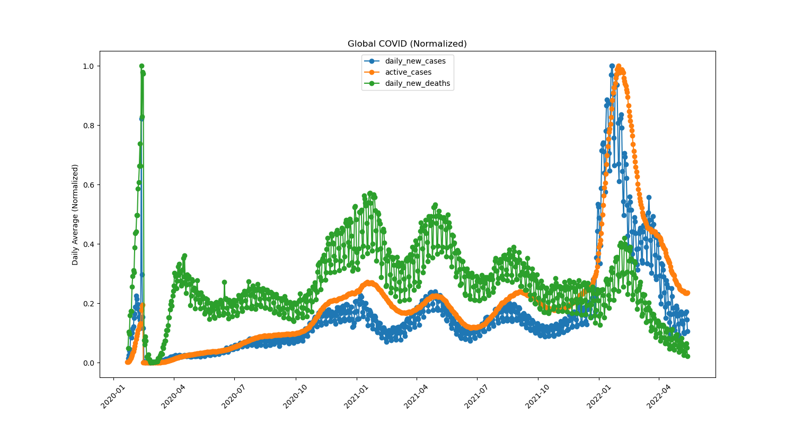
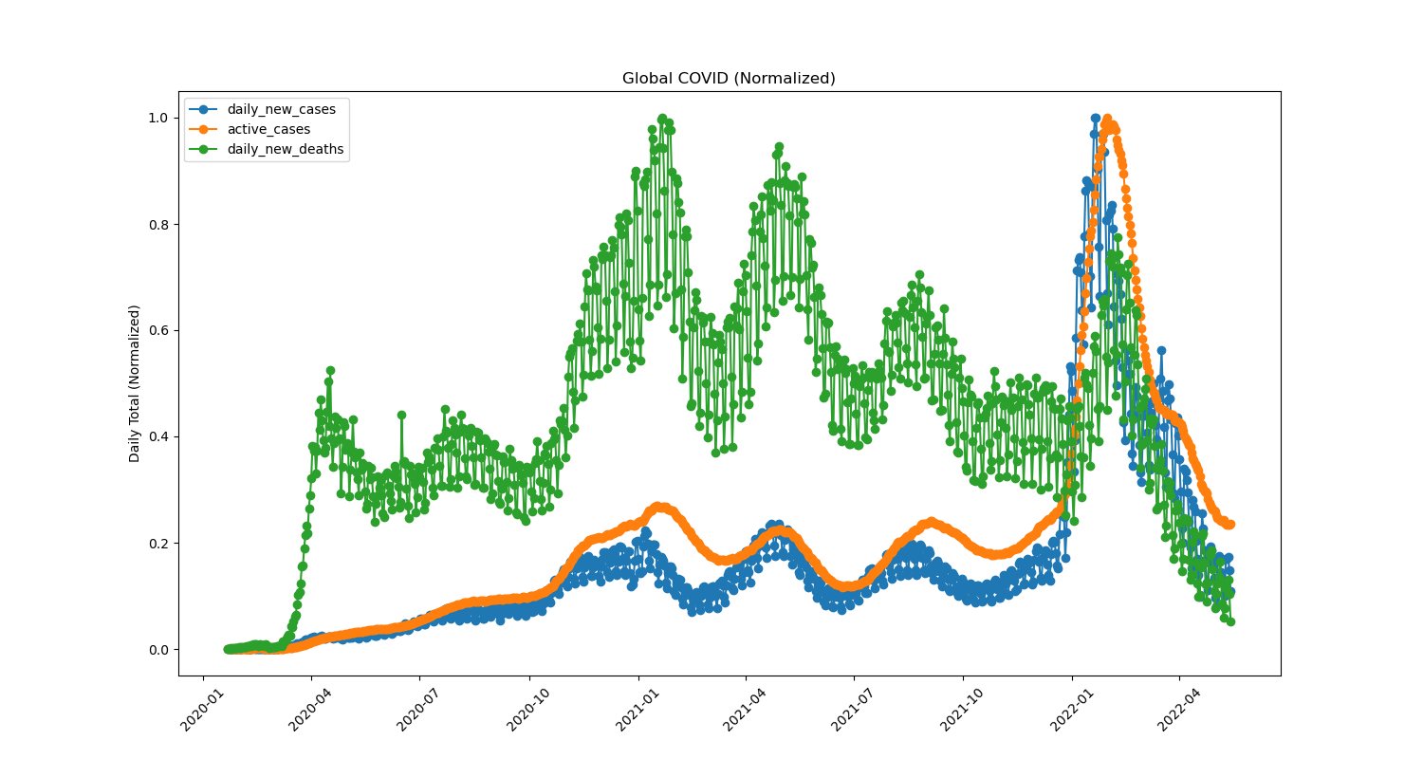
What are the trends and relationships between new cases, active cases and deaths worldwide?
Daily Average of All Countries
Daily Totals of All Countries

Slide 5
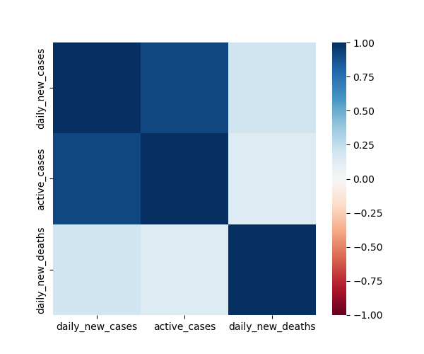
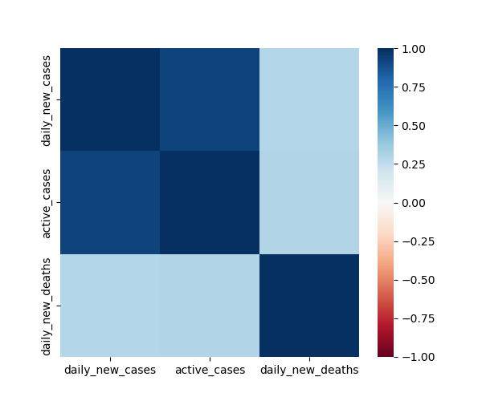
Worldwide Trends and Relationships
Daily Average of All Countries
Daily Totals of All Countries

Slide 6
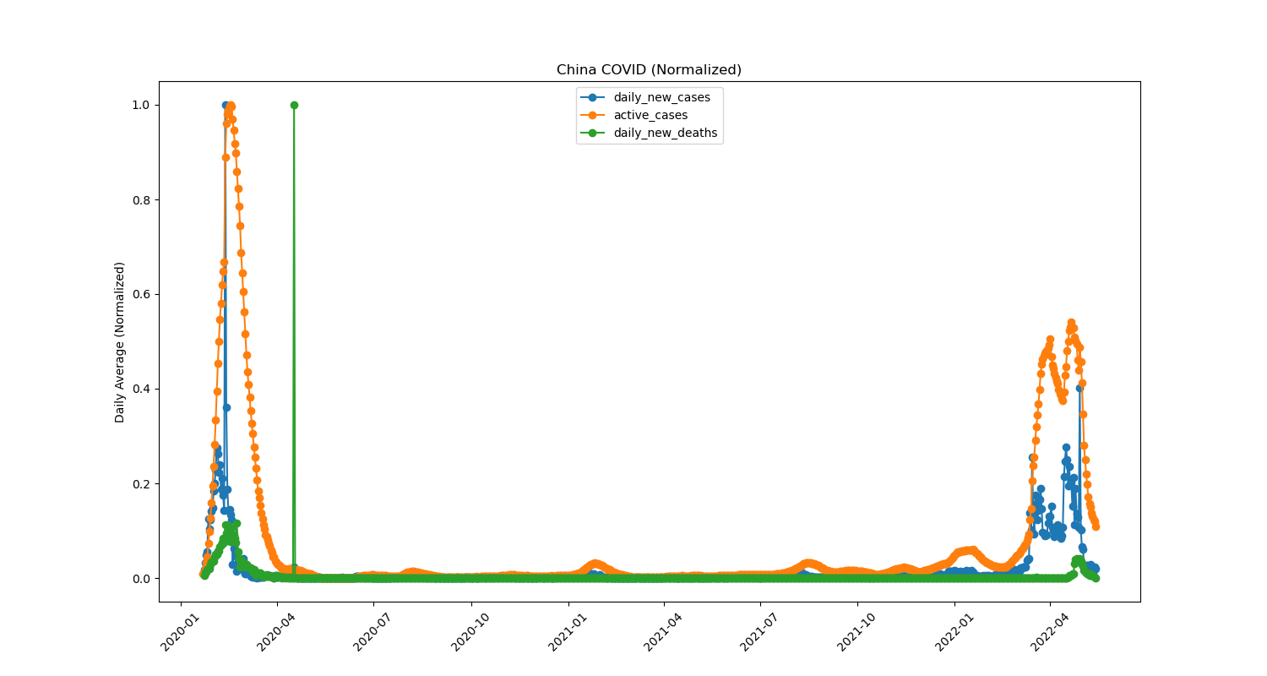
What caused the daily average data spike in early 2020?
Daily Totals in China

Slide 7
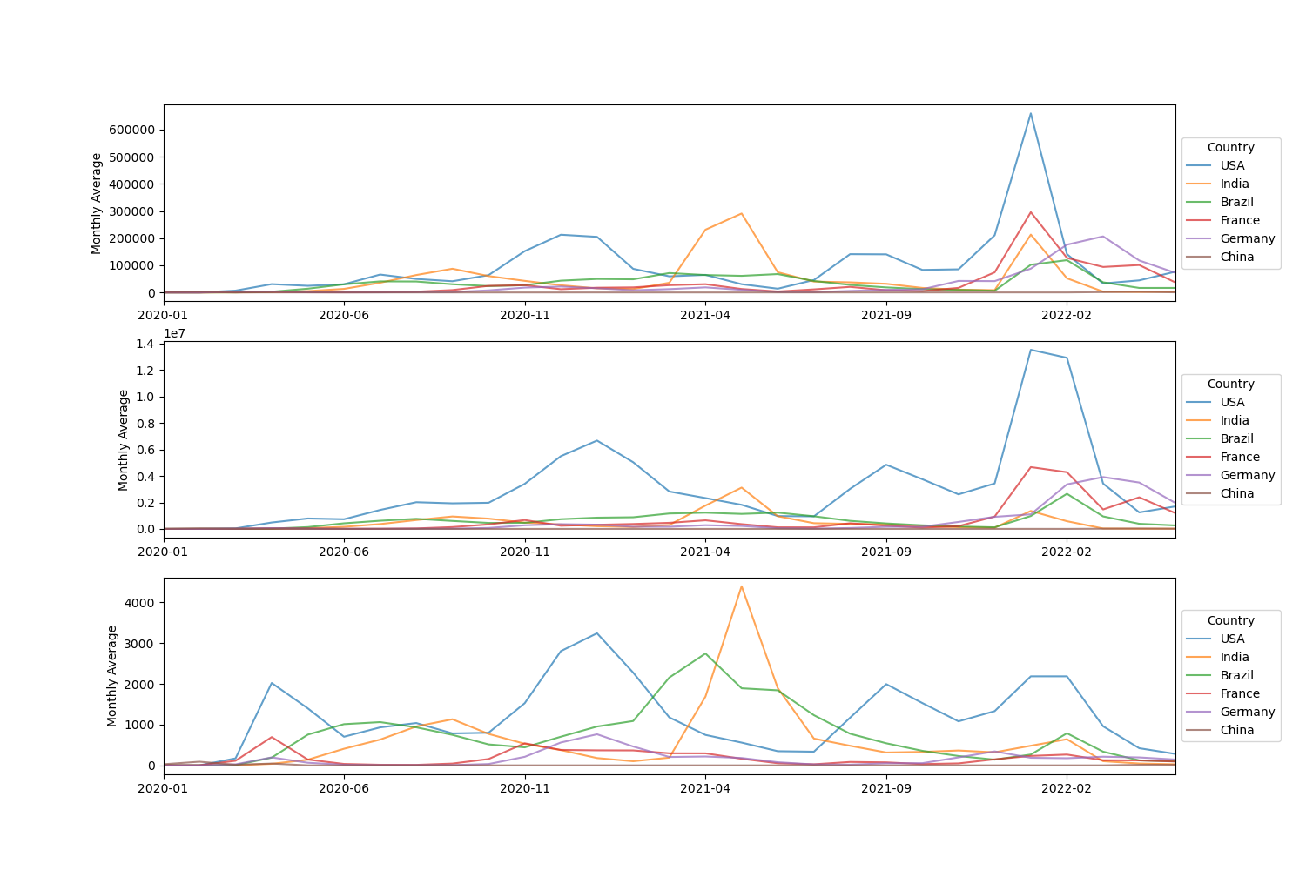
What are these trends and relationships in the countries with the most COVID cases and how do they compare worldwide?
Daily Averages for Most COVID Countries
Daily New Cases by Country
Active Cases by Country
Daily New Deaths by Country

Slide 8
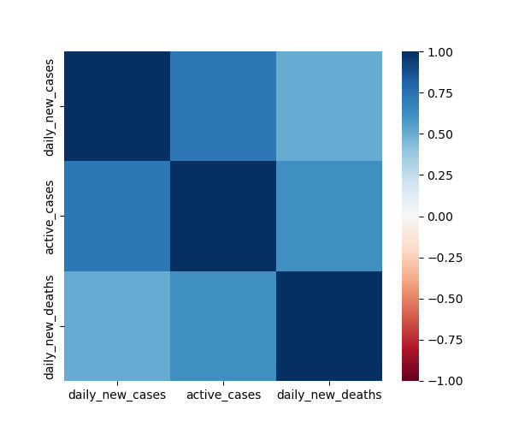
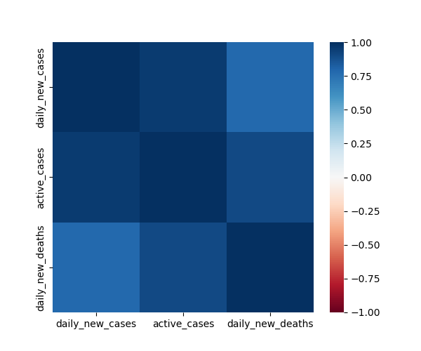
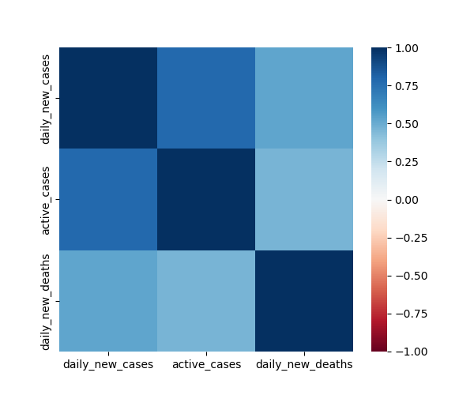


What are these trends and relationships in the countries with the most COVID cases and how do they compare worldwide?
USA Heatmap
India Heatmap
Brazil Heatmap
France Heatmap
Germany Heatmap
France Correlations
New Cases to Deaths .089
Active Cases to Deaths .121
Germany Correlations
New Cases to Deaths .181
Active Cases to Deaths .126
India Correlations
New Cases to Deaths .784
Active Cases to Deaths .903

Slide 9
Project 1: Comorbidity factors governing the mortality during COVID-19 Pandemic
Our World in Data
https://covid.ourworldindata.org/data/owid-covid-data.csv
Presentation by
Meenakshi Tiwary Kleiman, PhD
05/22/2024

Slide 10
Data and Aims
Our World in Data: https://covid.ourworldindata.org/data/owid-covid-data.csv
Complied data from:
European Centre for Disease Prevention and Control (ECDC)
World health Organization (WHO)
Johns Hopkins
Data from 187 countries
Aims
Analyze data to see the correlation between comorbidity factors during COVID_19 pandemic
To compare the correlation between comorbidity factors in Asia, Europe and North America
Cardiovascular Death Rate Vs Diabetes Prevalence
Cardiovascular Death Rate Vs Old Age
Cardiovascular Death Rate Vs Smoking

Slide 11
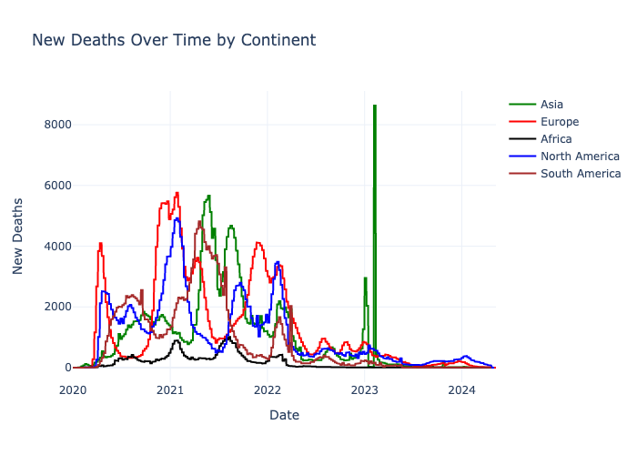
COVID-19 deaths over time

Slide 12
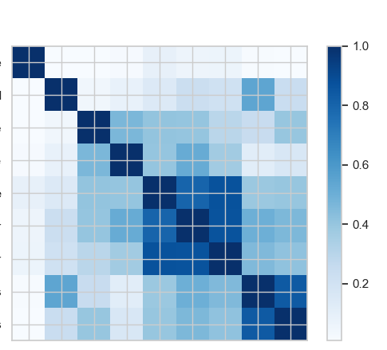
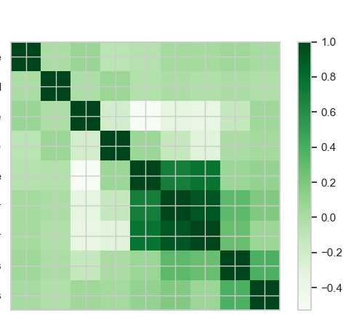
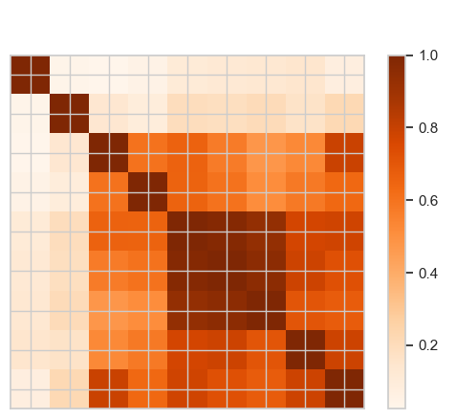
Correlation Matrix Between Comorbidity Factors
North America
Asia
Europe
death_rate
new_cases_smoothed
cardiovasc_death_rate
diabetes_prevalence”
median_age
aged_65_older
aged_70_older
female_smokers
male_smokers
death_rate
new_cases_smoothed
cardiovasc_death_rate
diabetes_prevalence”
median_age
aged_65_older
aged_70_older
female_smokers
male_smokers
death_rate
new_cases_smoothed
cardiovasc_death_rate
diabetes_prevalence”
median_age
aged_65_older
aged_70_older
female_smokers
male_smokers
death_rate
new_cases_smoothed
cardiovasc_death_rate
diabetes_prevalence”
median_age
aged_65_older
aged_70_older
female_smokers
male_smokers

Slide 13
Correlation Matrix Between Comorbidity Factors
North America
Asia
Europe
death_rate
new_cases_smoothed
cardiovasc_death_rate
diabetes_prevalence”
median_age
aged_65_older
aged_70_older
female_smokers
male_smokers
death_rate
new_cases_smoothed
cardiovasc_death_rate
diabetes_prevalence”
median_age
aged_65_older
aged_70_older
female_smokers
male_smokers
death_rate
new_cases_smoothed
cardiovasc_death_rate
diabetes_prevalence”
median_age
aged_65_older
aged_70_older
female_smokers
male_smokers
death_rate
new_cases_smoothed
cardiovasc_death_rate
diabetes_prevalence”
median_age
aged_65_older
aged_70_older
female_smokers
male_smokers

Slide 14
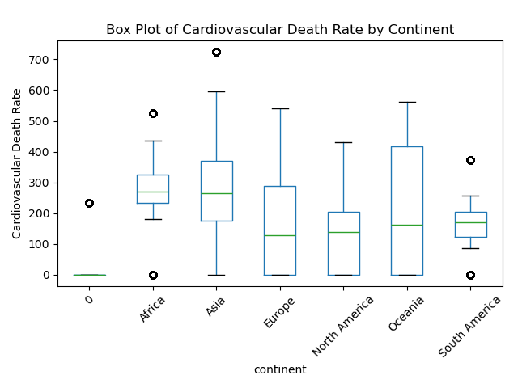
Cardiovasc Death Rate

Slide 15
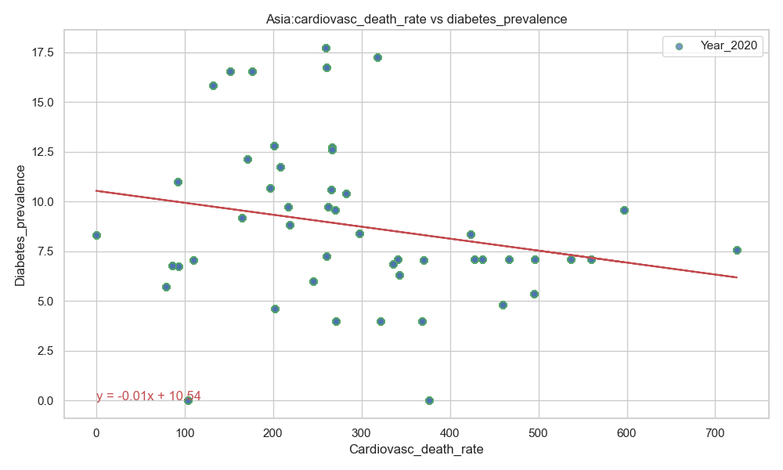
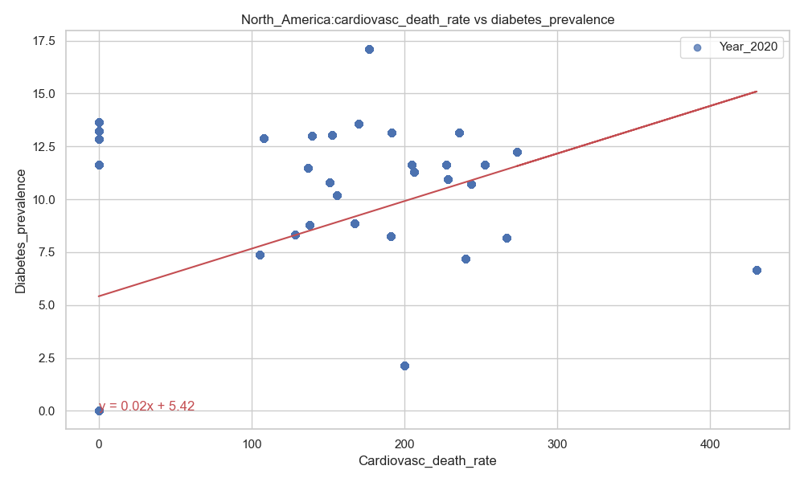
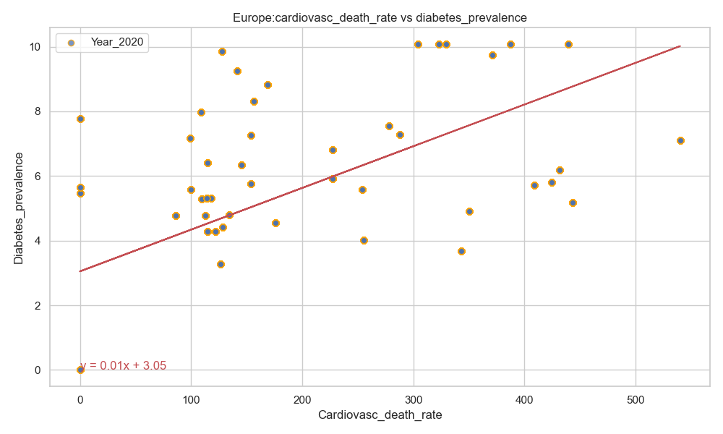
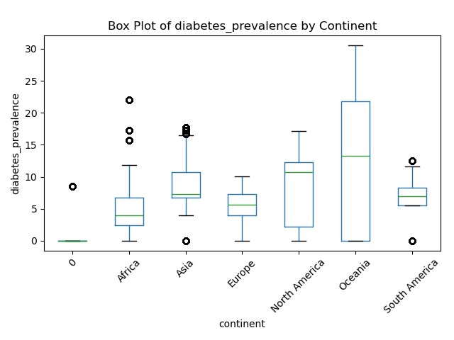
Cardiovasc Death Rate vs Diabetes Prevalence
R-value (Correlation coefficient): -0.22
R-value (Correlation coefficient): 0.46
R-value (Correlation coefficient): 0.60
There was a stronger correlation between the cardiovascular death rate and diabetes prevalence in Europe as compared to North America.
A negative correlation was observed between the cardiovascular death rate and diabetes prevalence in Asia.

Slide 16
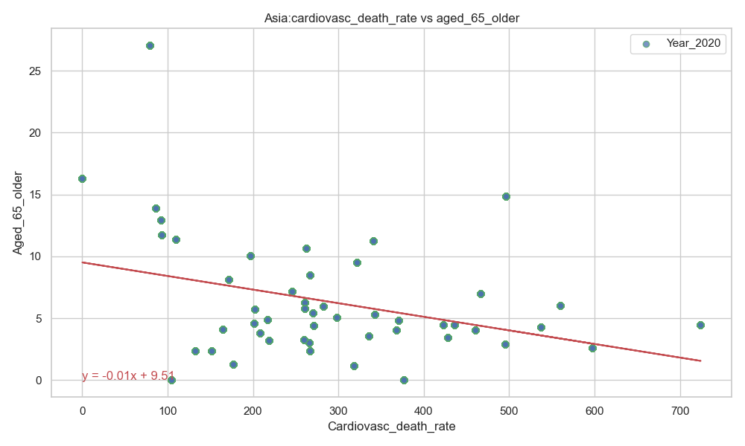
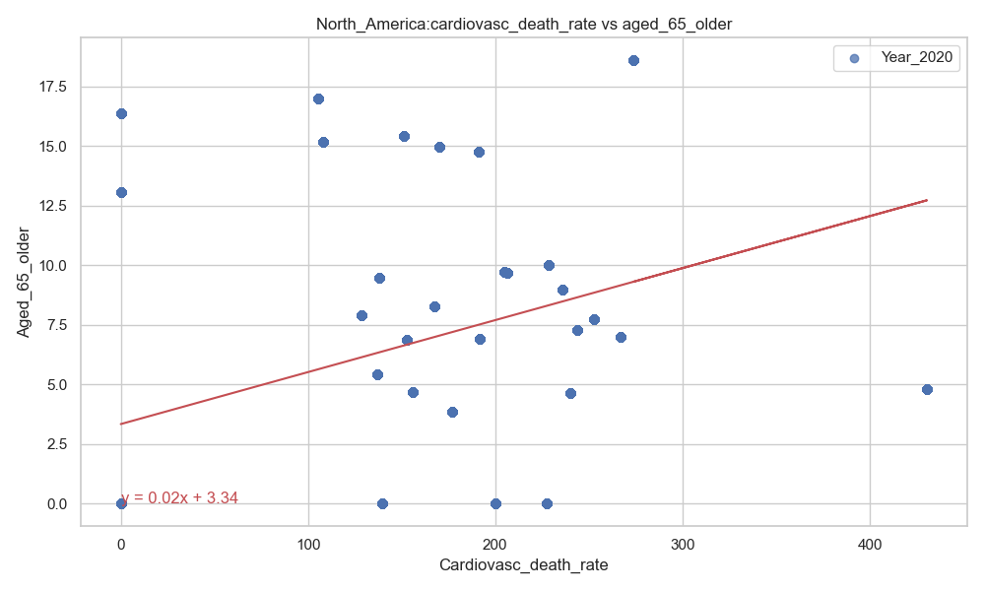
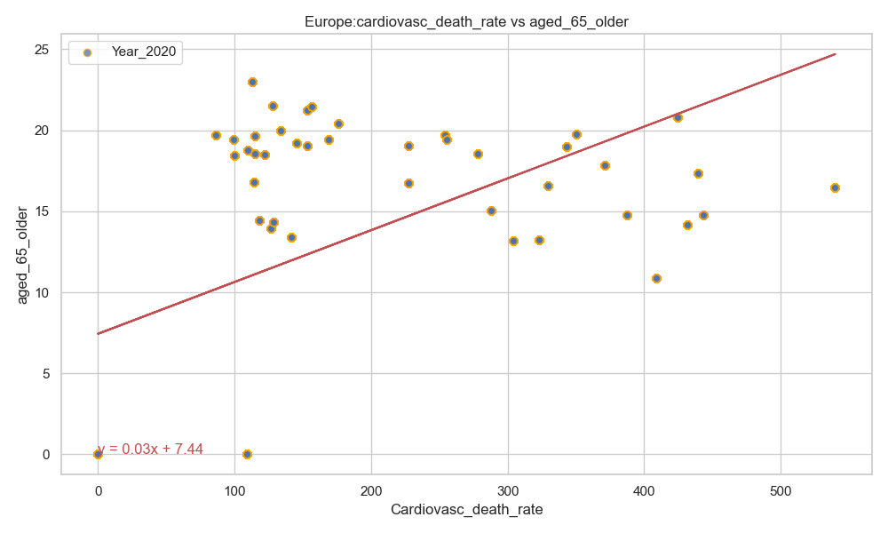
Cardiovasc Death Rate vs Age >65 Years Old
R-value (Correlation coefficient):-0.34
R-value (Correlation coefficient):- 0.40
R-value (Correlation coefficient):-0.53
There was a stronger correlation between the cardiovascular death rate and old age (above 65 years) in Europe as compared to North America.
A negative correlation was observed between the cardiovascular death rate and old age (above 65 years) in Asia.

Slide 17
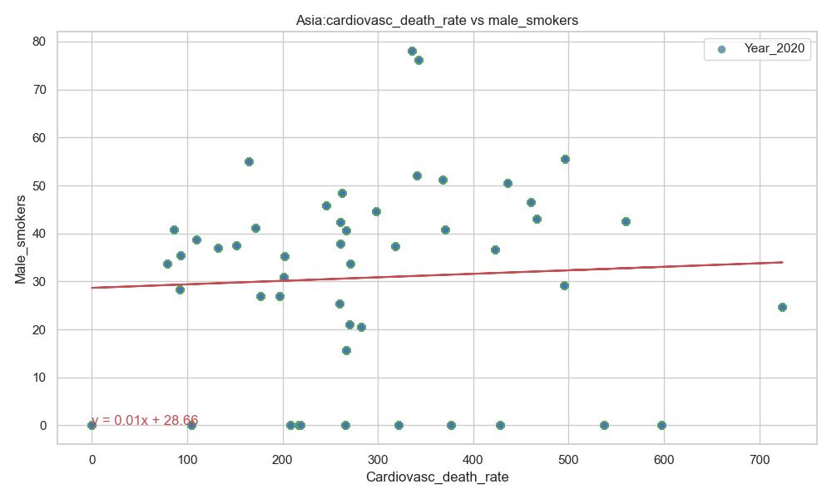
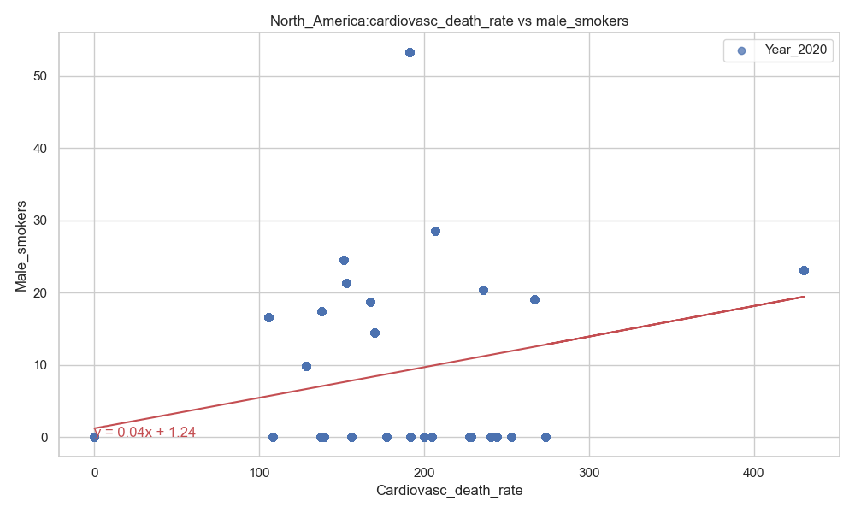
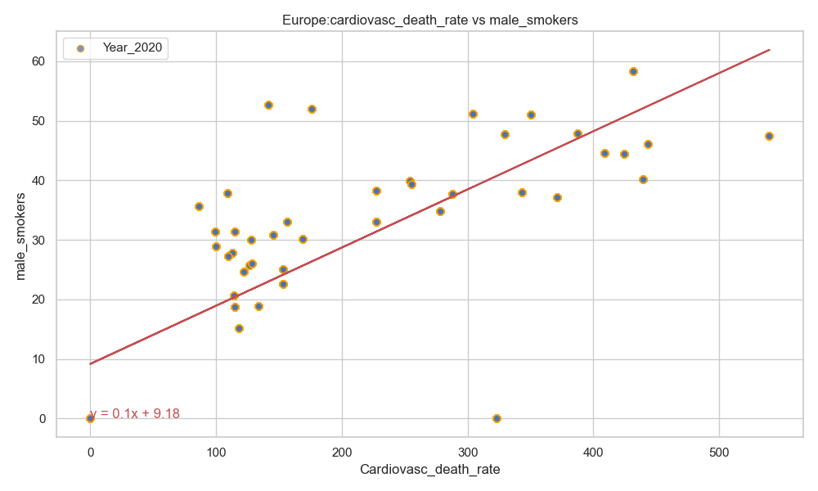
Cardiovasc Death Rate vs Male Smoker
R-value (Correlation coefficient): 0.05
R-value (Correlation coefficient): 0.40
R-value (Correlation coefficient): 0.79
There was a stronger correlation between the cardiovascular death rate and smoking (male) in Europe as compared to North America.
There was no correlation between the cardiovascular death rate and smoking (male) in Asia.

Slide 18
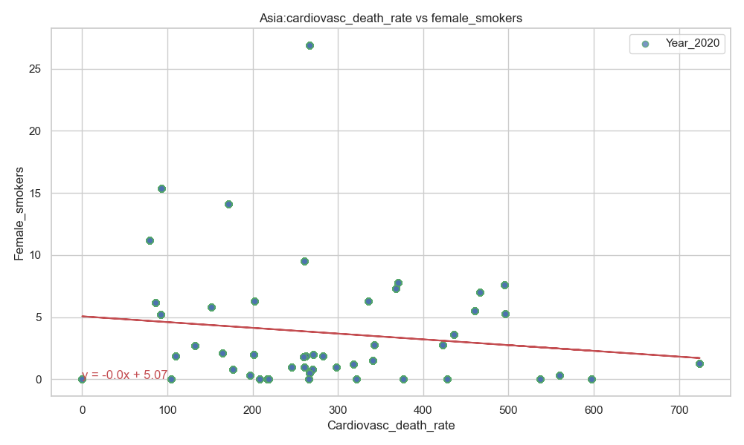
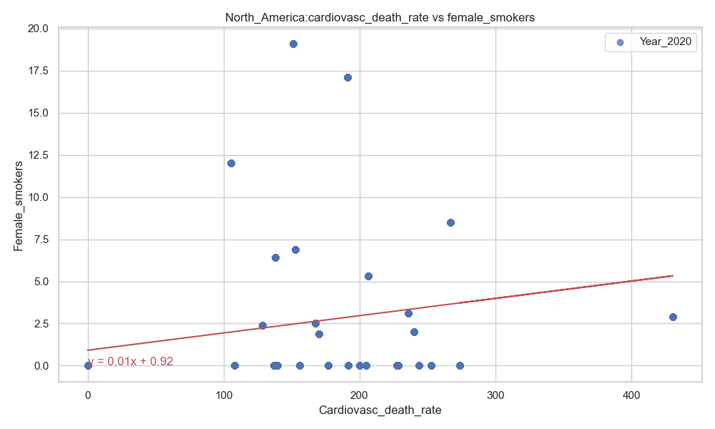
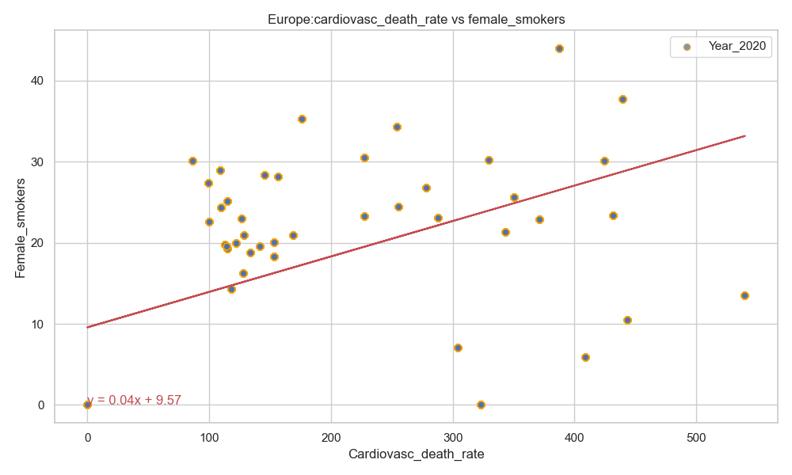
Cardiovasc Death Rate vs Female Smoker
R-value (Correlation coefficient): -0.14
R-value (Correlation coefficient): 0.24
R-value (Correlation coefficient): 0.53
There was a stronger correlation between the cardiovascular death rate and smoking (female) in Europe as compared to North America.
There was no correlation between between the cardiovascular death rate and smoking (female) in Asia.

Slide 19
Acknowledgement
Instructor: Dave Melillo
Team members
Eric Croston
Sarah Shuda

