Slide 1


Project 1: Determining the Relationships Between Pre-Existing Conditions and Death Rate During the COVID-19 Pandemic
https://www.kaggle.com/datasets/meirnizri/covid19-dataset.
Presentation by
Sarah Shuda, MSFS, ABC-DA
05/16/2024

Slide 2
Data and Aims
Data set was obtained from: https://www.kaggle.com/datasets/meirnizri/covid19-dataset.
  Provides information from the Mexican government from 2020
  Includes demographic information, information related to pre-existing conditions, treatment data including if the patient was intubated and the level of medical facility performing the treatment, and whether or not the patient died.
Aims
Analyze data to determine relationship between pre-existing conditions and death
  Determine relationship between the number of pre-existing conditions and death
  Analyze respiratory specific conditions and death
  Determine which pre-existing conditions were most correlated with death

Slide 3
Data Cleaning and Processing
Decoding the data set
  97, 98, 99, and 9999-99-99 were used when data was not collected
  2 = No & 1 = Yes
  1-3 meant the patient was COVID-19 positive, 4-7 meant the patient did not test positive for COVID-19
Data cleaning steps
  Replace missing data with 0
  Replace 2 with -1 so when summing, missing and negative results would have separate affects
  Drop COVID-19 negative patients
  Add a column with a binary response to indicate if a patient died
  Add a column that sums the binary response for all 9 pre-existing conditions
Original data set consisted of 1,048,576 patients. Cleaned data set contained 391,978 patients.

Slide 4
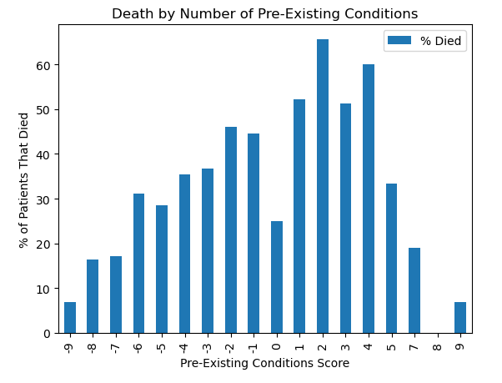
Multiple Pre-Existing Conditions and Death
Pre-existing conditions scores range from -9 to 9.
  -9 = no pre-existing conditions were documented
  9 = the patient had all pre-existing conditions listed
The percentage of patients who died tended to increase as the number of pre-existing conditions increased.
  At scores of 5 or greater the proportion of patients who died decreased.
  May be a function of the limited amount of patients who received those scores compared to the number of patients in some of the lower score brackets.

Slide 5
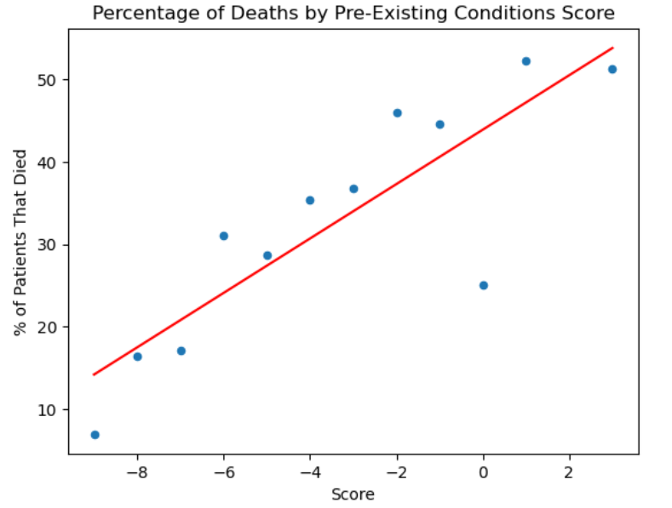
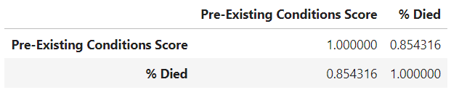
Multiple Pre-Existing Conditions and Death
Scores with fewer than 100 patients were dropped
Determined the correlation between score and death using a correlation matrix
  0.85
Performed a linear regression
  r² = 0.73

Slide 6
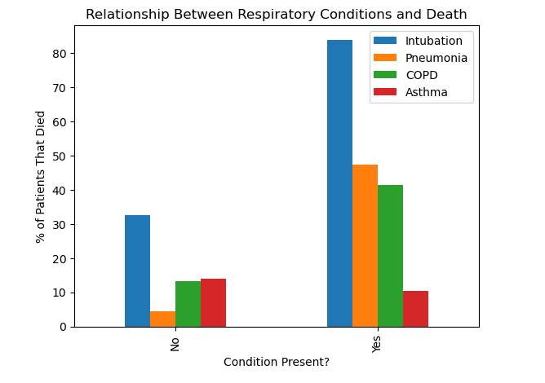
Respiratory Factors and Death
In 3 of 4 factors, presence of the factor lead to an increase in the percentage of patients who died.
  Intubated patients had the highest mortality of the factors assessed.
    84% of patients who were intubated died, whereas 33% of patients who were not intubated died.
  47% of patients who presented with pneumonia died while only 4% of patients who did not have pneumonia died.
  In COPD positive patients, 41% died compared to 13% of patients without COPD.
Asthma was the only variable where the percentage of patients who died was slightly higher for patients without the condition (14%) compared to patients with the condition (10%)

Slide 7
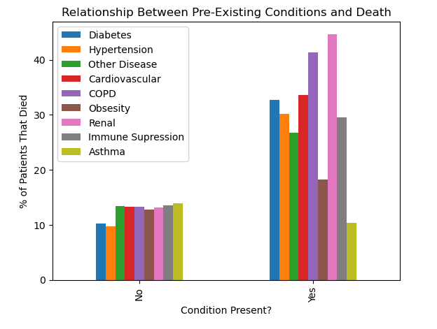
Comparison of All Pre-Existing Conditions
In general, presence of any of the conditions increases the risk of death
  Exception: Asthma and obesity
Limitation: Co-occurrence of conditions was not taken into account.
  For instance, a patient who died with a history of obesity, cardiovascular disease, and hypertension would be counted in all three categories.
  Could increase their likelihood of dying over a patient with one of those conditions alone.

