Slide 1


Project 1: What can we learn about COVID-19 trends to reduce death in a future pandemic?
https://www.kaggle.com/datasets/josephassaker/covid19-global-dataset
Presentation by
Eric Croston
05/22/2024

Slide 2
Data and Aims
Data set was obtained from: https://www.kaggle.com/datasets/josephassaker/covid19-global-dataset
The CSV dataset was pulled from the worldometers.info website
Included is daily data for 255 countries on case counts and death counts
Aims
Analyze data to determine trends relating death rates to cases
What are the relationships between new cases, active cases and deaths worldwide?
What are these relationships in the countries with the most COVID cases and do they follow a similar trend?

Slide 3
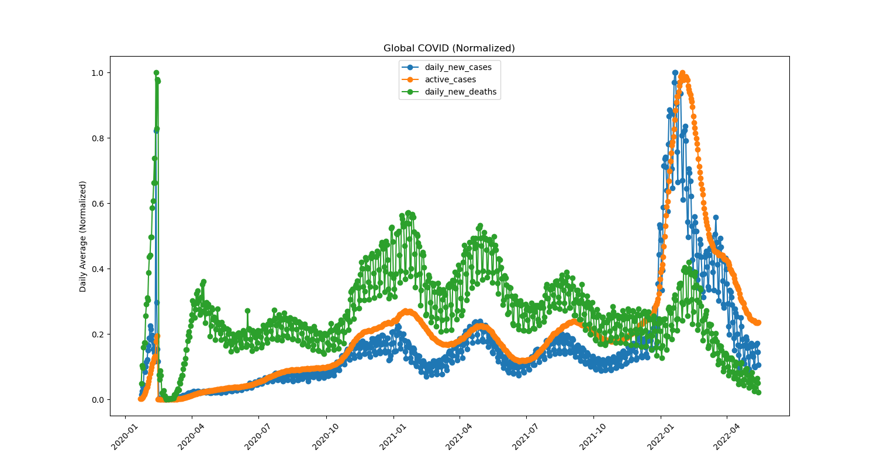
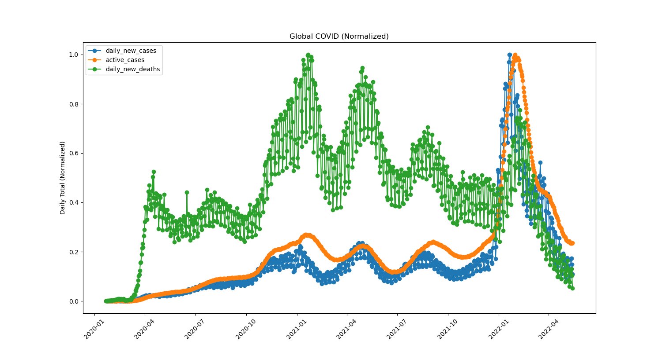
What are the relationships between new cases, active cases and deaths worldwide?
Daily Average of All Countries
Daily Totals of All Countries

Slide 4
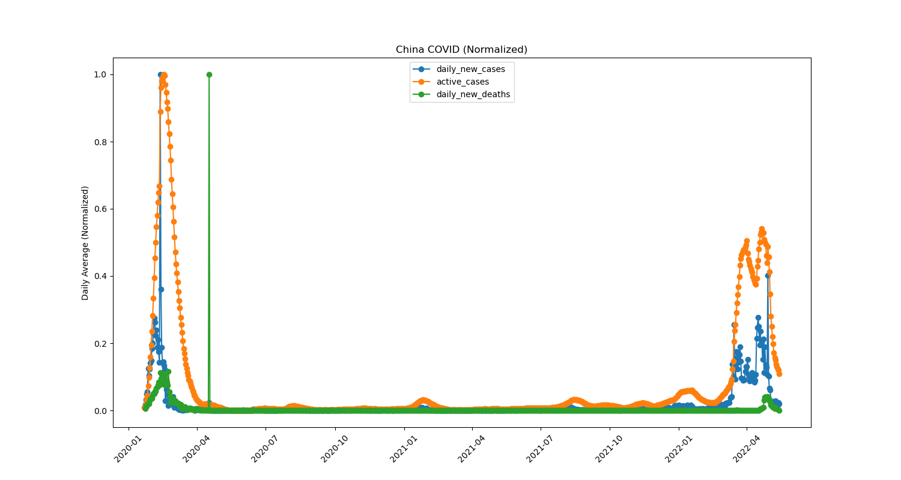
What caused the daily average data spike in early 2020?
Daily Totals in China

Slide 5
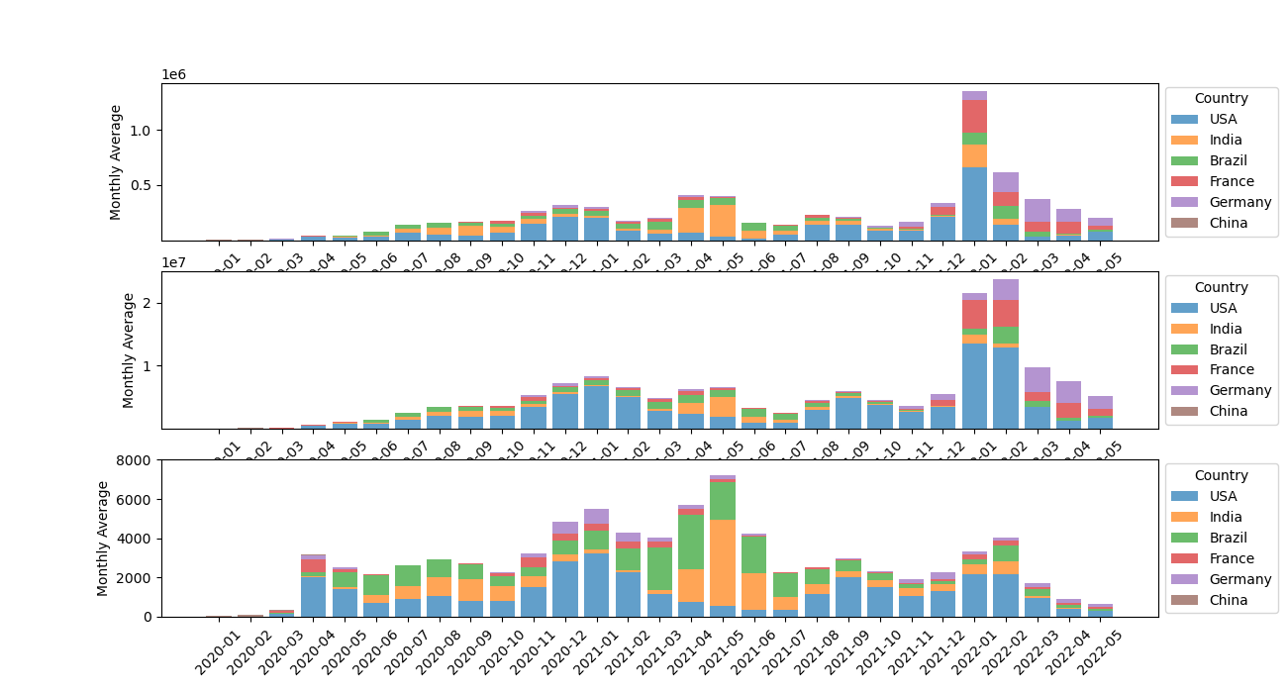
What are these relationships in the countries with the most COVID cases and do they follow a similar trend?
Most COVID Countries Daily Averages
Daily New Cases by Country
Active Cases by Country
Daily New Deaths by Country

Slide 6
Project 1: Determining the Relationships Between Pre-Existing Conditions and Death Rate During the COVID-19 Pandemic
https://www.kaggle.com/datasets/meirnizri/covid19-dataset.
Presentation by
Sarah Shuda, MSFS, ABC-DA
05/16/2024

Slide 7
Data and Aims
Data set was obtained from: https://www.kaggle.com/datasets/meirnizri/covid19-dataset.
Provides information from the Mexican government from 2020
Includes demographic information, information related to pre-existing conditions, treatment data including if the patient was intubated and the level of medical facility performing the treatment, and whether or not the patient died.
Aims
Analyze data to determine relationship between pre-existing conditions and death
Determine relationship between the number of pre-existing conditions and death
Determine relationship between pregnancy and death
Analyze respiratory specific conditions and death
Determine which pre-existing conditions were most correlated with death

Slide 8
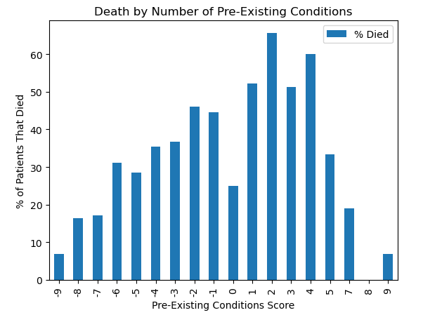
Multiple Pre-Existing Conditions and Death
Pre-existing conditions scores range from -9 to 9, with -9 meaning no pre-existing conditions were documented for a patient and 9 meaning the patient had all pre-existing conditions listed.
The percentage of patients who died tended to increase as the number of pre-existing conditions increased.
At scores of 5 or greater the proportion of patients who died decreased.
May be a function of the limited amount of patients who received those scores compared to the number of patients in some of the lower score brackets.

Slide 9
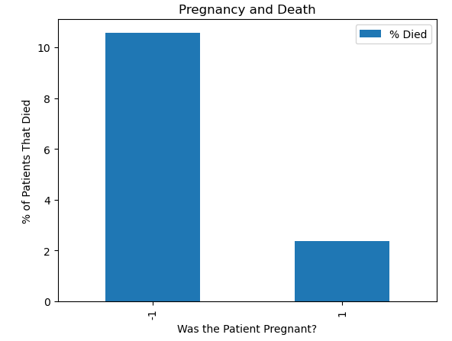
Pregnancy and Death
There was a higher rate of death in patients who were not pregnant, with 10.6% of patients dying.
In the pregnant patient population, only 2.3% of patients died.

Slide 10
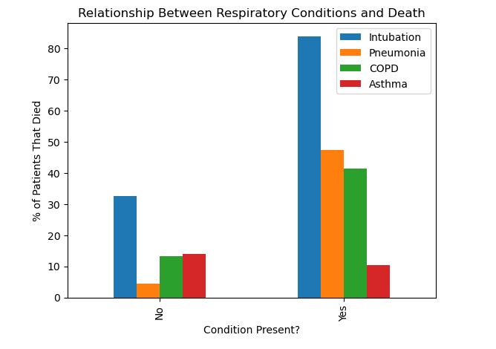
Respiratory Factors and Death
Three of the four factors examined, the presence of the factor lead to an increase in the percentage of patients who died.
Patients who were intubated had the highest mortality of the factors assessed. 84% of patients who were intubated died, whereas 33% of patients who were not intubated died.
47% of patients who presented with pneumonia died while only 4% of patients who did not have pneumonia died.
In COPD positive patients, 41% died compared to 13% of patients without COPD.
Asthma was the only variable assessed where the percentage of patients who died was slightly higher for patients without the condition (14%) compared to patients with the condition (10%), though these rates are quite close.

Slide 11
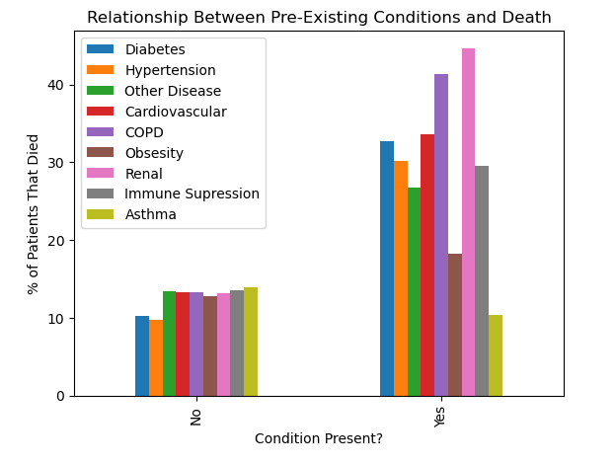
Comparison of All Pre-Existing Conditions
The data indicates the, with the exception of asthma and obesity, the presence of any of the conditions increases the risk of death.
One limitation to this data is that co-occurrence of conditions was not taken into account. For instance, a patient who died with a history of obesity, cardiovascular disease, and hypertension would be counted in all three categories, which could increase their likelihood of dying over a patient with one of those conditions alone.

Slide 12
Project 1: Comorbidity factors governing the mortality during COVID-19 Pandemic
Our World in Data
https://covid.ourworldindata.org/data/owid-covid-data.csv
Presentation by
Meenakshi Tiwary Kleiman, PhD
05/16/2024

Slide 13
Data and Aims
Our World in Data: https://covid.ourworldindata.org/data/owid-covid-data.csv
Complied data from:
European Centre for Disease Prevention and Control (ECDC)
World health Organization (WHO)
Johns Hopkins
Data from 187 countries
Aims
Analyze data to see the correlation between comorbidity factors during COVID_19 pandemic
To compare the correlation between comorbidity factors in Asia, Europe and North America
Cardiovascular Death Rate Vs Diabetes Prevalence
Cardiovascular Death Rate Vs Old Age
Cardiovascular Death Rate Vs Smoking

Slide 14
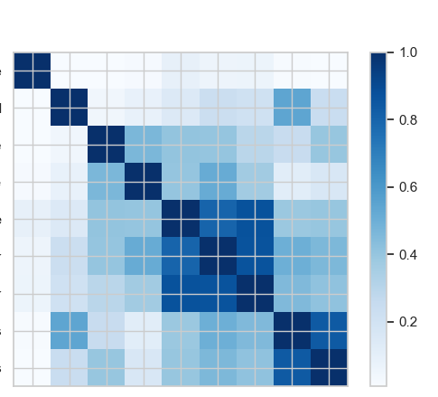
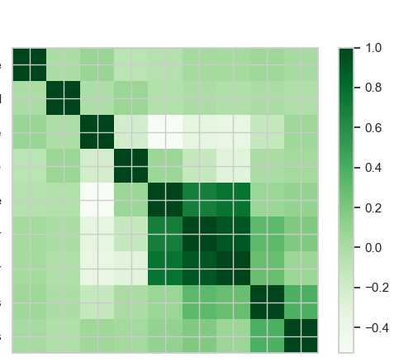
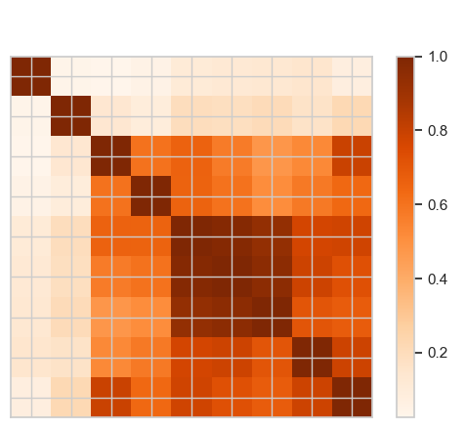
Correlation Matrix Between Comorbidity Factors
North America
Asia
Europe
death_rate
new_cases_smoothed
cardiovasc_death_rate
diabetes_prevalence”
median_age
aged_65_older
aged_70_older
female_smokers
male_smokers
death_rate
new_cases_smoothed
cardiovasc_death_rate
diabetes_prevalence”
median_age
aged_65_older
aged_70_older
female_smokers
male_smokers
death_rate
new_cases_smoothed
cardiovasc_death_rate
diabetes_prevalence”
median_age
aged_65_older
aged_70_older
female_smokers
male_smokers
death_rate
new_cases_smoothed
cardiovasc_death_rate
diabetes_prevalence”
median_age
aged_65_older
aged_70_older
female_smokers
male_smokers

Slide 15
Correlation Matrix Between Comorbidity Factors
North America
Asia
Europe
death_rate
new_cases_smoothed
cardiovasc_death_rate
diabetes_prevalence”
median_age
aged_65_older
aged_70_older
female_smokers
male_smokers
death_rate
new_cases_smoothed
cardiovasc_death_rate
diabetes_prevalence”
median_age
aged_65_older
aged_70_older
female_smokers
male_smokers
death_rate
new_cases_smoothed
cardiovasc_death_rate
diabetes_prevalence”
median_age
aged_65_older
aged_70_older
female_smokers
male_smokers
death_rate
new_cases_smoothed
cardiovasc_death_rate
diabetes_prevalence”
median_age
aged_65_older
aged_70_older
female_smokers
male_smokers

Slide 16
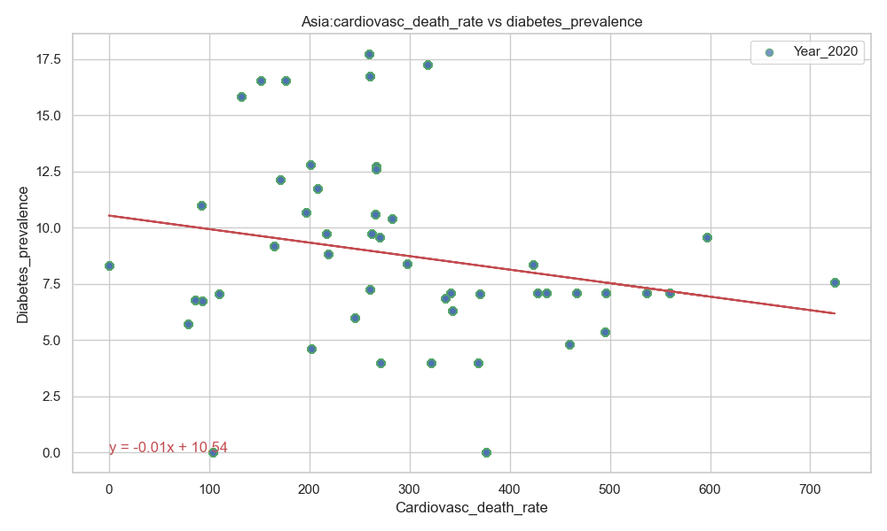
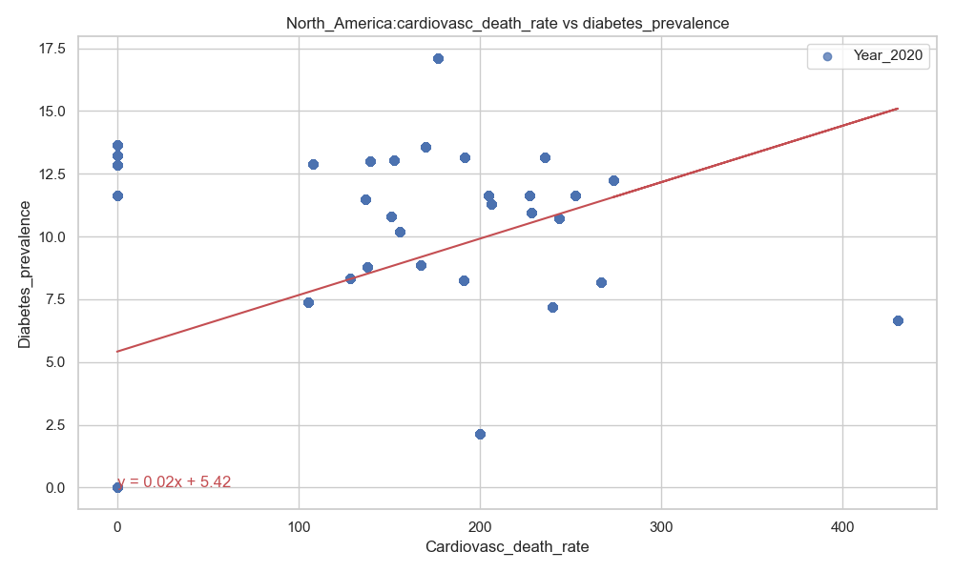
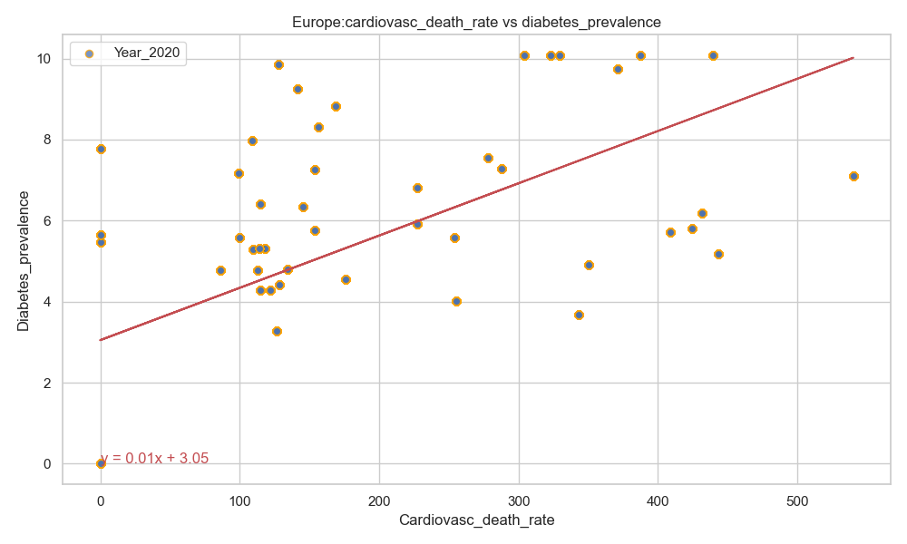
Cardiovasc Death Rate vs Diabetes Prevalence
R-value (Correlation coefficient): -0.22
R-value (Correlation coefficient): 0.46
R-value (Correlation coefficient): 0.60
There was a stronger correlation between the cardiovascular death rate and diabetes prevalence in Europe as compared to North America.
A negative correlation was observed between the cardiovascular death rate and diabetes prevalence in Asia.

Slide 17
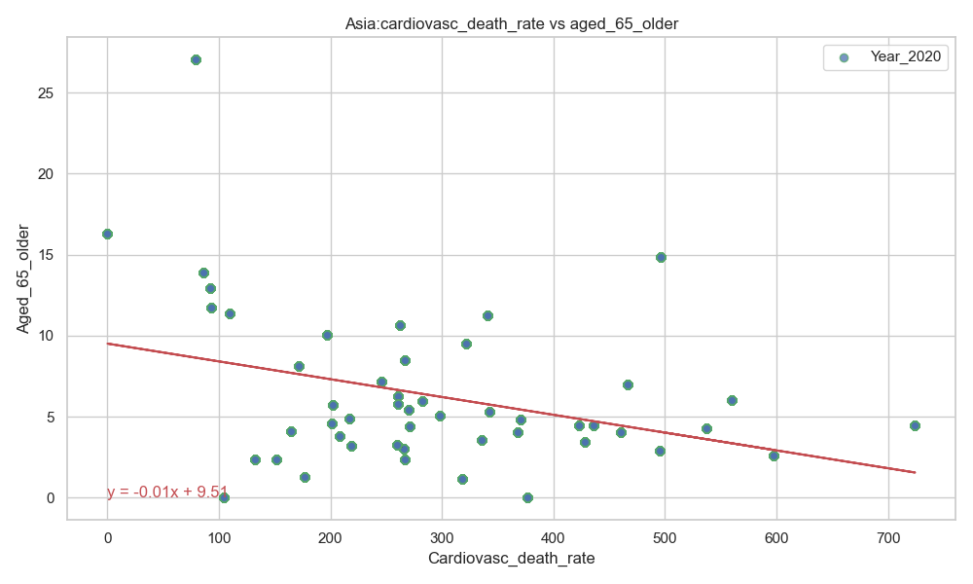
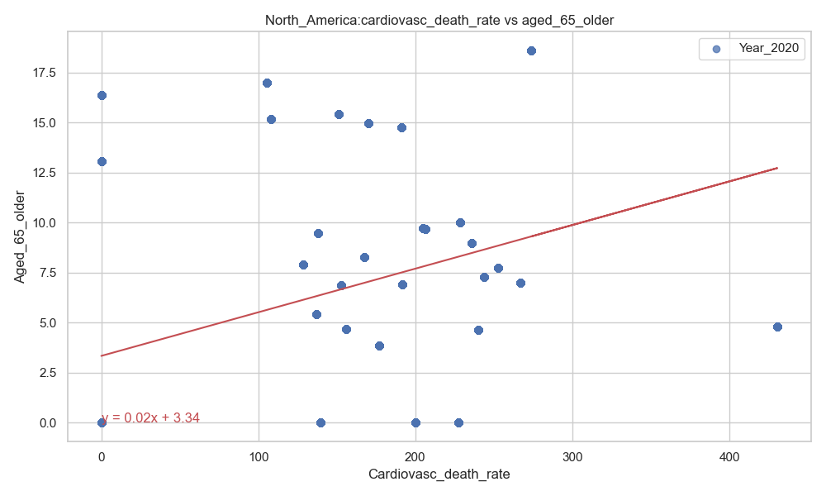
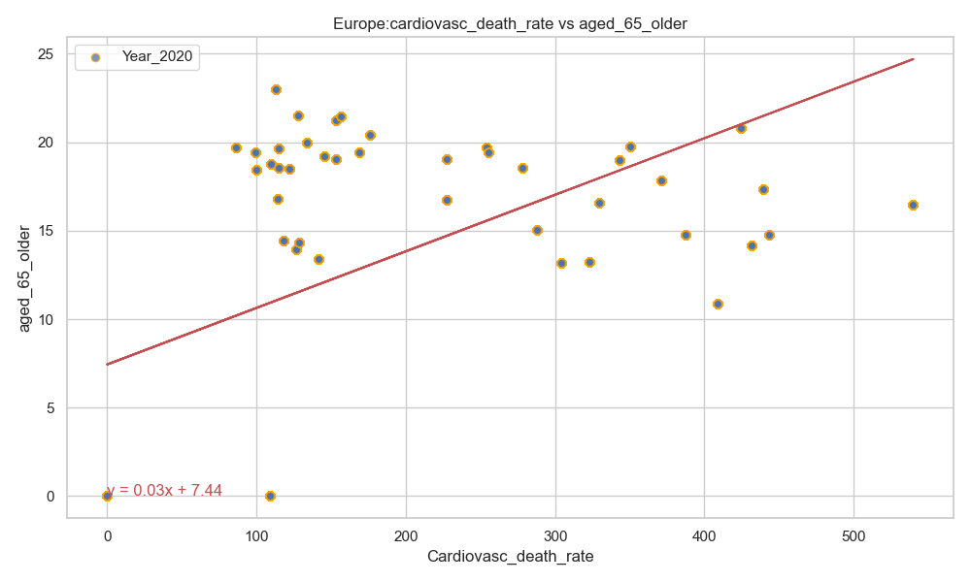
Cardiovasc Death Rate vs Age >65 Years Old
R-value (Correlation coefficient):-0.34
R-value (Correlation coefficient):- 0.40
R-value (Correlation coefficient):-0.53
There was a stronger correlation between the cardiovascular death rate and old age (above 65 years) in Europe as compared to North America.
A negative correlation was observed between the cardiovascular death rate and old age (above 65 years) in Asia.

Slide 18
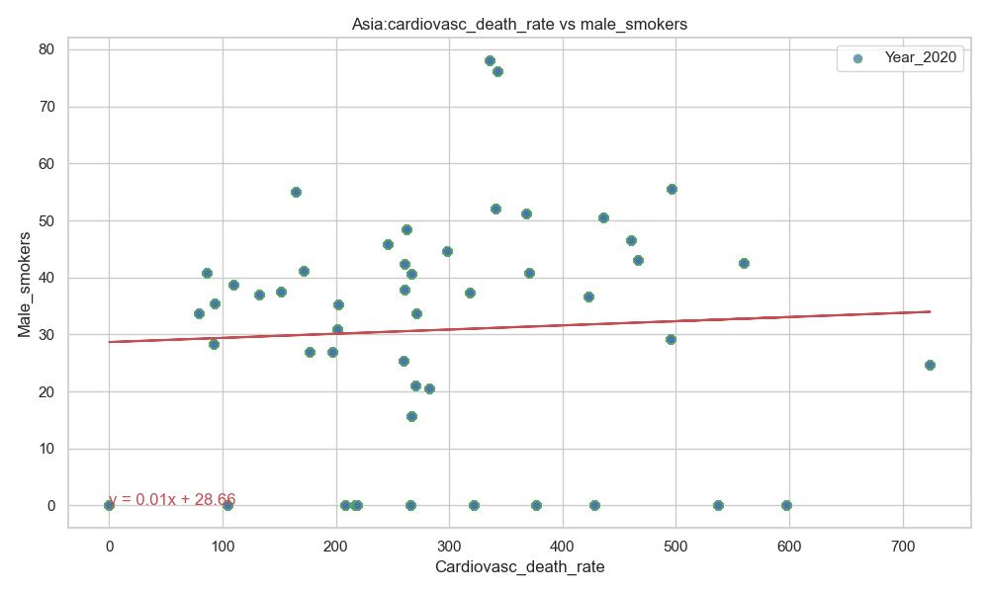
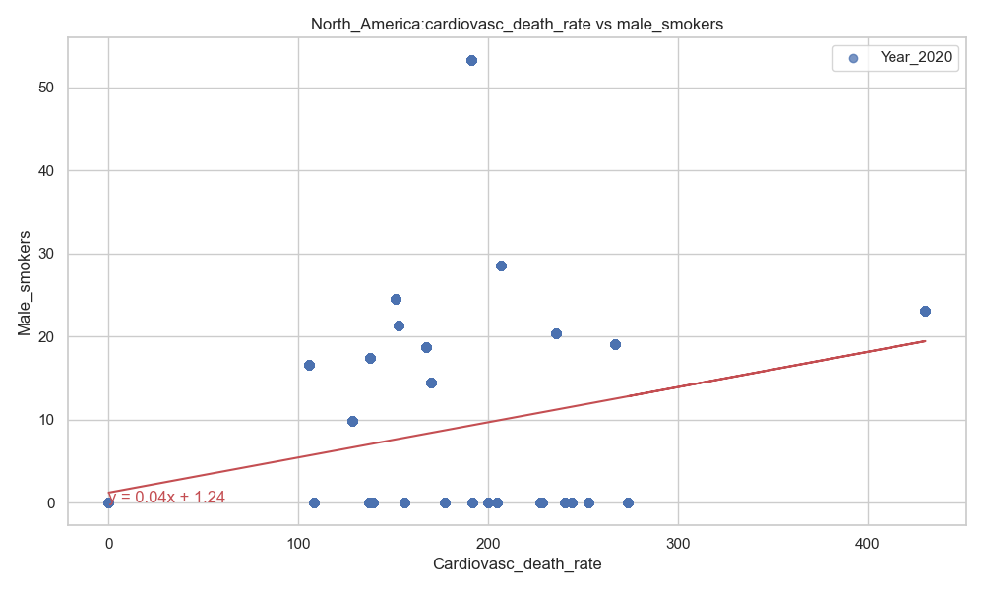
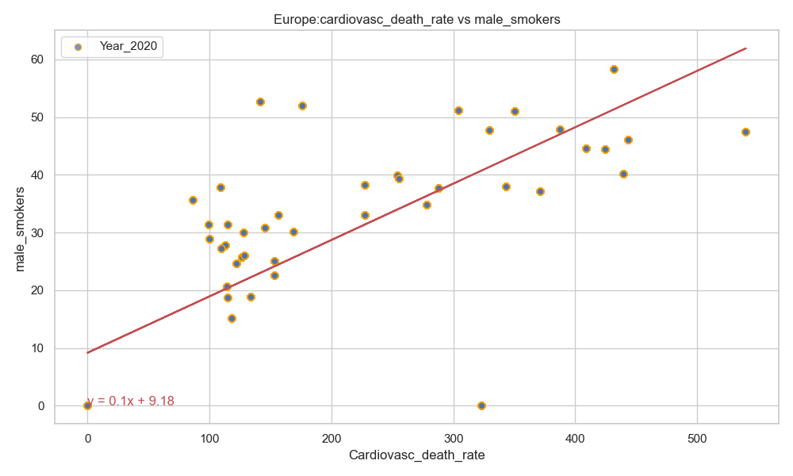
Cardiovasc Death Rate vs Male Smoker
R-value (Correlation coefficient): 0.05
R-value (Correlation coefficient): 0.40
R-value (Correlation coefficient): 0.79
There was a stronger correlation between the cardiovascular death rate and smoking (male) in Europe as compared to North America.
There was no correlation between the cardiovascular death rate and smoking (male) in Asia.

Slide 19
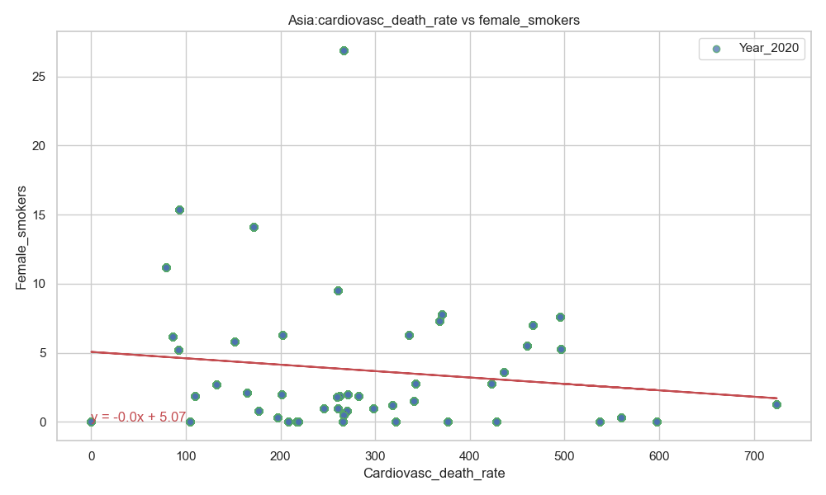
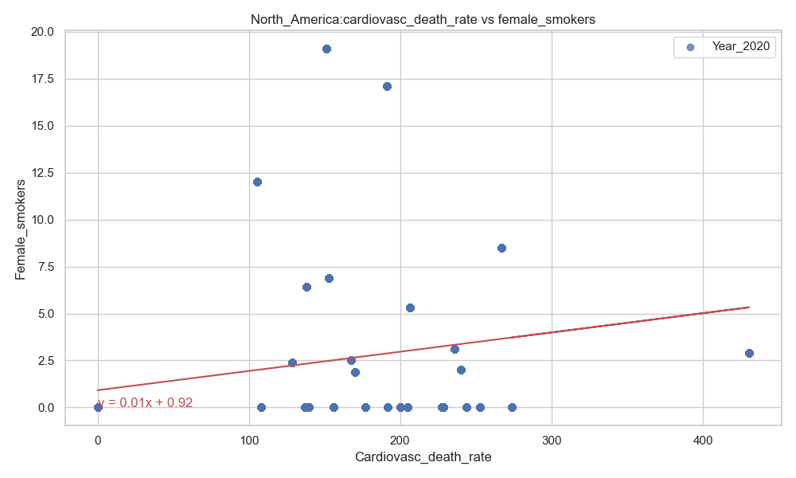
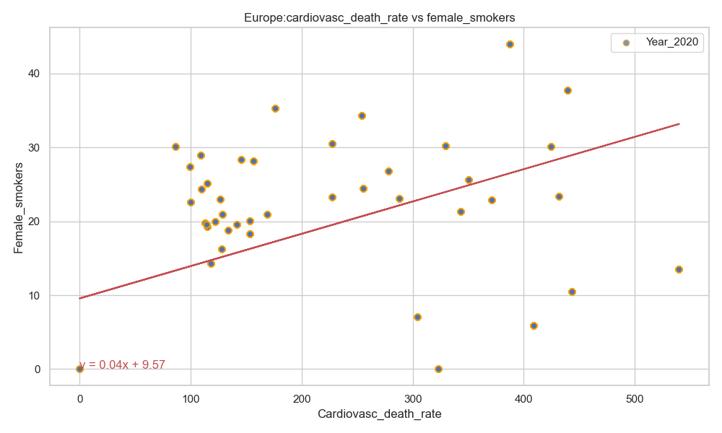
Cardiovasc Death Rate vs Female Smoker
R-value (Correlation coefficient): -0.14
R-value (Correlation coefficient): 0.24
R-value (Correlation coefficient): 0.53
There was a stronger correlation between the cardiovascular death rate and smoking (female) in Europe as compared to North America.
There was no correlation between between the cardiovascular death rate and smoking (female) in Asia.

Slide 20
Acknowledgement
Instructor: Dave Melillo
Team members
Eric Croston
Sarah Shuda

