Slide 1

Project 1: COVID-19
Presentation by:
Eric Croston
Sarah shuda
Meenakshi Tiwary kleiman

Slide 2

What are the trends and relationships between new cases, active cases and deaths worldwide?
What are these trends and relationships in the countries with the most COVID cases and how do they compare worldwide?
Presentation by
Eric Croston
05/22/2024

Slide 3
The Data
The CSV dataset was pulled from the worldometers.info and made available at https://www.kaggle.com/datasets/josephassaker/covid19-global-dataset
Daily COVID Data
225 Countries
New Cases, Active Cases and Cumulative Cases
New Deaths and Cumulative Deaths
Data Cleaning
184,787 rows data in the original data set
844 rows data in the world average and totals data sets
29 rows of data in the individual country data sets

Slide 4
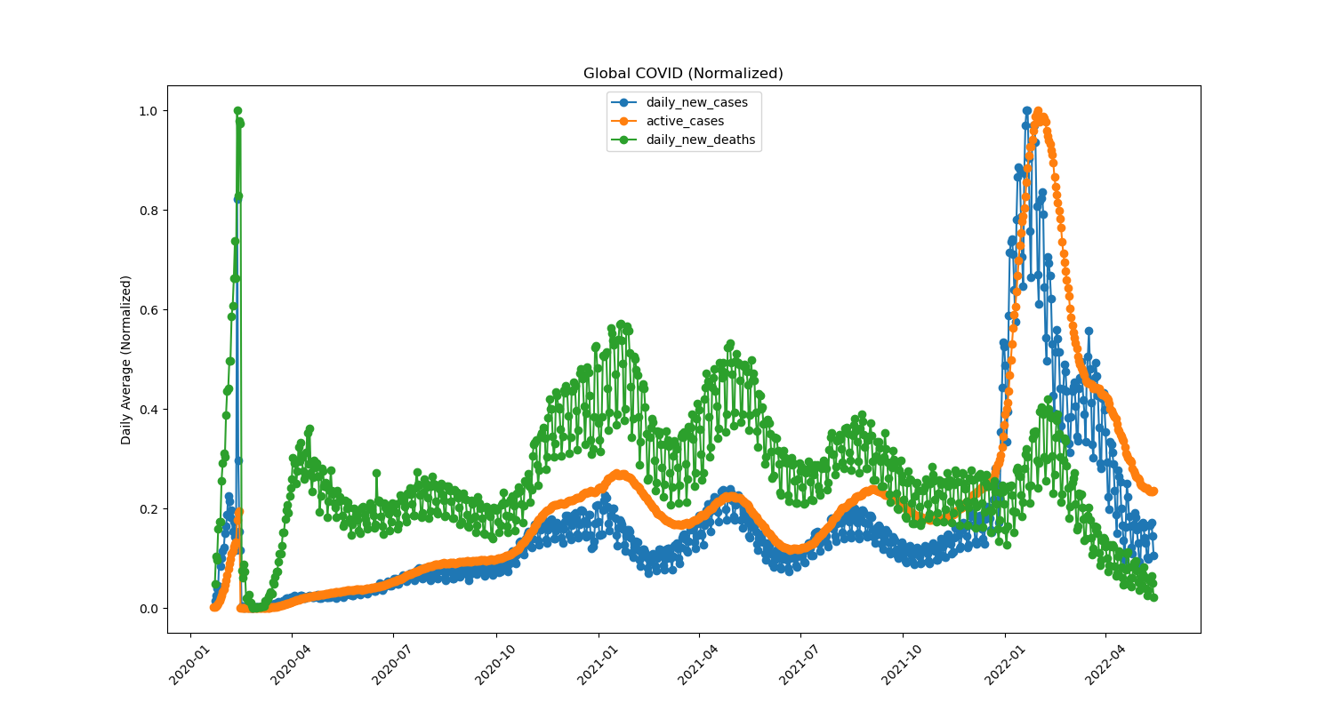
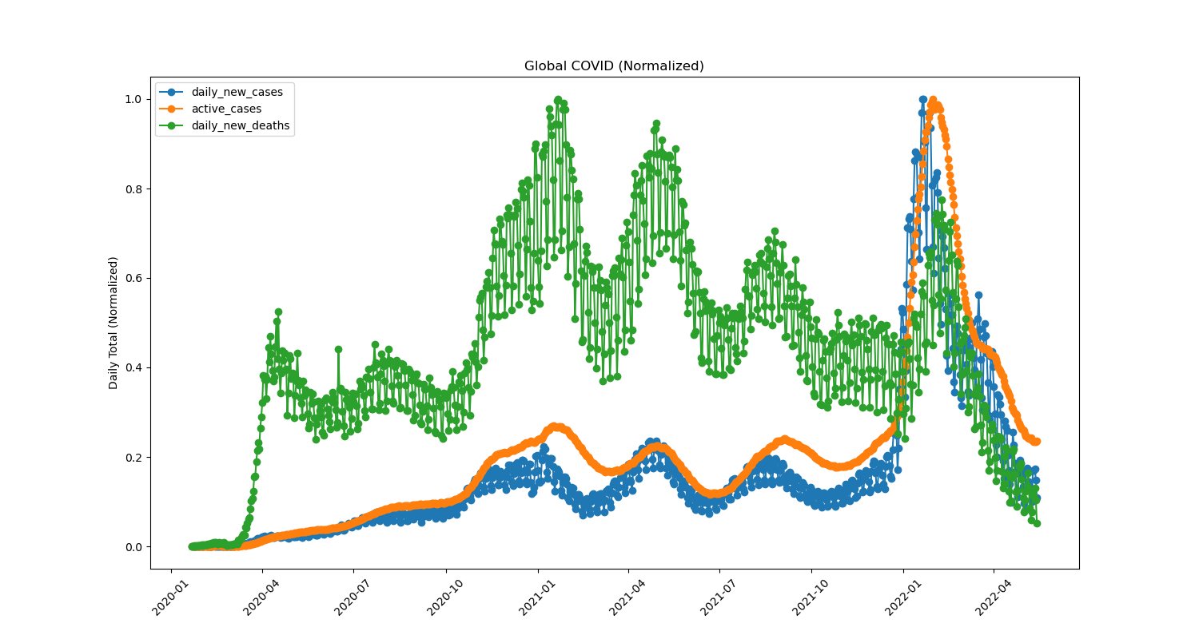
What are the trends and relationships between new cases, active cases and deaths worldwide?
Daily Average of All Countries
Daily Totals of All Countries

Slide 5
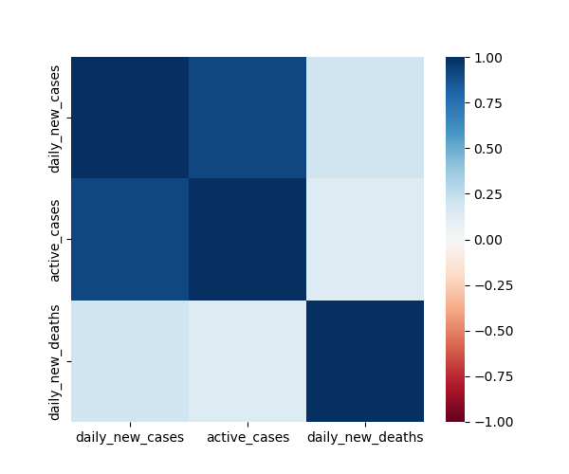
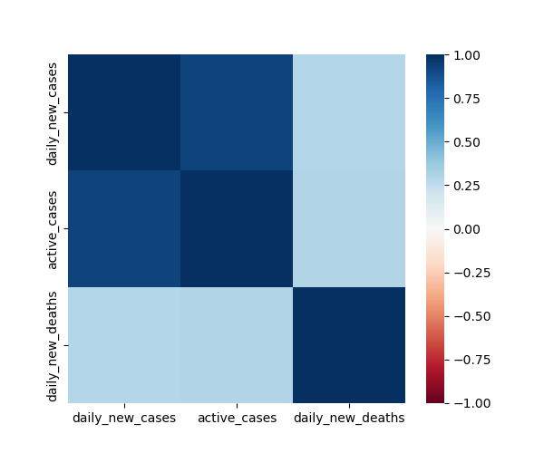
Worldwide Trends and Relationships
Daily Average of All Countries
Daily Totals of All Countries

Slide 6
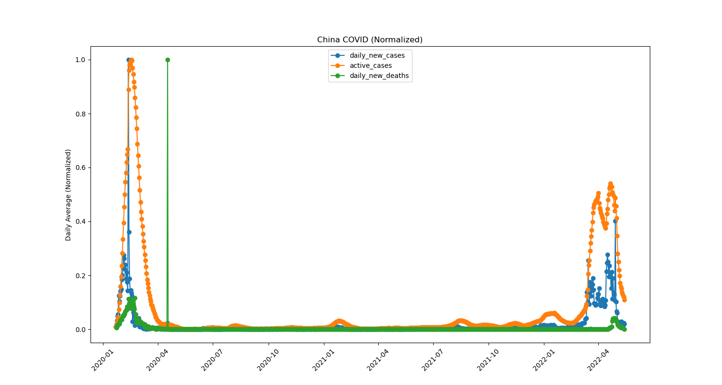
What caused the daily average data spike in early 2020?
Daily Totals in China

Slide 7
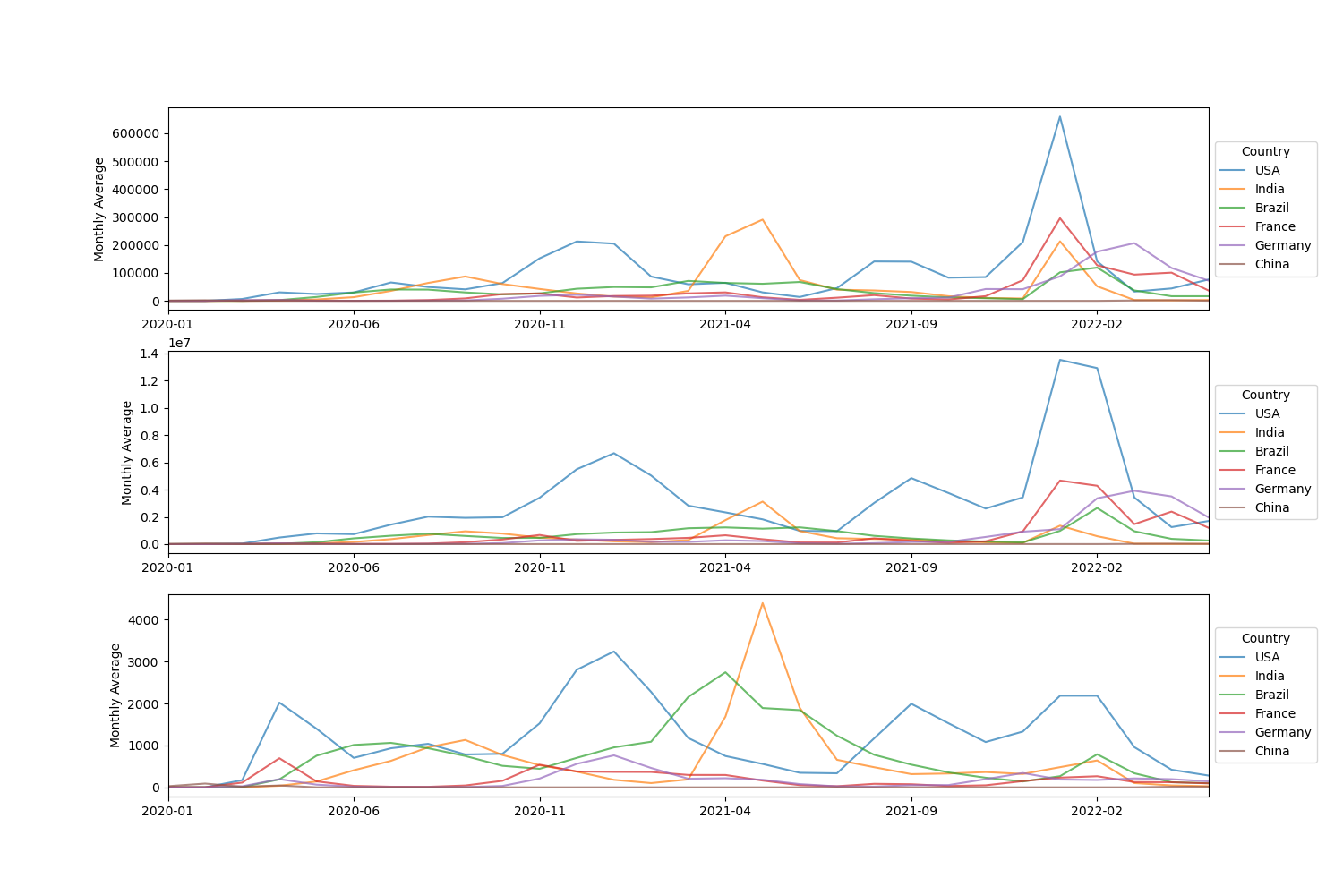
What are these trends and relationships in the countries with the most COVID cases and how do they compare worldwide?
Daily Averages for Most COVID Countries
Daily New Cases by Country
Active Cases by Country
Daily New Deaths by Country

Slide 8
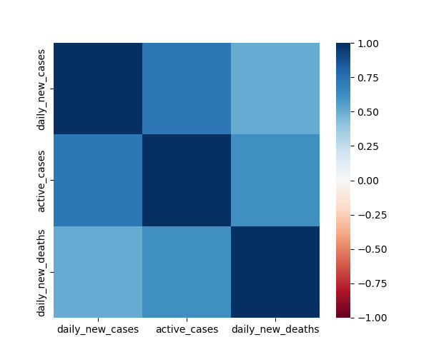
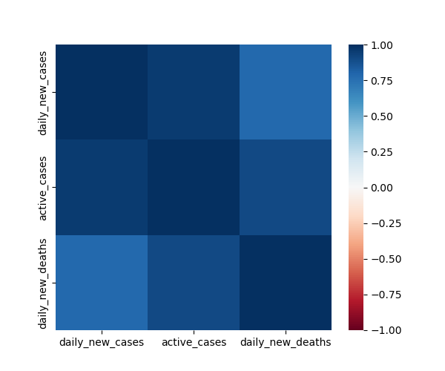
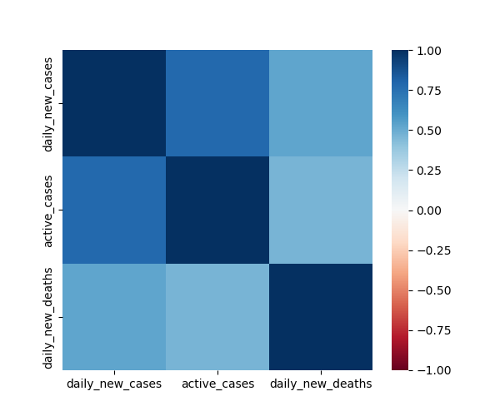


What are these trends and relationships in the countries with the most COVID cases and how do they compare worldwide?
USA Heatmap
India Heatmap
Brazil Heatmap
France Heatmap
Germany Heatmap
France Correlations
New Cases to Deaths .089
Active Cases to Deaths .121
Germany Correlations
New Cases to Deaths .181
Active Cases to Deaths .126
India Correlations
New Cases to Deaths .784
Active Cases to Deaths .903

Slide 9
Project 1: Determining the Relationships Between Pre-Existing Conditions and Death Rate During the COVID-19 Pandemic
https://www.kaggle.com/datasets/meirnizri/covid19-dataset.
Presentation by
Sarah Shuda, MSFS, ABC-DA
05/16/2024

Slide 10
Data and Aims
Data set was obtained from: https://www.kaggle.com/datasets/meirnizri/covid19-dataset.
Provides information from the Mexican government from 2020
Includes demographic information, information related to pre-existing conditions, treatment data including if the patient was intubated and the level of medical facility performing the treatment, and whether or not the patient died.
Aims
Analyze data to determine relationship between pre-existing conditions and death
Determine relationship between the number of pre-existing conditions and death
Analyze respiratory specific conditions and death
Determine which pre-existing conditions were most correlated with death

Slide 11
Data Cleaning and Processing
Decoding the data set
97, 98, 99, and 9999-99-99 were used when data was not collected
2 = No & 1 = Yes
1-3 meant the patient was COVID-19 positive, 4-7 meant the patient did not test positive for COVID-19
Data cleaning steps
Replace missing data with 0
Replace 2 with -1 so when summing, missing and negative results would have separate affects
Drop COVID-19 negative patients
Add a column with a binary response to indicate if a patient died
Add a column that sums the binary response for all 9 pre-existing conditions
Original data set consisted of 1,048,576 patients. Cleaned data set contained 391,978 patients.

Slide 12
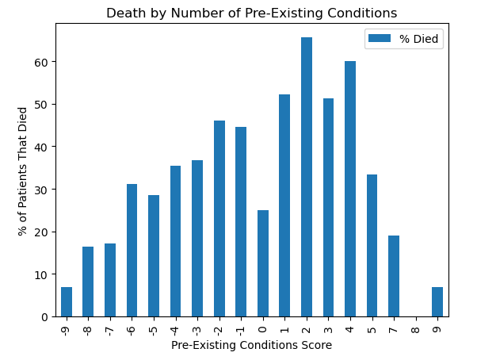
Multiple Pre-Existing Conditions and Death
Pre-existing conditions scores range from -9 to 9.
-9 = no pre-existing conditions were documented
9 = the patient had all pre-existing conditions listed
The percentage of patients who died tended to increase as the number of pre-existing conditions increased.
At scores of 5 or greater the proportion of patients who died decreased.
May be a function of the limited amount of patients who received those scores compared to the number of patients in some of the lower score brackets.

Slide 13
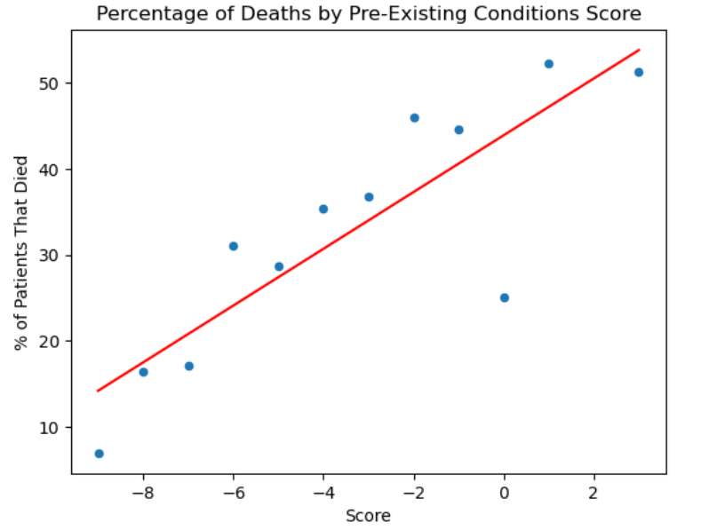
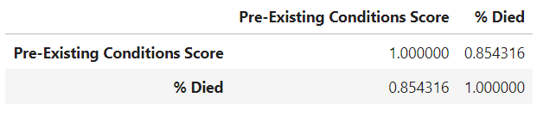
Multiple Pre-Existing Conditions and Death
Scores with fewer than 100 patients were dropped
Determined the correlation between score and death using a correlation matrix
0.85
Performed a linear regression
r² = 0.73

Slide 14
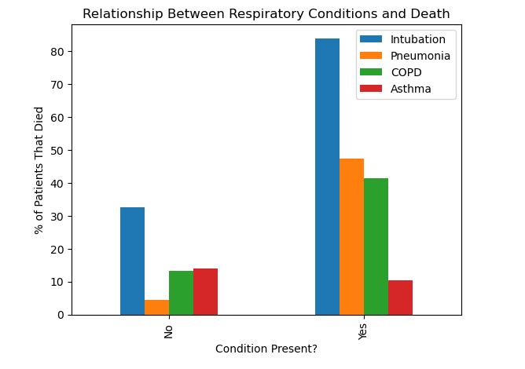
Respiratory Factors and Death
In 3 of 4 factors, presence of the factor lead to an increase in the percentage of patients who died.
Intubated patients had the highest mortality of the factors assessed.
84% of patients who were intubated died, whereas 33% of patients who were not intubated died.
47% of patients who presented with pneumonia died while only 4% of patients who did not have pneumonia died.
In COPD positive patients, 41% died compared to 13% of patients without COPD.
Asthma was the only variable where the percentage of patients who died was slightly higher for patients without the condition (14%) compared to patients with the condition (10%)

Slide 15
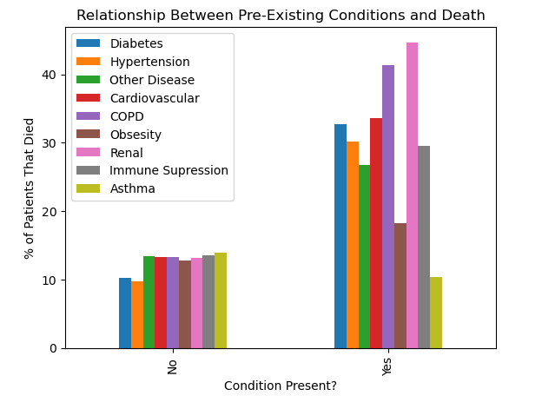
Comparison of All Pre-Existing Conditions
In general, presence of any of the conditions increases the risk of death
Exception: Asthma and obesity
Limitation: Co-occurrence of conditions was not taken into account.
For instance, a patient who died with a history of obesity, cardiovascular disease, and hypertension would be counted in all three categories.
Could increase their likelihood of dying over a patient with one of those conditions alone.

Slide 16
Project 1: Comorbidity factors governing the mortality during COVID-19 Pandemic
Our World in Data
https://covid.ourworldindata.org/data/owid-covid-data.csv
Presentation by
Meenakshi Tiwary Kleiman, PhD
05/22/2024

Slide 17
Data and Aims
Our World in Data: https://covid.ourworldindata.org/data/owid-covid-data.csv
Complied data from:
European Centre for Disease Prevention and Control (ECDC)
World health Organization (WHO)
Johns Hopkins
Data from 187 countries
Aims
Analyze data to see the correlation between comorbidity factors during COVID_19 pandemic
To compare the correlation between comorbidity factors in Asia, Europe and North America
Cardiovascular Death Rate Vs Diabetes Prevalence
Cardiovascular Death Rate Vs Old Age
Cardiovascular Death Rate Vs Smoking

Slide 18
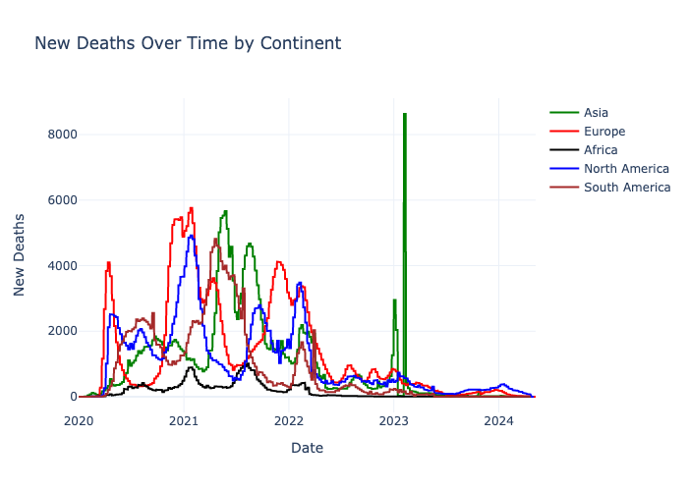
COVID-19 deaths over time

Slide 19
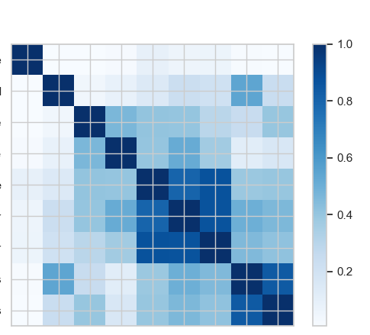
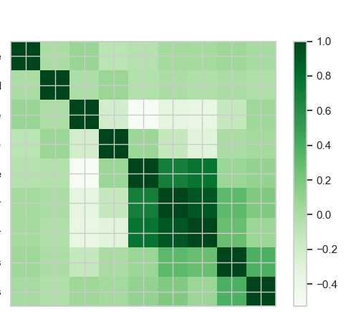
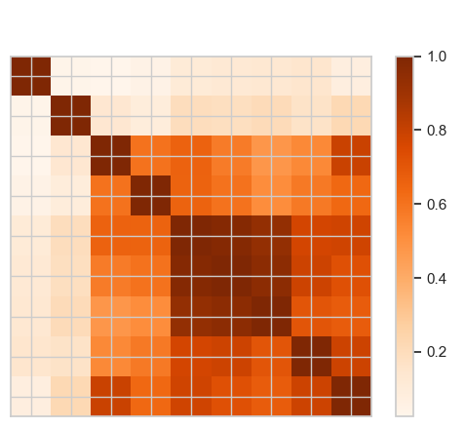
Correlation Matrix Between Comorbidity Factors
North America
Asia
Europe
death_rate
new_cases_smoothed
cardiovasc_death_rate
diabetes_prevalence”
median_age
aged_65_older
aged_70_older
female_smokers
male_smokers
death_rate
new_cases_smoothed
cardiovasc_death_rate
diabetes_prevalence”
median_age
aged_65_older
aged_70_older
female_smokers
male_smokers
death_rate
new_cases_smoothed
cardiovasc_death_rate
diabetes_prevalence”
median_age
aged_65_older
aged_70_older
female_smokers
male_smokers
death_rate
new_cases_smoothed
cardiovasc_death_rate
diabetes_prevalence”
median_age
aged_65_older
aged_70_older
female_smokers
male_smokers

Slide 20
Correlation Matrix Between Comorbidity Factors
North America
Asia
Europe
death_rate
new_cases_smoothed
cardiovasc_death_rate
diabetes_prevalence”
median_age
aged_65_older
aged_70_older
female_smokers
male_smokers
death_rate
new_cases_smoothed
cardiovasc_death_rate
diabetes_prevalence”
median_age
aged_65_older
aged_70_older
female_smokers
male_smokers
death_rate
new_cases_smoothed
cardiovasc_death_rate
diabetes_prevalence”
median_age
aged_65_older
aged_70_older
female_smokers
male_smokers
death_rate
new_cases_smoothed
cardiovasc_death_rate
diabetes_prevalence”
median_age
aged_65_older
aged_70_older
female_smokers
male_smokers

Slide 21
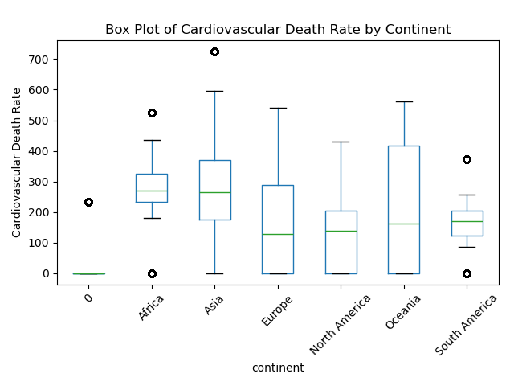
Cardiovasc Death Rate

Slide 22
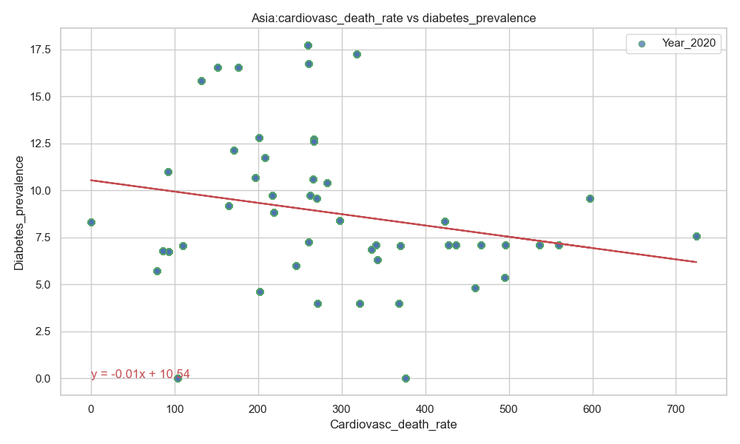
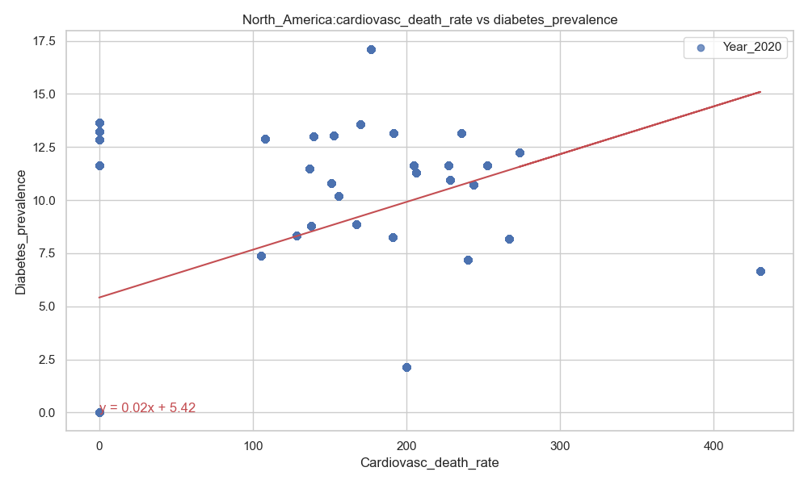
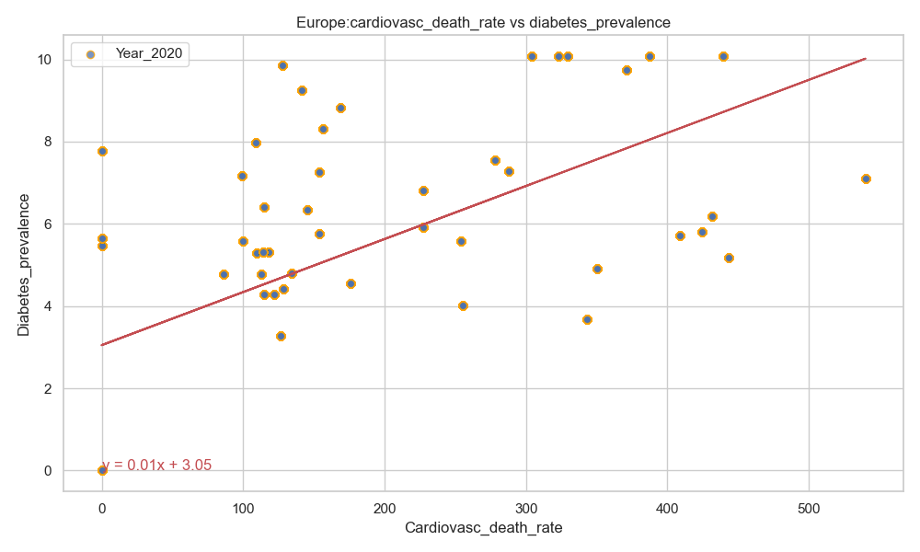
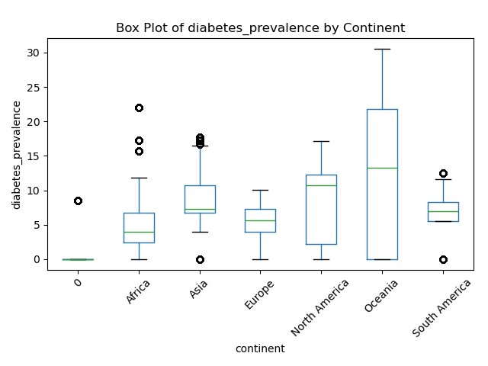
Cardiovasc Death Rate vs Diabetes Prevalence
R-value (Correlation coefficient): -0.22
R-value (Correlation coefficient): 0.46
R-value (Correlation coefficient): 0.60
There was a stronger correlation between the cardiovascular death rate and diabetes prevalence in Europe as compared to North America.
A negative correlation was observed between the cardiovascular death rate and diabetes prevalence in Asia.

Slide 23
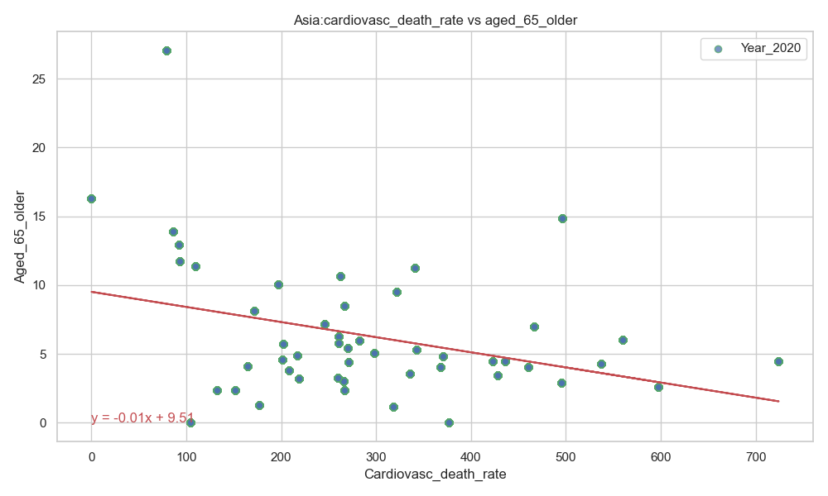
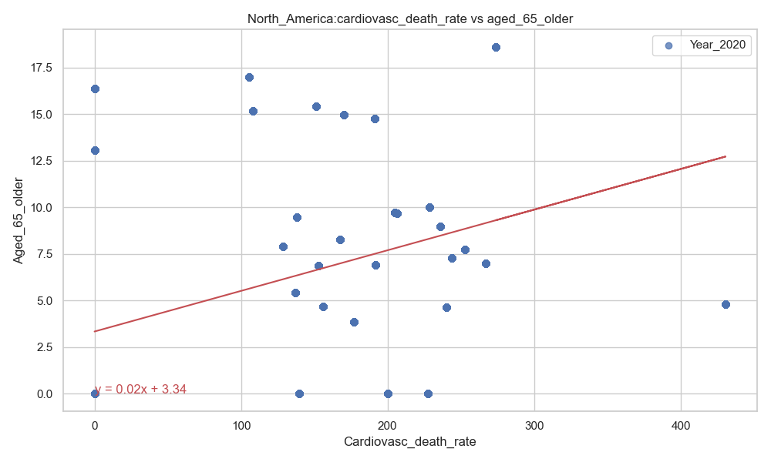
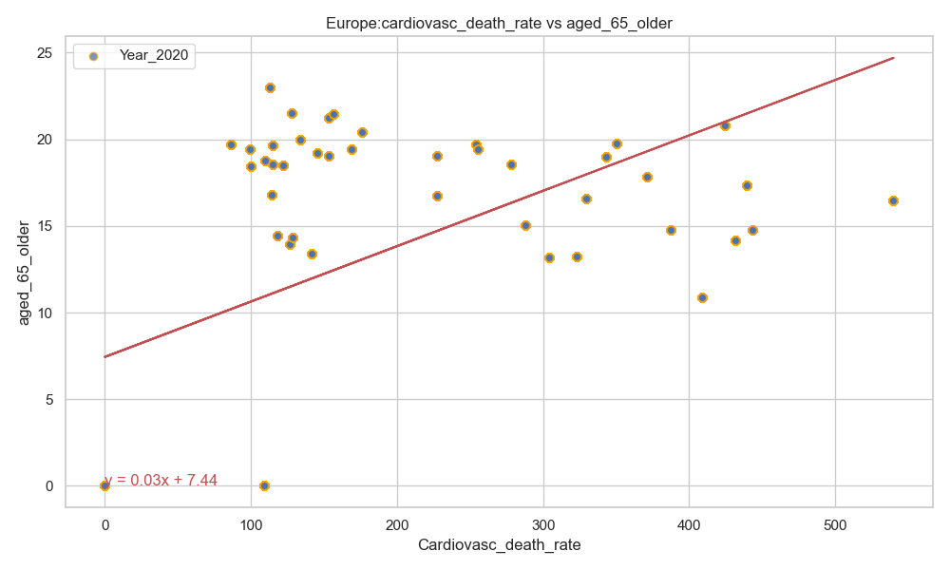
Cardiovasc Death Rate vs Age >65 Years Old
R-value (Correlation coefficient):-0.34
R-value (Correlation coefficient):- 0.40
R-value (Correlation coefficient):-0.53
There was a stronger correlation between the cardiovascular death rate and old age (above 65 years) in Europe as compared to North America.
A negative correlation was observed between the cardiovascular death rate and old age (above 65 years) in Asia.

Slide 24
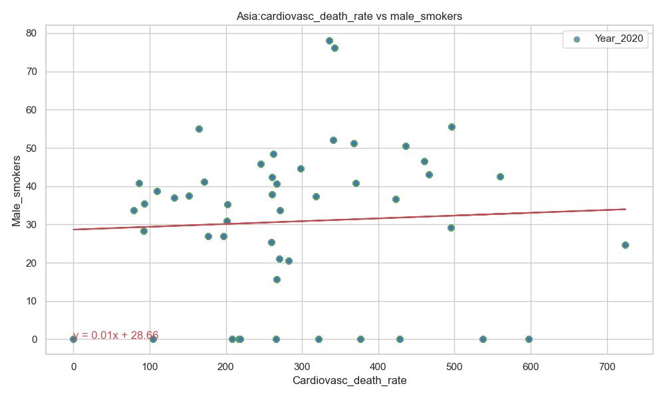
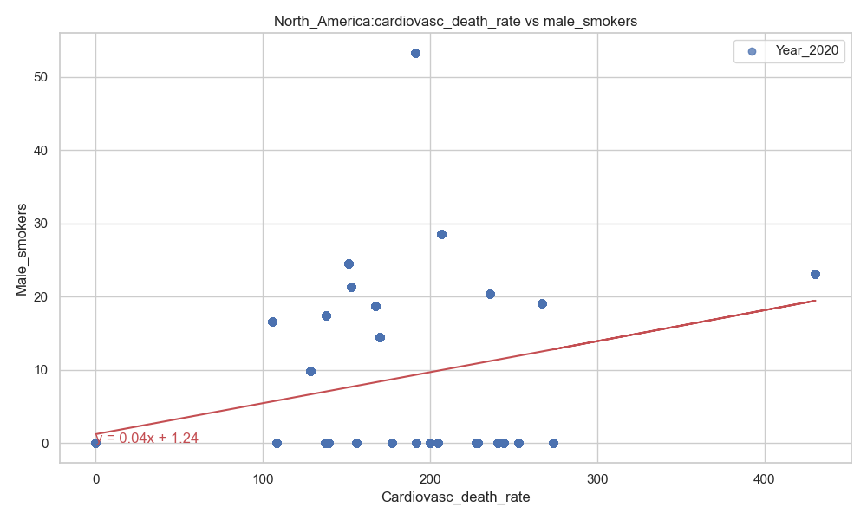
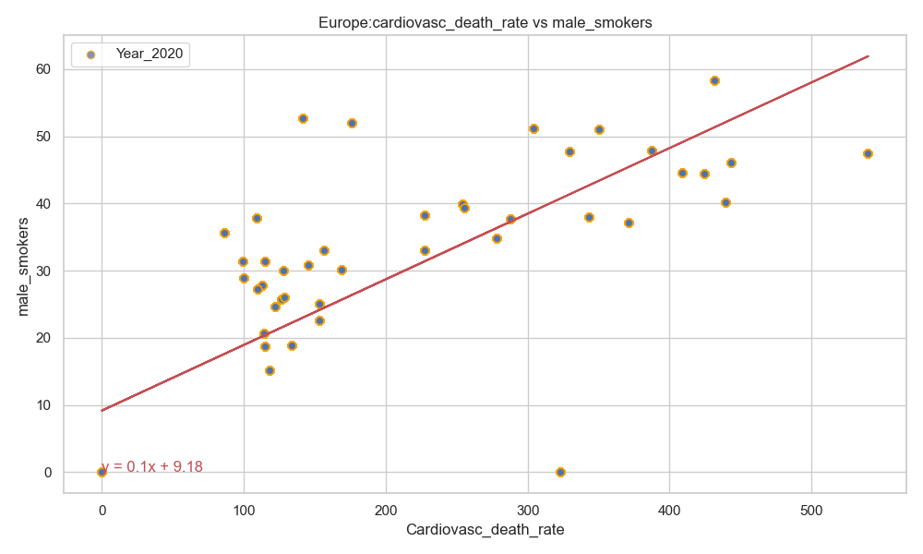
Cardiovasc Death Rate vs Male Smoker
R-value (Correlation coefficient): 0.05
R-value (Correlation coefficient): 0.40
R-value (Correlation coefficient): 0.79
There was a stronger correlation between the cardiovascular death rate and smoking (male) in Europe as compared to North America.
There was no correlation between the cardiovascular death rate and smoking (male) in Asia.

Slide 25
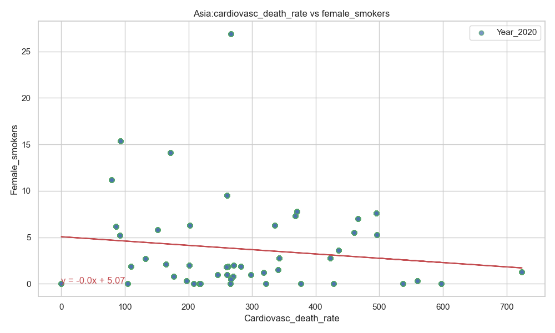
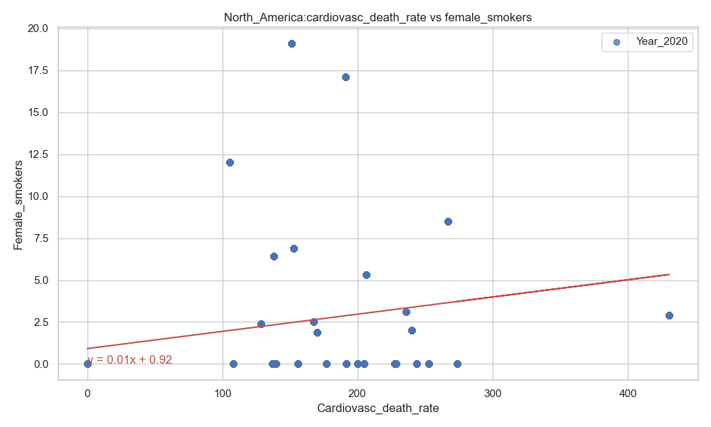
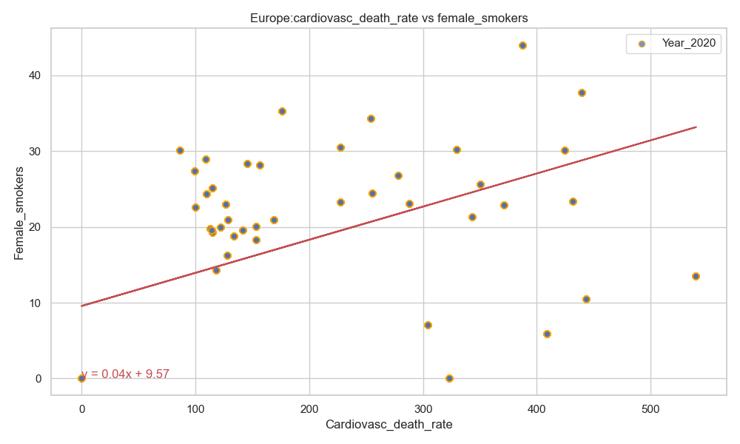
Cardiovasc Death Rate vs Female Smoker
R-value (Correlation coefficient): -0.14
R-value (Correlation coefficient): 0.24
R-value (Correlation coefficient): 0.53
There was a stronger correlation between the cardiovascular death rate and smoking (female) in Europe as compared to North America.
There was no correlation between between the cardiovascular death rate and smoking (female) in Asia.

Slide 26
Acknowledgement
Instructor: Dave Melillo
Team members
Eric Croston
Sarah Shuda

