Slide 1
COVID-19
What can we learn about the recent COVID pandemic to help reduce risks and respond better to a future pandemic.

Slide 2
Questions
What are the relationships between new cases, active cases and deaths worldwide?
What are these relationships in the countries with the most COVID cases and do they follow a similar trend?

Slide 3
Datasets
Covid-19 Global Dataset
https://www.kaggle.com/datasets/josephassaker/covid19-global-dataset
CSV dataset containing daily data from Jan 2020 to May 2022
Dataset
website
Dataset
website

Slide 4
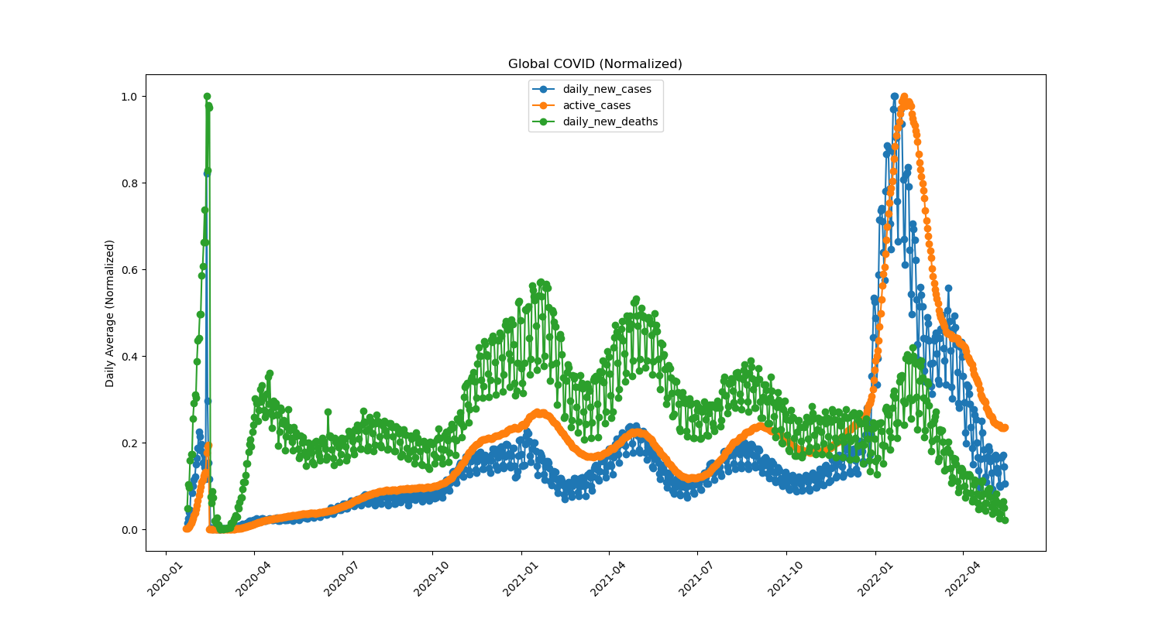
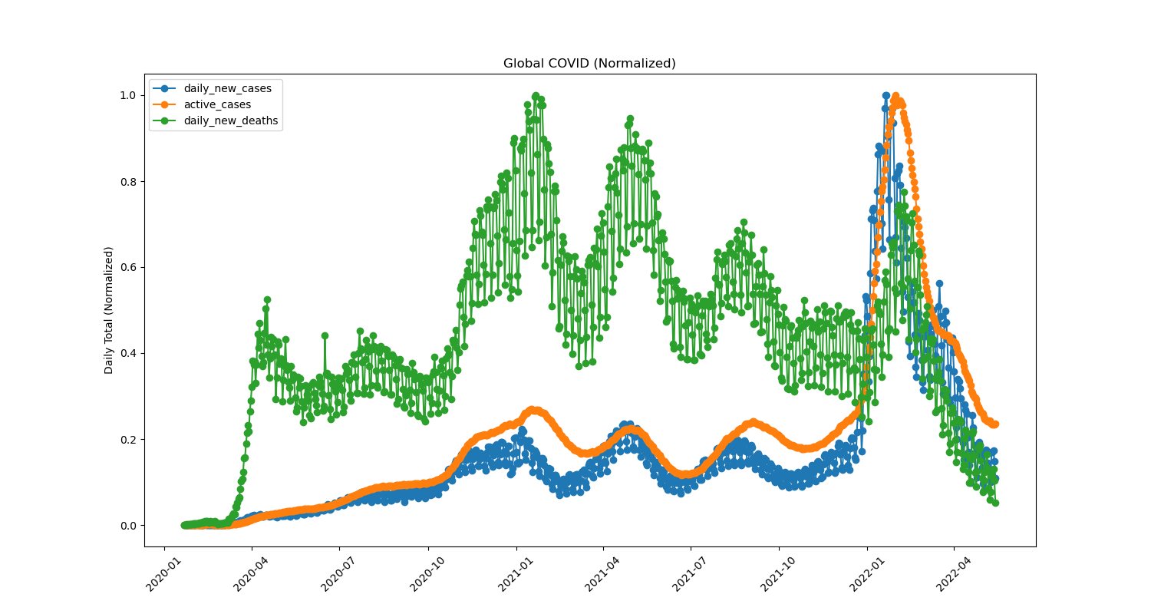
What are the relationships between new cases, active cases and deaths worldwide?
Daily Average of All Countries
Daily Totals of All Countries

Slide 5
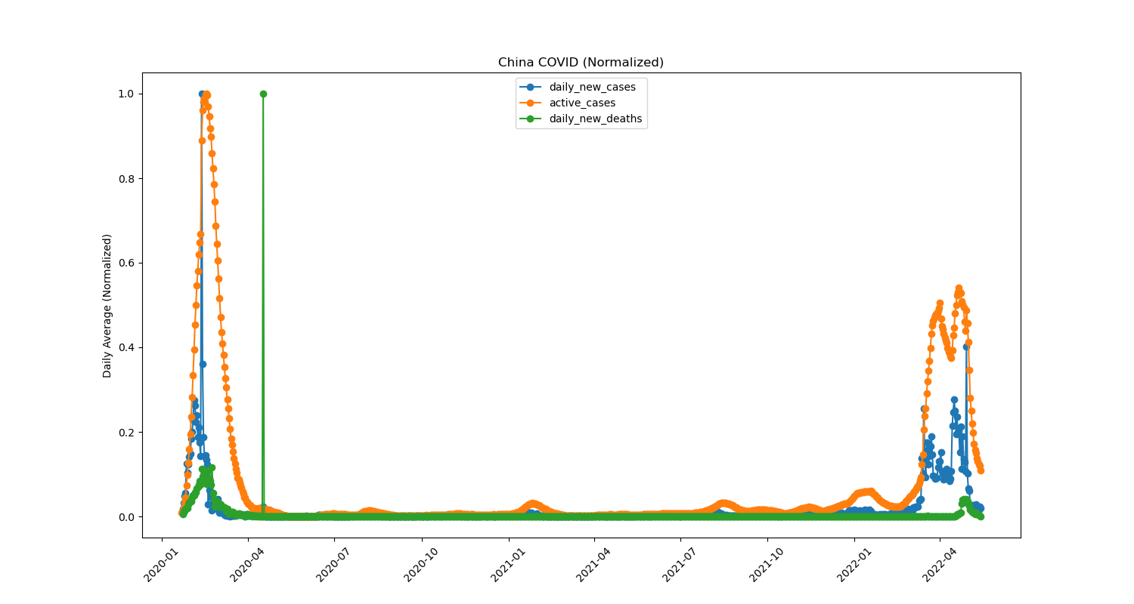
What caused the daily average data spike in early 2020?
Daily Totals in China

Slide 6
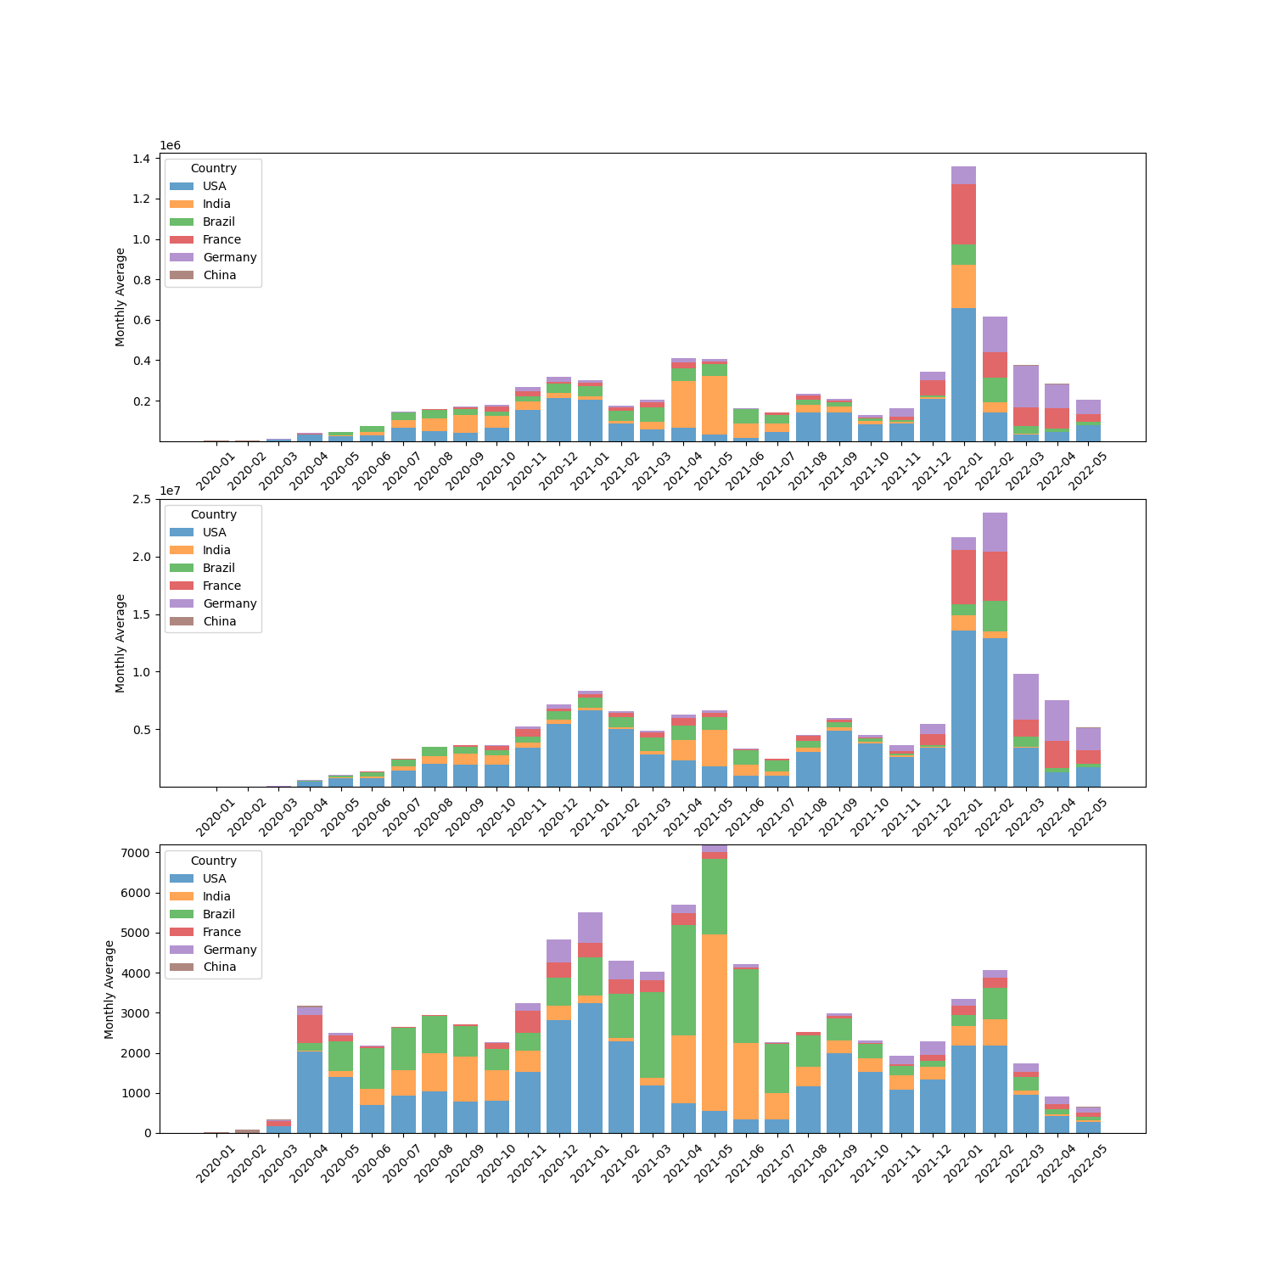
What are these relationships in the countries with the most COVID cases and do they follow a similar trend?
Most COVID Countries Daily Averages
Daily New Cases by Country
Active Cases by Country
Daily New Deaths by Country

