Slide 1


Project 1: Comorbidity factors governing the mortality during COVID-19 Pandemic
Our World in Data
https://covid.ourworldindata.org/data/owid-covid-data.csv
Presentation by
Meenakshi Tiwary Kleiman, PhD
05/22/2024

Slide 2
Data and Aims
Our World in Data: https://covid.ourworldindata.org/data/owid-covid-data.csv
Complied data from:
European Centre for Disease Prevention and Control (ECDC)
World health Organization (WHO)
Johns Hopkins
Data from 187 countries
Aims
Analyze data to see the correlation between comorbidity factors during COVID_19 pandemic
To compare the correlation between comorbidity factors in Asia, Europe and North America
Cardiovascular Death Rate Vs Diabetes Prevalence
Cardiovascular Death Rate Vs Old Age
Cardiovascular Death Rate Vs Smoking

Slide 3
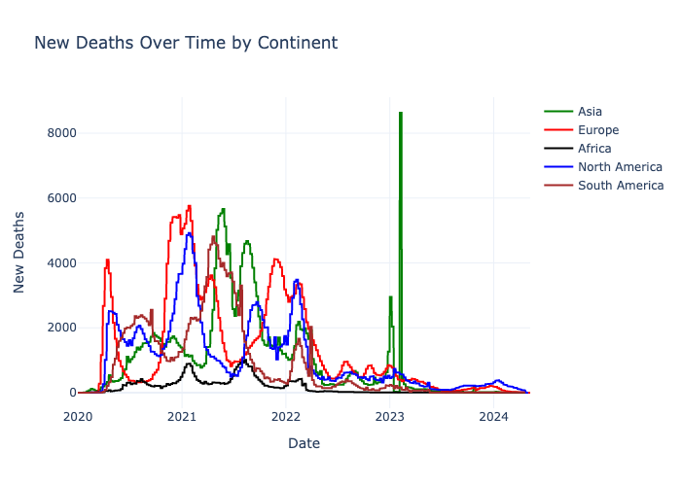
COVID-19 deaths over time

Slide 4
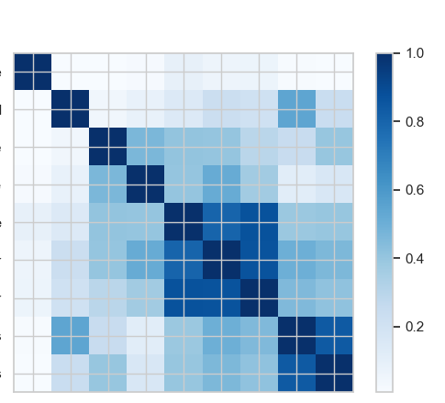
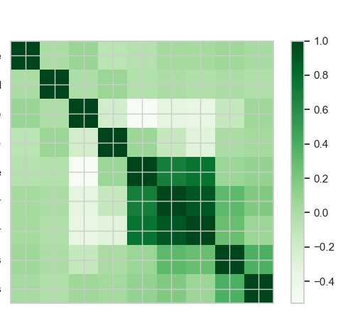
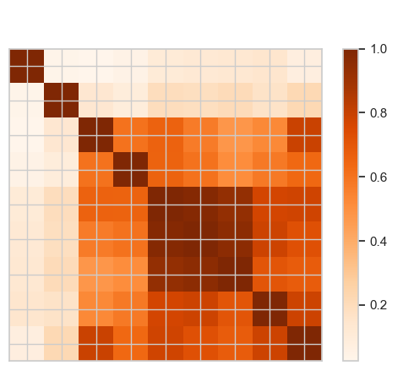
Correlation Matrix Between Comorbidity Factors
North America
Asia
Europe
death_rate
new_cases_smoothed
cardiovasc_death_rate
diabetes_prevalence”
median_age
aged_65_older
aged_70_older
female_smokers
male_smokers
death_rate
new_cases_smoothed
cardiovasc_death_rate
diabetes_prevalence”
median_age
aged_65_older
aged_70_older
female_smokers
male_smokers
death_rate
new_cases_smoothed
cardiovasc_death_rate
diabetes_prevalence”
median_age
aged_65_older
aged_70_older
female_smokers
male_smokers
death_rate
new_cases_smoothed
cardiovasc_death_rate
diabetes_prevalence”
median_age
aged_65_older
aged_70_older
female_smokers
male_smokers

Slide 5
Correlation Matrix Between Comorbidity Factors
North America
Asia
Europe
death_rate
new_cases_smoothed
cardiovasc_death_rate
diabetes_prevalence”
median_age
aged_65_older
aged_70_older
female_smokers
male_smokers
death_rate
new_cases_smoothed
cardiovasc_death_rate
diabetes_prevalence”
median_age
aged_65_older
aged_70_older
female_smokers
male_smokers
death_rate
new_cases_smoothed
cardiovasc_death_rate
diabetes_prevalence”
median_age
aged_65_older
aged_70_older
female_smokers
male_smokers
death_rate
new_cases_smoothed
cardiovasc_death_rate
diabetes_prevalence”
median_age
aged_65_older
aged_70_older
female_smokers
male_smokers

Slide 6
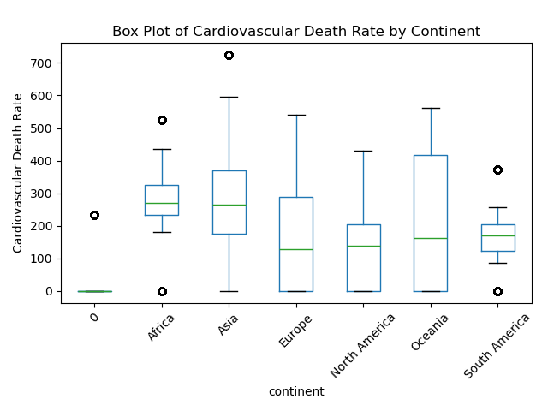
Cardiovasc Death Rate

Slide 7
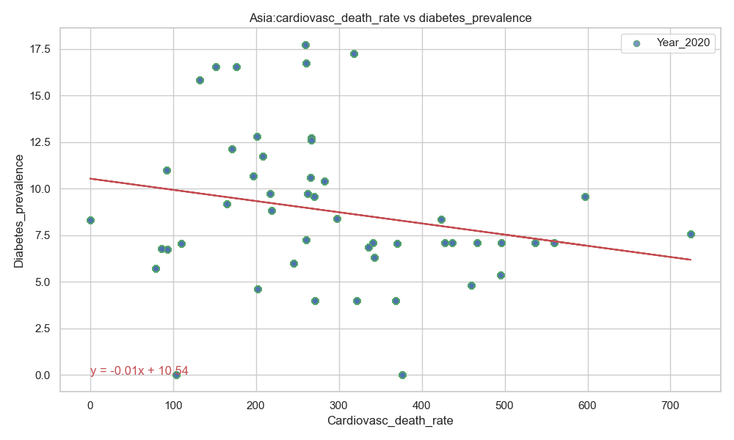
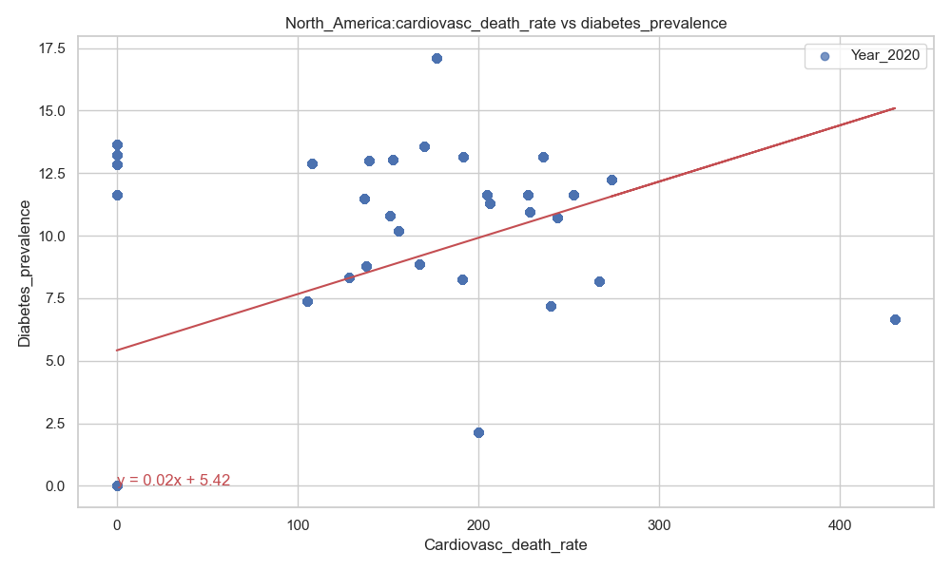
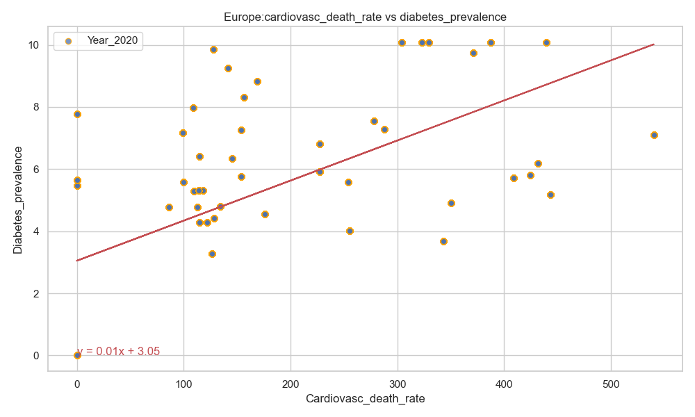
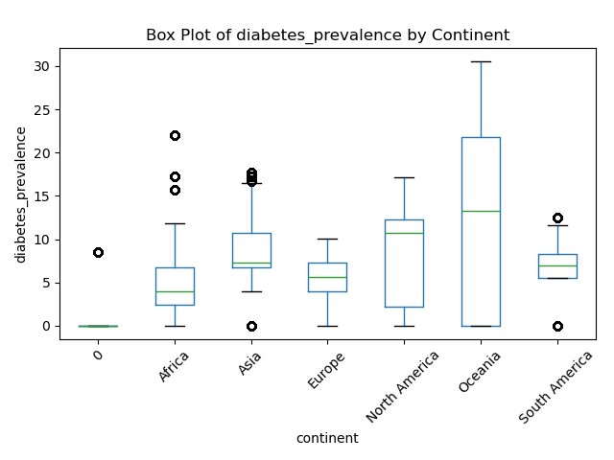
Cardiovasc Death Rate vs Diabetes Prevalence
R-value (Correlation coefficient): -0.22
R-value (Correlation coefficient): 0.46
R-value (Correlation coefficient): 0.60
There was a stronger correlation between the cardiovascular death rate and diabetes prevalence in Europe as compared to North America.
A negative correlation was observed between the cardiovascular death rate and diabetes prevalence in Asia.

Slide 8
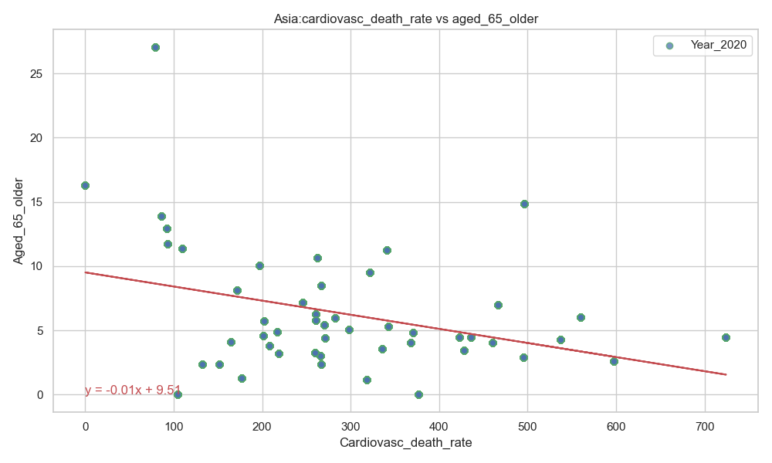
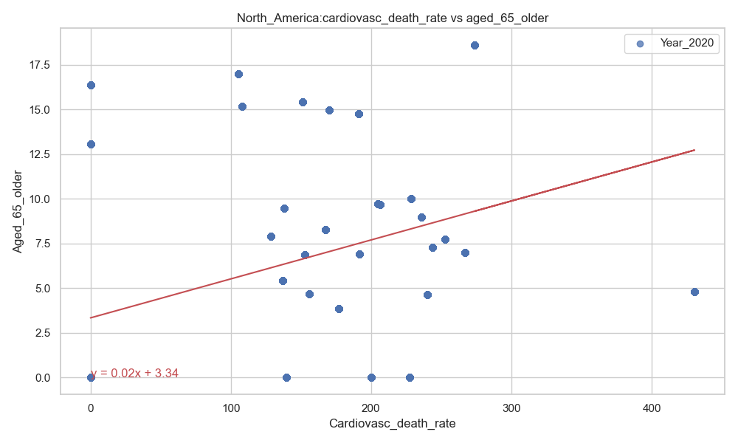
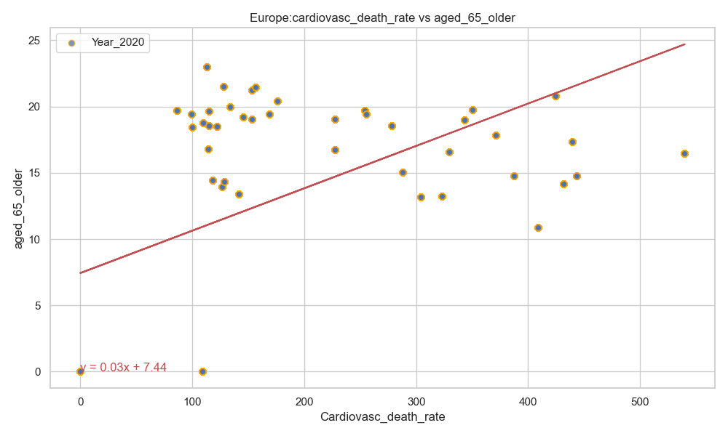
Cardiovasc Death Rate vs Age >65 Years Old
R-value (Correlation coefficient):-0.34
R-value (Correlation coefficient):- 0.40
R-value (Correlation coefficient):-0.53
There was a stronger correlation between the cardiovascular death rate and old age (above 65 years) in Europe as compared to North America.
A negative correlation was observed between the cardiovascular death rate and old age (above 65 years) in Asia.

Slide 9
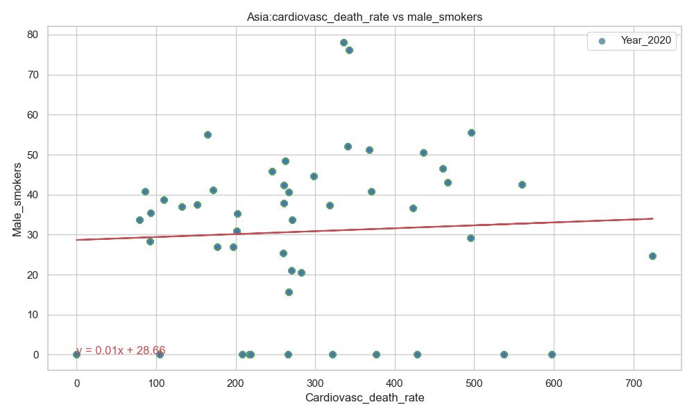
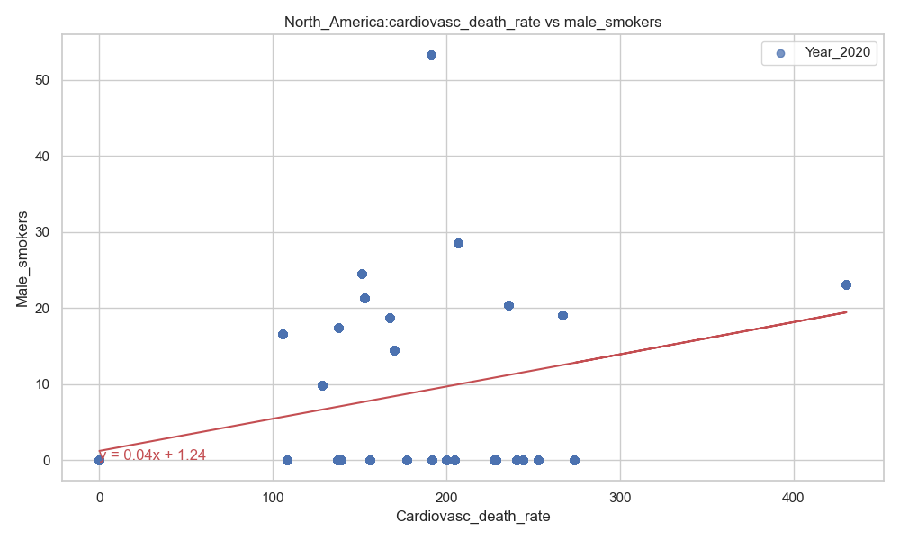
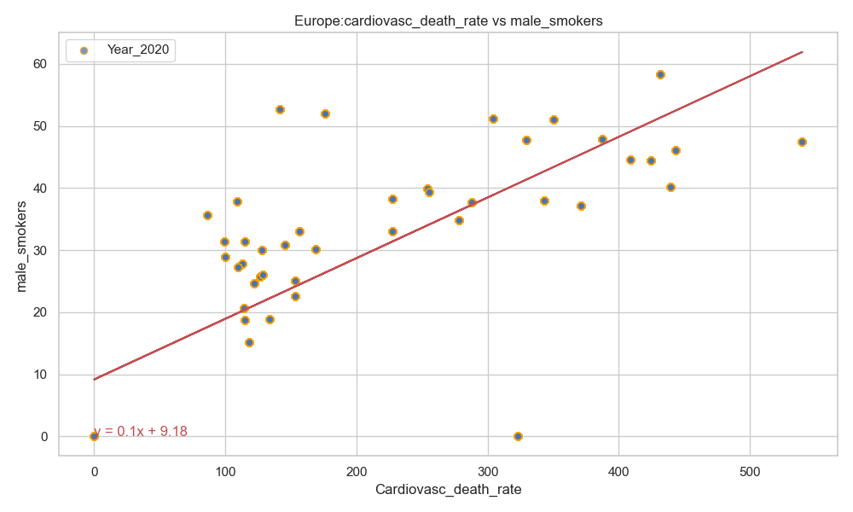
Cardiovasc Death Rate vs Male Smoker
R-value (Correlation coefficient): 0.05
R-value (Correlation coefficient): 0.40
R-value (Correlation coefficient): 0.79
There was a stronger correlation between the cardiovascular death rate and smoking (male) in Europe as compared to North America.
There was no correlation between the cardiovascular death rate and smoking (male) in Asia.

Slide 10
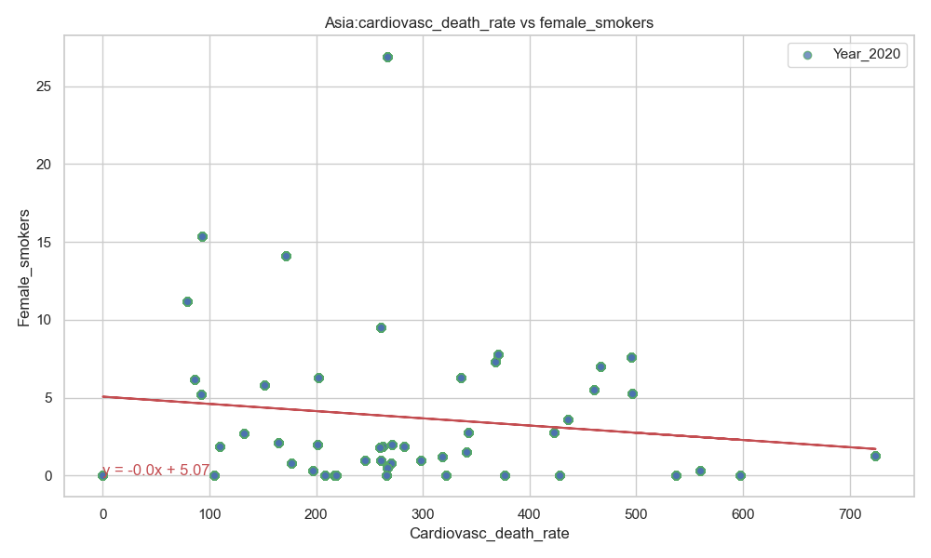
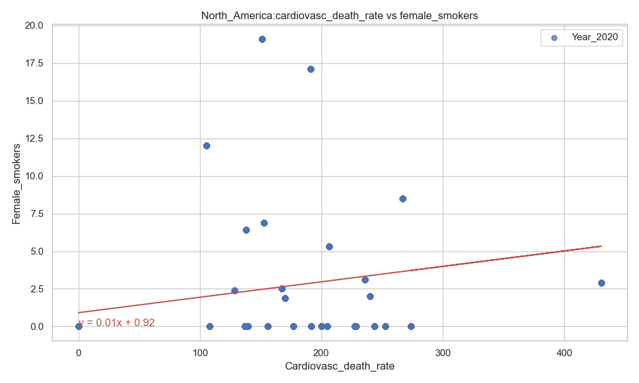
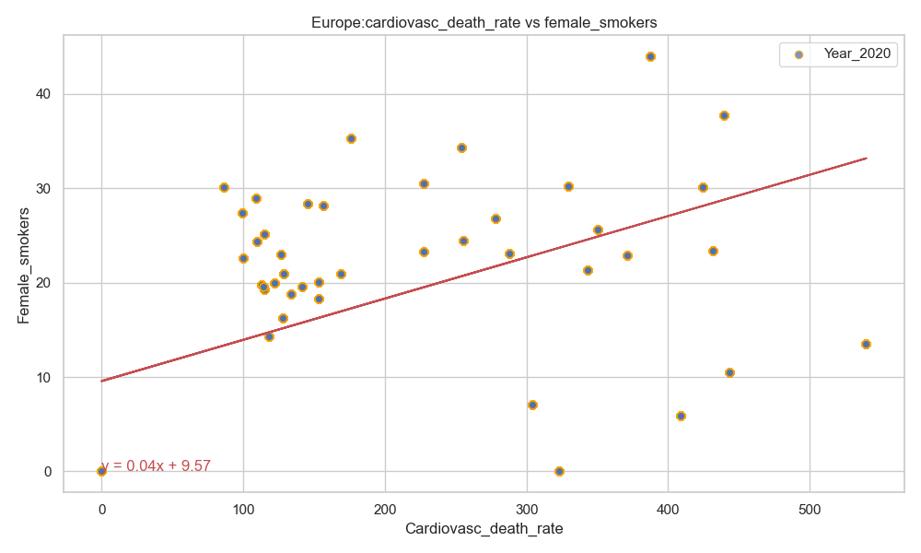
Cardiovasc Death Rate vs Female Smoker
R-value (Correlation coefficient): -0.14
R-value (Correlation coefficient): 0.24
R-value (Correlation coefficient): 0.53
There was a stronger correlation between the cardiovascular death rate and smoking (female) in Europe as compared to North America.
There was no correlation between between the cardiovascular death rate and smoking (female) in Asia.

Slide 11
Acknowledgement
Instructor: Dave Melillo
Team members
Eric Croston
Sarah Shuda

