Slide 1
CAR RENTAL SYSTEM
ASP.NET & C#

Slide 2
Introduction
The car rental system implements a dynamic design for both users, administrators and functionally aligns each feature correctly. In the logic, each of the steps of user car booking are followed correctly, a user can book, and manage their rented vehicles correctly.

Slide 3
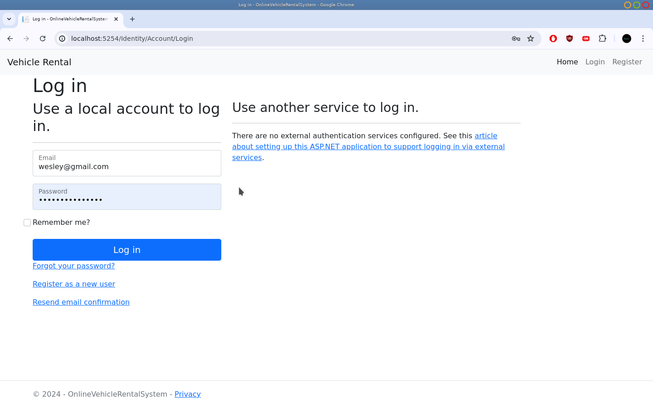
Login Forms
The login ensures a seamless access for both admin and regular user

Slide 4
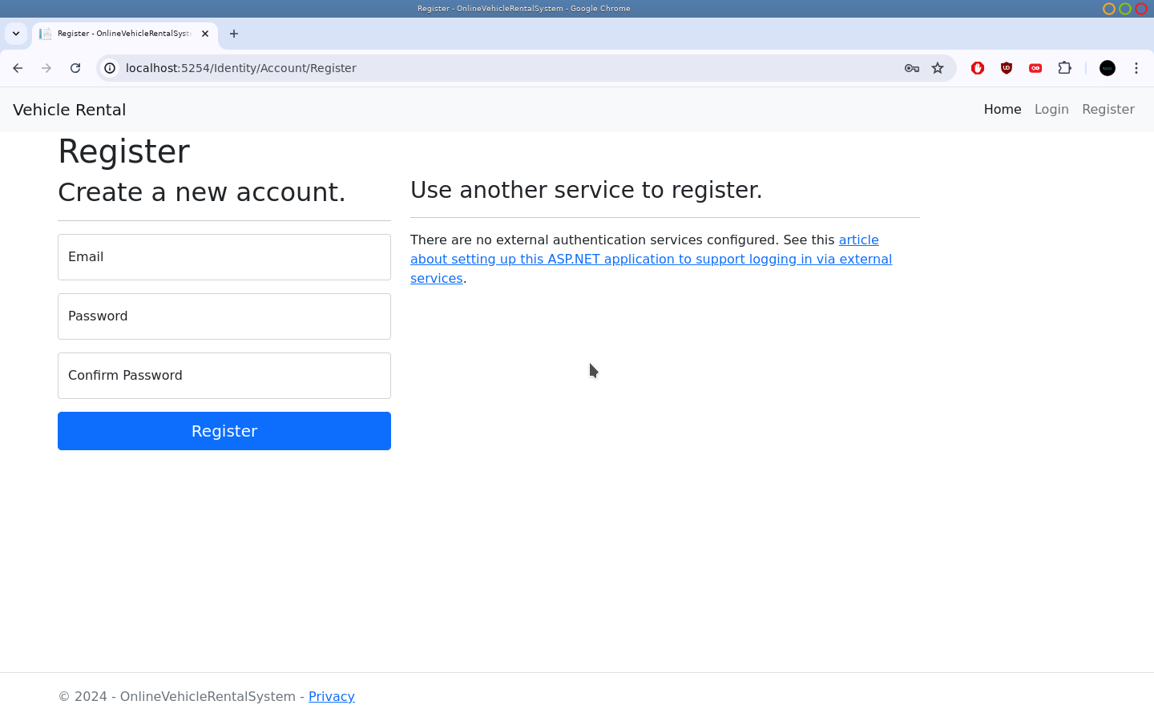
Register
The register forms allows users to register into the system and create user accounts with their email and passwords.

Slide 5
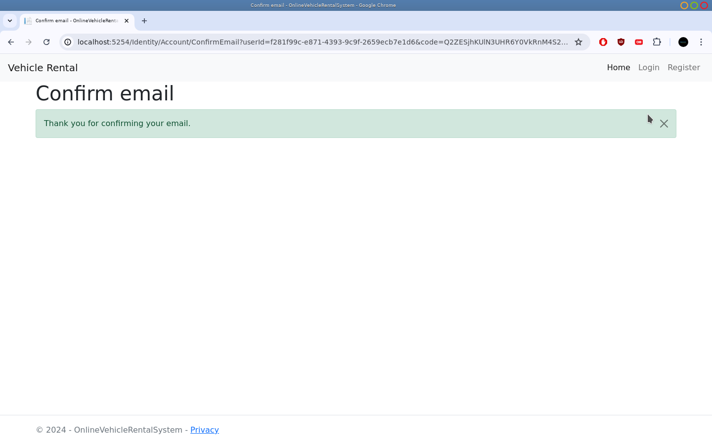
Email Confirmation
The system allows email confirmation from a registered user.

Slide 6
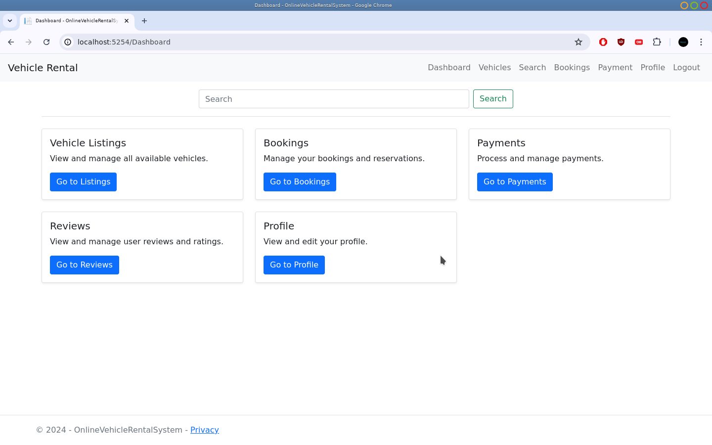
User Dashboard
User Dashboard allows a user to view all vehicles in the system and enables him/her to make bookings

Slide 7
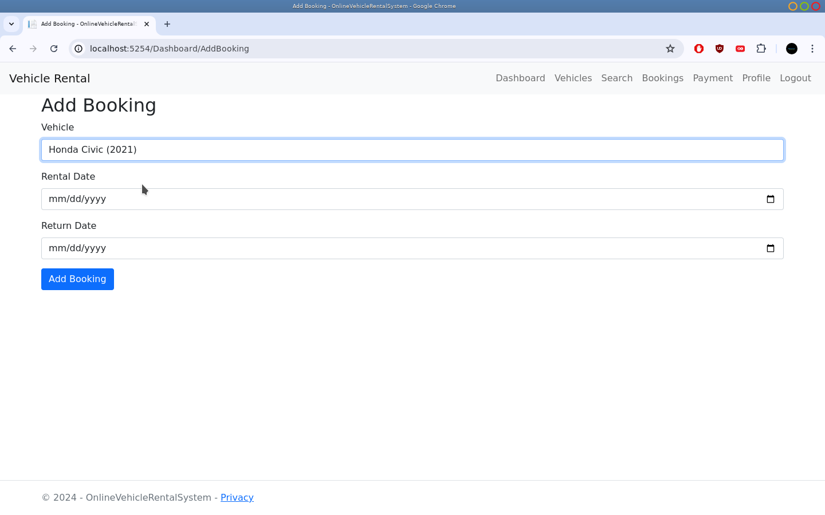
Booking
A user can make booking using the form and the results will be reflected to the admin

Slide 8
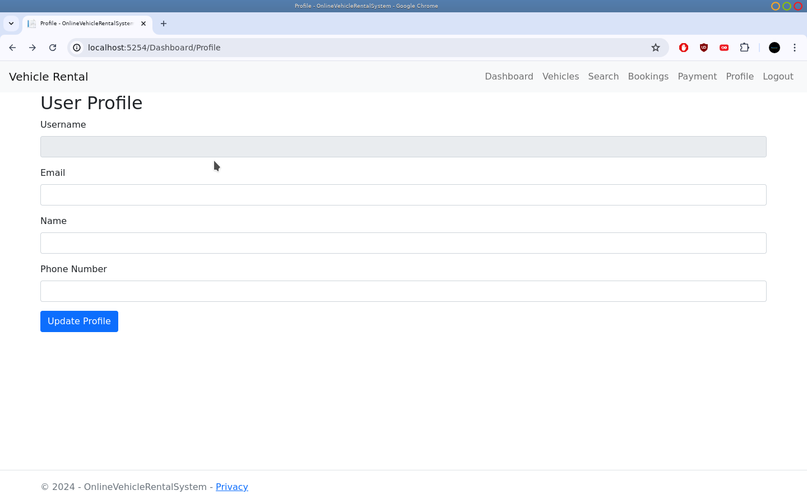
Profile
The Profile section allows a user to edit his/her details

Slide 9
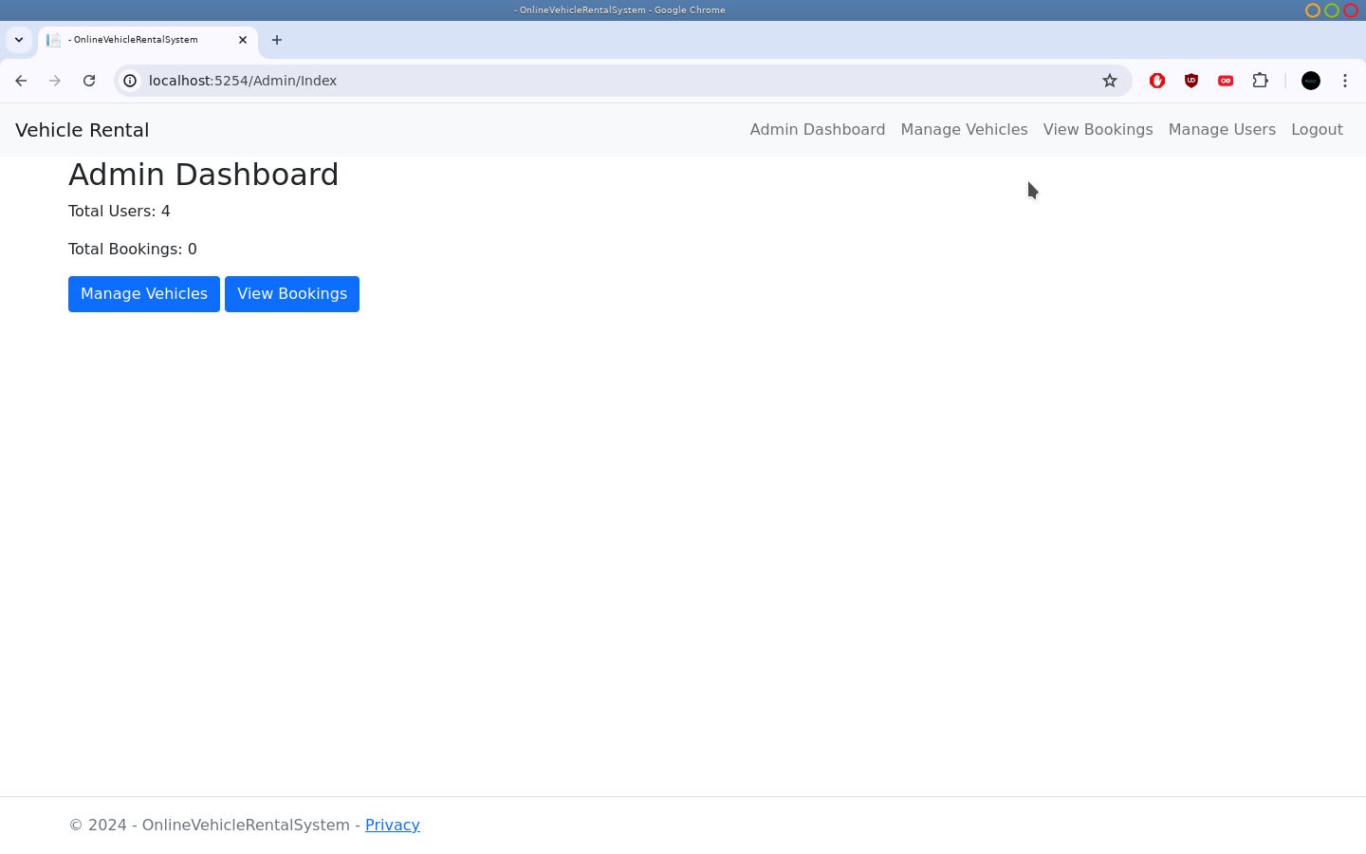
Admin Dashboard
An admin can manage all users within the system and be able to add vehicles and also perform CRUD processes.

Slide 10
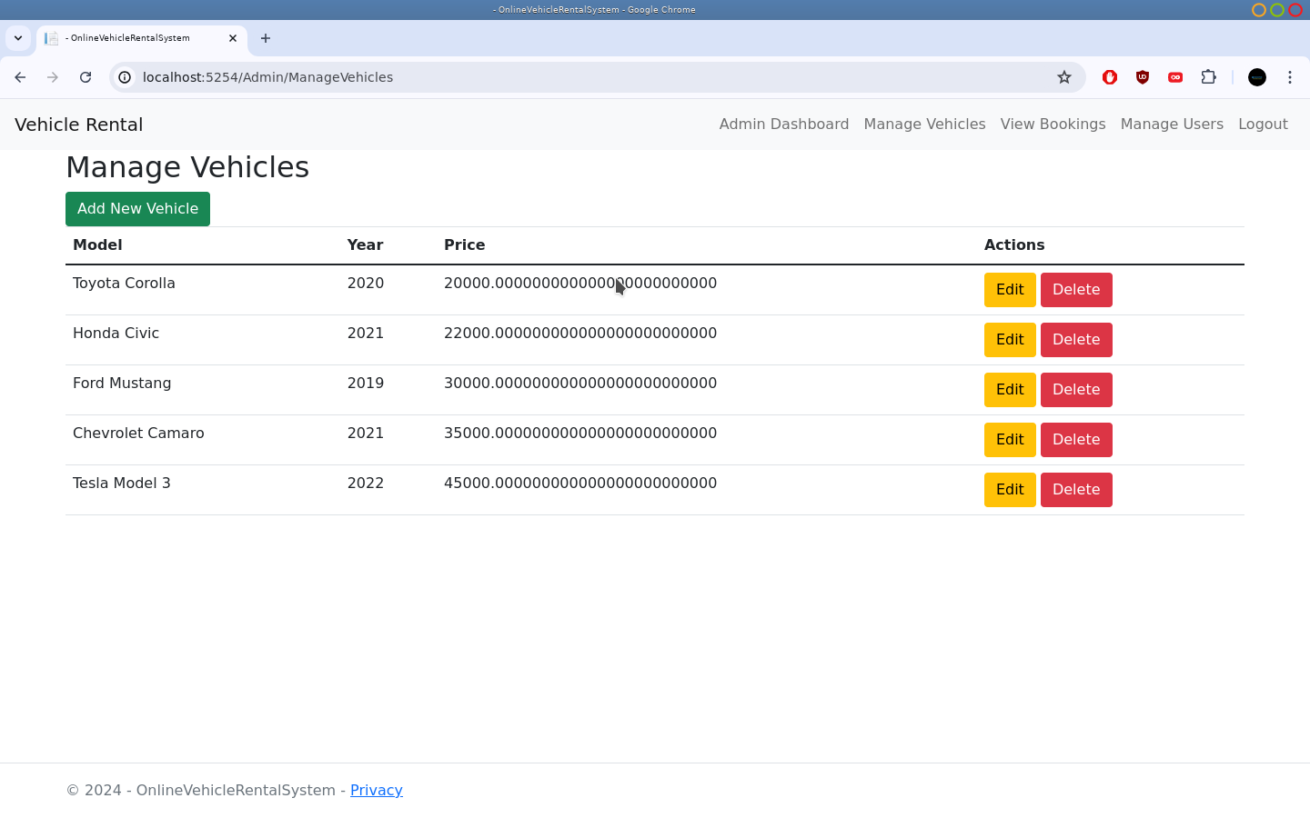
Manage Vehicles
An admin can manage vehicle listings that will display to the client side

Slide 11
Conclusion
The system addresses all the logical functionalities as required in the assignment document. Each logic is aligned with software specifications correctly to allow a user to navigate correctly with the system

