Slide 1
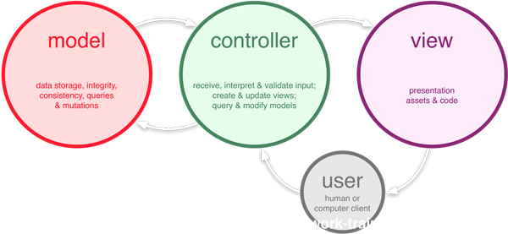
MVC
Model – View - Control

Slide 2
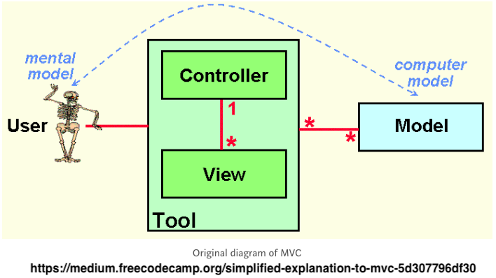
MVC
Architectural pattern
Created in 1978
Trygve Reenskaug at Xerox PARC

Slide 3
Model
Responsible for data’s
Storage
Integrity
Consistency

Slide 4
View
Presentation

Slide 5
Controller
Traffic Cop
Receiving user input
Determines what that means
Query/modify models
Create/update views

Slide 6
MVC Flow

Slide 7
HATEOS
{
"attributes": [
{
"name": "name",
"description": "User's name",
"label": "User Name",
"type": "string",
"value": "Erik"
},
.....
{
"name": "active",
"description": "Is user active",
"label": "Active",
"type": "boolean",
"defaultValue": 1,
"value": "1"
}
],
"links": [
{
"rel": "boards",
"link": "/users/12345/boards"
}
]
]
{
"uuid": "8894aff2",
"name": “Erik”,
"password": “password”,
"active": 1,
"id": 1,
"email": "tank@jundy.com",
"username": "erik",
"created": "2018-06-14T12:50:36Z"
}

Slide 8
What about these URIs?
Document resource
Singular concept
/users/12345
/users/12345/boards/5
/boards/5
Collection resource
Group of items
/users
/users/12345/boards

Slide 9
Rules!!!
Use NOUNs not verbs*
Yes: DELETE /user/1235
No: GET /delete_user/1235
GET
must not have side effects
POST
Add data to a collection
PUT
Update a resource
DELETE
HEAD
Return only the HTTP Header information
OPTIONS
Return what can be done to a target resource

Slide 10
What about PATCH!?!
Only update what you need – Right?
Please do not patch like an idiot: “Now, please, either don’t use the PATCH method, or use it the right way!”
RFC 5789: requests that a set of changes described in the request entity be applied to the resource identified by the Request- URI

Slide 11
Rules?
Nouns should be plural
/users/1234/boards
‘-’ vs ‘_’
Lower case
Use HTTP headers!!!!
No http://0.0.0.0:3123/healthcheck.json
Pagination
Query Parameters – filter a collection
Yes: /users?active=0
NO: /users?uuid=12345
Versioning
/v1/users/1234
Healthcheck
/healthcheck

Slide 12
Rules? - Enveloping
GET /users/456798
{
"uuid": "8894aff2",
"name": “Erik”,
"password": “password”,
"active": 1,
"id": 1,
"email": "tank@jundy.com",
"username": "erik",
"created": "2018-06-14T12:50:36Z"
}
{
“data” :{
"uuid": "8894aff2",
"name": “Erik”,
"password": “password”,
"active": 1,
"id": 1,
"email": "tank@jundy.com",
"username": "erik",
"created": "2018-06-14T12:50:36Z”
},
“error” : {}
}

Slide 13
HTTP Headers
Content-Type: type/subtype; parameter
text/html; charset=ISO-8859-4
application/json
Etag
Last-Modified
Expires
Accept: type/subtype

Slide 14
HTTP Response Codes
Success
200 – OK
201 – Created
204 – No content
Client Error
400 – Bad request
401 – Unauthorized
403 – Forbidden
404 – Not Found
409 – Conflict
418 – I’m a teapot
Server Error
500 – Internal Server Error

Slide 15
Perl 6 & Bailador
“light-weight route-based web application framework for Perl 6”
Spanish: Dancer
Based off of Perl 5 Dancer framework
2011?

Slide 16
Perl 6 & Bailador
bailador new Project-Name
Bailador easy bin/app.pl6
Bailador watch bin/app.pl6

Slide 17
Resources
https://github.com/skeletonkey/Perl6_REST
Bailador
https://github.com/Bailador/Bailador
https://github.com/Bailador/Bailador/tree/dev/doc
https://github.com/Bailador/Bailador/tree/dev/examples
REST API Design Rulebook by Mark Masse
Fiedling’s dissertation: https://www.ics.uci.edu/~fielding/pubs/dissertation/top.htm
https://williamdurand.fr/2014/02/14/please-do-not-patch-like-an-idiot/
https://medium.com/studioarmix/learn-restful-api-design-ideals-c5ec915a430f

