Slide 1
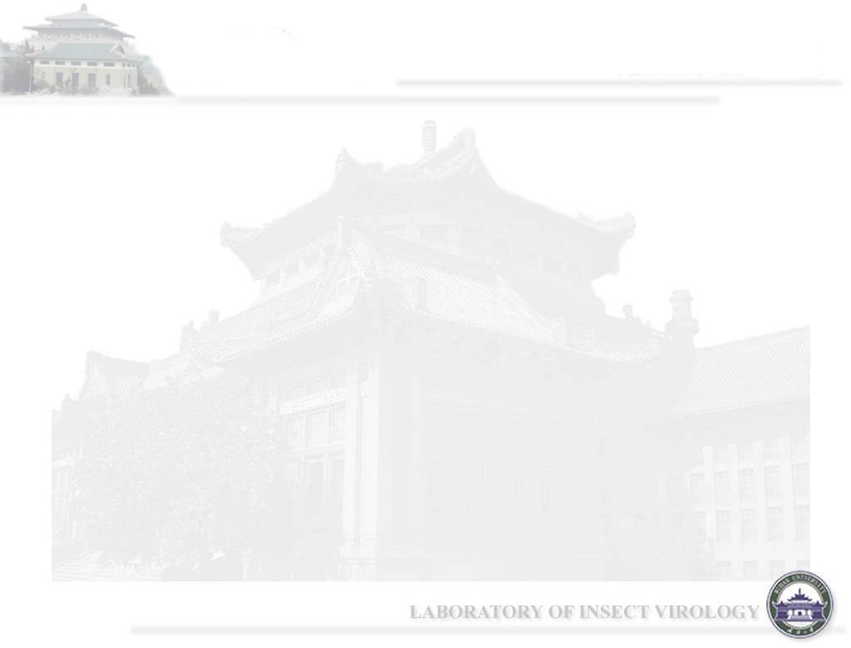
Human papillomavirus (HPV)
Principles of Medical Virology - Chapter 8

Slide 2
HPV genotypes
HPV is a small, nonenvelope, double - stranded DNA virus of the Papillomaviridae family.
Different HPVs are defined by their genotypes, with more than 100 described to date.
HPV genotypes are clustered into genera based on genetic relatedness.
Within each genus, HPVs are categorized into species based on distinct genotypes;
Members of a species have similar biological properties or phenotypes.
Differences of 10% or more in the viral capsid gene (L1) are noted as different HPV types, differences of 2% – 10% as subtypes, and differences of less than 2% are variants

Slide 3
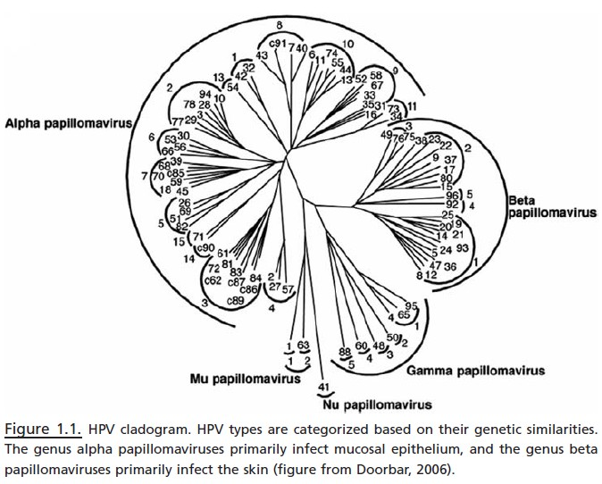
Alpha and Beta genera

Slide 4
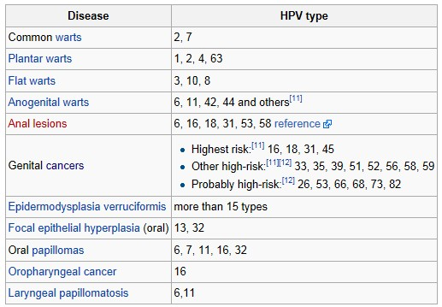
Signs and symptoms

Slide 5
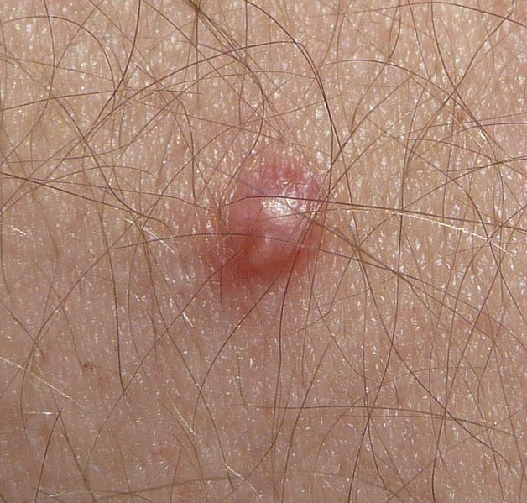
Papilloma

Slide 6
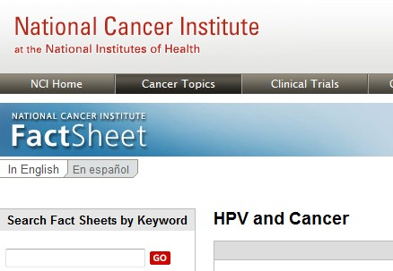
HPV and Cancer

Slide 7
Key Points
Some types of sexually transmitted human papillomaviruses (HPVs) can cause genital warts. Other types, called high-risk or oncogenic HPVs, can cause cancer.
High-risk HPVs cause virtually all cervical cancers. They also cause most anal cancers and some vaginal, vulvar, penile, and oropharyngeal （口咽） cancers.
Most infections with high-risk HPVs do not cause cancer. Many HPV infections go away on their own within 1 to 2 years. However, infections that last for many years increase a person’s risk of developing cancer.

Slide 8
Association between HPV infection and cancer
High-risk HPV infection accounts for approximately 5% of all cancers worldwide.
However, most high-risk HPV infections occur without any symptoms, go away within 1 to 2 years, and do not cause cancer. These transient infections may cause cytologic abnormalities, or abnormal cell changes, that go away on their own.
Some HPV infections, however, can persist for many years. Persistent infections with high-risk HPV types can lead to more serious cytologic abnormalities or lesions that, if untreated, may progress to cancer.

Slide 9
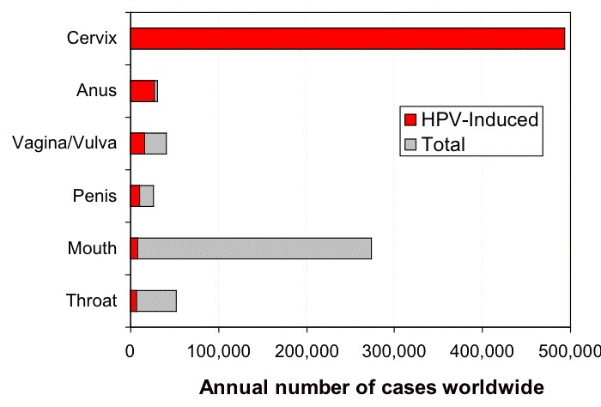
HPV-induced cancers

Slide 10
Transmission
Since cervical and female genital infection by specific HPV types is highly associated with cervical cancer, those types of HPV infection have received most of the attention from scientific studies.
HPV infections in that area are transmitted primarily via sexual activity.
At least 40 identified HPV types infect the genital tract. If a college woman has at least one different partner per year for four years, the probability that she will leave college with an HPV infection is greater than 85% (USA data).

Slide 11
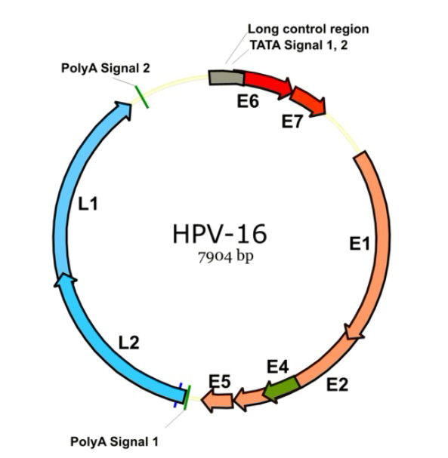
Genome organization of HPV Type 16, one of the subtypes known to cause cervical cancer. E1-E7 early genes, L1-L2 late genes: capsid

Slide 12
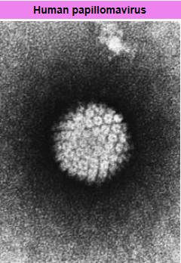

Slide 13
HPV infection
HPV infection is limited to the basal cells of stratified epithelium, the only tissue in which they replicate.
The virus cannot bind to live tissue; instead, it infects epithelial tissues through micro-abrasions or other epithelial trauma that exposes segments of the basement membrane.
The infectious process is slow, taking 12–24 hours for initiation of transcription. It is believed that involved antibodies play a major neutralizing role while the virions still reside on the basement membrane and cell surfaces.

Slide 14
HPV life cycle
The HPV life cycle strictly follows the differentiation program of the host keratinocyte 角化细胞.
It is thought that the HPV virion infects epithelial tissues through micro-abrasions, whereby the virion associates with putative receptors such as alpha integrins and laminins, leading to entry of the virions into basal epithelial cells through clathrin-mediated endocytosis and/or caveolin-mediated endocytosis depending on the type of HPV.
At this point, the viral genome is transported to the nucleus by unknown mechanisms and establishes itself at a copy number between 10-200 viral genomes per cell.
A sophisticated transcriptional cascade then occurs as the host keratinocyte begins to divide and become increasingly differentiated in the upper layers of the epithelium.

Slide 15
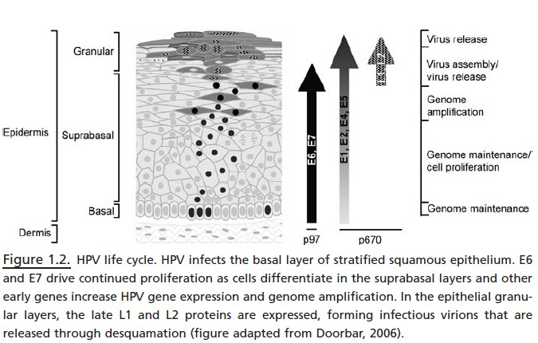

Slide 16
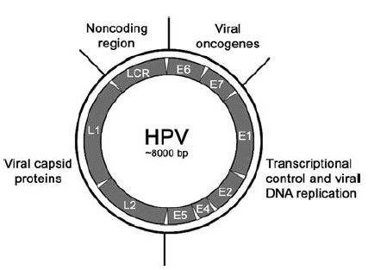
Early and Late Genes

Slide 17
E6/E7 proteins
E6 and E7 are the HPV proteins associated with cancer.
The HPV genome is composed of six early (E1, E2, E4, E5, E6, and E7) genes, two late (L1 and L2) genes, and a non-coding long control region (LCR).
After the host cell is infected E1 and E2 are expressed first.
High E2 levels repress expression of the E6 and E7 proteins.
When the host and HPV genomes integrate, E2 function is disrupted, preventing repression of E6/E7.

Slide 18
Roles of E6/E7 in cancer
E6/E7 proteins inactivate two tumor suppressor proteins, p53 (inactivated by E6) and pRb (inactivated by E7).
The viral oncogenes E6 and E7 are thought to modify the cell cycle so as to retain the differentiating host keratinocyte in a state that is favourable to the amplification of viral genome replication and consequent late gene expression.
E6 in association with host E6-associated protein, which has ubiquitin ligase activity, acts to ubiquitinate p53, leading to its proteosomal degradation.
E7 (in oncogenic HPVs) acts as the primary transforming protein. E7 competes for retinoblastoma protein (pRb) binding, freeing the transcription factor E2F to transactivate its targets, thus pushing the cell cycle forward.

Slide 19
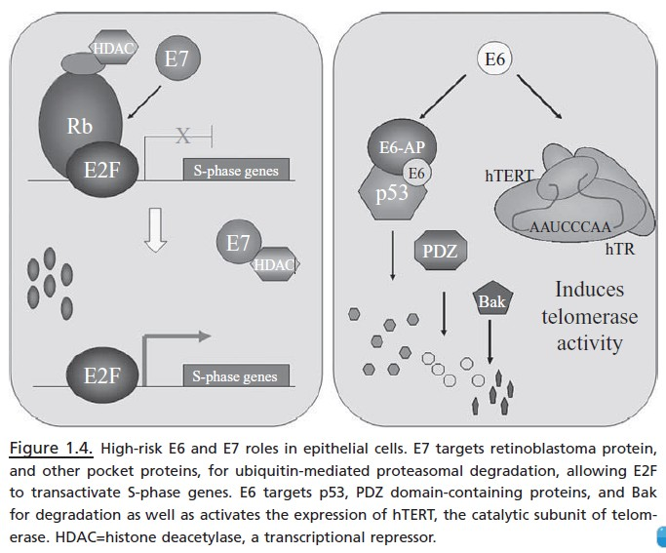

Slide 20
E2 and E1
E2 protein has several critical roles in HPV genome expression and replication.
E2 is expressed early in the viral life cycle and is found in basal and suprabasal layers of stratified squamous epithelium infected by HPV. E2 binds as a dimer to DNA and recognizes a motif in the noncoding region of HPV genome 5′ of the early promoter.
E2 recruits the HPV viral helicase E1 to the viral origin and increases the DNA-binding affinity to the noncoding region;
Both E1 and E2 together utilize cellular machinery for DNA replication and transcription.
Although E2 is a transcriptional activator at low concentrations, high levels of E2 repress expression of E6 and E7 from the late promoter.
Finally, E2 also functions to segregate the HPV genome as cells divide by tethering the genome to cellular chromosomes during mitosis.

Slide 21
E4
The E4 protein is found in the suprabasal and granular layers of stratified squamous (鳞状) epithelium.
Without a functional E4 protein, HPV episomal DNA cannot amplify from their initial 50 – 100 copies per cell to the several thousands normally seen

Slide 22
E5
E5 protein has effects on both cellular transformation and viral genome amplification.
Although HPV E5 has little effect on monolayer undifferentiated keratinocytes in vitro, E5 does increase the number of suprabasal cells dividing in organotypic cultures grown to mimic stratified squamous epithelium.
Additionally, in differentiated keratinocytes, E5 induces HPV genome amplification. HPV16 E5 can cause epithelial hyperplasia, abnormal cellular differentiation, and skin tumors when expressed in mice.
This effect occurs through the epidermal growth factor receptor,although this may not be consistent across all HPV types

Slide 23
L1 and L2
The viral coat proteins L1 and L2 are expressed from the late promoter after a change in splicing patterns and a transition to the late polyadenylation site.
Three hundred sixty L1 proteins organize into 72 capsomers, with one L2 protein associated with each pentavalent capsomer.
The capsomers self-assemble without HPV DNA in vitro as virus-like particles (VLPs) and in the cellular nucleus in vivo to encapsulate the HPV genome into infectious virus particles.

Slide 24
How are HPV infections detected?
HPV infections can be detected by testing a sample of cells to see if they contain viral DNA or RNA.
The most common test detects DNA from several high-risk HPV types, but it cannot identify the type(s) that are present.
Another test is specific for DNA from HPV types 16 and 18, the two types that cause most HPV-associated cancers.
A third test can detect DNA from several high-risk HPV types and can indicate whether HPV-16 or HPV-18 is present.
A fourth test detects RNA from the most common high-risk HPV types. These tests can detect HPV infections before cell abnormalities are evident.

Slide 25
What are treatment options for HPV-infected individuals?
There is currently no medical treatment for HPV infections. However, the genital warts and precancerous lesions resulting from HPV infections can be treated.
Methods commonly used to treat precancerous cervical lesions include cryosurgery, LEEP, surgical conization, and laser vaporization conization.
HPV-infected individuals who develop cancer generally receive the same treatment as patients whose tumors do not harbor HPV infections, according to the type and stage of their tumors.
However, people who are diagnosed with HPV-positive oropharyngeal cancer may be treated differently than people with oropharyngeal cancers that are HPV-negative.

Slide 26
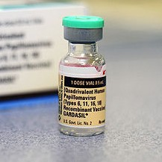
HPV vaccines (1)
HPV vaccine prevents infection with certain species of human papillomavirus associated with the development of cervical cancer, genital warts, and some less common cancers.
Two HPV vaccines are currently on the market: Gardasil and Cervarix.
Both vaccines protect against the two HPV types (HPV-16 and HPV-18) that cause 70% of cervical cancers, 80% of anal cancers, 60% of vaginal cancers, and 40% of vulvar cancers.
These HPV types also cause most HPV induced oral cancers, and some other rare genital cancers. Gardasil also protects against the two HPV types (HPV-6 and HPV-11) that cause 90% of genital warts.

Slide 27
HPV vaccines (2)
The vaccines provide little benefit to women having already been infected with HPV types 16 and 18, which includes most sexually active females. For this reason, the vaccine is recommended primarily for those women not yet having been exposed to HPV during sex. The WHO position paper on HPV vaccination clearly outlines appropriate, cost-effective strategies for using HPV vaccine in public sector programs.
Both vaccines are delivered in three shots over six months. In most countries, they are approved only for female use, but are approved for male use in countries like USA and UK. The vaccine does not have any therapeutic effect on existing HPV infections or cervical lesions.
In 2010, 49% of teenage girls in the US got the HPV vaccine.

Slide 28
HPV vaccines (3)
Women should continue to seek cervical screening, such as Pap smear testing, even after receiving the vaccine. Cervical cancer screening recommendations have not changed for females who receive HPV vaccine. Without continued screening, the number of cervical cancers preventable by vaccination alone is less than the number of cervical cancers prevented by regular screening alone.
Both men and women are carriers of HPV. The Gardasil vaccine also protects men against anal cancers and warts and genital warts.
No efficacy trials for children under 15 have been performed. Duration of vaccine efficacy is not yet answered by rigorous methodologic trials. Cervarix efficacy is proven for 7.4 years with published data through 6.4 years while Gardasil efficacy is proven for 5 years. Age of vaccination is less important than the duration of efficacy.

