Slide 1
Database Software

Slide 2

Let's Play ...
Name that Database!
Try to name the databases described on the following slides...
Notes:
Oracle - Oracle Database 11g, Warehouse Builder, Oracle Data Miner, Oracle OLAP
IBM - DB2, has "community edition"
Microsoft - MS SQL Server
Teradata - Teradata Database, Enterprise Data Warehouse

Slide 3
"World's most popular"
Free relational database system (RDBMS) that...
the "M" in "LAMP" and "XAMP" stacks
claims to be the world's most popular client-server database
Created a a Swiss company, sold to Sun Microsystems.
Now owned by Oracle.
SOLD

Slide 4
MySQL
MySQL - a client-server database
the "M" in "LAMP" and "XAMP" stacks
"free" for non-commercial use
many useful tools:
  MySQL Administrator (Windows or Linux)
  MySQL Workbench & Query Browser
  phpMyAdmin
Owned by Oracle
http://www.mysql.com

Slide 5
What is "LAMP"? "XAMPP"?
What does "LAMP stack" mean?
What does "XAMPP stack" mean?

Slide 6
LAMP
A platform (stack) to create a web server & web apps:
Linux OS
Apache web server
MySQL or MariaDB database
Php, Perl, or Python language to write your apps

Slide 7
XAMPP
Web platform for mult-OS developed by Apache Friends.
X cross platform (any OS)
Apache web server
MariaDB database
PHP and
Perl language to write your apps
XAMPP is intended for development and testing, not production use (not very secure).

Slide 8
What database is a clone of MySQL ?
What database is a fork of MySQL ?
based on MySQL source code
led by the original MySQL creator (Micheal Widenius)
compatible with MySQL up to version 5.5
used by Google! (switched from MySQL in 2013)

Slide 9
MariaDB
MariaDB is a fork of MySQL
led by the original MySQL creator (Micheal Widenius)
based on MySQL source code!
slightly faster (3-5%) than MySQL
used by Google! (switched from MySQL in 2013)
compatible with MySQL up to version 5.5
http://www.mariadb.org

Slide 10
SQL database from Berkeley?
Originally developed at Berkeley, as "Postgres"
Open Source, can be used in commercial apps without a licence
Very stable and reliable
Has some O-O features

Slide 11
PostgreSQL
Based on Berkeley Postgres (non-SQL database)
Now an open-source project, with friendly commercial use license
Very stable and reliable
Has some O-O features
http://www.postgresql.org

Slide 12
Small, Light, and Embedded?
"World's most widely deployed database engine" [Wikipedia]
Embedded database – no server!
included on Android devices
written in C and very small (about 1MB)
supports only a subset of SQL commands & datatypes

Slide 13
SQLite
"World's most widely deployed database engine"
written in C & very small: 350KB binary
included on Android
supports only a subset of SQL cmds & datatypes
used in Django, Ruby on Rails, and Firefox
"language bindings" for many programming languages
  http://code.google.com/p/sqlite-jdbc/
  http://www.xerial.org/trac/Xerial/wiki/SQLiteJDBC

Slide 14
Really fast, pure Java database?
Lightweight, fast database written in Java
Embedded and client-server modes possible.
can store database on disk or in memory
included in OpenOffice, Libre Office, Mathematica

Slide 15
Hypersonic SQL (HSQLDB)
Lightweight, fast database written in Java
database can be stored in memory or on disk.
embed in your Java app
  don't need a database server or disk-based database
can also run in client-server mode & network access
useful for development and "demo" systems
http://hsqldb.org

Slide 16
(Almost) Correct: H2
H2 - "Hypersonic 2", as successor to HSQLDB
Started by the original Hypersonic SQL team in 2004
embedded database written in Java
a competitor to Hypersonic SQL (HSQLDB)
the default database in Play! framework

Slide 17
Another lightweight Java database?
an Apache project; formerly "Cloudscape"
included in Java SDK (JDK) as "Java DB"
  located in the JDK "db" subdirectory
embedded mode and client-server mode
good support for SQL standard and JPA
supports transactions and crash recovery

Slide 18
Derby
"Lightweight", pure Java database
Apache project; formerly named Cloudscape
only 1 user can connect to a database at a time
embed in app or run in client-server mode
good support for SQL standard and JPA
included in Java JDK (in jdkxxx/db directory)
not as fast or light as HSQLDB or H2
http://db.apache.org/derby

Slide 19
Top 3 Commercial Databases?
Name these:
_____________ database server made by Oracle Corp.
_____________ IBM's commercial database
_____________ Microsoft's SQL database

Slide 20
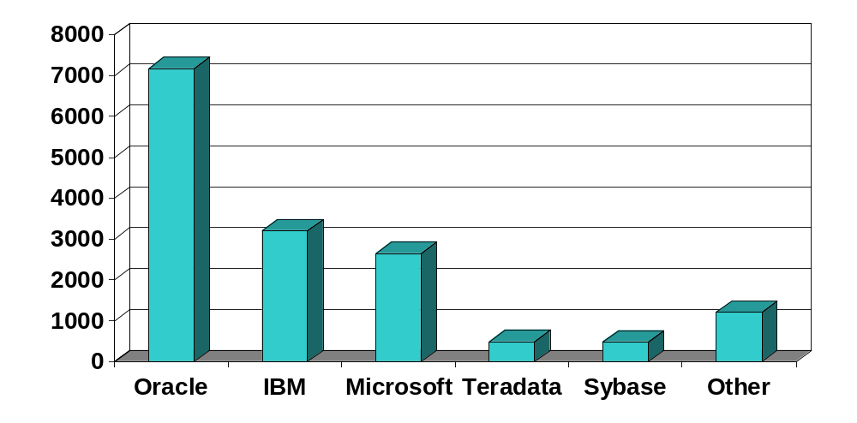
Commercial Databases
Databases ranked by 2006 revenue (million US$).
  Source: Gartner Research (www.gartner.com)
Notes:
Oracle - Oracle Database 11g, Warehouse Builder, Oracle Data Miner, Oracle OLAP
IBM - DB2, has "community edition"
Microsoft - MS SQL Server
Teradata - Teradata Database, Enterprise Data Warehouse

Slide 21
"Community Edition" Databases
IBM DB2 Express-C - relational DB with XML support
free edition of IBM DB2
good documentation and learning tools:
  http://www.ibm.com/university
http://www.ibm.com/db2/express
Oracle 11g Express Edition (XE)
leading market share among commercial databases
XE is easier to administer than full Oracle
http://www.oracle.com

Slide 22
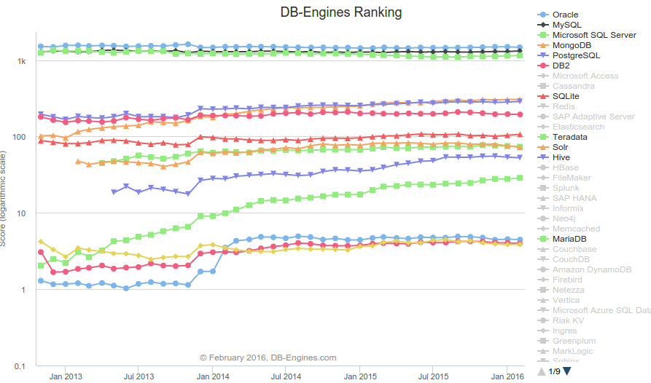
Ranking by Popularity
http://db-engines.com/en/ranking_trend

