Slide 1
Using a Database with JDBC
How to access a database from within Java using JDBC. JDBC provides low-level access to a database.
For many applications, using Object-Relational Mapping (ORM) is much productive.

Slide 2
A Tiny Example
A Todo database containing tasks to do.
What's a Todo?
"id" uniquely identifies the Todo and will be the primary key in the TODO table.
Todo
id: int
title: String
done: boolean

Slide 3
What You Need
1. Database software
2. A JDBC database "driver" for your database
3. A database or at least a place to create a database

Slide 4
Accessing a Database using JDBC
Java has a standard programming interface for accessing databases, called the Java DataBase Connectivity (JDBC) API.
JDBC is included in the Java JDK.
Can connect to almost any database. All you need is a JDBC driver for your database.
JDBC is very low level and we won't cover it in detail.
But, to understand the mechanism we'll look at one brief example: saving and retrieving Todos.

Slide 5
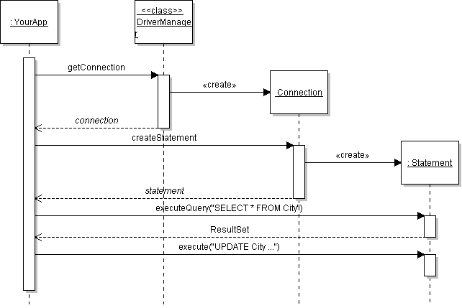
JDBC Overview
Create a Connection to the database.
Create a Statement using the Connection.
Use the Statement to execute SQL commands.
Use the results.

Slide 6
JDBC Overview
selects a specific Connection type and instantiates it
creates Statements for database actions

Slide 7
JDBC Code
static final String URL = "jdbc:mysql://dbserver/tododb";
static final String USER = "student";
static final String PASSWORD = "secret";
// 1. Get a Connection to the database.
Connection connection =
DriverManager.getConnection( URL, USER, PASSWORD );
// 2. Create a Statement
Statement statement = connection.createStatement();
// 3. Execute the Statement with SQL command.
ResultSet rs = statement.executeQuery("SELECT * FROM todo");
// 4. Use the Result.
while ( rs.next( ) ) {
String name = rs.getString("title");

Slide 8
Connecting to a Database in Java (1)
java.sql.Connection is a standard interface for connecting to any database.
Each database type requires its own jdbc driver that implements this interface.
DriverManager selects the driver based on URL.
Database | JDBC Driver
MySQL | mysql-connector-java-5.1.7-bin.jar
Derby | derby.jar
Hypersonic SQL (HSQLDB) | hsqldb.jar

Slide 9
DriverManager returns a Connection
url = "jdbc:mysql://hostname/database"
<<interface>>
Connection
createStatement(): Statement
close( )
isClosed( ): boolean
getCatalog( ): String
DriverManager
getConnection( url, user, passwd) : Connection
creates
HSQLConnection
MySqlConnection

Slide 10
Database URL
The format of a database URL is:
String DB_URL = "jdbc:mysql://localhost:3306/tododb";
Protocol Sub-protocol Hostname Port DatabaseName
Port is the TCP port number where the database server is listening.
  3306 is the default port for MySQL
Use hostname or "localhost" for the local machine.

Slide 11
Database URL
The hostname and port are optional.
For MySQL driver: defaults are localhost and port 3306
Example: These 3 URL refer to the same database
"jdbc:mysql://localhost:3306/tododb"
"jdbc:mysql://localhost/tododb"
"jdbc:mysql:///tododb"

Slide 12
SQL to save data
To save a "todo" using SQL we would write:
sql> INSERT INTO todo(title, done)
VALUES('Learn JDBC',false);
OK, 1 record added.
We didn't specify an ID because the database is configured to assign the ID automatically.
id | title | done
1 | Go to OOP class | true
11 | Learn JDBC | false

Slide 13
JDBC code to save data
To save a "todo" using JDBC in Java:
String sql = "INSERT INTO todo(title,done)
VALUES('Learn JDBC',false)";
// this code may throw SQLException
Statement stmt =
connection.createStatement();
int count = stmt.executeUpdate( sql );
System.out.printf("Added %d record", count);

Slide 14
SQL to retrieve data
To retrieve all the Todo in the table we would write:
sql> SELECT * FROM todo;
| id | title | done |
+------+-------------------------+-------+
| 1 | Go to OOP class | true |
| 11 | Learn JDBC | false |
...

Slide 15
JDBC code to retrieve data
String sql = "SELECT * FROM todo";
// this code may throw SQLException
Statement stmt =
connection.createStatement();
ResultSet rs = stmt.executeQuery( sql );
// print the data
while( rs.next( ) ) {
int id = rs.getInt("id");
String title = rs.getString("title");
boolean done = rs.getBoolean("done");
System.out.printf("%d: %s (%s)\n",
id, title, done );
}

