Slide 1
Lab 10:
Add WithdrawStrategy to Purse

Slide 2
When to use the Strategy Pattern?
Strategy is useful when your code has some complex task, and there is more than one way to do the task.
That is, more than one algorithm.
Examples:
encryption problem has more than one algorithm for encrypting text, and we want to select the algorithm based on command line input
there are many algorithms for how to withdraw money from the Purse

Slide 3
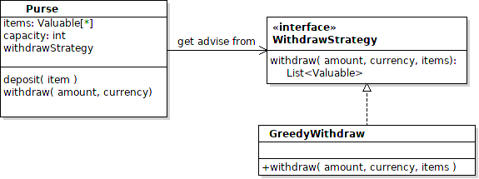
Add Withdraw Strategy to the Purse
Add an interface for WithdrawStrategy.
Write a class the implements this, using code you already have

Slide 4
The Steps
1. Test your current code -- it must work before you modify it.
2. Define the strategy interface.
3. Write a class that implements it & move part of your withdraw() code to this method.
4. Call your new code instead of doing all the work in the Purse's own withdraw() code.
5. Add a setWithdrawStrategy() method so we can change the strategy.
6. Test it!

Slide 5
WithdrawStrategy interface
Defines a method for withdraw()
withdraw() method needs enough parameters so it can compute the withdraw...
needs to know what is in the Purse & amount to w/d
It should not change contents of the Purse.
Use a separate package: coinpurse.strategy

Slide 6
References
Lab 10 Part 2 - details of what to do.
https://skeoop.github.io/labs/Lab10-Purse-with-Strategy.pdf
Strategy Pattern - slides on course web site.
https://skeoop.github.io/ - "Design Patterns" topic

Slide 7
Refactoring
1. Extract method - what we already did
2. Rename variable
3. Introduce Temporary Variable - in withdraw method
money.get(i) is called many times
Code is clearer if you use a temporary variable
for the result.

