Slide 1
UML Intro & Class Diagram

Slide 2
Unified Modeling Language
A standard graphical notation for describing software models and code
Unifies Booch, OMT (Rumbaugh et al), and OOSE (Jacobson et al) + many other influences

Slide 3
Many Kinds of UML Diagrams
different views and different levels of abstraction
Types of diagrams in UML:
  Class diagram
  Sequence diagram
  State Machine diagram (aka State Chart Diagram)
  Object diagram
  Interaction diagram
  Activity diagram
  Package Diagram
  many others!

Slide 4
Class Diagram
A class diagram shows the structure of a class
It can also show relationships between classes
Here is the simplest possible class diagram:
BankAccount

Slide 5
Class Diagrams methods & attributes
BankAccount
deposit( amount )
withdraw( amount )
getBalance( )
BankAccount
balance
owner
id
deposit( amount )
withdraw( amount )
getBalance( )

Slide 6
Class Diagram with data types
Class diagram can show data types & visibility
Not Java notation ("double balance")
BankAccount
-balance: double
+deposit(amt: double): void
+withdraw(amt: double): boolean
+getBalance( ): double

Slide 7
Visibility of Members
  balance is private (visible only within BankAccount objects)
  deposit and withdraw are public
BankAccount
- balance : double
+ deposit( amount: double )
+ withdraw( amount: double )
+ getBalance( ) : double

Slide 8
Visibility Prefixes
+ indicates public
  Visible everywhere
– indicates private
  Visible only in the class in which it is defined
# indicates protected
  Visible either within the class in which it is defined or within subclasses of that class
~ indicates package visibility
  other classes in the same package as this one

Slide 9
Constructors
BankAccount
-balance: double
<<constructor>>
+BankAccount( owner )
+deposit(amount)
. . .
BankAccount
-balance: double
+BankAccount( owner )
+deposit(amount)
. . .

Slide 10
Static Members
Use underscore to show static attributes or methods.
Example: BankAccount class has a static nextAccountId attribute.
BankAccount
-nextAccountId: long
-balance: double
-id: long
+BankAccount( owner )
+getBalance( ): double
. . .
private static attribute

Slide 11
Practice

Slide 12
A Single Class
Draw a UML class diagram of this class.
public class Student {
public static String idPattern = "[1-9]\\d{9}";
private long id;
protected String name;
public String getName( ) { . . . }
public void setName(String aname) { . . . }

Slide 13
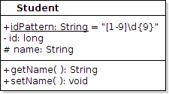
A Single Class
Draw a UML class diagram of this class.

Slide 14

Class with Dependency
A Student uses the Registrar to get his Courses, but he doesn't save a reference to it.
public class Student {
private long id;
//NO Registrar attribute!
public void addCourse(Course course) {
Registrar regis = Registrar.getInstance();
regis.enroll(this, course);

Slide 15
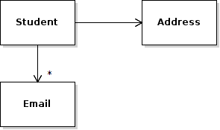
Class with Association
A Student has an Address and 0 or more Emails.
public class Student {
private Address homeAddress;
/** his email addresses. He may have many. */
private List<Email> emails;

Slide 16

A Student owns his Email Addresses
Composition: A Student owns his Email addresses and when he is deleted we delete his addresses, too!
public class Student {
/** student uniquely owns his email addresses*/
private List<Email> emails;
Modeling:
Composition shows "ownership" or "is composed of" (e.g.: a game board is composed of squares). Be careful about using it.

Slide 17
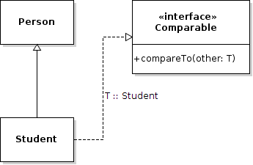
Inheritance & Implements
Student is a subclass of Person
public class Student extends Person
implements Comparable<Student> {

Slide 18
Errors
A UML diagram is for communication.
To communicate clearly, use the correct notation.
wrong
Student
Person
wrong
<<interface>>
Comparable
No partial credit for wrong relationships or bad notation.

Slide 19
Reference
UML Distilled, 3rd Edition. Chapter 3 & 5 cover UML class diagrams.

