Slide 1
Design Patterns
James Brucker

Slide 2
Reusable Ideas
Developers reuse knowledge, experience, & code
Application Level
reuse a project design & code of a similar project
Design Level
apply known design principles and design patterns
Logic Level
apply algorithms to implement some behavior
Code Statement Level
use programming idioms for common tasks

Slide 3
A Programming Idiom
Task: process every element of an array...
Idiom:
1. initialize result
2. loop over the array
3. process each element of the array
// add the values of all the coupons we have sold...
Coupon [ ] coupons = ...
double total = 0; // initialize
for( int k=0; k<coupons.length; k++ ) { // loop
total += coupons[k].getTotal(); // process each one
}

Slide 4
An Algorithm
Task:
find the shortest path from node A to node B in a graph
Algorithm:
apply Dykstra's Shortest Path algorithm

Slide 5
Reusable Code
Requirement:
record activity & events in a file,
so we have a record of what the program has done and any problems that occur.
Solution:
Use the open-source Log4J framework.
public class Purse {
private static final Logger log =
Logger.getLogger(Purse.class);
public boolean insert(Money m) {
if (m == null) log.error("argument is null");
else log.info("inserting " + m);

Slide 6
Logging Output
Log File:
You control where logging is output, and how much detail is recorded. Config file: log4j.properties.
Example:
6:02:27 Purse insert INFO inserting 10 Baht
6:03:00 Purse insert INFO inserting 20 Baht
6:03:10 Purse insert ERROR argument is null
6:03:14 Purse withdraw INFO withdraw 10 Baht
Class and Method
message
Severity

Slide 7
Reusable Applications
Requirement:
Write a web application to manage appointments at a beauty shop.
Solution:
Modify the SpringFramework JPetStore sample application.
SpringFramework and AppFuse have sample applications you can adopt to your project.
The sample apps generally have good design and use best practices from experienced developers.

Slide 8
What is a Design Pattern?
A situation that occurs over and over,
along with forces that motivate design of a solution,
leading to
a reusable pattern for the design of a solution

Slide 9
Format for Describing a Pattern
Pattern Name: Iterator
Context
We need to access elements of a collection.
Motivation (Forces)
We want to access elements of a collection without the need to know the underlying structure of the collection.
Solution
Each collection provides an iterator with methods to get the next element without exposing how it is done.
Consequences
Application is not coupled to the collection. Collection type can be changed w/o changing the application.

Slide 10
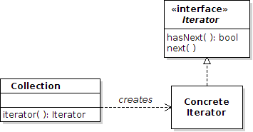
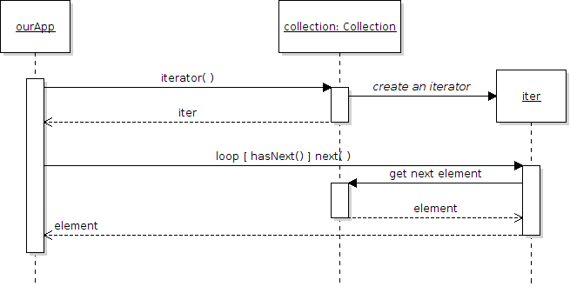
Diagram of Iterator Pattern
Structure:
Behavior:

Slide 11
Example Code
The Purse has a collection of Coin objects.
We want to get the value of each coin in the collection.
// get the coins from the Purse
Collection<Coin> coins = purse.getCoins();
Iterator<Coin> iter = coins.iterator( );
while( iter.hasNext( ) ) {
Coin c = iter.next( );
sum = sum + c.getValue();
}

Slide 12
Iterator for Data Source
access elements of
Application
Collection
iterator( ): Iterator
Iterator
hasNext( ): bool
next( ): Element
creates
ConcreteIterator
cursor
hasNext( ): bool
next( ): Element
Data Source

Slide 13
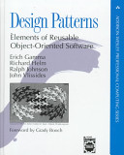
Design Patterns - Gang of Four book
The "Gang of Four"
The first book to popularize the idea of software patterns:
Gamma, Helm, Johnson, Vlissides
Design Patterns: Elements of Reusable Object-Oriented Software. (1995)

Slide 14
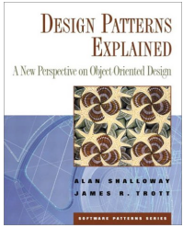
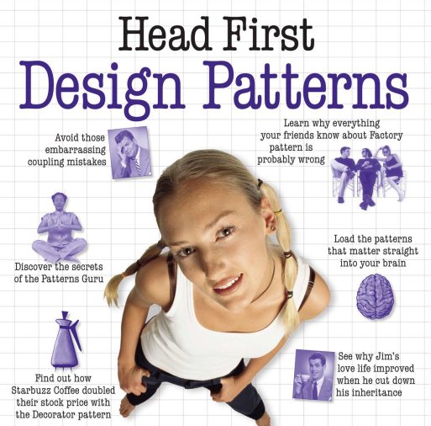
Other Good Design Patterns Books
Good for Java programmers
Design Patterns Explained, 2E (2004)
by Allan Shallow & James Trott
also wrote: Pattern Oriented Design.
Head First Design Patterns (2004)
by Eric & Elizabeth Freeman
Visual, memorable examples,
too simple code.

Slide 15
Structure of Patterns in
Gang of Four book
Name of Pattern
Intent
what the pattern does.
Motivation
Why use this pattern? When to apply this pattern
Structure
Logical structure of the pattern. UML diagrams.
Participants and Collaborators
What are the elements of the pattern? What do they do?
Consequences
The benefits and disadvantages of using the pattern.

Slide 16
Singleton Pattern
Pattern Name: Singleton Pattern
Context
We want to ensure there is only one instance of a class. All parts of the application should share this instance.
Motivation (Forces)
Several objects need to access the same resource, or we want objects to share a resource that is "expensive". Many parts of the program need to access this shared resource.
Solution
Prevent direct instantiation by making the constructor private.
Provide a static accessor method that always returns the same instance of this class (same object).

Slide 17
Singleton Pattern
1
Singleton
- instance: Singleton
<<constructor>>
- Singleton( )
+ getInstance( ) : Singleton
+ other methods for the
object's behavior
Single instance of this class
Static accessor for instance

Slide 18
Singleton Pattern
Singleton has 3 elements:
Singleton
- instance: Singleton
<<constructor>>
- Singleton( )
+ getInstance( ) : Singleton
(1) private static attribute that is the only instance of this class
(2) constructor is private to prevent other classes from creating objects
(3) public static accessor returns the single instance of this class.

Slide 19
Example of Singleton Pattern
A Store that has only one instance.
public class Store {
// (1) the single static instance
private static Store theStore = null;
private List<Transaction> transactions;
// (2) private constructor
private Store( ) {
transactions = new ArrayList<Transaction>( );
}
// (3) static accessor method also creates singleton public static Store getInstance() {
if ( theStore == null ) theStore = new Store( );
return theStore;
}
lazy instantiation

Slide 20
Getting the Singleton object
How do other objects get the Store?
// in your application use:
Store store = Store.getInstance( );

Slide 21
Lazy Instantiation
Means that you create a resource only when it is needed.
This avoids creating something that may never be used.
// (3) static accessor method creates the singleton
public static Store getInstance() {
if ( theStore == null ) theStore = new Store();
return theStore;
}
The store instance is created the first time that getInstance( ) is called, but not before.
If getInstance is never called, no Store is created.

Slide 22
Lazy Instantiation of Loggers
Using Log4J you will see a lot of code like this:
// Create the logger for this class
private static Logger log = Logger.getLogger(...);
What if this class never logs any messages?
We wasted time and memory creating the logger.
So many apps use lazy instantiation:
// Don't create logger yet
private static Logger log = null;
private static Logger getLogger() {
if (log == null) log = Logger.getLogger(...);
return log;
}

Slide 23
Consequences of Using Singleton
Benefits
control access to a single instance
reduce name space pollution - better than using a global variable (in languages with global variables)
permits a variable number of instances - you can modify the singleton to produce more than one instance, w/o changing other parts of application
Disadvantages
Singleton cannot be subclassed, since the constructor is private and static getInstance() is not polymorphic.
Related patterns
Factory Method

Slide 24
Observer Pattern
Context:
An object (the Subject) is the source of interesting events. Other objects (Observers) want to know when an event occurs.
Solution:
(1) Subject provides a method for Observers to register themselves as interested in the event.
(2) Subject calls a known method (notify) of each Observer when event occurs.

Slide 25
Observer Pattern
Context: An object (the Subject) is the source of interesting events. Other objects (Observers) want to know when an event occurs.
Solution: (1) Subject provides a method for Observers to register themselves as interested in the event.
(2) Subject calls a known method (notify) of each Observer when event occurs.
Subject
- observers: Collection
+addObserver( Observer )
+removeObserver( ... )
Observer
+notify( event: Object )
...
ConcreteObserver
+notify( event )
...
AnotheObserver
+notify( event )
...
What are some examples of this?

Slide 26
Table for Identifying a Pattern
Name In Pattern | Name in Application: this is for a JButton
Subject | JButton
Observer | ActionListener
Concrete Observer | a class that implements ActionListener
addObserver( Observer ) | addActionListener( )
notify( Event ) [in the observer] | actionPerformed( ActionEvent )
notifyObservers [in Subject] | fireActionPerformed( )

Slide 27
Observer Pattern in Java
Java provides an Observable class and Observer interface that make it easy to use the Observer pattern..
Observable
- observers: Collection
+addObserver( Observer )
+deleteObserver( ... )
+notifyObservers( Object )
Observer
+update( Observable, Object )
addObserver(this)
YourApplication
-event( )
...
YourObserver
+update( observable, event )
...
event( ) { setChanged( );
notifyObservers(obj);
}

Slide 28
Using the Observable class
(1) Declare that your class extends Observable
public class MySubject extends Observable
{
Object myinfo;
/** An event the observers want to know about */
public void event( ) {
doSomeWork( );
// now notify the observers
setChanged( );
notifyObservers( ); // can include a parameter
}
(2) When an event occurs, invoke setChanged() and notifyObservers( )

Slide 29
Writing an Observer
(3) Declare that observers implement the Observer interface.
public class MyObserver implements Observer {
/* This method receives notification from the
* subject (Observable) when something happens
* @param message is value of parameter sent
* by subject in notifyObservers. May be null.
*/
public void update( Observable subject,
Object message ) {
info = ((MySubject)subject).getInfo( );
...
...
}
(4) update takes action using notification from the Subject.

Slide 30
Connecting Observer to Subject
Call addObserver( ) to add Observers to the subject. You can have many Observers.
public static void main(String [] args) {
Observable subject = new MySubject( );
MyObserver observer = new MyObserver( );
subject.addObserver( observer );
subject.run( );
}

Slide 31
Example for Coin Purse
Observable
notifyObservers()
GUI Interface
Balance: 35 Baht
Not Full
extends
Purse
insert( Coin )
Interesting events
withdraw( amt )

Slide 32
C# Delegates as Observers
Delegate is a type in the C# type system.
It describes a group of functions with same parameters.
Delegate can act as a collection for observers.
/** define a delegate that accepts a string **/
public delegate void WriteTo( string msg );
/** create some delegates **/
WriteTo observers = new WriteTo( out.WriteLine );
observers += new WriteTo( button.setText );
observers += new WriteTo( textarea.append );
/** call all the observers at once! **/
observers("Wake Up!");

Slide 33
Design Patterns We Studied
What design patterns have already been used in the text book?
1. Iterator
2. Observer
3. Command
4. Strategy - Layout Manager, used in a Container
5. State
6. Adapter

Slide 34
Categories of Patterns
Creational - how to create objects
Structural - relationships between objects
Behavioral - how to implement some behavior

Slide 35
Strategy Pattern
Context: A class requires some behavior, but there are many ways that this behavior can be implemented.
Solution: implement the behavior in a separate class, called the Strategy.
Create a Strategy interface to de-couple the context class from the Strategy.
<<interface>>
Strategy
+doSomething( Context )
...
Context
- strategy: Strategy
+setStrategy( Strategy)
What are some examples of this?
ConcreteStrategy
+doSomething( )
...
AnotherStrategy
+doSomething( )
...

Slide 36
Container uses Strategy Pattern
Context: Swing container.
Strategy: LayoutManager.
Create a Strategy interface to de-couple the context class from the Strategy.
Container
- strategy: LayoutManager
+add( Component )
+setLayout( LayoutManager )
<<interface>>
LayoutManager
+layoutContainer(Container )
...
What are some examples of this?
BorderLayout
+layoutContainer( )
...
FlowLayout
+layoutContainer( )
...

Slide 37
Using the Strategy Pattern
(1) The application creates a concrete strategy and assigns it to the context.
(2) The context delegates some work to the Strategy.
Strategy
: Context
create
cs : ConcreteStrategy
setStategy(cs)
doSomething( )
doSomething( context )

Slide 38
Strategy Pattern for Coin Purse
Context: A coin purse must decide what coins to withdraw; there are many ways to do this and we may want to change strategies.
Solution: Separate the withdraw( ) method from the Purse.
Define a WithdrawStrategy interface for the withdraw operation, and modify the purse to delegate the withdraw operation to a concrete instance of WithdrawStrategy.
CoinPurse
- strategy: WithdrawStrategy
+setWithdrawStrategy( ws )
WithdrawStrategy
+withdraw( context, amount )
GreedyWithdraw
+withdraw( )
...
RecursiveWithdraw
+withdraw( )
...

Slide 39
Strategy needs access to Context
To do its job, the Strategy usually needs a reference to the Context or some data of the Context.
Context: AWT/Swing Container (JPanel ...) contains components.
Container
setlayout(LayoutManager lm)
Strategy: A LayoutManager arranges and resizes components.
LayoutManger needs a reference to Container to get size and list of Components.
LayoutManager
layoutContainer(Container c)
BorderLayout

Slide 40
Composite Pattern
Context: We have a generic component that our application uses. We'd like to group together multiple components so that they look and behave like a single component.
Solution: Create a composite that implements the component interface and contains a collection of components. The compposite is responsible for managing components.
Component
+ paint( g: Graphics )
...other methods...
*
Composite
+add( Component )
+remove( Component )
Button
+paint( g: Graphics )
...
TextComponent
+paint( g: Graphics )
...

Slide 41
Situations (Context) not Patterns
Don't memorize pattern names.
Learn the situation and the goals (forces) that motivate the solution.

Slide 42
Adding New Behavior
Situation:
we want to add some new behavior to an existing class
Forces:
1. don't want to add more responsibility to the class
2. the behavior may apply to similar classes, too
Example:
Scrollbars

Slide 43
Changing the Interface
Situation:
we want to use a class in an application that requires interface A. But the class doesn't implement A.
Forces:
1. not appropriate to modify the existing class for the new application
2. we may have many classes we need to modify
Example:
change an Enumeration to look like an Iterator

Slide 44
Convenient Implementation
Situation:
some interfaces require implementing a lot of methods. But most of the methods aren't usually required.
Forces:
1. how can we make it easier to implement interface?
2. how to supply default implementations for methods?
Example:
MouseListener (6 methods), List (24 methods)

Slide 45
A Group of Objects act as One
Situation:
we want to be able to use a Group of objects in an application.
But the application can treat the whole group like a single object.
Forces:
1. need many objects in a framework that one allows us to insert one object.
Example:
KeyPad in a mobile phone app.

Slide 46
Creating Objects without Knowing Type
Situation:
we are using a framework like OCSF.
the framework needs to create objects.
how can we change the type of object that the framework creates?
Forces:
1. want the framework to be extensible.
2. using "new" means coupling between the class and the framework.
Example:
OCSF, JDBC DriverManager

Slide 47
Do Something Later
Situation:
we have a task that we want to run at a given time
Forces:
we don't want our "task" to be responsible for the schedule of when it gets run.
This problem occurs a lot, so let's write a reusable solution.
Example:

Slide 48
Decorator Pattern
Context: We want to enhance the behavior of a class, and there may be many (open-ended) ways of enhancing the class.
The enhanced class can be used the same as the base class.
Solution: Create an interface for the base class. The base class implements the interface. Create a decorator that implements the interface and wraps the plain class, "decorating" its behavior.
Component
+ paint( g: Graphics )
...other methods...
1
JScrollPane
createHorizontalScrollBar
createVerticalScrollBar
Button
+paint( g: Graphics )
...
TextComponent
+paint( g: Graphics )
...

Slide 49
Decorator Example
Purpose: create a TextArea with scrollbars so that text will scroll when larger than the viewport.
// create TextArea with 5 rows, 40 columns
JTextArea textArea = new JTextArea( 5, 40 );
// decorate with JScrollPane to add scrollbars
JScrollPane pane = new JScrollPane( textArea );
pane.setVerticalScrollBarPolicy(
JScrollPane.VERTICAL_SCROLLBAR_AS_NEEDED );
// Add the decorator to the contentpane.
// Don't add the textArea!
contentPane.add( pane );

Slide 50
Advantage of Using Decorators (1)
We can write a behavior one time and apply it to many different kinds of objects.
Example: a JScrollPane can be applied to any component, not just JTextArea.

Slide 51
Advantage of Using Decorators (2)
Improves the cohesion of objects, by not adding responsibility that isn't part of the object's main purpose.
Example: the purpose of a TextArea is to display text!
Not to manage scrolling.

Slide 52
Advantage of Using Decorators (3)
New decorators can be added in the future, extending the behavior of the class.
Example: a zoom decorator to zoom a component.
Open-Closed Principle
A class should be open for extension but closed for modification.

Slide 53
Adapter Pattern
to be added.

Slide 54
Readers as Adapters
InputStream reads input as bytes.
int b = inputStream.read( );
InputStreamReader interprets the input as characters.
InputStreamReader reader
= new InputStreamReader( inputStream );
char c = (char) reader.read( );
BufferedReader groups the characters into lines
BufferedReader bufReader
= new BufferedReader( reader );
String line = bufReader.readLine( );

Slide 55
Adapter wraps a component
IInputStream instream =
new FileInputStream( "filename" );
InputStreamReader reader =
new InputStreamReader( instream );
BufferedReader bufReader =
new BufferedReader( reader );
String line = bufReader.readLine( );
BufferedReader (reads strings)
InputStreamReader (read chars)
InputStream (reads bytes)

Slide 56
Factory Method
Context:
One class (the Factory) creates objects of another type (the Product). But, different classes need to create different implementations of the Product.
Example:
We need to access every item in a collection or other composite object, so we define an iterator that performs this job.
Every collection must create an iterator, but the implementation of the iterator depends on the type of collection.

Slide 57
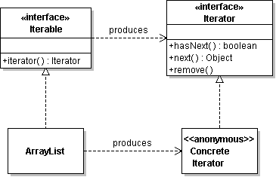
Factory Method
The Solution
Factory Interface | Iterable
Factory Method | iterator( )
Product | Iterator
Concrete Product | class implementing Iterator

Slide 58
Model-View-Controller (MVC) Pattern
An architectural pattern used to help separate the external view of an application from the logic
  The model contains the underlying classes containing the logic and state of the application
  The view contains objects used to render the appearance of the data from the model in the user interface
  The controller handles the user’s interaction with the view and the model

Slide 59
MVC Applications
GUI Interfaces, like Swing (see Core Java, p.339-345)
Editors: Dreamweaver

Slide 60
Model and Views
The model and view relationship is often implemented as the Observable Pattern.
This lets the application have multiple views.
Reduces "coupling" between model and view.
event( ) {
setChanged( );
notifyObservers(message);
}
Model
-event( )
...
View
+notify( event )
...
update( subject, message )
Send what message?

Slide 61
View and Controller
The view calls the controller class when it wants to do something.
Controller
+doAction( params )
...
2. update model
1. do something
Model
+setState(state)
+getState():state
View
+notify( event )
...
3. notify observers
4. get state of model

Slide 62
Guessing Game with UI
Main
...
GameManager
...
GameGUI
...
ScoreBoard
...
new GameManager
new GameGUI(manager)
new ScoreBoard(manager)
update(event)
what?

