Slide 1
Coding Guidelines
Widely used guidance for writing good code.

Slide 2
Guidelines
1. Code should be easy to read.
2. Be consistent in naming and formatting.
3. Use comments where helpful. Explain & document code. Write Javadoc.
4. Avoid duplicate logic and duplicate code (DRY).
5. Localize variables.
6. No magic numbers.
7. Treat warnings like errors.

Slide 3
Why?
1. Help write correct code.
  Easy to Read -> fewer bugs
  No duplicate code -> no inconsistencies
2. Easy to modify or update.
3. Code that others can understand.
  If they don't understand it, they won't use it.
4. Reusable.

Slide 4
Code should be easy to read
1. Use a coding standard for names and formatting.
2. Use descriptive variable & method names:
Good: gameBoard, player, piece, moveTo( Piece, x, y)
Bad: b, play, pc, mv( Piece, x, y)
3. Prefer simple expressions to complex ones.
4. Use space around operators (except "." and a[index]).
Bad: if(x<0||x>=board.width)return false;
Good: if (x < 0 || x >= board.width) return
5. Add space between methods: 1 blank line.

Slide 5
Do you understand this code?
Write comments!
Use meaningful variable names
Follow a formatting convention
public Coin[] withdraw(double x) {
int t=Math.min(x/10,tens); x -= t*10;
int f=Math.min(x/5,fives); x -= f*5;
int o=Math.min(o,ones); x -= o*1;
if (x==0) return getCoins(t,f,o);
else return null;
}

Slide 6
Use Comments to Explain "why"
Good comments help reader understand the code
public void paint(Graphic g) {
// create a copy of g so we don't change it
// this is recommended by Swing
g = g.create();
Bad comments just state the obvious
// if the piece is null then return
if (piece == null) return;
// add all the scores in list
int total = scores.stream( ).sum( );

Slide 7
4. Avoid Duplicate Code & Logic
/** Initialize a new Banknote with default currency. */
public Banknote(double amount) {
if (amount <= 0) throw new IllegalArgumentException();
this.amount = amount;
this.currency = DEFAULT_CURRENCY;
this.serialNumber = getNextSerialNumber();
}
/** Initialize a Banknote with given currency. */
public Banknote(double amount, String currency) {
if (amount <= 0) throw new IllegalArgumentException();
this.amount = amount;
this.currency = currency;
this.serialNumber = getNextSerialNumber();
}

Slide 8
this( ) - call another constructor
/** Initialize a new Banknote with default currency. */
public Banknote(double amount) {
this(amount, DEFAULT_CURRENCY);
}
/** Initialize a Banknote with given currency. */
public Banknote(double amount, String currency) {
if (amount <= 0) throw new IllegalArgumentException();
this.amount = amount;
this.currency = currency;
this.serialNumber = getNextSerialNumber();
}

Slide 9
duplicate code that's hard to read
/** Read words from inputStream & count words by length. */
Map<Character,Integer> map =
new HashMap<Character,Integer>();
Scanner in = new Scanner(inputStream);
while(in.hasNext()){
String word = in.nextLine();
if(map.containsKey(word.charAt(0))){
map.put(word.charAt(0),map.get(word.charAt(0))+1);
}
else{
map.put(word.charAt(0),1);
}
}
What is duplicate (used many times) in this code?

Slide 10
use a variable to avoid redundant method call
/** Read words from inputStream & count words by length. */
Map<Character,Integer> map =
new HashMap<Character,Integer>();
Scanner in = new Scanner(inputStream);
while (in.hasNext()) {
String word = in.nextLine();
char firstChar = word.charAt(0);
if ( map.containsKey(firstChar) ) {
map.put(firstChar, map.get(firstChar)+1);
}
else {
map.put(firstChar, 1);
}
}
and add space for readability!

Slide 11
add explanatory variable (count)
/** Read words from inputStream & count words by length. */
Map<Character,Integer> map =
new HashMap<Character,Integer>();
Scanner in = new Scanner(inputStream);
while (in.hasNext()) {
String word = in.nextLine();
char firstChar = word.charAt(0);
int count = 0;
if ( map.containsKey(firstChar) ) {
count = map.get(firstChar);
}
map.put(word.firstChar, count+1);
}

Slide 12
Use the API: get -> getOrDefault
/** Read words from inputStream & count words by length. */
Map<Character,Integer> map =
new HashMap<Character,Integer>();
Scanner in = new Scanner(inputStream);
while (in.hasNext()) {
String word = in.nextLine();
char firstChar = word.charAt(0);
// get the character count or 0 if char not seen yet
int count = map.getOrDefault(firstChar, 0);
// update the frequency count for the new word
map.put(word.firstChar, count+1);
}

Slide 13
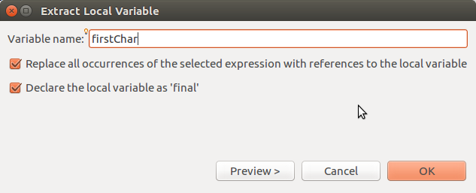
Let Eclipse do it for you
"Define a variable" is an example of refactoring.
1) select expression you want to define as variable:
word.charAt(0)
2) From menubar (or right-click):
Refactor -> Extract Local Variable...

Slide 14
Anticipate and avoid errors
/** Read words from inputStream & count words by length. */
Map<Character,Integer> map =
new HashMap<Character,Integer>();
Scanner in = new Scanner(inputStream);
while (in.hasNext()) {
String word = in.nextLine();
char firstChar = word.charAt(0);
// get the character count or 0 if char not seen yet
int count = map.getOrDefault(firstChar, 0);
// update the frequency count for the new word
map.put(word.firstChar, count+1);
}
What could go
wrong here?

Slide 15
(1) blank line or (2) starts with space
/** Read words from inputStream & count words by length. */
Map<Character,Integer> map =
new HashMap<Character,Integer>();
Scanner in = new Scanner(inputStream);
while (in.hasNext()) {
String word = in.nextLine().trim();
if ( word.isEmpty() ) continue; // skip blank lines
char firstChar = word.charAt(0);
// get the character count or 0 if char not seen yet
int count = map.getOrDefault(firstChar, 0);
// update the frequency count for the new word
map.put(word.firstChar, count+1);
}

Slide 16
Avoid Duplicate Logic
/** Insert money if the purse is not full. */
public boolean insert(Valuable obj) {
if (money.size() == capacity) return false;
return money.add(obj);
}
Avoid duplicate logic and make the intention clear:
public boolean insert(Valuable obj) {
if ( isFull() ) return false;
return money.add(obj);
}

Slide 17
Anticipate and avoid errors
What if (somehow) the purse contains more than capacity?
/** Test if the purse is full or not. */
public boolean isFull( ) {
return (money.size() == capacity);
}
public boolean isFull( ) {
return (money.size() >= capacity);
}

Slide 18
5. Localize variables
Use the smallest possible scope
use attributes only for things that are part of object's state
minimize sharing of information between methods
public class Purse {
List<Coin> items;
int balance;
public int getBalance( ) {
balance = 0;
for(Coin c: items) balance += c.getValue();
return balance;
}

Slide 19
Localize variables
balance is only needed in getBalance, so it should be local.
won't fail if 2 threads call getBalance() simultaneously
public class Purse {
List<Coin> items;
public int getBalance( ) {
int balance = 0;
for(Coin c: items) balance += c.getValue();
return balance;
}

Slide 20
Localize scope as much as possible
don't define a variable until you need it.
public class CoinMachine {
List<Coin> items;
public int getBalance( ) {
int balance = 0;
for(Coin c: items) balance += c.getValue();
return balance;
}

Slide 21
Avoid Magic Numbers
Use NAMED CONSTANTS for special values.
public double getElapsed() {
return (stopTime - startTime) * 1.0E-9; // Bad
}
/** conversion from nanoseconds to seconds */
static final double NANOSECONDS = 1.0E-9; // Good
public double getElapsed() {
return (stopTime - startTime) * NANOSECONDS;
}

Slide 22
Avoid Magic Strings, too
Use named constants for strings.

Slide 23
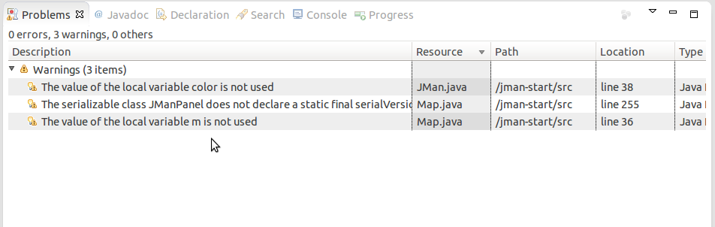
Treat Warnings Like Errors
Try to eliminate all the warnings in Eclipse or IntelliJ.
Eclipse: Close unrelated projects so you only see problems for this project.

Slide 24
References
Steve McConnell, Code Complete, 2nd Edition.
Robert Martin, Clean Code.
http://www.unclebob.com - Robert Martin's blog
Joshua Bloch, Effective Java.

