Slide 1
Coding Standard & Javadoc

Slide 2
Java Naming Convention
class name begins with Uppercase: Double, String
method name uses camelCase: length(), valueOf()
variable name also uses camelCase: myCoffee
constants use UPPER_CASE and _: MAX_VALUE
package names are all lowercase (with a few exceptions):
java.lang java.io java.time java.util
org.junit
primitive type names are all lowercase:
boolean, char, int, double, long

Slide 3
Example - a Java class
package ku.ske;
import java.util.Scanner;
/** A customer has one or more accounts */
public class Customer extends Person {
private String customerId;
private List<Account> accounts;
public Customer(String name) . . .
public List<Account> getAccounts( )...
public void addAccount(Account acct)...

Slide 4
Identify each of these
Martian
org.nerd.hacker
System
System.nanoTime( )
System.out
System.out.println( )
double
Double
"Hello nerd".length( )
Double.MAX_VALUE
java.text
java.util.ArrayList
java.util.Comparable
Is it a ...
class
package
primitive type
attribute ("field")
method
(static or instance)
constant
(static final attribute)
interface (more advanced)
something else???

Slide 5
Use Full Words as Names
Good Name | Bad Name
BankAccount | BankAct
balance | bal
count | n
accountId | num, id
Exception: short names OK for local variables, esp. loop vars.
double getTotal( ) {
double sum = 0.0;
for(int k=0; k<transactions.length; k++) {
sum += transaction.getValue( );
...

Slide 6
Writing Javadoc (Required)
Must start with a complete sentence, ending with a period.
package ku.ske;
/**
* A Person contains information about a
* person including name and contact info.
* @author Bill Gates
* @since 2014.01.12
*/
public class Person {
/** person's name, of course */
private String name;
@author, @since are tags. Use only the standard tags.

Slide 7
Method Javadoc
/**
* Set the person's birthday.
* @param birthday a date containing the
* person's birthday. Must not be null.
*/
public void setBirthday(Date birthday) {
if (birthday == null)
throw new IllegalArgumentException(
"Read the javadoc, stupid!");
this.birthday = (Date)birthday.clone();
.

Slide 8
Method Javadoc with Return
/**
* Withdraw money from the coin machine.
* @param amount is amount to withdraw.
* @return array of money withdrawn,
* or null if cannot withdraw the
* requested amount.
*/
public Money[] withdraw(double amount) {
if (double <= 0.0) return null;
.
.

Slide 9
More Method Javadoc
/**
* Compare 2 coins by value.
* @param a the first Coin to compare.
* @param b the second Coin to compare
* @return -1 if first coin's value is
* smaller, +1 if first coin's value is
* larger, and 0 if values are same.
* @throws IllegalArgumentException if
* the currencies are not the same.
*/
public int compare(Coin a, Coin b) {
.
.

Slide 10
Bad Javadoc - what's wrong?
/**
* The Person class
* @Bill Balmer
* @Version 1.0
*/
package ku.ske.badcode;
public class Person {
private String name;
/**
* get the firstname
* @param k is index of first space in name
*/
public String getFirstname( ) {
int k = name.indexOf(' ');
return name.substring(0,k); // bug?
}

Slide 11
Good Code has Documentation
Use documentation to describe a class and its methods.
Describe what and why – not "how" which is obvious from the code.
Describe rationale and logic that is not obvious from code.
No Javadoc = No Credit
// sum elements in the array (BAD: it's obvious)
int sum = 0;
for(int k=0; k<array.length; k++) {
sum += array[k];
}

Slide 12
Generate Javadoc from your Code
3 ways to create HTML pages from Javadoc:
the javadoc command
let Eclipse or BlueJ or Netbeans create it for you
use an automatic build system, like Maven

Slide 13
Demo
Demo how BlueJ will create Javadoc (HTML) from your Javadoc comments.
Demo how any IDE gives interactive help using Javadoc, including Javadoc in your code.

Slide 14
javadoc Command
You can use the javadoc command line to create Javadoc. It has many options, only a few are shown here.
First, open a terminal "shell" and "cd" to the top-level directory of your project:
cmd> cd workspace/lab2
cmd> dir
stopwatch/
util/
This shows your source code is in packages named stopwatch and util.

Slide 15
Using the javadoc Command
Create HTML doc files in a directory named "docs", and include everything with visibility package (default) and above, and include @author tags
cmd> javadoc --frames -author -package
-d docs stopwatch util
Constructing Javadoc information...
Standard Doclet version 11.0.5
Building tree for packages and classes...
Generating docs/stopwatch/Main.html...
Generating docs/stopwatch/Stopwatch.html...
Generating docs/index.html...

Slide 16
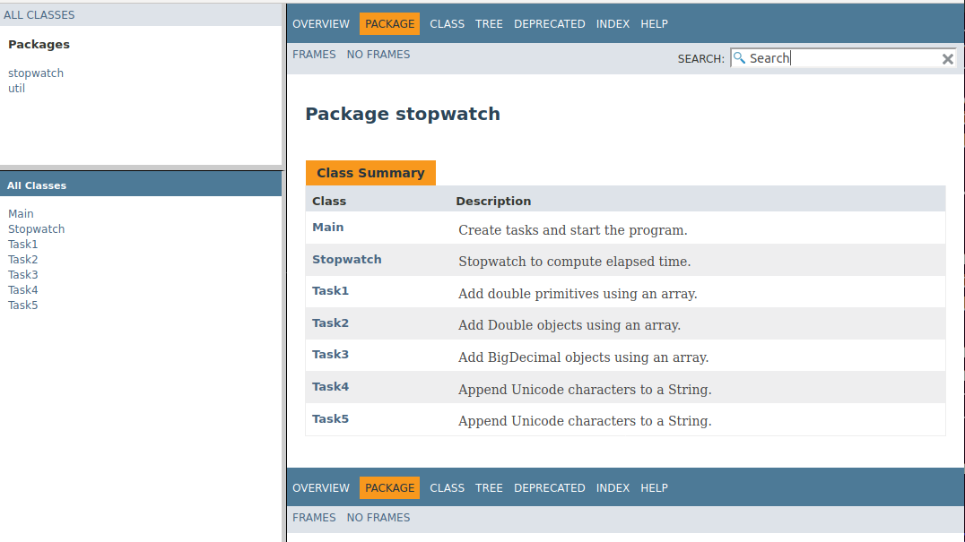
View Your Javadoc!
Open the file docs/index.html in a web browser:

