Slide 1
Week 15 Meeting

Slide 2
Topics
TA Meeting this Week
English
Java in VS Code
PA4 - Only 11 Proposal On-time

Slide 3
TA Meeting
Schedule another online meeting with T.A. or instructor.
Between now & Sunday night.
Purpose is to discuss work on your PA4 project.
Don't ask "what's on the exam?" -- TA's don't know.

Slide 4
English
Mass Noun
A noun describing something that cannot be counted, e.g. a substance.
Examples
sand
"There is sand at the beach" not "There are sands at the beach"
water, coffee, ...
"A glass of water" not "a glass of waters"

Slide 5
Refers to a Collection, not one item
alphabet
"Learn the alphabet" not "learn the alphabets"
unless you are learning several alphabets
staff
"the department staff" not "the staffs"
CPE and IUP web sites contain this mistake

Slide 6
Punctuation You Should Know
1. Always leave a space after , . ? ! ) : ;
Unless they occur together (like this).
2. Never leave a space before , . ? ! ) : ;
Enter your name : wrong
Observer , Strategy ,and Singleton - 3 mistakes
I like Java.And Python ,too. - no excuse for this

Slide 7
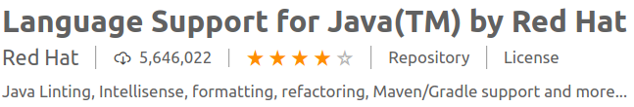
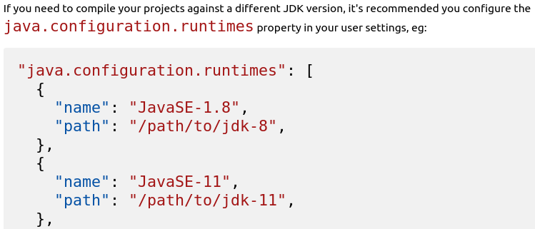
Know Your Tools
If you use VS Code, open the Extensions and READ the description for installed extensions. It has important info!

Slide 8
How to Change Java Compiler
Setting the JDK
The path to the Java Development Kit is searched in the following order:
the java.home setting in VS Code settings (workspace then user settings)
the JDK_HOME environment variable
the JAVA_HOME environment variable
on the current system path
Eclipse & IntelliJ users:
You should know how to select JDK for a project, too.

Slide 9
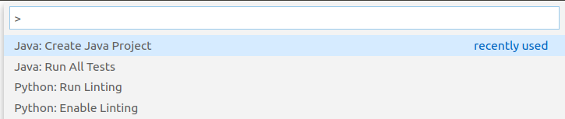
VS Code Commands & Settings
1. What keys do you press so you can enter a VS Code command? _______________________
Note: if no one can answer this, then we end the class meeting here. A "meeting" requires participation.

Slide 10
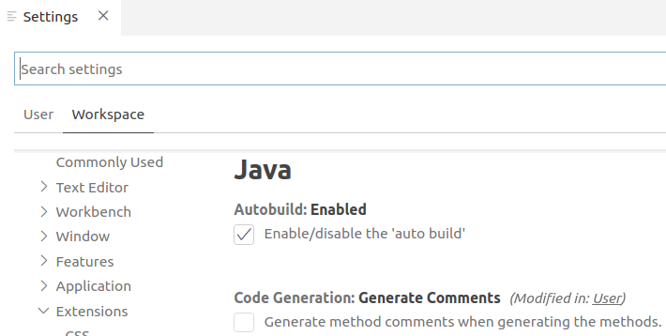
VS Code Commands & Settings
2. How do you display the project settings page?

Slide 11
Using Java I/O
Want to read Strings, numbers, and more
Want to read Strings
Want to read characters
Want to read bytes
InputStream

Slide 12
Using I/O Hierarchy
Want to read Strings, numbers, and more
Want to read Strings
Want to read characterss
Want to read bytes
Reader
InputStream

Slide 13
Using More Hierarchy
Want to read Strings, numbers, and more
Want to read Strings
Want to read characterss
Want to read bytes
BufferedReader
Reader
InputStream

Slide 14
Many ways to tokenize
String
Tokenizer
(*)
Want to read Strings, numbers, and more
Want to read Strings
Want to read characterss
Want to read bytes
Scanner
BufferedReader
Reader
InputStream
* or string.split(regex)

Slide 15
Final Exam
May cover anything from the course.
Written & programming parts.
Divided in 60-90 minute sessions, with break.
Most time will be for coding.
Need to reduce bandwidth for proctoring.

Slide 16
Reducing Bandwidth
Kittitouch 10MB
Chanathip 9MB
Suchon 523MB
Nuttapol 1,101MB (1GB)
Thornthep Upload Failed (too large)
Saruj 1,720MB
Setthanat 714MB

Slide 17
Didn't Follow Instructions
"6210545602" - Wrong name for share, Sorawichaya
stream - 58MB but incorrect content, not IDE

Slide 18
Reducing Bandwidth & Video Size
This is an ASSIGNMENT for whole class.
People who make best contributions get points.
1. Experiment & Search Web to find what OBS settings result in the smallest video subject to the requirement that the clock and code are readable in video?
2. More than one set of settings OK. Create a table.
3. What to write:
Settings used Stream rate/min Video size/min
2. Class is divided into 4 groups. To prevent stealing of ideas, only your group can access your file.
3. Top contributors get score.

Slide 19
Quiz on Recursion
Involves a list.
May require use of a helper method.
About same difficulty as codingbat problems.

