Slide 1
JavaFX and FXML
How to use FXML to define the components in a user interface.

Slide 2
FXML
FXML is an XML format text file that describes an interface for a JavaFX application.
You can define components, layouts, styles, and properties in FXML instead of writing code.
<GridPane fx:id="root" hgap="10.0" vgap="5.0" xmlns="...">
<children>
<Label fx:id="topMessage"
GridPane.halignment="CENTER"/>
<TextField fx:id="inputField" width="80.0" />
<Button fx:id="submitButton" onAction="#handleGuess" />
<!-- more components -->
</children>
</GridPane>

Slide 3
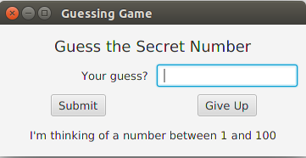
Creating a UI from FXML
The FXMLLoader class reads an FXML file and creates a scene graph for the UI (not the window or Stage).
It creates objects for Buttons, Labels, Panes, etc. and performs layout according to the fxml file.
creates
FXMLLoader
reads
game.fxml

Slide 4
Code to Provide Behavior
The FXML scene define components, layouts, and property values, but no behavior or event handlers.
You write a Java class called a Controller to provide behavior, including event handlers:
class GameController {
private TextField inputField;
private Button submitButton;
/** event handler */
void handleGuess(ActionEvent e)...

Slide 5
Connecting References to Objects
The FXML scene contains objects for Button, TextField, ...
The Controller contains references to the objects, and methods to supply behavior.
How to Connect Objects to References?
class GameController {
private TextField inputField;
private Button submitButton;
/** event handler */
void handleGuess(ActionEvent e)...

Slide 6
fx:id and @FXML
In the FXML file, you assign objects an "fx:id".
The fx:id is the name of a variable in the Controller class annotated with @FXML. You can annotate methods, too.
fx:id="inputField"
class GameController {
@FXML
private TextField inputField;
@FXML
private Button submitButton;
/** event handler */
@FXML
void handleGuess(ActionEvent e)

Slide 7
The fxml "code"
You can use ScaneBuilder to create the fxml file. This example is just to illustrate the connection.
Name of controller class (can also set this in code)
<GridPane fx:id="root" hgap="10.0" vgap="5.0" xmlns="..."
fx:controller="game.GameController" >
<children>
<Label fx:id="topMessage" GridPane.halignment="CENTER"/>
<TextField fx:id="inputField" width="80.0" />
<Button fx:id="submitButton" onAction="#handleGuess" />
<!-- more components -->
</children>
</GridPane>
Reference to variables and methods in Controller.

Slide 8
FXMLLoader creates scene from FXML
Tell FXMLLoader to load FXML and create a scene graph.
Instead of initComponents() use FXMLLoader.load()
public void start(Stage stage) throws IOException {
// Find the fxml file as part of our application
URL fxmlfile = getClass().getResource("game/GameUI.fxml");
// Create the scene graph
Parent root = FXMLLoader.load( fxmlfile );
Scene scene = new Scene(root);
stage.setScene( scene );
stage.setTitle("Guessing Game");
stage.show();
}

Slide 9
What is getClass().getResource()?
getClass().getResource(filename) finds files that are included as part of your application.
Parameter is the relative path to the file.
You must use getResource(filename) because you do not know where on the user's computer your app is installed.
[YOUR APPLICATION]/
GameApp.class
game/
GameUI.fxml
GuessingGame.class
GameController.class
path is relative to your application

Slide 10
Example: image as resource
Suppose your app has some images in a subdirectory named images/ relative to your source code root.
These images will be copied to the compiler output (bin/) and included in a JAR file.
URL background =
getClass().getResource("images/Backgnd.jpg");
src/
GameApp.java
images/
Backgnd.jpg
Player.png

Slide 11
Example: getting an InputStream
You can also create an InputStream for the resource.
InputStream in = getClass()
.getResourceAsStream("images/Player.png");
ImageView image = new ImageView( in );
src/
GameApp.java
images/
Backgnd.jpg
Player.png

Slide 12
getResource() is a "short cut"
getClass().getResource() is a convenience method.
The work is actually done by the ClassLoader object:
this.getClass().getResource("dat/foo.csv");
is short cut for:
this.getClass().getClassLoader()
.getResource("dat/foo.csv");
src/
dat/
foo.csv

Slide 13
Better code for start()
Two problems may occur when creating a scene graph from an fxml file:
public void start(Stage stage) throws IOException {
(1) Returns null if the file is not found
URL fxmlfile = getClass().getResource("game/GameUI.fxml");
(2) May throw IOException
Parent root = FXMLLoader.load( fxmlfile );

Slide 14
FXMLLoader as Instance
Sometimes you want a reference to the FXMLLoader. Using the loader, you can get/set the Controller class or set properties. To get an instance of FXMLLoader:
// Find the fxml file as part of our application
URL fxmlfile = getClass().getResource("game/GameUI.fxml");
// Create the scene graph
FXMLLoader loader = new FXMLLoader( fxmlfile );
Parent root = loader.load();

Slide 15
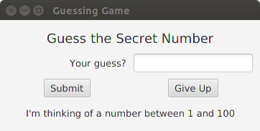
Example Using SceneBuilder
Create a GUI for the GuessingGame using FXML.
Using SceneBuilder for FXML and VS Code for Code.
Eclipse & IntelliJ can invoke SceneBuilder inside the IDE, but in VS Code you use SceneBuilder separately.

Slide 16
GuessingGame Components
GameUI.fxml
GameController
inputField: TextField
submitButton: Button
giveUpButton: Button
handleGuess()
initialize()
FXMLLoader.load()
GameApp
the "main" class
main( )
start( )
GuessingGame
secret
count
guess(number)
getMessage()

Slide 17
fx:id for components
topMessage
inputField
submitButton
giveUpButton
statusMessage

Slide 18
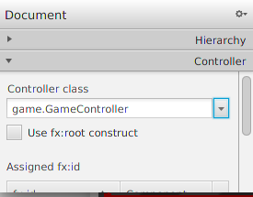
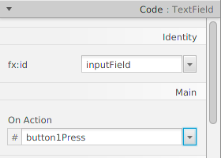
SceneBuilder Important Parts
1. Specify the Controller class (left side, at bottom).
2. Assign fx:id to components:
  select the component &
  open "Code" pane
  select the fx:id from a list
3. Assign Event Handlers
(or do it in code).

Slide 19
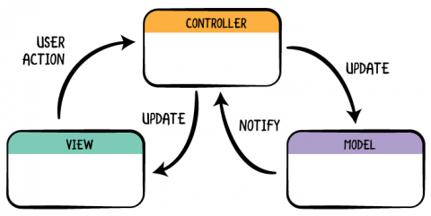
Model - View - Controller Design
Most Web and GUI applications use the Model-View-Controller design.
The Controller translates UI requests into requests the model understands and conveys results to the UI.

Slide 20
Source Code for Example
https://github.com/jbrucker/guessing-game.git
Some details are slightly different.

