Slide 1
Review of Design Patterns

Slide 2
Notifying Observers
The FloorView must update the display whenever the elevator changes state.
How is this done?
1. _______________ invokes _______________
2. _______________ invokes _______________
3. ____________ (Observer) calls _______________
4. _______________ calls _______________

Slide 3
Notifying Observers
The FloorView must update the display whenever the elevator changes state.
How is this done?
1. Elevator invokes notifyObservers_
2. notifyObservers() invokes observer.update( )
3. FloorView (Observer) calls elevator.getFloor()
4. FloorView calls label.setText( "Floor "+floor )

Slide 4
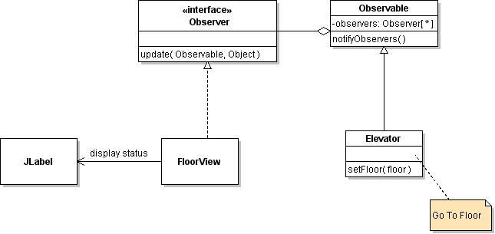
Notifying Observers
The FloorView must update when the Elevator moves.
How is this done?
Draw and number the method calls.

Slide 5
O-O Fundamentals
How are the fundamental O-O characteristics used in the Observer pattern?
How does this benefit the program?

Slide 6
Views and Controls
Views are Observers. They get notified by Subject.
Q: Do views need a reference to Subject?
2. wake up!
View
(Observer)
Abstract
Subject
3. what happened?
1. notify observers
4. update display
Subject
Floor 5

Slide 7
Views and Controls
Controls send messages to the Subject.
Q: Do controls need a reference to the Subject?
UP BUTTON
Abstract
Subject
1. event occurs
4. notify observers
2. handle this
Subject
Control
3. do something

Slide 8
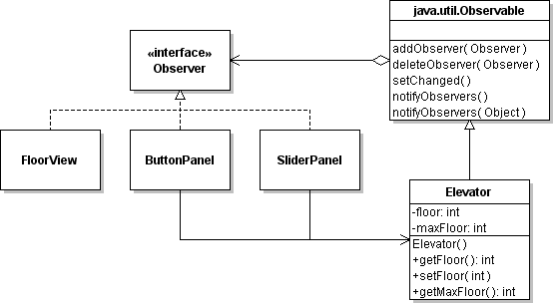
Elevator Views and Controls
Some components are both observer and control.
Notification Path
Control Path

Slide 9
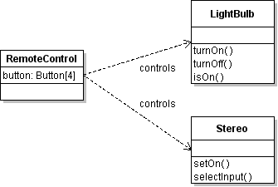
Remote Control problem
We have a 4-button Remote Control.
Design a solution to program the Remote Control.
Goals:
1. Don't couple Remote Control to a LightBulb or any other device.
2. Can program RemoteControl to control anything.
1
2
3
4

Slide 10
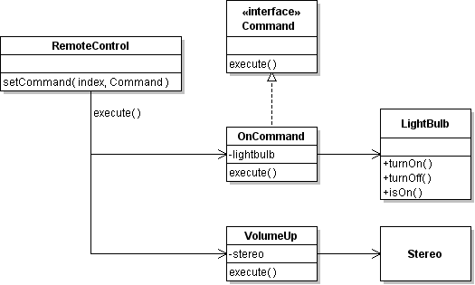
Remote Control solution
We have a 4-button Remote Control.
Design a solution to program the Remote Control.
1
2
click
3
4

Slide 11
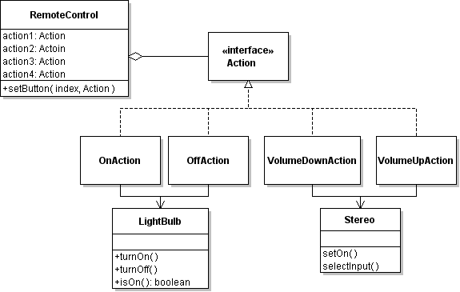
Use Commands for RemoteControl

Slide 12
How to Program using an Action
class OnAction extends AbstractAction {
private LightBulb light;
public OnAction(LightBulb light) {
super("Light On");
this.light = light;
}
public void actionPerformed( ) {
light.turnOn( );
}
}

Slide 13
How to Program using an Action (2)
Now you can put the action in as many components as you want.
Action on = new OnAction( );
JButton onButton = new JButton( on );
MenuItem mitem = new MenuItem( on );
menu.addItem( mitem );
Components will get their name, status, icon from the action.
They use OnAction as ActionListener.

Slide 14
How to Program using an Action (3)
You can disable the components by disabling the action.
on.setEnabled( false );
Disable all components using this action.

Slide 15
3 O-O Characteristics
How does the Command Pattern (using Actions) use the 3 O-O characteristics?
What is the benefit of each one?

Slide 16
How does Remote Control use the Pattern?
Complete the table.
Name in Command Pattern | Name in Application
Invoker
Command
ConcreteCommand
Receiver
execute( )

Slide 17
Abstract Superclass
What is an Abstract Class?
a class with one or more abstract methods (method without an implementation)
class must be declared "abstract"
you cannot create an instance of an abstract class
Give example of an Abstract Class is Java.
AbstractAction, AbstractList, Observable
Why use an Abstract Class?
see following slides

Slide 18
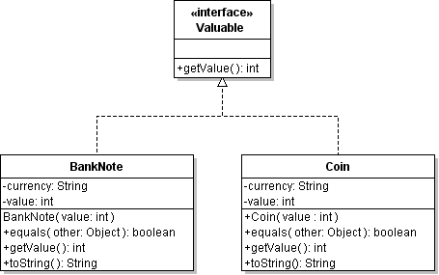
Abstract Class
How would you use an Abstract Class?

Slide 19
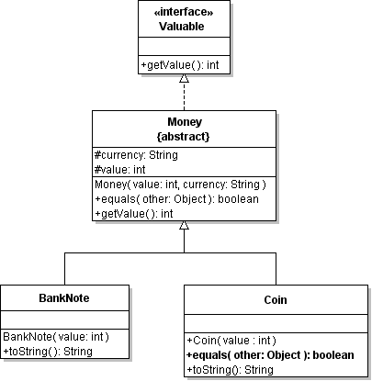
Abstract Class for Money
Factor out common behavior and attributes needed by subclasses

Slide 20
Abstract Class for Money
Provide default implementations for methods
if you don't like my equals then do it yourself!
@Override
equals(Object)
{ ... }

Slide 21
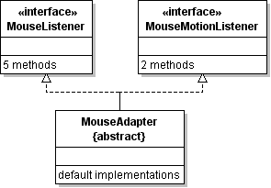
MouseAdapter
Abstract class provides default implementations of methods (convenience). Most of them do nothing.
Makes it easier to implement the interface.

Slide 22
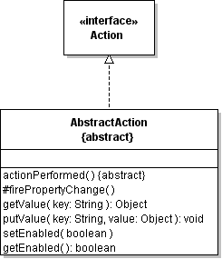
Abstract Classes Provide Behavior
Observable, AbstractList, AbstractAction
Abstract superclass providing methods and attributes that implement useful behavior.
Subclass can reuse this functionality or override it.
AbstractAction provides useful behavior to its subclasses.

Slide 23
Benefits of Abstract Superclass
1.
2.
3.

Slide 24
Disadvantage of Abstract Superclass
Are there any disadvantages or limitations on using an Abstract Superclass?
1.
2.

Slide 25
Abstract Superclass or Interface?
Compare Abstract Class with Interface.
Abstract Superclass | Interface

Slide 26
Patterns

Slide 27
What Pattern Should We Use?
General Problem:
some resource needs to be shared by all objects.
How can we guarantee that only one instance exists?
Example:
share a connection to a database.
// DatabaseManager should ensure we always
// use the same connection
Connection connection =
DatabaseManager.getConnection( );

Slide 28
Draw a Class Diagram of Solution

Slide 29
Changing Some Behavior
General Problem:
we have a reusable class but some methods need to change their behavior (algorithm) in different situations.
Example:
change the way a Container arranges Components.
panel.setLayout( new GridLayout(4,3) );
panel.add( button1 );
panel.add( button2 );
...

Slide 30
Draw a Class Diagram
Draw a class diagram of the parts of the Strategy Pattern

Slide 31
Complete the Table
How do Container and LayoutManager use this pattern?
Complete this table.
Name in Strategy Pattern | Name in this application
Context
Strategy
ConcreteStrategy
setStrategy( )
doWork( )

Slide 32
Give Another Example
Give another example of the Strategy Pattern.

Slide 33
What Pattern Should We Use?
General Problem:
we want to modify or enhance some behavior of a class, but we don't want to modify the class.
Example:
how to add scroll bars to components
JTextArea textarea = new JTextArea( 8, 40);
JScrollPane pane = new JScrollPane( textarea );
pane.setVerticalScrollbarPolicy(
JScrollPane.VERTICAL_SCROLLBAR_AS_NEEDED ):
// add pane (not textarea) to container
contentpane.add( pane );

Slide 34
Class Diagram of Decorator
Draw a class diagram of the decorator pattern.

Slide 35
Give Example of Observer Pattern
Name in Observer Pattern | Name in Application
Observer
Subject (Observable)
addObserver( )
upate( ) [in Observer class]

Slide 36
What Pattern Should We Use?
General Problem:
we have some legacy (existing) class we want to use, but it doesn't have the correct interface.
Example:
The Vector class creates an Enumeration (old), but our application wants an Iterator.
Enumeration<String> en = vector.elements( );
// process all the elements
while ( en.hasMoreElements() ) {
String s = en.nextElement( );
}

Slide 37
Draw a Class Diagram of Solution
Design an EnumerationAdapter<T> that implements Iterator<T>.

Slide 38
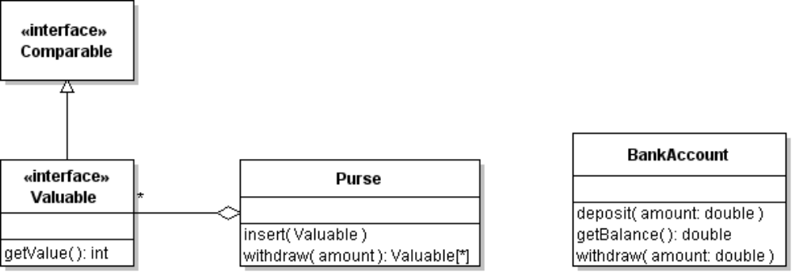
Being Adaptive
Problem:
We want to put a BankAccount object in the Purse.
But BankAccount doesn't implement the Valuable interface. We don't want to change the BankAccount class, either.
Adapter
getValue()

Slide 39

BankAccountAdapter
class BankAccountAdapter implements Valuable {
private BankAccount account;
// dependency injection
public BankAccountAdapter( BankAccount acct ) {
this.account = acct;
}
public int getValue() {
return account.getBalance();
}
}

Slide 40
Give Example of Observer Pattern
Name in Observer Pattern | Name in Application
Observer
Subject (Observable)
addObserver( )
upate( ) [in Observer class]

