Slide 1
Principles for Good Design & Code
A few principles you can use often.

Slide 2
Guidelines & Principles
1. Don't Repeat Yourself (DRY).
2. Separate the part that varies from the part that stays the same... and encapsulate the part that varies.
3. Single Responsibility Principle (SRP): A class should have a single purpose, and all its methods relate to that purpose.
4. Code to an interface, not to an implementation.
5. Code should be easy to read.

Slide 3
Don't Repeat Yourself (DRY)
Avoid writing duplicate code.
Avoid duplicate logic.
Example: lab9
"Let's Remove Duplicate Code" by Thai
  https://drive.google.com/open?id=1mFqx0mIYg9BTLdFu9-wudo6XLDkSIY08ezpnAtadeM4

Slide 4
Example: Not DRY
class CoinMachine {
final int capacity = 100;
List<Coin> coins;
/** return true if the machine is full */
public boolean isFull() { return coins.size() >= capacity; }
/** insert a coin if machine is not full */
public boolean insert(Coin coin) {
if ( coins.size() >= capacity isFull() ) return false;
coins.add( coin );

Slide 5
How to write DRY code?
1. Define a method to perform duplicate code.
  use a parameter for parts that change
2. Define a class to contain duplicate code.

Slide 6
Not DRY Example
Compare the run times for some different code tasks.
void task1( ) {
System.out.println("Starting task 1");
long start = System.nanoTime();
do task 1
long stop = System.nanoTime();
double elapsed = (stop - start)*1.0E-9; // sec
System.out.printf("Elapsed %g sec\n", elapsed);
}
void task2( ) {
System.out.println("Starting task 2");
long start = System.nanoTime( );
do task 2
long stop = System.nanoTime( );

Slide 7
Separate the part that varies from the part that stays the same
. . . and then encapsulate the part that varies.
Part that stays the same:
define as parameterized method or a class
Part that varies:
pass as parameters to the method, and/or
encapsulate in object that implements an interface.
Example: TaskTimer

Slide 8
Code should be easy to read
1. Consistently use a coding standard.
2. Use descriptive variable & method names:
Good: gameBoard, player, piece, moveTo( Piece, x, y)
Bad: b, play, pc, mv( Piece, x, y)
3. Use space around operators (except ".").
Bad: if (x<0||x>=board.width)return false;
Good: if (x < 0 || x >= board.width) . . .
4. Leave 1 blank line between methods.

Slide 9
Use Comments to Explain "why"
Good comments help reader understand the code
public void paint(Graphic g) {
// create a copy of g so we don't change it
// this is recommended by Swing
g = g.create();
Comments that state the obvious are useless:
// if the piece is null then return
if (piece == null) return;
// add all the scores in list
int total = scores.stream( ).sum( );

Slide 10
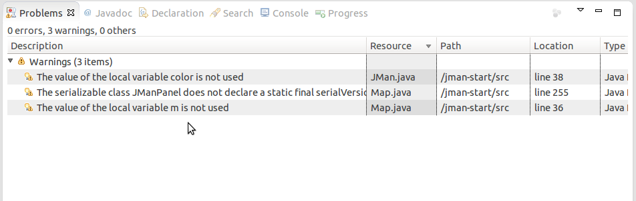
Treat Warnings Like Errors
Try to eliminate all the warnings in Eclipse or IntelliJ.
Eclipse: Close unrelated projects so you only see problems for this project.

