Slide 1
Try Checkstyle
Popular style checking tool for code.
Thai Pangsakulyanont's checkstyle rules for SKE:
Github
skeoop/oop2016/misc/ku-checkstyle.xml
1. Save on your computer.
2. Eclipse Window -> Preferences and choose Checkstyle.
3. Add ku-checkstyle rules file.
4. Select KU Checkstyle as the Default rule set.
For each project you want to check style, enable it in Project -> Properties.

Slide 2
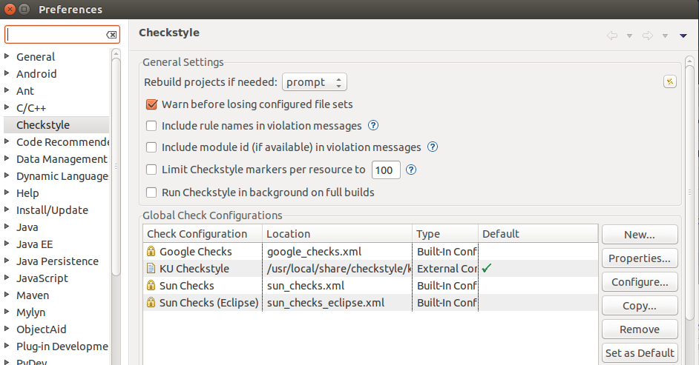
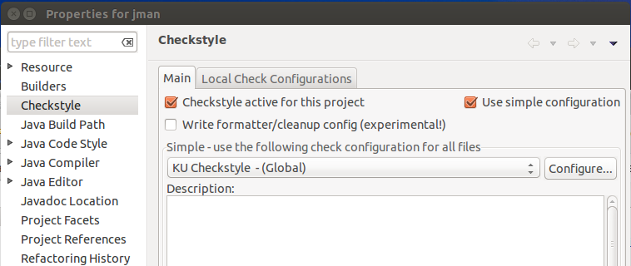
Eclipse Preferences
Project Properties

