Slide 1
Mathematical Functions
Operations on numeric data types,
esp. functions in the Math class.
James Brucker

Slide 2
Mathematical Functions
The Math class contains methods for common math functions.
They are static methods, meaning you can invoke them using the "Math" class name (more on "static" later).
// compute the square root of x
double x = 50.0;
double y = Math.sqrt( x );
This means: the sqrt( ) method in the Math class.
// raise x to the 5th power ( = x*x*x*x*x)
double x = 50.0;
double y = Math.pow( x , 5 );

Slide 3
Mathematical Functions
Common Math Functions
abs( x ) absolute value of x
cos( x ), sin( x ), tan( x ) cosine, sine, etc. x is in radians
acos( y ), asin( y ), atan( y ), ... inverse cosine, sine, etc.
toDegrees( radian ) convert radians to degrees
toRadians( degree ) convert degrees to radians
ceil( x ) ceiling: round up to nearest int
floor( x ) floor: round down to nearest int
round( x ) round to the nearest integer
exp( x ) exponential: y = e^{x}
log( y ) natural logarithm of y ( y = e^{x} )
pow(a, b) a^{b} (a to the power b)
max(a, b) max of a and b
min(a, b) min of a and b

Slide 4
Examples of Using Math Functions
Expression
Math.sqrt( 25.0 );
Math.sqrt( 25 );
Math.log( 100 );
Math.log10( 100.0 );
Math.sin( Math.PI/2 );
Math.cos( Math.PI/4 );
Math.abs( -2.5 );
Math.abs( 12 );
Math.max( 8, -14);
Math.min( 8L, -14L);
Math.max( 8.0F, 15);
Math.pow( 2, 10 );
Math.toRadians( 90 );
Math.E;
Math.PI;
Result Type of result
5.0 double
5.0 double
4.60517018 double
2.0 double
1.0 double
0.70710678 double
2.5 double
12 int
8 int
-14L long
15F float
1024.0 double
1.5707963 double
2.7182818... double
3.1415926... double

Slide 5
Overloaded Math Functions
Some methods in Math have multiple implementations for different parameter types.
abs(x) returns "int" if x is "int"; returns "long" if x is long; returns "float" if x is float; returns "double" if x is "double".
max(a,b) returns "int" if a and b are "int"; returns "long" if a and b are "long"; etc.
round(x) returns "float" if x is float; returns "double" if x is "double".
but...
sqrt(x) always promotes x to double and returns a double.
Most math functions are like this (sin, cos, tan, log, log10, ...).
overload: using the same name for functions that have different parameters.
Example: Math.abs( int ) has int parameter and returns an int result.
Math.abs( double ) has double parameter and returns a double

Slide 6
Overloaded Functions Example
Example Returns
Math.max( 2, 10 ) (int) 10
Math.max( -1L, -4L ) (long) -1L
Math.max( 2F, 10.0F ) (float) 10.0F
Math.max( -4.0, 0.5 ) (double) 0.5
What if the arguments are of different date types?
What should be the data type of the returned value?
Example Returns
Math.max( 2, 10.0F ) ?
Math.max(-1, -4L ) ?
Math.max( 3, 1.25 ) ?

Slide 7
Functions and Data Types
Java promotes one of the arguments until it finds a matching function prototype.
double
float
long
int
short,char
byte
Example Promotion Then Call
Math.max( 2, 10.0F ) 2 to 2.0F max(2F, 10F)
Math.max(-1, -4L ) -1 to -1L max(-1L, -4L)
Math.max( 3, 2.236 ) 3 to 3.0 max(3.0,2.236)
Automatic Conversions
When necessary, Java automatically "promotes" an argument to a higher data type according to the diagram. These widening conversions will never "overflow" the data type, but may result in lose of precision

Slide 8
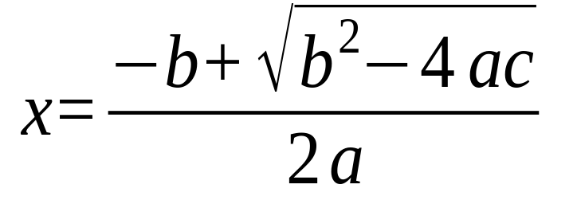
Analyzing an Expression
How would you write this in Java syntax?
Hint: use Math.sqrt( desc )
Your answer:
_____________________________________________

Slide 9
Analyzing an Expression
How would you write this in Java syntax?
In what order would Java evaluate this expression:
x = ( -b + Math.sqrt(b*b - 4*a*c) ) / ( 2 * a)

Slide 10
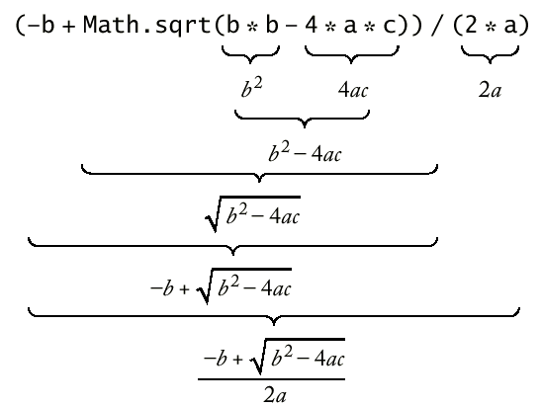
Analyzing an Expression

Slide 11
Converting Strings to Numbers
Many times we have a String containing a number. How can we convert it to a number?
Java has "wrapper classes" for primitive data types. These classes perform useful services.
Convert
To Method Example
String s = "1234", t = "0.52";
int Integer.parseInt( ) int n = Integer.parseInt(s);
long Long.parseLong( ) long m = Long.parseLong(s);
float Float.parseFloat( ) float x = Float.parseFloat(t);
double Double.parseDouble( ) y = Double.parseDouble(t);
Warning: if you apply these methods to a String that does not contain a valid number, Java will throw an Exception at run-time.

Slide 12
Converting Numbers to Strings
Java automatically converts numbers to strings when:
  used in print & println: System.out.println( x );
  concatenated to a String: String s = "x = " + x;
To create a String from a numeric value use toString :
Datatype to string form Example
int Integer.toString( ) Integer.toString( 500/12 );
long Long.toString( ) Long.toString( 2L );
float Float.toString( ) Float.toString( 1.0F/7.0F );
double Double.toString( ) Double.toString( Math.PI );
For more control over the appearance, use String.format( )

Slide 13
Efficient Computation
Here are a couple of common ways to improve your code. You should use them!
Example: find the distance from point (x1, y1) to (x2, y2)
double length = Math.hypot(x1-x2, y1-y2);
You should not use Math.sqrt( ) for this. Math.sqrt() can overflow or underflow.
Math.hypot does not overflow or underflow.

Slide 14
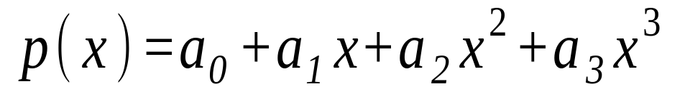
Efficient Computation
Example: evaluate the polynomial:
where the polynomial coefficients are a0, a1, a2, a3
double p = a0 + x*(a1 + x*(a2 + x*a3));
You should not use Math.pow(x,n) to compute powers of x.
The above formula is more efficient and more accurate.

Slide 15
Scientific Notation
1.0E8 means 1.0 x 10⁸
1.0E-9 means 1.0 x 10⁻⁹ or 0.000000001
final double AVAGADRO = 6.022E+23;
final double NANO = 1.0E-9;
Don't write Math.pow(10,-6) for this!
(waste of time, harder to read)

