Slide 1
Multi-dimensional Arrays
James Brucker

Slide 2
1-Dimensional Arrays
An array is a sequence of values of same type
In Java, array is an object and knows its own length
int[] p =
new int[5];
<reference>
int[]
length=5
2
4
6
8
10

Slide 3
2-Dimensional Arrays
A 2-dimensional array is an array of arrays
Example: array of 4 elements (rows),
each element is an array of 5 int.
int[]
length=5
1
2
3
4
5
int [][] m =
new int[4][5];
for(k=0;k<5;k++){
m[0][k] = k;
m[1][k] = 2*k;
}
int[][]
length=4
int[]
length=5
0
2
4
6
8

Slide 4
2-dimensional Array Syntax
1. Define a two-dimensional array reference:
int [][] score;
2. Create an array object with 4 "rows" of length 5 each:
score = new int[4][5];
1-2. Perform both steps at once:
int [][] score = new int[4][5];
3. Assign value to "row" j, element (column) k
score[j][k] = 999;

Slide 5
Example: student scores
score[j] = the scores for j-th student (an array)
/* score[j][k] = score of student j on lab k */
int NSTUDENT = 50; // we have 50 students
int NLAB = 10; // there are 10 labs
int [][] score = new int[NSTUDENT][NLAB];
/* read the lab scores */
for(int student=0; student< NSTUDENT; student++) {
for(int lab=0; lab < NLAB; lab++)
score[student][lab] = scanner.nextInt();
}

Slide 6
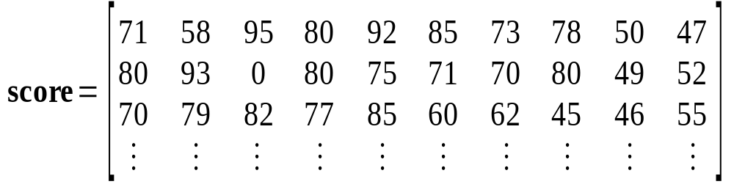
Visualize the Lab Scores
score[][3] = (column 3) scores for all students on lab 3.
score[2][] = Scores for student 2 (an array of int)
score[2][0] = 70, score[2][1] = 79, ...

Slide 7
2-D Array in Memory
score[0] --> score[0][1], score[0][2], ..., score[0][9]
score[1] --> score[1][1], score[1][2], ..., score[1][9]
score[2] --> score[2][1], score[2][2], ..., score[2][9]
score[2] is an array of int (int[10])
score is an "array of arrays"

Slide 8
Summing Lab Scores by Student
Sum the scores for student n:
int n = 8; // 9-th student (index starts at 0)
int sumScores = 0;
for(int lab=0; lab<NLAB; lab++)
sumScores = sumScores + score[n][lab];
Code Improvement: replace NLAB with the actual length of this student's scores.
int n = 8; // 9-th student (index starts at 0)
int sumScores = 0;
for(int lab=0; lab<__________________; lab++)
sumScores = sumScores + score[n][lab];

Slide 9
Average scores for one lab
Find the average score on lab 5:
int lab = 5;
int sum = 0;
for(int j=0; j<NSTUDENT; k++)
sum = sum + score[j][lab];
double average = ((double)sum) / NSTUDENT;
Code Improvement: use actual #students in score[][]
int lab = 5;
int sum = 0;
for(int j=0; j<__________________; k++)
sum = sum + score[j][lab];
double average = ((double)sum) / ______________;

Slide 10
Array length
Two-dimensional arrays have a .length
int [][] a = ...;
a.length is the number of rows in a
a[0].length is the length of row 0
a[1].length is the length of row 1
score.length is 50 (rows, or students)
score[0].length is 10

Slide 11
Exercise: use .length
How many students in the score 2-D array?
int[][] score = readAllScores( );
// all student scores
// How many students are in the array?
int numberOfStudents = score.__________ ;
How many lab scores does student n have?
int n = 8; // 9-th student
int sum = 0;
for(int lab=0; lab < ___________; lab++)
sum = sum + score[n][lab];

Slide 12
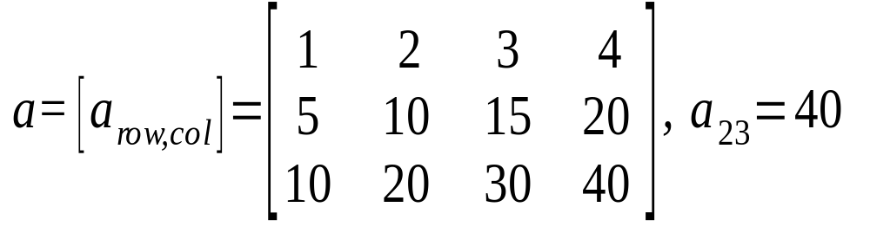
Array as Matrix
columns
rows
int [][] a = new int[3][4];
a[1][2] = 15;
a[0][3] = 4;
System.out.println( a.length ); // = 3
System.out.println( a[0].length ); // = 4

Slide 13
Common Array Usage
To process every element in an array, a common usage is two nested "for" loops like this:
/* sum all elements in the array */
int sum = 0;
for(int row=0; row < score.length; row++) {
for(int col=0; col < score[row].length; col++) {
/* process element a[row][col] */
sum = sum + score[row][col];
}
/* finished processing of this row */
}

Slide 14
Initializing a 2-D array
Example: set all elements to 1
Example: initialize b[row][col] = row+col
for(int j=0; j<a.length; j++) /* rows */
for(int k=0; k<a[j].length; k++) /* cols */
a[j][k] = 1;
for(int j=0; j<b.length; j++) { /* rows */
for(int k=0; k<b[j].length; k++) { /* cols */
// process element b[j][k]
b[j][k] = j + k;
}
}

Slide 15
2-D array as parameter or return
Method with 2D array as parameter:
Return a 2D array of double:
public int[] sumScore( int[][] scores ) {
public double[][] makeMatrix( int size ){
double[][] theMatrix = new double[size][size];
// put some values in theMatrix
. . .
return theMatrix;
}

Slide 16
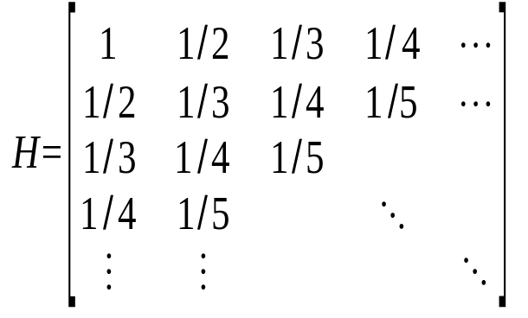
The Hadamand Matrix
//TODO Write a method that returns a
// Hadamand matrix of any size >= 1.
public _________ makeHadamand( int size)

Slide 17
The Hadamand Method
public double[][] makeHadamand(int size) {
double[][] matrix = new double[size][size];
for(int k=0; k<size; k++) {
// be lazy -- its symmetric
for(int j=0; j<=k; j++) {
matrix[j][k] = matrix[k][j] = 1.0/(1+j+k);
}
}
return matrix;
}

Slide 18
The Truth about 2-D Arrays
Java doesn't have 2-dimensional array!

Slide 19
2-D array is an array of 1-D arrays
2-D array in Java is really an array of arrays.
Each row of the array is an array reference.
final int N = 10;
double [][] a;
a = new double[N][ ]; // create rows (an array)
for(int k=0; k<N; k++)
a[k] = new double[k+1]; // create columns
a[0] =
a[0] is an array: = new double [1]
a[1] =
a[1] is an array: = new double [2]
a[2] =
a[2] is an array: = new double [3]
a[3] =
a[2] is an array: = new double [1]

Slide 20
Ragged Array Example
We record the rainfall month for the days when it rains.
How would you read this data into a 2-D array?
How would you compute the total rainfall each month?
Rainfall data
jan 5 1.5 2.3 0.5 2.0 0.1
feb 4 1.1 0.3 0.3 1.0
mar 3 1.0 1.3 0.3
apr 0
may 0
jun 0
jun 0
jul 1 1.5
aug 4 0.8 1.2 1.8 0.9
sep 10 2.4 1.8 3.0 2.0 1.5 2.0 1.8 3.2 1.1 0.9
No rain

Slide 21
Output from Rainfall Problem
Month Total Rain Number of Rain days
Jan 6.4 5
Feb 2.7 4
Mar ... ...

Slide 22
Algorithm for Rainfall Problem
Open file of rainfall data
Create arrays to hold names of rows and rainfall data
month [] = row names
rain[][] = rain each day of each month
more data?
read month[k]
read number of data points this month.

Slide 23
Examples of 2-D Arrays
Some extra examples. OK to skip these slides.

Slide 24
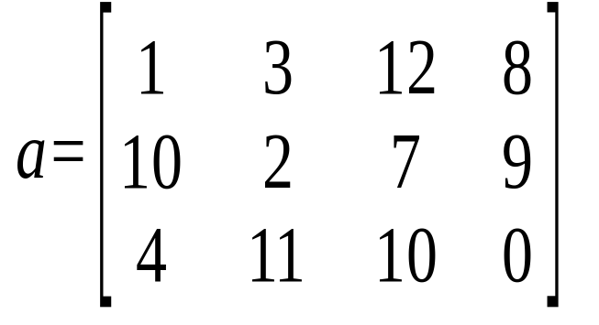
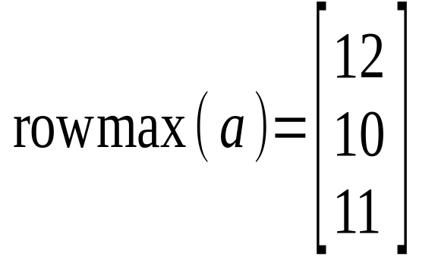
rowmax: find the max in each row
rowmax( int[][] a) returns the max value from each row
in each row, find the maximum element like this:
/* find the largest value in this row */
max = a[row][0];
for(int col=1; col < a[row].length; col++)
if ( a[row][col] > max ) max = a[row][col];
/* done processing this row. save max value. */
rowmax[ row ] = max;

Slide 25
rowmax: find the max of each row (2)
rowmax returns an array: one element for each row of a
public static int [] rowmax( int [][] a ) {
int max;
int rows = a.length;
int [] rowmax = new int[ rows ];
for(int row = 0; row < rows; row++) {
/* find the largest value in this row */
max = a[row][0];
for(int col=1; col < a[row].length; col++)
if ( a[row][col] > max ) max = a[row][col];
/* record the max value for this row. */
rowmax[ row ] = max;
}
return rowmax;
}

Slide 26
Pascal's Triangle
Pascal's Triangle is a pyramid of binomial coefficients.
Each element is the sum of 2 elements above it.
1
1 1
1 2 1
1 3 3 1
1 4 6 4 1
1 5 10 10 5 1
Pascal's triangle can be applied to combinatorial problems. It can also be used in algebra:

Slide 27
Pascal's Triangle (2)
Implement Pascal's Triangle as a 2-D array of size n.
1. Create a 2-D array with n rows:
2. Create each row (say, row number row)
3. Compute elements using Pascal's rule
int [][] p = new int[n];
p[row] = new int[row+1];
p[row][0] = p[row][row] = 1;
p[row][k] = p[row-1][k] + p[row-1][k-1];

Slide 28
Pascal's Triangle (3)
Implement Pascal's Triangle as a 2-D array.
/** generate Pascal's triangle of size n rows */
int [][] Pascal( int n ) {
// create array for row references
int [][] p = new int[n];
// create row = 0, 1, ..., n-1 of triangle
for(int row=0; k < n; k++) {
p[row] = new int[row+1];
p[row][0] = 1;
for(int k=1; k<p[row]; k++)
p[row][k] = c[row-1][k] + p[row-1][k-1];
p[row][row] = 1;
}
return p; // return reference to 2-D array
}

Slide 29
Vector-Matrix Multiplication
How would you multiply a 2-dimensional array a by a 1-dimensional array x?
/* return a vector that is the product of a*x (matrix * vector) */
public static double [] multiply( double[][] a, double [] x) {
int nrows = a.length;
int ncols = x.length;
double [ ] y = new double[ nrows ];
for(int i = 0; i < nrows; i++ ) {
double sum = 0.0;
for(int j = 0; j < ncols; j++)
sum += a[i][j]*x[j];
y[i] = sum;
}
return y;
}

Slide 30
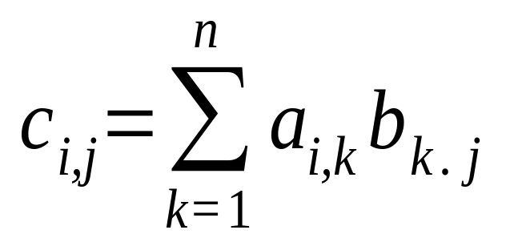
Array Multiplication
Let
A = [ a_{i j} ] = array of size m x n
B = [ b_{i j} ] = array of size n x p
What is C = A * B ?
What are the dimensions of C? m x p
Formula for computing C = [ c_{i j} ]

Slide 31
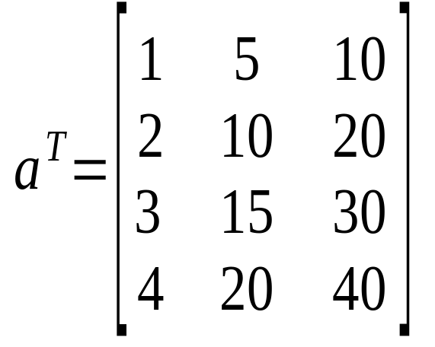
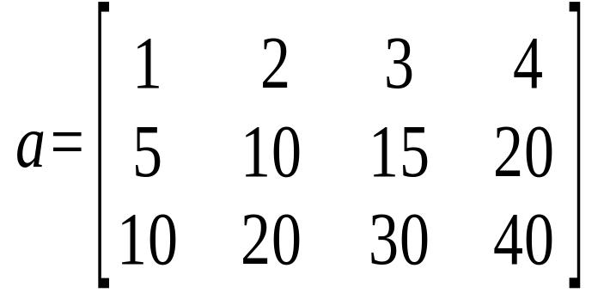
Transpose an Array
A common task to to switch the rows and columns of an array.
transpose
If a is a 3 x 4 array,
then b = transpose(a) is a 4 x 3 array,
such that b[j][k] = a[k][j] for all j, k.

Slide 32
Transpose an Array (2)
A transpose method must return a new array.
int[][]: the return value is a 2-D array of int
int[][] a: this parameter is a 2-D array of int
public static int [][] transpose( int [][] a ) {
int rows = a.length;
int cols = a[0].length;
int [][] atrans = new int[cols][rols];
.
.
.
.
return atrans;
}
new array for the transpose of a
return a reference to an int[][] array.

Slide 33
Transpose an Array (3)
Inside the method we use the standard pattern:
for(int row=0; row < number_of_rows; row++)
for(int col=0; col < number_of_cols; col++)
process element a[row][col]
public static int [][] transpose( int [][] a ) {
int rows = a.length;
int cols = a[0].length;
int [][] atrans = new int[cols][rols];
for(int row = 0; row < rows; row++) {
for(int col=0; col < cols; col++)
atrans[col][row] = a[row][col];
}
return atrans;
}
return a reference to the new array.

Slide 34
Example: Contamination
An environmental engineer is assessing the levels of contaminant in the soil at a polluted site. The contaminated area has been divided into a grid and the level of contaminant (C) has been measured in each rectangle in the grid.
This data can be stored as a 2D array and analysed
grid of sample locations
contaminated site

Slide 35
Contamination Example (2)
A student collects the data and enters it in an array...
double [][] c = {
{ 0.002, 0.005, 0.004, 0.007, 0.006 },
{ 0.003, 0.001, 0.008, 0.009, 0.010 },
{ 0.002, 0.003, 0.006, 0.009, 0.008 },
{ 0.001, 0.002, 0.005, 0.008, 0.007 },
{ 0.001, 0.002, 0.004, 0.005, 0.003 },
{ 0.002, 0.001, 0.004, 0.003, 0.002 } };
Q: What are the dimensions of the C array?
Q: Why do we have nested parenthesis?
double [][] c = { { a, b, c}, { d, e, f}, ... { m, n, o} } ;

Slide 36
Contamination Example (2)'
You can also initialize each row separately...
double [][] c = new double[6][]; // 6 rows
c[0] = { 0.002, 0.005, 0.004, 0.007, 0.006 };
c[1] = { 0.003, 0.001, 0.008, 0.009, 0.010 };
c[2] = { 0.002, 0.003, 0.006, 0.009, 0.008 };
c[3] = { 0.001, 0.002, 0.005, 0.008, 0.007 };
c[4] = { 0.001, 0.002, 0.004, 0.005, 0.003 };
c[5] = { 0.002, 0.001, 0.004, 0.003, 0.002 };
This method works even if the rows are different sizes.

Slide 37
Contamination Example (3)
We have another array of data with the soil depth (in cm) in each grid cell (depth of soil down to bedrock).
double [][] depth = { // dept in centimeters
{ 285, 310, 320, 315, 300 },
{ 275, 305, 310, 320, 295 },
{ 270, 300, 300, 310, 280 },
{ 260, 290, 280 ,270, 255 },
{ 255, 285, 270, 265, 250 },
{ 250, 280, 265, 260, 240 } };
What is the depth of this cell?

Slide 38
Contamination Example (4)
The size of each cell is 2 meter by 2 meter.
So the area of each cell is 4 m² = 40,000 cm².
the formula for calculating from concentration (c) is:
the volume of one cell is 40,000 * depth.
the mass of pollutant in cell [j][k] is:
mass in cell [j][k] = c[j][j] * volume
= c[j][k]* ( 40000 * depth[j][k] );
we need to sum this over all cells in the grid.
mass = concentration * volume ;

Slide 39
Contamination Example (5)
Use nested for loops to sum the pollution over all grid cells...
double [][] c = { /* concentration data */ };
double [][] depth = { /* grid depth data */ };
double area = 40000; // surface area per cell
double sum = 0.0;
for (int row=0; row < c.length; row++) {
for (int col=0; col < c[row].length; col++)
sum += c[row][col] * area * depth[row][col];
}
// sum = total mass of pollutant

Slide 40
Building Materials
A company makes 3 grades of cement. Each grade uses a different proportion of 4 raw materials.
Input: the number of tons (1000 kg) of each product that will be produced.
Output: how many tons of filler, binder, hardener, and sealant are needed?
Filler Binder Hardener Sealant
Product 1 0.80 0.18 0.02 0.00
Product 2 0.74 0.20 0.02 0.04
Product 3 0.64 0.22 0.04 0.10

Slide 41
Building Materials (2)
Let amount of each product to produce be:
prod[1] = tons of Product 1
prod[2] = tons of Product 2
prod[3] = tons of Product 3
Output: tons of filler, binder, hardener, and sealant
filler = 0.80*prod[1] +0.74*prod[2] +0.64*prod[3]
binder = 0.18*prod[1] +0.20*prod[2] +0.22*prod[3]
harden = 0.02*prod[1] +0.02*prod[2] +0.04*prod[3]
Filler Binder Hardener Sealant
Product 1 0.80 0.18 0.02 0.00
Product 2 0.74 0.20 0.02 0.04
Product 3 0.64 0.22 0.04 0.10

Slide 42
Building Materials (3)
/** Compute the amount of raw materials needed to
* produce a given quantity of 3 products.
* @param product is an array of quantities of
* the 3 products.
* @return amount of raw materials needed.
*/
public double [] materials( double [] product ) {
// mat = matrix of raw material per unit prod
// mat[k] = { filler, binder, harden, sealant}
// for product k.
double [][] mat = { {0.80, 0.18, 0.02, 0.0 },
{0.74, 0.20, 0.02, 0.04 },
{0.64, 0.22, 0.04, 0.10 } };

Slide 43
Building Materials (4)
double [][] mat = { {0.80, 0.18, 0.02, 0.0 },
{0.74, 0.20, 0.02, 0.04 },
{0.64, 0.22, 0.04, 0.10 } };
// how many raw materials are there?
int materials = mat[0].length;
// define an array for returned values
double [] quantity = new double[ materials ];
// compute the quantity of each
// raw material: sum over all products
for(int m= 0; m < materials; m++) {
double sum = 0;
for(int k= 0; k < product.length; k++)
sum = sum + product[k]*mat[k][m];
quantity[m] = sum;
}

