Slide 1
JOptionPane Dialogs
javax.swing.JOptionPane
A useful class for creating dialog boxes.
Has both static methods and instance methods for dialogs.
Easy to create 4 Common Dialog Types:
  Message Dialog - display a message
  Confirm Dialog - Yes, No, or Cancel dialog
  Choice Dialog - click a button to make choice
  Input Dialog - request input, return a string

Slide 2
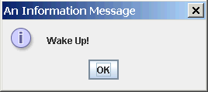
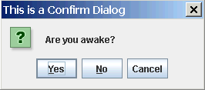
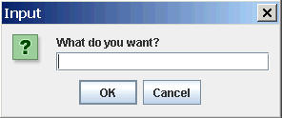
Dialog Examples
JOptionPane is a class for showing dialog boxes.
It can display dialogs like these:
showMessageDialog(...)
showConfirmDialog(...)
reply = showInputDialog(...)

Slide 3
Message Dialog
// basic message dialog
JOptionPane.showMessageDialog( null,
"Wake Up!");
// message dialog with a title and message type.
JOptionPane.showMessageDialog( null, "Wake Up!", "An Information Message",
JOptionPane.INFORMATION_MESSAGE );
Syntax:
static void showMessageDialog( Component parent, Object message )
static void showMessageDialog( Component parent ,
Object message ,
String title_line ,
int messageType )
messageType is one of: INFORMATION_MESSAGE,
QUESTION_MESSAGE, WARNING_MESSAGE, ERROR_MESSAGE

Slide 4
Modal or Non-Modal Dialog?
Graphics frameworks support 2 ways of using dialogs:
Modal Dialog - user must close the dialog (click OK, Cancel, etc) before he can work in the parent window. Example: "Open file" dialog.
Non-modal Dialog - user can go back and work in the parent window while the dialog is still open.
JOptionPane.showMessageDialog( parent, "Wake Up!" );
First parameter is a reference to parent window.
if parent == null, it displays a non-modal dialog.
if parent != null, it displays a modal dialog

Slide 5
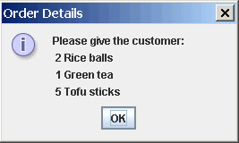
Multi-line Message Dialog
String message = "Please give the customer:\n"
+ "2 Rice balls\n"
+ "1 Green tea\n"
+ "5 Tofu sticks");
JOptionPane.showMessageDialog( null,
message, "Order Details",
JOptionPane.INFORMATION_MESSAGE );
Use correct singular / plural
Avoid errors like this:
You have 1 new messages

Slide 6
Confirm Dialog
int choice;
choice = JOptionPane.showConfirmDialog( null,
"Are you awake?",
"This is a Confirm Dialog",
JOptionPane.YES_NO_CANCEL_OPTION );
if ( choice == JOptionPane.NO_OPTION )
JOptionPane.showMessageDialog( null, "Liar!" );
Syntax:
static int showConfirmDialog(
Component parent,
Object message ,
String title_line,
int optionType )
optionType is: YES_NO_OPTION or YES_NO_CANCEL_OPTION
return value is: YES_OPTION, NO_OPTION, or CANCEL_OPTION

Slide 7
Input Dialog
String reply;
reply = JOptionPane.showInputDialog( null,
"What do you want?",
"This is an Input Dialog",
JOptionPane.QUESTION_MESSAGE );
if ( reply == null ) /* user pressed CANCEL */ ;
else doSomething( reply );
Syntax:
static String showInputDialog(
Component parent,
Object message,
String title_line,
int messageType )
return value is null if "Cancel" pressed; else string typed in textbox.

Slide 8
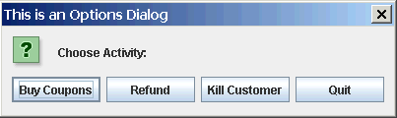
Option Dialog
String [] choices = { "Buy Coupons",
"Refund", "Kill Customer", "Quit"};
int reply =
JOptionPane.showOptionDialog(
null, // parent
"Choose Action:", // message
"This is an Options Dialog", // title string
JOptionPane.YES_NO_OPTION, // useless
JOptionPane.QUESTION_MESSAGE, // msg type
null, // no icon
choices, // array of choices
choices[0] // default choice
);
switch( reply ) {
case 0: couponDialog( ) ; break;
case 1: refundDialog( ) ; break;
case 2: killCustomer( ) ; break;
default: confirmQuit( ) ;
}

Slide 9
JOptionPane Usage
These 4 dialogs are static methods: you don't need to create an instance of JOptionPane.
JOptionPane also has instance methods for more control over dialogs. See the Java API.
JOptionPane is in javax.swing:
import javax.swing.JOptionPane;
or:
import javax.swing.*;

Slide 10
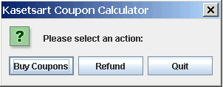
KU Coupons Design using Dialogs
Draw a UML state chart diagram.
Start
Input wait state (display choice dialog)
"Buy" action
"Quit" action
"Refund" action
Buy Coupons dialog
Confirm quit
dialog
Refund dialog
OK
cancel
cancel
OK
cancel
OK
error
make coupons, show result
compute refund, show result
error
Exit
OK
OK

Slide 11
Bad Input Dialog
String red = JOptionPane.showInputDialog( null,
"How many red?",
"Red Dialog",
JOptionPane.QUESTION_MESSAGE );
String blue = JOptionPane.showInputDialog( null,
"How many blue?",
"Blue Dialog",
JOptionPane.QUESTION_MESSAGE );
String green = JOptionPane.showInputDialog( null,
"How many green?",
"Green Dialog",
JOptionPane.QUESTION_MESSAGE );
// now parse the Strings
Too many dialogs!
No feedback from previous dialog (how many red and blue did he enter?).

Slide 12
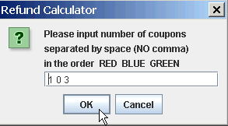
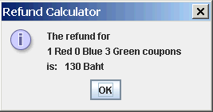
Better Input Dialog
Display input data for verification and feedback.

Slide 13
Hints
How to convert a String containing a number like "123" to a number?
Use results of Homework 2, or use Scanner.
How to process a String containing several numbers, such as "12 25 7.5 4"?
Look at the API for the "Scanner" class.
There is a constructor that accepts a String argument
Scanner( String source );
String reply = /* string containing numbers */ ;
Scanner scan = new Scanner( reply );
/* now use Scanner methods to read the values */

Slide 14
Crashable Input Method: Java 1.5
private void refundDialog( ) {
String coupons = JOptionPane.showInputDialog( null,
"Please input number of RED BLUE GREEN coupons",
"Refund Calculator",
JOptionPane.QUESTION_MESSAGE );
Scanner scan = new Scanner( coupons );
// if user presses CANCEL this will crash!
int red = scan.nextInt( ); // crash! if no nextInt
int blue = scan.nextInt( ); // crash! if no nextInt
int green = scan.nextInt( ); // crash! if no nextInt
// what if user inputs TOO MUCH data?

Slide 15
Writing a Crash-proof Method
private void refundDialog( ) {
String coupons = JOptionPane.showInputDialog( null,
"Please input number of RED BLUE GREEN coupons",
"Refund Calculator",
JOptionPane.QUESTION_MESSAGE );
if ( coupons == null ) return; // dialog cancelled
Scanner scan = new Scanner( coupons );
boolean inputOK = true;
// test before reading
if ( scan.hasNextInt() ) red = scan.nextInt( );
else inputOK = false;
... // get blue and green
// test for too much data
inputOK = inputOK && ( ! scan.hasNext() );
if ( inputOK ) { /* compute refund */ }
else { /* display error message */ }

Slide 16
Java 1.4 Crashable Input Method
private void ancientRefundDialog( ) {
String coupons = JOptionPane.showInputDialog( null,
"Please input number of RED BLUE GREEN coupons",
"Refund Calculator",
JOptionPane.QUESTION_MESSAGE );
String [] words = coupons.split("\\s+");
// if user presses CANCEL this will crash!
int red = Integer.parseInt(words[0]); // can crash!
int blue = Integer.parseInt(words[1]); // can crash!
int green = Integer.parseInt(words[2]); // can crash!
// what if user inputs TOO MUCH data?

Slide 17
Java 1.4 Crash-proof Method
private void ancientRefundDialog( ) {
String coupons = JOptionPane.showInputDialog( null,
"Please input number of RED GREEN BLUE coupons",
"Refund Calculator",
JOptionPane.QUESTION_MESSAGE );
if ( coupons == null ) return; // dialog cancelled
String [] words = coupons.split("\\s+");
if ( words.length != 3 ) { /* wrong amount of data */}
try {
red = Integer.parseInt( words[0] );
blue = Integer.parseInt( words[1] );
green = Integer.parseInt( words[2] );
} catch ( NumberFormatException e ) {
/* display error message */
)
Error to declare these variables inside "try" block.

Slide 18
Making Your Program Crash-proof
Don't assume input exists or is of expected type.
Ask someone else to test your program!
Tester should be malicious.

