Slide 1
Sequence and Interaction Diagrams
James Brucker

Slide 2
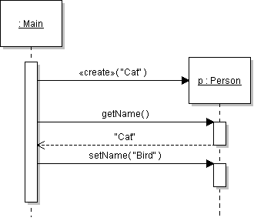
Sequence Diagrams
objectName : Class
run()
Time
Activation bar: when method is active.
Lifeline

Slide 3
What goes in the Box?
Boxes represent objects.
Text is box is: name : ClassName
Object name or ClassName may be empty (blank).
Show the object reference name (p1) if it is used elsewhere in the diagram.
p1 : Person
:Person
p1 :

Slide 4
Found Message and Creation
objectName : Class
run()
Time
Activation bar: when method is active.
class Main {
void run( ) {
Person p = new Person("Cat");
String s = p.getName( );
p.setName( "Bird" );
Lifeline

Slide 5
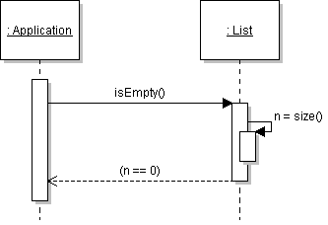
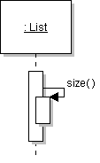
Self-call
one method calls another method of the same object
Other way to show return value.

Slide 6
Synchronous & Asynchronous Calls

Slide 7
Sequence Diagrams (contd)
Other kinds of method calls:
Self-call: method calls another method in same object
  An object sends a message to itself
Call-back: A calls B, then B calls A.
  Not the same as "return"!

Slide 8
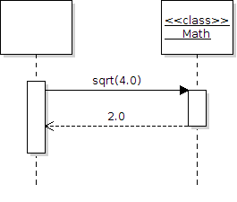
Static Method Call
Use a separate box with stereotype <<class>>.
Larman says to write <<meta>> instead.

Slide 9
Interaction Diagrams: Flat Sequences
message
1 : liftHandset()
c : Caller
: Telephone
sequence number,
flat flow of control
2 : assertCall()
: Exchange
anonymous object

Slide 10
Procedural Sequences
: View
2 : clickAt(p)
2.2 : putRecentPick(I)
c : Controller
: Cache
sequence number,
nested flow of control
2.1 : I=findAt(p)

Slide 11
An Interaction Diagram
2 : addStudent()
r : RegistrarAgent
: School
1 : create()
3.1 : getSchedule()
3 : register()
s : Student
registered=False
s : Student
registered=True
3.4 : become()
3.2 : add(s)
3.3 : add(s)
c1 : Course
c2 : Course

