Slide 1
Introduction to Java
James Brucker

Slide 2

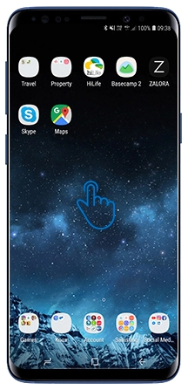
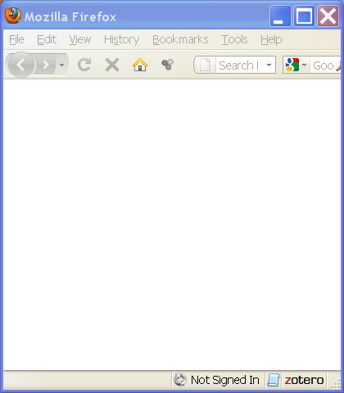

What is Java?
Java is a language for writing computer programs.
it runs on almost any "computer".
  desktop
  mobile phones
  game box
  web server & web apps
  smart devices

Slide 3
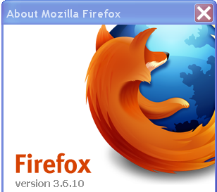



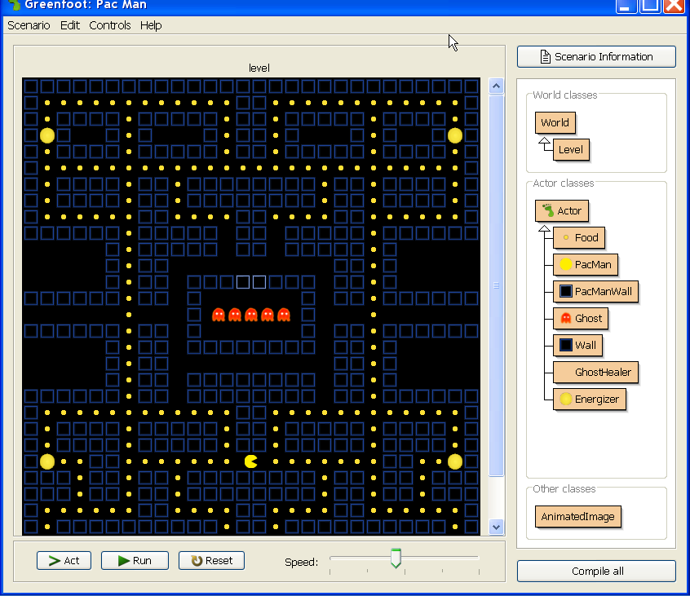
What Uses Java?
OpenOffice & LibreOffice (like Microsoft Office)
Firefox
Google App Engine
Android
MindCraft & Greenfoot
IDE: Eclipse, IntelliJ, NetBeans

Slide 4
How Java Works: Compiling
1. You (programmer) write source code in Java.
2. A compiler (javac) checks the code and translates it into "byte code" for a "virtual machine".
Java source code
Java
byte code
Hello.java
javac
Hello.class
compiler
public class Hello {
public static void main( String [ ] args ) {
System.out.println( "I LOVE programming" );
}
}
public Hello();
aload_0
invokespecial #1; //Method java/lang/Object."<init>":()V
return
main(java.lang.String[]);
getstatic #2; //Field ...

Slide 5
How Java Works: Run the Bytecode
3. Run the byte code in a Java Virtual Machine (JVM).
4. The JVM (java command) interprets the byte code
and loads other code from libraries as needed.
Java byte code
java
I LOVE programming
Hello.class
java virtual machine
public Hello();
aload_0
invokespecial #1; //Method java/lang/Object."<init>":()V
return
main(java.lang.String[]);
getstatic #2; //Field ...
Other java classes, saved in libraries.

Slide 6
Summary: How Java Works
You (programmer) write program source code in Java.
Java compiler checks the code and translates it into "byte code".
A Java virtual machine (JVM) runs the byte code.
Libraries
Hello, World!
Hello.java
javac
Hello.class
java
Java source program
compiler
byte code
JVM:
- load byte code
- verify the code
- runs byte code
- enforce security model
Program execution

Slide 7
How to Write Source Code?
You can use any editor to write the Java source code.
For your first program, use a text editor (e.g. Notepad).
Later you will use an Integrated Development Environment (IDE) such as Eclipse, IntelliJ, Netbeans,
or VS Code. Or a beginner's IDE: BlueJ.
An IDE makes you much more productive, but you need some practice... so for now, use a text editor.

Slide 8
How to Get Java
To do these examples you must install the Java Development Kit (JDK).
Useful to also install the Java documentation (Javadoc).
Implementations of Java
Oracle Java: java.oracle.com
OpenJDK: AdoptOpenJdk.net
Stick with LTS versions: Java 8 & Java 11

Slide 9
Install Java Development Kit (JDK)
Your Choice:
1. Oracle Java
https://www.oracle.com/technetwork/java/javase/downloads/
2. OpenJDK Java (with choice of JVM)
https://adoptopenjdk.net/
3. (if you use BlueJ) JDK included with BlueJ for Windows and MacOS https://bluej.org

Slide 10
Installation Notes
There are some suggestions at the end of these slides
You can also find videos on YouTube for help installing Java and writing your first program.

Slide 11
Check your Java Installation
1. Open a command line window or "terminal" (Mac). This is where you will enter commands.
2. Enter "java -version" and "javac -version"
C:>
C:> java -version
java version "11.0.5" 2019-10-15 LTS
If it prints "command not found", then the Java "bin" directory is not on your terminal's "search path",
specified by the PATH environment variable.

Slide 12
What Are We Going to Write?
First version: a program to print
Hello, human.
Second version: program will ask for your name, save it as a String, and print a personal greeting. Example:
What is your name? Cat
Hello, Cat.
Third version: we will get the current time and use it to print a time-aware greeting. We will also write a method for this.
Good morning, Cat. (before 12:00)
Good afternoon, Cat. (after 12:00)

Slide 13
Write this Program
1. Use a text editor (WordPad, EditPlus, not MS Word).
2. Save the file as Hello.java
Name of the class must be same as name of file
public class Hello {
public static void main( String[ ] args ) {
System.out.println( "Hello, human" );
}
}

Slide 14
Compile and Run the Program
3. Compile the program using "javac". This translates the source code into byte code.
4. Run it. "java" runs the virtual machine.
C:> javac Hello.java
C:> java Hello
Hello, human.

Slide 15
Errors?
javac: Command not found.
This means Java isn't on your PATH environment variable. Fix it. :-)
Hello.java:1:public Class Hello {
^ class, interface, or enum expected
Message like this are syntax errors.
Check your typing. Java is case-sensitive. In particular, the main method must be "main", not "Main".
In this example, the source code contains "Class" instead of "class".

Slide 16
2nd Version: read some input
In this version we'll see how to read input and use a local variable.
The easiest way to read input in Java is with a Scanner object. A Scanner parses input into strings, numbers, etc
To create a Scanner object for reading the console use:
import tells the compiler where to find the Scanner class
import java.util.Scanner;
public class Hello {
private static Scanner console =
new Scanner( System.in );
this declares a variable of type Scanner. "static" means the variable belongs to this class.
System.in is a predefined variable for byte-by-byte input from the default input

Slide 17
2nd Version: main method
Scanner has a method named nextLine( ) that reads the rest of the input line and converts it to a String.
System.out.print("string") does not print a newline after the output.
public static void main(String [] args) {
System.out.print("What is your name? ");
String who = console.nextLine( );
System.out.println("Hello, " + who );
}
}
+ joins two strings together.

Slide 18
dot notation for object methods
console is the name of a variable (an object reference) that refers to a Scanner object.
To invoke an object's method, you write the object reference (variable) + "." + the method name:
Strings are also objects and have methods. To get the length of a String use:
String who = console.nextLine( );
nextLine method of console object
int n = "hello world".length( );

Slide 19
Compile and Run 2nd Version
Compile (javac) and run (java) the 2nd version:
C:> javac Hello.java
C:> java Hello
What is your name? Nerd
Hello, Nerd.

Slide 20
3nd Version: decisions
Most programs contain logic for decision making.
We'll write a program that greets and show the time.
The logic is:
get the current time
if now is before 12:00
print "Good Morning, " + user's name
else if now is before 18:00 then
print "Good Afternoon, " + user's name
else print "Good Evening, " + user's name
print "It is now hh:mm:ss" (say the actual time)

Slide 21
Creating a Date Object
Java has a Date class (also located in java.util package).
Date has lots of methods. getHours( ) returns the hour.
To create a Date object with the current date and time, use:
Date now = new Date( );
To create an object from a class, write:
new ClassName( );
Some classes allow parameters when creating a new object, for example:
new Double( 0.5 ); // double with value 0.5

Slide 22
3rd version: using a method
import java.util.Date;
import java.util.Scanner;
/** Greeting with time of day. */
public class Hello {
private static Scanner console = ...;
public static void main( String[] args ) {
// ask user his name and call greet
System.out.print("What is your name? ");
String who = console.nextLine( );
greet( who );
}
}
we will add greet method here

Slide 23
3rd version: greet method
This declares a method named greet that doesn't return any value (void) and has one parameter (name)
public static void greet( String name ) {
Date now = new Date( );
if ( now.getHours() < 12 )
Sytem.out.println("Good morning, "+name);
else
System.out.println("Good afternoon, "+name);
System.out.println("The time is "+now);
}

Slide 24
Compile and Run
Compile (javac) and run (java) the 3rd Hello program.
You will notice that it prints the date and time. If you want to print only the time, such as 12:45:00, use this:
System.out.printf("The time is now %tT\n", now );
printf creates formatted output. The first string is the format (including text to print). %tT is a format code to output a time value (using the next argument). You'll study formatted output later in the course.
It is similar to printf in the C language.

Slide 25
That's It!
This program was a quick overview of how to program in Java.
After this, we'll write code in BlueJ. BlueJ makes it much easier to edit, compile, and run your code.
In BlueJ, you can also run Java commands interactively, without creating a program.

Slide 26
What do you need to use Java?
Programmer needs:
  Java compiler (javac)
  the Java foundation classes (included with JDK)
  documentation called "Java API" which can be viewed in a web browser
User who runs a program needs:
  Java Virtual Machine (JVM): java command
  foundation classes used by the JVM
  This is the "Java Runtime Envionment" (JRE)

Slide 27
Where Are the Classes?
The Java Runtime (also included in JDK) has thousands of classes.
Where are they?
Where is the Java compiler (javac)?

Slide 28
Know Your Tools
Craftman, Farmers, Engineers, Scientists, ...
Know Their Tools

Slide 29
Layout of the JDK
C:/java /jdk1.8.0_231 /bin /demo /include /jre /lib /sample src.zip | Location for java (your choice) JDK 8u231 programs ("binaries") demo apps with source interface to C language code Java Runtime for JDK libraries used by JDK samples with source source code for JRE classes

Slide 30
Executable are in /bin
C:/java /jdk1.8.0_231 /bin java javac javadoc javaw jar jvisualvm | Java Virtual Machine (JVM) compiler create Javadoc (HTML) JVM for GUI applications manage Java Archive (jar) files monitor the Java VM

Slide 31
Demo applications
C:/java /jdk1.8.0_231 /demo /jfc/ /applets/ /plugins/ /netbeans/ | "Demo" is optional. You might not have it. Demos for Java core classes Java applets (run in browser) Java plugins jfc and applets as Netbeans projects

Slide 32
Java 11 JDK (new layout)
C:/java /jdk11.0.5 /bin /conf /include /jmods /lib /legal release | Location for java (your choice) JDK 11u05 programs ("binaries") configuration files (.properties) interface to C language code Java module system libraries used by JDK legal notices for lawyers version no. & release info

Slide 33
Java Archive (JAR)
A JAR file (*.jar) is a ZIP file with special directory structure.
* Used to contain Java class files.
* May also contain other kinds of files (images).
* You can run JAR files! - if they designate a "main" class

Slide 34
Organize Your Software
You may have many JDK and JRE.
Organize them so you can find them.
C:/java /jdk1.8.0_231 /docs /jdk11u05 /docs /tutorial /... | Location for java (your choice) JDK 8 update 231 Documentation for JDK 8 JDK 11 update 5 Javadoc for JDK 11 Java tutorials More Java tools and libraries

Slide 35
Java on your PATH
JAVA_HOME=C:\java\jdk1.8.0_231
PATH=...;%JAVA_HOME%\bin;...
Java should be on your search PATH in order to be able to use Java at the command prompt.
May also affect double-click on executable JAR files.

Slide 36
Can't find javac or java ?
C:> javac -version
"javac" not found.
If "Not Found" then add Java's "bin" dir to your PATH.
1) Right-click "My Computer" → choose "Properties"
2) Select "Advanced" tab
3) Click "Environment Variables"
4) Select PATH and click "Edit"
5) Add this to PATH:
...;C:\java\jdk1.6.0_26\bin
MS Windows

Slide 37
Env Variables used by Java
These are not required, but used by many Java tools to find Java. On Windows they are usually set by the setup program, but you might want to check it.
How? open a cmd window and type "set" or "env".
JAVA_HOME=C:\java\jdk1.8.0_231
JRE_HOME=C:\java\jdk1.8.0_231\jre
CLASSPATH is another variable used by Java.
CLASSPATH tells Java where to look for class and jar files.

