Slide 1
Pull Requests
Why Use Them?

Slide 2
What is a Pull Request?

Slide 3
When and Why to Use PR
Propose a change - bug fix, improvement
Request help or feedback on your work
Request review and discussion of your work
  do this before merging branch into master
Unit & Integration Tests?
Case 3 should have new unit tests! And maybe integration (functional) tests.

Slide 4
What Happens after a Pull Request?
"Interested parties" (the core dev team):
1. Review the changes
2. Test the changes
3. Discuss the value and potential impact
4. Suggest modifications
In Github Flow,
5. Approve changes for merge into master, or give reasons why not.

Slide 5
References
About Pull Requests - Github
https://help.github.com/articles/about-pull-requests/
Commenting on a Pull Request (howto & examples)
https://help.github.com/en/articles/commenting-on-a-pull-request
Pull Request Tutorial - what buttons to press. Discusses squashing commits before a pull request.
https://yangsu.github.io/pull-request-tutorial/

Slide 6
Pyup
Radii has 82 closed pull requests.
40 are by pyup-bot See https://pyup.io
What does pyup-bot do?

Slide 7
pyup.io - Security Updates
Please look at Pyup's nicely formatted docs page.
(https://pyup.io/docs/)
Try to write documentation like this!
1. Add to repo as an online service.
* Must grant pyup.io OAuth access to the repository
* Can automatically update project dependencies
== or ==
2. Run the Safety Service on CI server.
pip install safety (installs several packages. use venv)
safety check [ -r requirements.txt ]

Slide 8
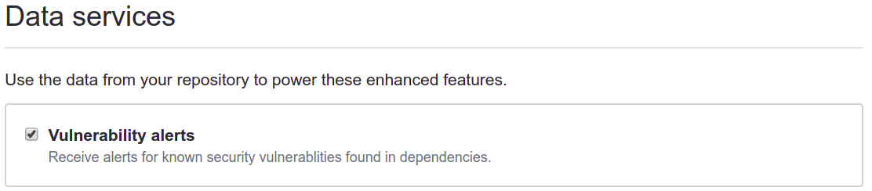
Security Alerts from Github
On Github repository settings page:
Github "vulnerabilities" based on CVE database.
Where are Alerts?
Repository "Insights" tab -> "Alerts"
or "Dependency Graph"

Slide 9
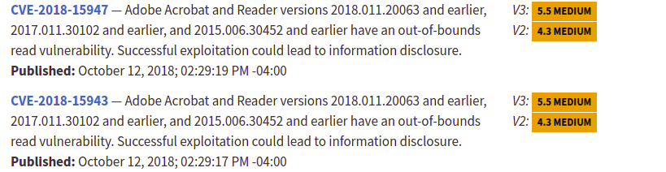
National Vulnerability Database
https://nvd.nist.gov
A global database of security problems.
Managed by U.S. NIST, but everyone can use.
Assigns CVE-# for reported & verified security problems.

Slide 10
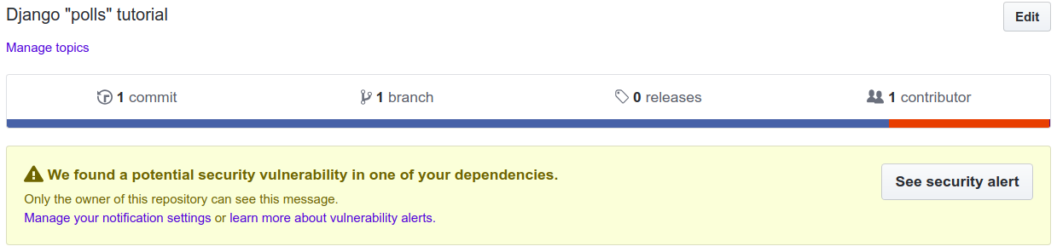
Is Django Secure?
Search the CVE database for "Django".
In your project requirements.txt put:
Django==2.1.0 # has a known vulnerability
Github will show:

