Slide 1
Using Github and Github Organization in this Course

Slide 2
How we Use Github
Submit some labs and quizzes
Submit Programming Project
Used for everything in OOP2.

Slide 3
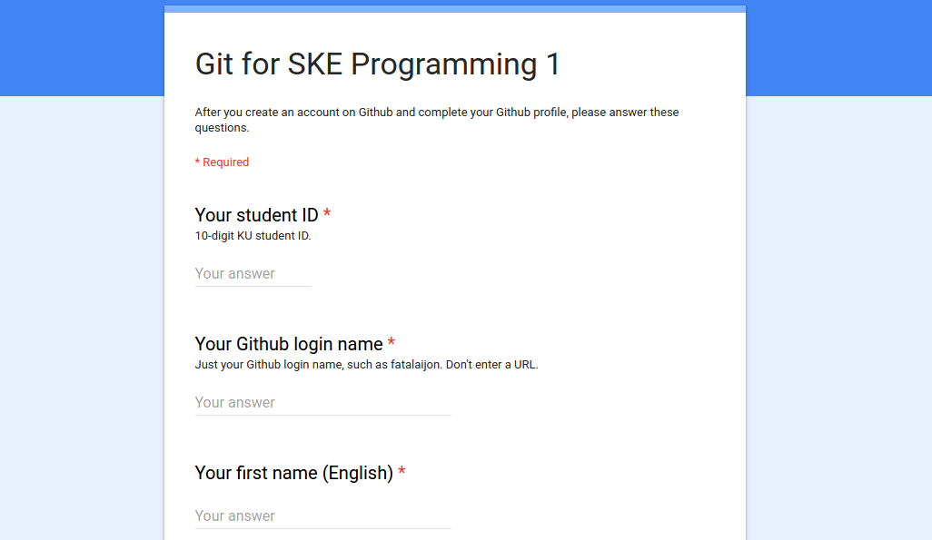
Complete a sign-up form: https://goo.gl/cwrBbW
Tell us your Github login!
Answer some simple questions about git.

Slide 4
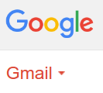
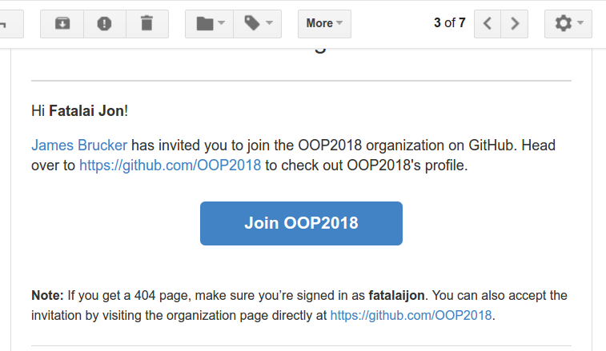
Receive invitation to join OOP2018
You must join this organization to receive starter code for assignments and quizzes.

Slide 5
You're a member of "OOP2018"
Github Organization for students in this course, and next semester, too.
Example: Github organization from OOP last year.

Slide 6
Why a Github Organization?
1. We use the organization to create assignments for you.
> Faster than creating your own repository, and avoids errors.
> Repository may contain starter code and instructions
2. Github creates a repository for you!
3. Just clone the repository and go to work.

Slide 7
Demo in class
Demo using Github organization to start an assignment.
1. Go to assignment URL (given by instructor)
2. Accept the assignment.
  Github will create a repository for you.
3. Go to the repository, using URL.
4. Clone the repository.
5. Do the assignment on your computer. "commit" your code to your local repository.
6. "git push" your code back to Github.

Slide 8
Personal Github vs Github Organization
Some assignments you will upload to your own Github account.
Example: a repo named ske-restaurant on Github. "push" your SKE Restaurant code to this repo.
The URL looks like:
https://github.com/yourname/ske-restaurant
On your local computer, the project can have any name your want. It does not have to be "ske-restaurant".

Slide 9
Personal Github vs Github Organization
For other assignments, we create a repository for you using the Github Organization.
The repository is located in Organization account instead of your account. But you can still "push" to it.
URL looks like:
https://github.com/OOP2018/assignment1-yourname
.

Slide 10
Assignment
https://cpske.github.io/programming1/coding/code-improvement-assignment

