Slide 1
UML Class Diagram
The Basics of Class Diagrams

Slide 2
Unified Modeling Language
A standard notation for describing software models and code
Unifies the notation of Booch, OMT (Rumbaugh et al), and OOSE (Jacobson et al)

Slide 3
Many Kinds of UML Diagrams
UML has 20+ different kinds of diagrams.
Each diagram shows a different kind of information (or different view) of application.
  Class diagram
  Sequence diagram
  State Machine diagram (aka State Chart Diagram)
  Object diagram
  Interaction diagram
  Activity diagram
  Package Diagram
  many others!
These 3 are the most common and most important to know.

Slide 4
Class Diagram
A class diagram shows the structure of a class
It can also show relationships between classes
Here is the simplest possible class diagram:
BankAccount

Slide 5
Class Diagrams methods & attributes
BankAccount
deposit( amount )
withdraw( amount )
getBalance( )
BankAccount
balance
owner
id
deposit( amount )
withdraw( amount )
getBalance( )

Slide 6
Class Diagram with data types
Class diagram can show data types & visibility
Not Java notation ("double balance")
BankAccount
-balance: double
+deposit(amt: double): void
+withdraw(amt: double): boolean
+getBalance( ): double

Slide 7
Visibility of Members
  balance is private (visible only within BankAccount objects)
  deposit, withdraw, getBalance are public
BankAccount
- balance: double
+ deposit( amount: double )
+ withdraw( amount: double )
+ getBalance( ): double

Slide 8
Visibility Prefixes
+ means public
  Visible everywhere
– means private
  Visible only in the class in which it is defined
# means protected
  Visible either within the class in which it is defined or within subclasses of that class
~ means package visibility
  visible to other classes in the same package

Slide 9
Constructors
BankAccount
-balance: double
<<constructor>>
+BankAccount( owner )
+deposit(amount)
. . .
BankAccount
-balance: double
+BankAccount( owner )
+deposit(amount)
. . .

Slide 10
Static Members
Use underscore to show static attributes or methods.
Example: BankAccount class has a static nextAccountId attribute.
BankAccount
-nextAccountId: long
-balance: double
-id: long
+BankAccount( owner )
+getBalance( ): double
. . .
private static attribute

Slide 11
Practice: Draw UML of class

Slide 12
Showing Multiplicity in UML
A Course has zero or more students.
public class Course {
private Student[] students;
Course
-students: Student[*]
A deck of cards has exactly 52 cards.
public class CardDeck {
private Card[] cards =
new Card[52];
CardDeck
-cards: Card[52]

Slide 13
A Single Class
Draw a UML class diagram of this class.
public class Student {
public static String idPattern = "[1-9]\\d{9}";
private long id;
protected String name;
public String getName( ) { . . . }
public void setName(String aname) { . . . }

Slide 14
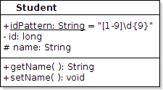
A Single Class
Draw a UML class diagram of this class.

Slide 15

Class with Dependency
A Student uses the Registrar to get his Courses, but he doesn't save a reference to it.
public class Student {
private long id;
//NO Registrar attribute!
public void addCourse(Course course) {
Registrar regis = Registrar.getInstance();
regis.enroll(this, course);

Slide 16
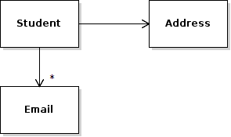
Class with Association
A Student has an Address and 0 or more Emails.
public class Student {
private Address homeAddress;
/** his email addresses. He may have many. */
private List<Email> emails;

Slide 17

A Student owns his Email Addresses
Composition: A Student owns his Email addresses and when he is deleted we delete his addresses, too!
public class Student {
/** student uniquely owns his email addresses*/
private List<Email> emails;
Modeling:
Composition shows "ownership" or "is composed of" (e.g.: a game board is composed of squares). Be careful about using it.

Slide 18
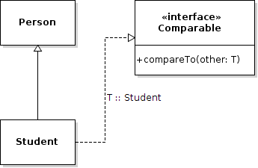
Inheritance & Implements
Student is a subclass of Person
public class Student extends Person
implements Comparable<Student> {

Slide 19
Errors
A UML diagram is for communication.
To communicate clearly, use the correct notation.
wrong
Student
Person
wrong
<<interface>>
Comparable
No partial credit for wrong relationships or bad notation.

Slide 20
Reference
UML Distilled, 3rd Edition. Chapter 3 & 5 cover UML class diagrams.

