Slide 1
Decorator Pattern
Context: We want to enhance the behavior of a class, without making the class more complicated.
The enhanced class can be used the same as the base class.
Solution: A base class or interface defines the required behavior. Create a decorator that implements the base interface and wraps an instance of the plain class, "decorating" its behavior.
BaseComponent
operation( )
calls
PlainComponent
operation( )
Decorator
operation( )
moreBehavior( )

Slide 2
Decorator Example
Context: We want to add Scroll Bars to different graphical components. We don't want duplicate code for Scroll Bars
Solution: Component is the base class for all components. ScrollPane "wraps" any component and adds scroll bars to it.
We can "wrap" any component with a Scroll Pane and the component behaves the same, but has scroll bars
Component
+ paint( g: Graphics )
...other methods...
ScrollPane
component: Component
ScrollPane( component )
Button
+paint( g: Graphics )
...
TextComponent
+paint( g: Graphics )
...

Slide 3
Decorator Example
Purpose: create a TextArea with scrollbars so that text will scroll when larger than the viewport.
// a TextArea with 5 rows and 40 columns
JTextArea textArea = new JTextArea( 5, 40 );
// decorate with JScrollPane to add scrollbars
JScrollPane pane = new JScrollPane( textArea );
pane.setVerticalScrollBarPolicy(
JScrollPane.VERTICAL_SCROLLBAR_AS_NEEDED );
// Add the decorated component to the window
// *instead of* the original textArea
window.add( pane );

Slide 4
Advantage of Using Decorators (1)
We can write the decorator behavior one time and apply it to many different kinds of objects.
Example: a JScrollPane can be applied to any kind of Component, even buttons!

Slide 5
Advantage of Using Decorators (2)
Improves the cohesion of objects, by not adding extra responsibility that isn't part of the object's main purpose.
Example: the purpose of a TextArea is to display text!
Not to manage scroll bars.

Slide 6
Advantage of Using Decorators (3)
New decorators can be added in the future, extending the behavior of the class.
Example: a zoom decorator to zoom a component.
Open-Closed Principle
A class should be open for extension but closed for modification.

Slide 7
Disadvantage of Decorators
Lots of pass-through methods
Any method the decorator doesn't "decorate" itself, it must pass to the decorated object.

Slide 8
Class Decorator?
Usually a Decorator encapsulates another instance of the base type, and calls its methods. This is composition.
But, if you only want to decorate a single base type you could define the decorator as a subclass that directly uses the superclass.
That means you create a Decorator object instead of creating a base type object.
BaseComponent
operation( )
PlainComponent
operation( )
DecoratedComponent
operation( )
moreBehavior( )

Slide 9
GuessingGame Decorator
A GuessingGameWithPrint class that extends the Guessing Game class.
GuessingGameWithPrint overrides the guess( ) method to print the guess, call the superclass guess(), and return value (true or false).
Other methods it simply inherits from GuessingGame.
GuessingGame
guess( value ): boolean
getCount( )
getMessage( )
getUpperBound( ): int
GuessingGameWithPrint
(constructors)
guess( value ): boolean

Slide 10
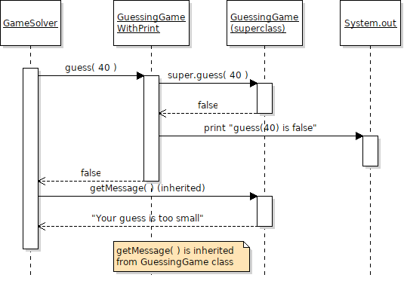

Slide 11
Example Code
class GuessingGameWithPrint
extends GuessingGame {
// must provide all required constructors
public GuessingGameWithPrint() {
super( );
}
public GuessingGameWithPrint(int bound) {
super(bound);
}
public boolean guess(int value) {
boolean result = super.guess(value);
System.out.printf("guess(%d) is %b\n",
value, return);
return result;
}

Slide 12
System.out.printf( )
printf prints a formatted string with data.
Syntax:
printf( format, arg1, arg2, ... )
Example:
printf( "Hello %s, the day is %d\n", "Nok", 22 );
Hello Nok, the day is 22
See:
https://dzone.com/articles/java-string-format-examples

Slide 13
Python Function Decorator
Context: We want to see each time a function is called and what the function returns.
Forces: We don't want to modify the code (add "print" statements), and a debugger is too cumbersome & slow.
Solution: Wrap the function in another function that prints each time it is called.
def decorate(fun):
"""fun is a function to decorate."""
def new_fun(*args, **kwargs):
s = ", ".join(str(arg) for arg in args)
print(f"{fun.__name__}({s})")
return fun(*args, **kwargs)
return new_fun
f = decorate(fibonacci) # decorate fibonacci

