Slide 1
Try Checkstyle
A popular style checking tool for code.
Thai Pangsakulyanont's checkstyle rules for SKE:
skeoop.github.io/docs/ku-checkstyle.xml
1. Save on your computer.
2. Eclipse: Window -> Preferences
and choose Checkstyle.
3. Add ku-checkstyle rules file.
4. Select KU Checkstyle as the Default rule set.
For each project you want to check style, enable it in Project -> Properties.

Slide 2
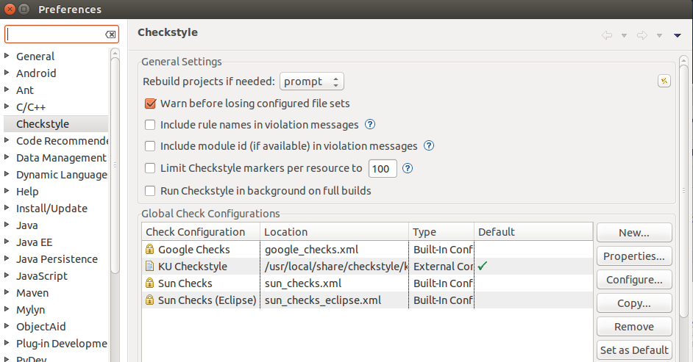
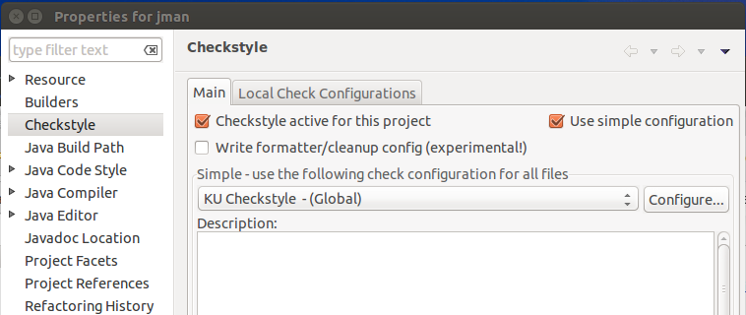
Eclipse Preferences
Project Properties

Slide 3
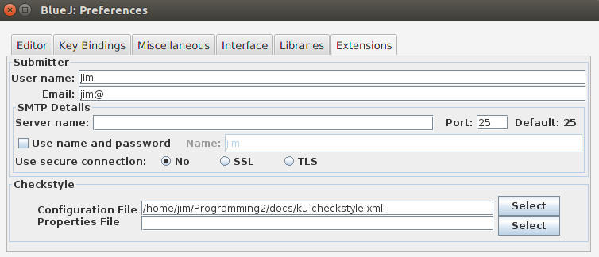
Checkstyle in BlueJ
1. Install a Checkstyle extension for BlueJ.
2. Then look for Checkstyle in Tools -> Preferences...
in the "Extensions" tab.
3. Add Checkstyle Configuration file (ku-checkstyle.xml)

