Slide 1
Basing Software Development on
Reusable Technology
Chapter 3 of
Object-Oriented Software Engineering
Practical Software Development using UML and Java

Slide 2
Building on the Experience of Others
Software developers should avoid re-creating software already developed
Types of reuse:
  Reuse of expertise
  Reuse of standard designs and algorithms
  Reuse of libraries of classes or procedures
  Reuse of powerful commands built into languages and operating systems
  Reuse of frameworks
  Reuse of complete applications

Slide 3
Reusability and Reuse
Developing reusable software is not easy.
But there are problems to overcome:
  Why take the extra time needed to develop something that will benefit other projects/customers?
  Management may only reward the efforts of people who create the visible ‘final products’.
  Reusable software is often created in a hurry and without enough attention to quality.

Slide 4
Frameworks: Reusable Subsystems
A framework is reusable software that implements a generic solution to a generalized problem.
  It provides common facilities applicable to different application programs.
Principle: Applications that do different, but related, things tend to have similar designs

Slide 5
Frameworks to promote reuse
A framework is intrinsically incomplete
  Certain classes or methods are required by the framework, but are missing (slots)
  Some functionality is optional
    Allows for developer to add optional functionality (hooks)
  Developers use the services that framework provides
The programmable interface to using a framework is called the Application Program Interface (API)

Slide 6
Frameworks and product lines
  A product line (or product family) is a set of products built on a common base of technology.
    The various products in the product line have different features to satisfy different markets
    The software technology common to all products in included in a framework
    Each product is produced by filling the available hooks and slots
    E.g. software products offering ‘demo’, ‘lite’ or ‘pro’ versions

Slide 7
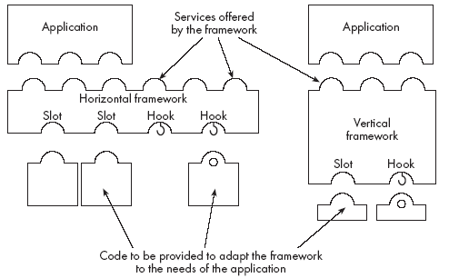
Types of frameworks
A horizontal framework provides general application facilities that a large number of applications can use
A vertical framework (application framework) is designed for a specific type of application or domain

Slide 8
The Client-Server Architecture
Server
  A program that provides a service for other programs that connect to it using a communication channel
  A server may be accessed by many clients simultaneously
Client
  A program that accesses a server (or several servers) to obtain services

Slide 9
Sequence of activities in a client-server system
  The server starts running
  The server waits for clients to connect. (listening)
  Clients start running and perform operations
    Some operations involve requests to the server
  When a client attempts to connect, the server accepts the connection (if it is willing)
  The server waits for messages to arrive from connected clients
  When a message from a client arrives, the server takes some action in response, then resumes waiting
  Clients and servers continue functioning in this manner until they decide to shut down or disconnect

Slide 10
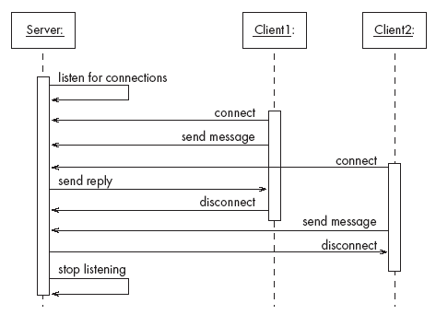
A server with two clients

Slide 11
Alternatives to client server architecture
  Have a single program that does everything.
    Stand-alone operation
  Peer-to-peer
    all machines know how to be a client & server
  Have some mechanism other than client-server communication for exchanging information
    E.g. one program writes to a database; the other reads from the database

Slide 12
Advantages of client-server systems
  The work can be distributed among different machines
  The clients can access the server’s functionality from a distance
  The client and server can be designed separately
  They can both be simpler
  The server can be accessed simultaneously by many clients (shared resource)
  Competing clients can be written to communicate with the same server, and vice-versa

Slide 13
Example of client-server systems
  The World Wide Web
  Email
  Network File System
  Transaction Processing System
  Remote Display System
  Communication System
  Database System

Slide 14
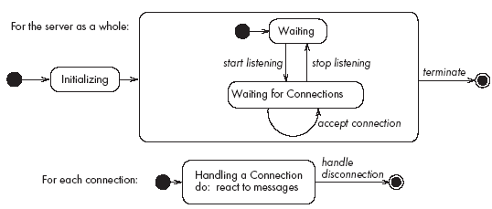
Activities of a server
Initializes itself
Starts listening for clients
Handles the following types of events originating from clients
  accepts connections
  responds to messages
  handles client disconnection
May stop
listening
Must cleanly terminate

Slide 15
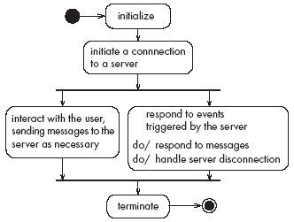
Activities of a client
Initializes itself
Initiates a connection
Sends messages
Handles the following types of events originating from the server
  responds to messages
  handles server disconnection
Must cleanly terminate

Slide 16
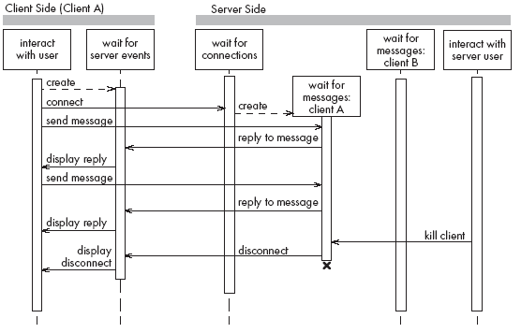
Threads in a client-server system

Slide 17
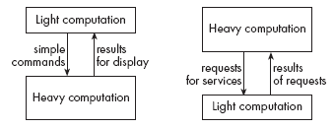
Thin- versus fat-client systems
Thin-client system (a)
  Client is made as small as possible
  Most of the work is done in the server.
  Client easy to download over the network
Fat-client system (b)
  As much work as possible is delegated to the clients.
  Server can handle more clients

Slide 18
Communications protocols
  The messages the client sends to the server form a language.
    The server has to be programmed to understand that language.
  The messages the server sends to the client also form a language.
    The client has to be programmed to understand that language.
  When a client and server are communicating, they are in effect having a conversation using these two languages
  The two languages and the rules of the conversation, taken together, are called the protocol

Slide 19
Tasks to perform to develop client-server applications
Design the primary work to be performed by both client and server
Design how the work will be distributed
Design the details of the set of messages that will be sent
Design the mechanism for
    Initializing
    Handling connections
    Sending and receiving messages
    Terminating

Slide 20
3.5 Technology Needed to Build Client-Server Systems
Internet Protocol (IP)
  Route messages from one computer to another
  Long messages are normally split up into small pieces
Transmission Control Protocol (TCP)
  Handles connections between two computers
  Computers can then exchange many IP messages over a connection
  Assures that the messages have been satisfactorily received
A host has an IP address and a host name
  Several servers can run on the same host.
  Each server is identified by a port number (0 to 65535).
  To initiate communication with a server, a client must know both the host name and the port number

Slide 21
Establishing a connection in Java
The java.net package
  Permits the creation of a TCP/IP connection between two applications
Before a connection can be established, the server must start listening to one of the ports:
    ServerSocket serverSocket = new
    ServerSocket(port);
    Socket clientSocket = serverSocket.accept();
For a client to connect to a server:
    Socket clientSocket= new Socket(host, port);

Slide 22
Exchanging information in Java
  Each program uses an instance of
    InputStream to receive messages from the other program
    OutputStream to send messages to the other program
    These are found in package java.io
output = clientSocket.getOutputStream();
input = clientSocket.getInputStream();

Slide 23
Sending and receiving messages
• without any filters (raw bytes)
    output.write(msg);
    msg = input.read();
• or using DataInputStream / DataOutputStream filters
    output.writeDouble(msg);
    msg = input.readDouble();
• or using ObjectInputStream / ObjectOutputStream filters
    output.writeObject(msg);
    msg = input.readObject();

Slide 24
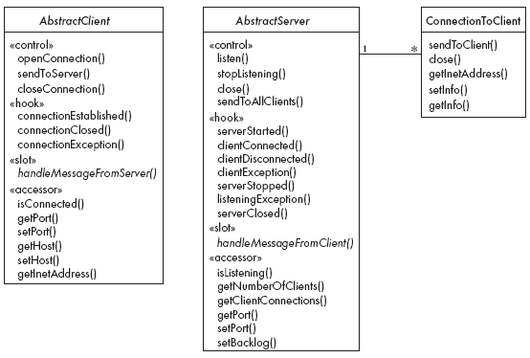
The Object Client-Server Framework
(OCSF)

Slide 25
Using OCSF
Software engineers using OCSF never modify its three classes
They:
  Create subclasses of the abstract classes in the framework
  Call public methods that are provided by the framework
  Override certain slot and hook methods (explicitly designed to be overridden)

Slide 26
OCSF Client Side
Consists of a single class: AbstractClient
  Must be subclassed
    Any subclass must provide an implementation for handleMessageFromServer
      Takes appropriate action when a message is received from a server
  Implements the Runnable interface
    Has a run method which
      Contains a loop that executes for the lifetime of the thread

Slide 27
The public interface of AbstractClient
Controlling methods:
  openConnection
  closeConnection
  sendToServer
Accessing methods (services):
  isConnected
  getHost
  setHost
  getPort
  setPort
  getInetAddress

Slide 28
The callback methods of AbstractClient
Methods that may be overridden:
  connectionEstablished
  connectionClosed
Method that must be implemented:
  handleMessageFromServer

Slide 29
Using AbstractClient
  Create a subclass of AbstractClient
  Implement handleMessageFromServer method (slot)
  How to make it “run”:
    Create an instance of the new subclass
    Call openConnection
    Send messages to the server using the sendToServer service method
  Implement the connectionClosed callback
  Implement the connectionException callback

Slide 30
Internals of AbstractClient
Instance variables:
  A Socket which keeps all the information about the connection to the server
  Two streams, an ObjectOutputStream and an ObjectInputStream
  A Thread that runs using AbstractClient’s run method
  Two variables storing the host and port of the server

Slide 31
The Server Side
Two classes:
  One for the thread which listens for new connections (AbstractServer)
  One for the threads that handle the connections to clients (ConnectionToClient)

Slide 32
The public interface of AbstractServer
Controlling methods:
  listen
  stopListening
  close
  sendToAllClients
Accessing methods:
  isListening
  getClientConnections
  getPort
  setPort
  setBacklog

Slide 33
The callback methods of AbstractServer
Method that must be implemented:
handleMessageFromClient
Methods that may be overridden (hooks):
  serverStarted
  clientConnected
  clientDisconnected
  clientException
  serverStopped
  listeningException
  serverClosed

Slide 34
Public interface of ConnectionToClient
Controlling methods:
  sendToClient
  close
Accessing methods:
  getInetAddress
  setInfo
  getInfo

Slide 35
Using AbstractServer and ConnectionToClient
  Create a subclass of AbstractServer
  Implement the slot method handleMessageFromClient
  Write code that:
    Creates an instance of the subclass of AbstractServer
    Calls the listen method
    Sends messages to clients, using:
      the getClientConnections and sendToClient service methods
      or sendToAllClients
  Implement one or more of the other callback methods

Slide 36
Internals of AbstractServer and ConnectionToClient
  The setInfo and getInfo methods make use of a Java class called HashMap
  Many methods in the server side are synchronized
  The collection of instances of ConnectionToClient is stored using a special class called ThreadGroup
  The server must pause from listening every 500ms to see if the stopListening method has been called
    if not, then it resumes listening immediately

Slide 37
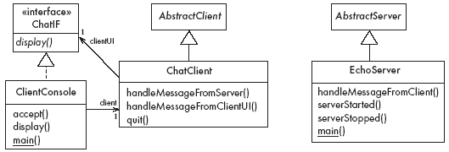
3.9 An Instant Messaging Application: SimpleChat
ClientConsole can eventually be replaced by ClientGUI

Slide 38
The server
EchoServer is a subclass of AbstractServer
  The main method creates a new instance and starts it
    It listens for clients and handles connections until the server is stopped
  The three callback methods just print out a message to the user
    handleMessageFromClient, serverStarted and serverStopped
  The slot method handleMessageFromClient calls sendToAllClients
    This echoes any messages

Slide 39
Key code in EchoServer
public void handleMessageFromClient
(Object msg, ConnectionToClient client)
{
System.out.println(
"Message received: "
+ msg + " from " + client);
this.sendToAllClients(msg);
}

Slide 40
The client
When the client program starts, it creates instances of two classes:
  ChatClient
    A subclass of AbstractClient
    Overrides handleMessageFromServer
      This calls the display method of the user interface
  ClientConsole
    User interface class that implements the interface ChatIF
      Hence implements display which outputs to the console
    Accepts user input by calling accept in its run method
    Sends all user input to the ChatClient by calling its handleMessageFromClientUI
      This, in turn, calls sendToServer

Slide 41
Key code in ChatClient
public void handleMessageFromClientUI(
String message)
{
try
{
sendToServer(message);
}
catch(IOException e)
{
clientUI.display (
"Could not send message. " +
"Terminating client.");
quit();
}
}

Slide 42
Key code in ChatClient - continued
public void handleMessageFromServer(Object msg)
{
clientUI.display(msg.toString());
}

Slide 43
3.10 Risks when reusing technology
  Poor quality reusable components
    Ensure that the developers of the reusable technology:
      follow good software engineering practices
      are willing to provide active support
  Compatibility not maintained
    Avoid obscure features
    Only re-use technology that others are also re-using

Slide 44
Risks when developing reusable technology
  Investment uncertainty
    Plan the development of the reusable technology, just as if it was a product for a client
  The ‘not invented here syndrome’
    Build confidence in the reusable technology by:
      Guaranteeing support
      Ensuring it is of high quality
      Responding to the needs of its users

Slide 45
Risk when developing reusable technology – continued
  Competition
    The reusable technology must be as useful and as high quality as possible
  Divergence (tendency of various groups to change technology in different ways)
    Design it to be general enough, test it and review it in advance

Slide 46
Risks when adopting a client-server approach
  Security
    Security is a big problem with no perfect solutions: consider the use of encryption, firewalls, ...
  Need for adaptive maintenance
    Ensure that all software is forward and backward compatible with other versions of clients and servers

