Slide 1
Computer Hardware Basics
204111 : Computers and Programming
James Brucker

Slide 2
Outline
Types of Computers
Organization of Computer Hardware
Units of Measure
Computer Components
Questions

Slide 3
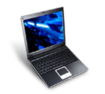
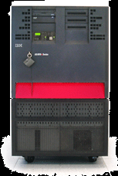

Traditional Types of Computers
Microcomputer
  Personal Computer: desktop, notebook, palm top
  Usually only one person uses computer at any time
  I/O performance and reliability are not critical
Minicomputer
  Higher speed and throughput. More reliable.
  Past: multi-user (up to 100). Now: business processes
  Application: web server, business back office, database, reservation system, point-of-sale (POS) system
  Example: IBM AS400
Mainframe -> Supercomputer
  Highest computation power (in one box)
  Very high reliability and throughput.

Slide 4
Newer Categories of Computers
Workstation
  designed for high computation and/or graphics performance
  examples are CAD and engineering workstations
  "workstation" is fuzzy... a PC can be a workstation, too!
Server
  server side of client/server computing
  web server, database, POS, reservation
  servers have invaded the market of mini-computers
  a personal computer can be a low-end server, too!
Cluster and Grid
  coordinate many computers to solve problems
  a "layer" of the OS manages interactions

Slide 5
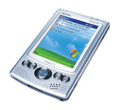
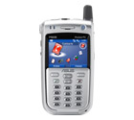
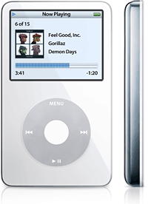
Computers you Don't Notice
Personnal Data Assistant (PDA)
  Palm, iPod
  can program them, too!
Your Mobile Phone
Embedded Processors
  special purpose, often to help control or manage a device
  automobiles, industrial machinery, elevators, air-conditioners
  features: high-reliability, on-board program (flash memory), often have limited memory and limited power
Smart Appliances
  have embedded processor
  cellular phones, home entertainment systems

Slide 6
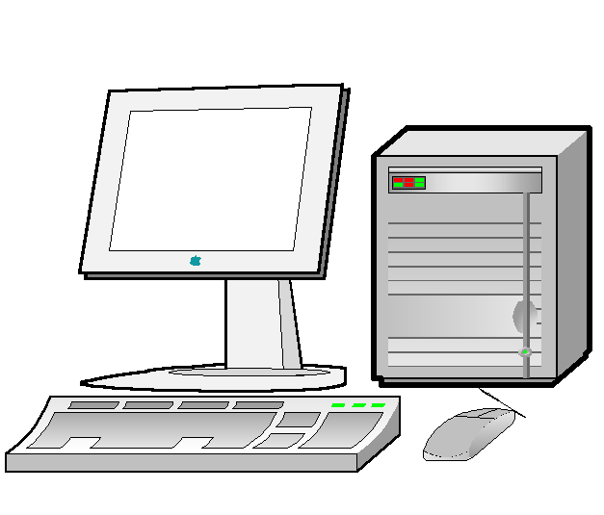
Computer Components
System unit
Monitor
Input devices

Slide 7
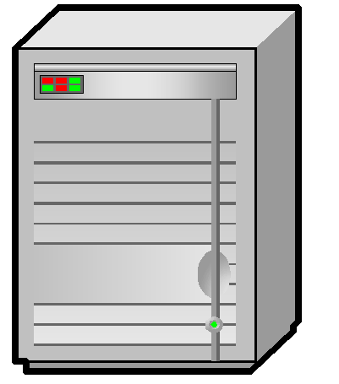
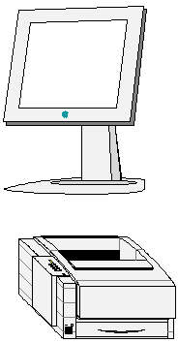

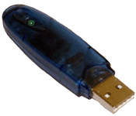
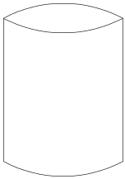
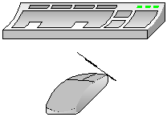
Computer Components
Secondary Memory
HD
BUS
Main
Memory
CTLR
CPU
Output Devices
Input Devices

Slide 8
Identify & classify these components
To be added: images of input devices (keyboard, mouse, barcode scanner, ...),
output devices (display, speakers, printer),
I/O devices (memory, hard disk, flash drive, tape)

Slide 9
Terminology
binary: something has has only 2 states, ex: 0 or 1
bit: one binary unit, ex: 0 or 1, "on" or "off", +5V or -5V
byte: a group of 8 (consecutive) bits
Example: To the computer, letters are binary codes...
'a' is 01100001 (ASCII code for letter a)
'ก' is 00001110 000000001 (UNIcode for ก)
See: http://www.unicode.org (code charts of alphabets)

Slide 10
Computer Units
Size (memory, disk, CD, flash drive)
  1 Kbyte = 2¹⁰ = 1024 bytes
  1 Mbyte = 2²⁰ = 1,048,576 bytes
  1 Gbyte = 2³⁰ = 1,073,741,824 bytes
Speed
  "clock cycle" - one time interval for doing work on the CPU, bus, etc.
  1 Hertz (Hz) - 1 cycle per second
  1 MHz = 1,000,000 Hz, 1 GHz = 1,000,000,000
  examples: Pentium-M clock is 1.5 GHz - 1.8 GHz, monitor "refresh rate" typically 75 Hz or faster

Slide 11
Computer Units (2)
Data Transfer Rate
  how much data can be transferred per second
  Bytes per second (Bps) or bits per second (bps)
  Kbps = kilobits per second (1000 bits/sec)
  Mbps = megabits per second (1000000 bits/sec)
  MBps = megabytes per second
Examples
  Modem: 56 Kbps (kilobits per second)
  CD ROM and Flash Drive: 1X = 150 KBps
  50X CD-ROM drive is 50 x 150 KBps = 7.5 MB/sec
  Cheap flash memory is "4X" = 600 KBps

Slide 12
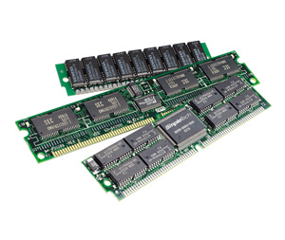
Computer Memory
Main Memory
  contains currently running programs and data
  contents are lost when computer shutdown!
  Dynamic RAM: Megabytes - Gigabytes
    SDRAM, DDR RAM, DDR2 RAM
    speeds: DDR PC3200 = 400Mhz x 8 Byte/cycle = 3200Bps
  Cache (SRAM) on CPU on nearby: 256KB - 8MB
    so the CPU doesn't have to wait for data from DRAM
    operates at CPU speed or nearly so
  Read Only Memory (ROM)
    holds boot strap program and self-test programs
    contents not lost when turned off (non-volatile)
RAM

Slide 13
Main Memory
Store information in addressable locations
Smallest addressable location is usually a byte
The CPU reads/writes memory by using an address
A memory controller handles the CPU's request (so the CPU doesn't wait)
000000
100
Memory Cells
000004
-34.9
000008
A
Memory
Address
00000B
23
...
FFFFFF
W

Slide 14
Main Memory
Memory Cells hold bits as charges
One "chip" holds millions of cells
A memory module (DIMM) contains several "chips" and logic for addressing
Memory module may contain extra cells for error checking, called parity or error-correcting code (ECC)
Memory can be divided into 2 Categories
  RAM (Random Access Memory)
  ROM (Read Only Memory)

Slide 15
Secondary Memory (Storage)
Floppy disk: 1.44 MB - 2.88 MB
Hard disk: xxx MB up to xxx GB
CD-ROM (650MB - 800MB) and DVD (4.7GB - 18 GB)
Flash drive ("handy drive"): 32 MB - 4 GB
Tape: 4mm DDS4 = 40GB
Characteristics:
non-volatile: data is saved (for years) even when turned off
smallest addressable unit is a sector (typically 4KB or larger)
data is organized into “files”
the device contains a "file system" that tells where each "file" is

Slide 16
Main VS. Secondary Memory
Main Memory
  Much faster
  More expensive, per megabyte
  Volatile (RAM)
Secondary Memory
  Slower
  Less expensive (except Flash Memory)
  Permanent... well, remembers for a few years

Slide 17
Computer Components
Secondary Memory
HD
BUS
Main
Memory
CTLR
CPU
Output Devices
Input Devices

Slide 18
Central Processor Unit (CPU)
Performs instructions according to a program
Gets data from memory and other input devices
Calculation, logic ("if ... then do ...")
Examples
Intel: Pentium 4, Pentium-M, Celeron
AMD: Athlon XP and 64, Sempron
Apple: PowerPC (made by IBM or other)

Slide 19
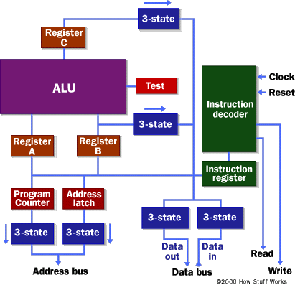
Central Processing Unit
See: How a Microprocessor Works
http://www.howstuffworks.com/microprocessor.htm

Slide 20
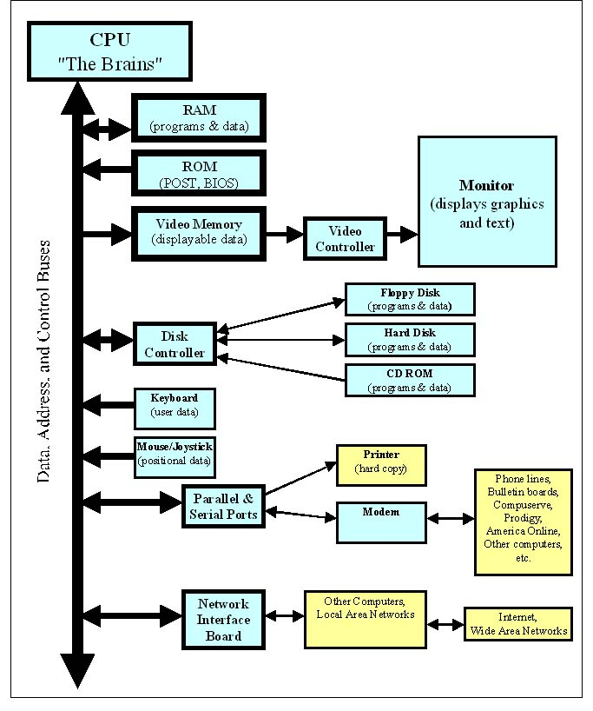
The Bus
A bus is a shared communications channel.
In a computer, a bus is used to send data and/or instructions between devices.
Your PC contains many buses! (not as shown in figure)

Slide 21
The Bus
A bus is a shared communications (or transportation) channel
A bus connects components together
I/O bus connects hard disk, keyboard, mouse, USB ports, etc., to CPU
  a "bus controller" handles the transactions
  bus controller decides who gets to use the bus next
memory bus connects CPU to main memory (DRAM)
  memory needs a separate bus to provide speed
USB (Universal Serial Bus) is also a bus!

Slide 22
Questions
Test your knowledge of current technology...

Slide 23
How fast is a CPU's clock?

Slide 24
How fast is a CPU's clock?
Pentium-M: 1.4 GHz - 2.0 GHz
Pentium-4: 2.0 GHz - 3.4 GHz
Athlon-XP: 1.4 GHz - 2.8 GHz
(actual speed, not rating)
Athlon-64:

Slide 25
What are typical size of memory modules (DIMM)?

Slide 26
What are typical size of memory modules (DIMM)?
DDR SDRAM:
128MB, 256MB, 512MB, 1GB, 2GB, 4GB
Memory Speeds:
  333MHz ("PC2700"),
  400MHz ("PC3200"),
  up to 500MHZ ("PC4000").
Each clock cycle can transfer 8 bytes of data, hence the "PC" rating:
333MHz x 8 bytes = 2700 MB/sec (PC2700)
Newer technology: DDR2, DDR3

Slide 27
How much data can be stored on a CD-ROM?

Slide 28
How much data can be stored on a CD-ROM?
650 MB - 800 MB.
Most CD-R today hold 700MB of data.
MP3 (compressed) music:
typical data rate is 1 minute of music = 1 MB
So, a 700 MB CD-ROM can hold about 700 minutes of music.
What else can you store on a CD-ROM?

Slide 29
How much data can be stored on a DVD? (range of values)

Slide 30
How much data can be stored on a DVD? (range of values)
Single-sided single-layer: 4.7GB
(1 DVD = 7 CD-ROM)
Single-sided double-layer: 9.4GB
Double-sided double-layer: 19.8GB
Next generation DVD (Blue-ray)
single-sided: 25GB

Slide 31
What are some typical hard disk storage capacities?

Slide 32
What are some typical hard disk storage capacities?
40GB - 500GB
larger sizes for servers
current hard disk interface for PCs:
  Ultra-ATA interface: 100MB/sec or 133MB/sec.
  Serial ATA (S-ATA): 150MB/sec
servers:
  SCSI is primary interface (more efficient bus)

Slide 33
What are the 2 leading monitor technologies?
what is the next generation monitor technology?

Slide 34
What are the 2 leading monitor technologies?
CRT (cathode ray tube)
LCD (liquid crystal display)
- less energy & less radiation than CRT display
next generation LCD: organic LCD (OLCD)
or LED LCD

Slide 35
How many pixels (dots) does a monitor display?

Slide 36
How many pixels (dots) does a monitor display?
typical 17" monitor:
1024 x 768 and 1280 x 1024. Maybe 1600 x 1200.
even more important (for CRT display) is the refresh rate which should be at least 75Hz.

Slide 37
What is the capacity of a FlashDrive?

Slide 38
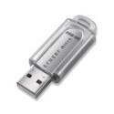
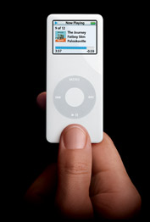
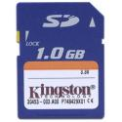
What is the capacity of a FlashDrive?
Increasing rapidly!
2006: 128 MB - 4 GB
2008:
2010: may overtake hard disk in cost-per-GB!
iPod Nano with 4GB of flash memory.

