Slide 1
Graphical Components
James Brucker

Slide 2

Name the Swing Components
What are the Swing components in this UI?

Slide 3
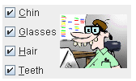
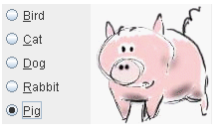

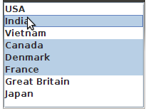
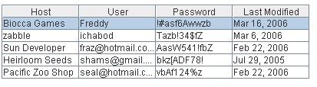
Name these Swing Components

Slide 4
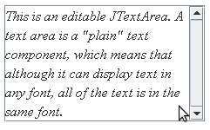
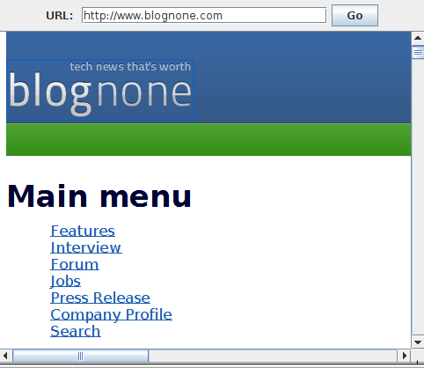
Name these text components...
Multi-line text, only simple formatting.
Multi-line text & complex styling. Can show HTML, images, and even web pages!
2 possible components

Slide 5
Name the Layout
What layouts could produce this look?

Slide 6
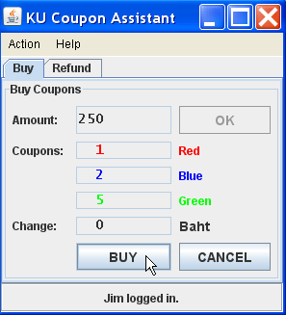
Name the Layout
KU Coupon Assistant is app for selling coupons (red, blue, green) at KU Faire.

Slide 7


Grouping Radio Buttons
How do you "group" radio buttons so that only one button in a group is selected?

Slide 8
Learning the Components
1. Visual Guide to Swing Components
http://circe.univ-fcomte.fr/Docs/Java/Tutorial.20060804/ui/features/components.html
2. Java Tutorial, Creating a GUI with Swing
.../tutorial/uiswing/index.html
3. Java Tutorial, Really Big Index
Has "How to ___" for many components.

