Slide 1
Relationships in UML Class Diagrams
Some examples

Slide 2
Exercise: draw the UML
A Person works for one company.
class Person {
private String firstName;
private String lastName;
private Company employer;
...
}

Slide 3
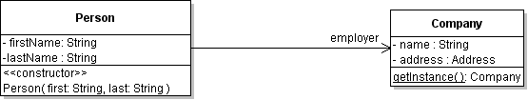
Unidirectional Association
A Person works for one company.
class Person {
private String firstName;
private String lastName;
private Company employer;
...
}

Slide 4
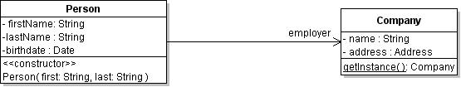
Association or Attribute?
Should birthdate be an attribute or association to the Date class?
class Person {
private String firstName;
private String lastName;
private Date birthdate;
private Company employer;
...
}

Slide 5
Association or Attribute?
For uninteresting objects like String and Date, show as attribute.
class Person {
private String firstName;
private String lastName;
private Date birthdate;
private Company employer;
...
}

Slide 6
Multiplicity of Association
A person works for 0 or 1 company, a company has many employees.
class Person {
private String firstName;
private String lastName;
private Date birthdate;
private Company employer; // may be null
...
}

Slide 7
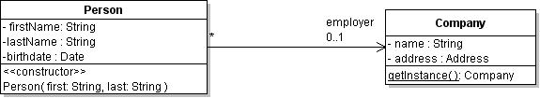
Multiplicity of Association
A person works for 0 or 1 company, a company has many employees.
class Person {
private String firstName;
private String lastName;
private Date birthdate;
private Company employer;
...
}

Slide 8
Bidirectional Association
A company has a collection (e.g. Set) of employees (no duplicates).
class Company {
private String name;
private Address address;
private Set<Person> employees;
public static Company getInstance( );
}

Slide 9
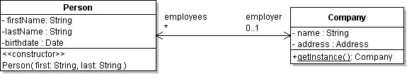
Bidirectional Association
A company has a collection (e.g. Set) of employees (no duplicates).
class Company {
private String name;
private Address address;
private Set<Person> employees;
public static Company getInstance( );
}

Slide 10
Composition: owning a collection
A Greenfoot World "owns" the cells in the world.
public class World {
private [][] Cell cells;
public World(int width, int height, int sz)
{
if (width<1 || height<1) throw new ...;
cells = new Cell[width][height];
}

Slide 11
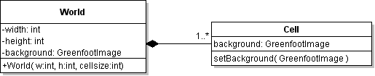
Composition: owning a collection
A Greenfoot World "owns" the cells in the world.
public class World {
private [][] Cell cells;
public World(int width, int height, int sz)
{
if (width<1 || height<1) throw new ...;
cells = new Cell[width][height];
}

Slide 12
Collection can be array, list, set, ...
A greenfoot World "owns" the actors in the world.
public class World {
private List<Actor> actors;
public void addObject(Actor a, int x, int y)
{
if ( ! actors.contains(a) ) actors.add(a);
else actors.add( a ); a.setLocation(x,y);
}
Exercise: draw the class diagram

Slide 13
Association to what?
A person has a mother and father.
public class Person {
private String firstName;
private String lastName;
private Person father;
private Person mother;
...
}

Slide 14
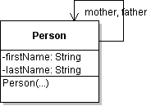
Self-Association
A person has a mother and father.
public class Person {
private String firstName;
private String lastName;
private Person father;
private Person mother;
...
}

Slide 15
Implementing an Interface
A Person can be compared to another Person.
public class Person implements Comparable<Person> {
private String firstName;
private String lastName;
private Date birthdate;
public int compareTo(Person other) {
if (other == null) return -1;
...
}
}

Slide 16
Key Words and Stereotypes
Convey extra information about a class, an attribute, or a relationship.
Stereotypes
<<abstract>>
<<interface>> or <<I>>
<<enum>>
for relationships:
<<use>> this is useless
<<create>>
Key Words
{abstract}
{readonly}
{ordered}
{unique}

Slide 17
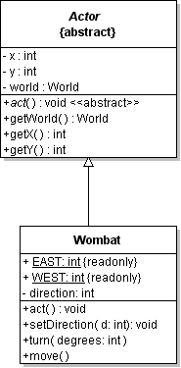
Stereotypes and Qualifiers
Actor is an abstract class
  name in Bold-Italic
act( ) is abstract method
  name in italic font
EAST and WEST are class constants
Two ways to show abstract class:
<<abstract>>
Actor
Actor
{abstract}

Slide 18
Dependency
Association implies an attribute of an object
Dependency just means one class somehow requires another class:
  type of parameter to a method
  creates a local object of the other class
  calls a method of another class

Slide 19
Uses
public class Person {
findAddress( AddressBook book, String what){
Address address = book.find( what );
...
}
}

Slide 20
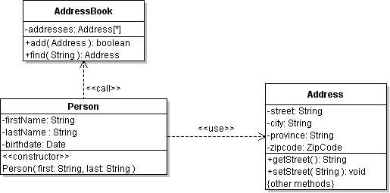
Uses
public class Person {
findAddress( AddressBook book, String what){
Address address = book.find( what );
...
}
}

Slide 21
Inheritance
In Greenfoot...
Animal is a kind of Actor
Crab is a kind of Animal
public abstract class Actor {
public abstract void act( );
}
public class Animal extends Actor {
public void act( ) { /* do nothing */ }
}
public class Crab extends Animal {
public void act( ) { /* move and eat worms */
if (canSee( Worm.class ) ) eat(Worm.class);
...

Slide 22
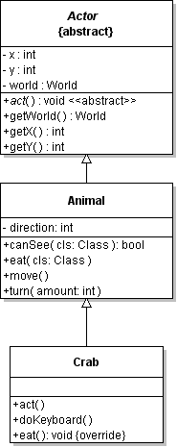
Inheritance or Generalization
Crab is a kind of Animal
Animal is a kind of Actor
in Java and C#, a class can only extend one other class

Slide 23
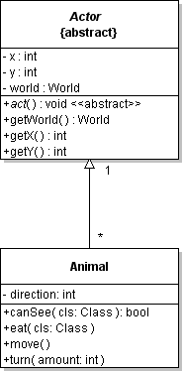
No multiplicity on inheritance/depends
multiplicity is used only on associations, not
  inheritance
  dependency
  implements
nonsense

Slide 24
Implementing an Interface
An interface specifies a type of behavior, but no implementation
Methods in an interface are automatically public and abstract
in Java, a class can implement any number of interfaces
<<interface>>
Comparable
compareTo( other: Object): int
Person
-firstName: String
-lastName: String
+equals( other: Person ): bool
+toString( ) : String

