Slide 1
Introduction
Object-Oriented Programming & Modeling with lab
at Kasetsart University
by
James Brucker

Slide 2
Why study object-oriented programming?
O-O is the dominant programming paradigm
You'll need it in your internship.
Many interns say they used OOP knowledge a lot.
Employers require good O-O background.
Many other courses build on what you learn in OOP.
  Without Java, O-O, and UML basics, you will struggle for the next 3 years.

Slide 3

3 Courses in 1
Java
Enroll 1 Get 2 FREE
Object Design
Modeling with UML

Slide 4
3 Areas We Will Study
these 3 areas are strongly related...
Java | Object Orientation | Modeling
Java syntax and use. How to use Java API. Graphical Programs Collections, generics, & Java object model. Frameworks. | OO approach to program design and construction. Encapsulation, polymorphism, & inheritance -- how to use them. Design Principles Design Patterns | Abstraction. Modularity. UML as modeling language. Modeling of real-world situations using objects.

Slide 5
General Goals
Gain understanding and practical skill in...
O-O paradigm and why it matters
Java programming skill
software design concepts and design patterns
Unified Modeling Language (UML) to express design
software development practices:
  design before coding
  unit testing
  iterative development
frameworks for developing apps

Slide 6
What You Will Learn
Java language
Programming
Guidance
Idiomatic Usage
Object Oriented Design Principles
String [] words = inputline.split( "\\s+" );
List<String> vocab = new ArrayList<String>( );
Source code should be readable
Document your code -- explain why, not what
for( String word : words )
if ( ! vocab.contains(word) ) vocab.add( word );
Program to an Interface, not an implementation
Don't repeat yourself.
Separate what varies from what stays the same

Slide 7
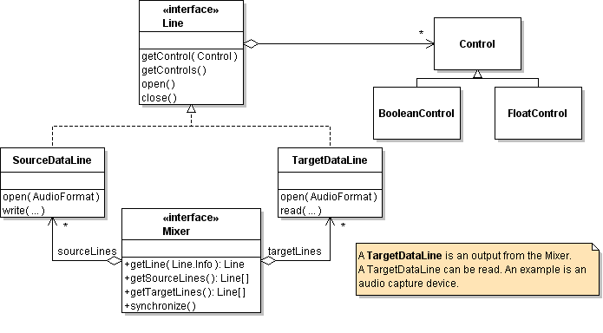
What You Will Learn
Modeling with UML
Design Patterns
Technology
& Frameworks
Command Singleton
Strategy State
Iterator Factory Method
Observer
Graphical User Interfaces
Unit testing with JUnit
Charting with JFreeChart

Slide 8
Approach
Labs to learn and practice concepts.
Mix of topics in labs
Java language programming style
OO principles design patterns technology
Programming assignments for deeper understanding

Slide 9
Evaluation
One grade for both lecture and lab work.
Your grade is based on:
  Midterm and Final exams
  Laboratory exams (programming)
  Programming assignments
  Class participation
  Quiz scores
  Laboratory participation
At least 50% on both written and lab exams to pass

Slide 10
Approximate Grading Scale
  A 85% and above
  B 75% - 85%
  C 65% - 75%
  D 55% - 65%
  F less than 55% overall
or written exam average < 50%
or lab exam average < 50%
that means, to pass you must average >= 50% on written exams and lab exams.

Slide 11
Class Homepage and Repository
Schedule and Info
https://bitbucket.org/skeoop/oop/wiki/Home
Weekly materials including labs and homework
https://bitbucket.org/skeoop/oop
or, check them out using Git:

Slide 12
Lab
Schedule: Evening 16:00 - 19:00 Room 201
Please do not bring food into lab.
Alternative: Start at 16:30? (vote)

Slide 13
Why Put in Effort?
We are what we do.
Excellence, therefore, is a habit.
-- Aristotle
Push yourself in this course ...
prepare for your career
develop a habit of excellence in anything
maybe get "A"
enjoy your time at KU more

Slide 14
Why Practice?
I hear and I forget,
I see and I remember,
I do and I understand.
-- Confucious

