Slide 1
Introduction to Programming 2
Object-Oriented Programming & Modeling
by
James Brucker

Slide 2
Why study object-oriented programming?
O-O is the dominant programming paradigm
You will need it in your internship.
Many interns say they used OOP knowledge a lot.
Employers require good O-O background.
Many other courses build on what you learn in OOP.
  Without Java, O-O, and modeling skills,
  you will struggle for the next 3 years.

Slide 3
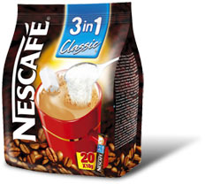
3 Courses in 1!
Java
Object Design
Modeling with UML

Slide 4
3 Areas We Will Study
Java | Object Orientation | Modeling
How to program in Java Collections Graphical UI Generics Interfaces & Lambdas Java 8 Features Packaging (JAR files) | Encapsulation Polymorphism Inheritance OO Approach to design Design Patterns | Modeling with UML Abstraction Design Principles Modularity

Slide 5
BONUS topics
O-O Programming in Python (occasionally)
How to test programs using JUnit
Some real frameworks for creating apps

Slide 6
General Goals
Gain understanding and practical skill in...
O-O paradigm
Java programming skill
good software design and coding skills
common Design Patterns (a few)
Unified Modeling Language (UML) to express design
how to use frameworks

Slide 7
Approach
Labs to learn and practice concepts.
Programming assignments for deeper learning
Homework to learn things on your own
Quiz to measure your understanding

Slide 8
Evaluation
One grade for both lecture and lab sections.
Your grade is based on:
  Midterm and Final written exams
  Programming exams
  Programming assignments
  Class participation
  Quiz scores
  Laboratory work and participation
At least 50% on both written exam and lab exams to pass.

Slide 9
Approximate Grading Scale
  A 85% and above
  B 75% - 85%
  C 65% - 75%
  D 55% - 65%
  F less than 55% overall
or written exam average < 50%
or lab exam average < 50%
To pass you must average >= 50% on written exams and lab exams.
Why? You must know concepts and how to use them.

Slide 10
Real Meaning of Grade
  A demonstrates mastery of the material and
  excellent ability to apply it to new problems
B very good understanding and ability to apply
  C satisfactory
  D incomplete understanding and/or unsatisfactory ability to apply course material
  F poor understanding or inability to apply material

Slide 11
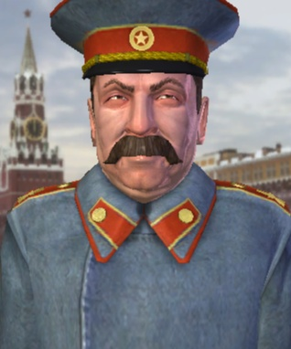
OOP is NOT a Democracy (sorry)
No copying
Do assigned reading & work
Write good quality code
Use the coding standard
Install required software on
your machine
No food in lab (drinks OK)
Participate in class

Slide 12
Copying
Copy anything => Fail (F). Including Homework.
No second chance.

Slide 13
Required Software (on your machine)
Java SDK version 8 or 11.
Java API docs: install locally and bookmark in your browser. Don't rely on Internet!
IDE your choice: Eclipse, Netbeans, IntelliJ, BlueJ
Git client
  command line "git" is required
  you can also use git client in your IDE
Recommended:
Java tutorial from Oracle.

Slide 14
Do Assigned Work
1. Some reading every week. Approx. 30-60 pages.
2. Programming assignment every 2 weeks.
Longer than lab exercises.
Learn a lot from PA, and big impact on your grade.
3. Homework, sometime submitted sometimes not.

Slide 15
Write Good Quality Code
1. Write meaningful Javadoc comments.
2. Code should be easy to read.
3. Use the class coding standard.
It is based on industry standards for Java, derived from Oracle's Java standard.
No Javadoc == No Credit

Slide 16
Use the Java Coding Standard
Always.
See handout.
Handout also in docs folder.
Exercise in class

Slide 17
Lab
Please do not bring food into lab.
Drinks are OK, but please clean up.

Slide 18
Class Homepage and Repository
Schedule and Info
https://skeoop.github.io/

Slide 19
e-Textbook
[BIGJ] Horstmann, Big Java. 5E or newer.
Other Good Books:
Programming with Java by David Eck - free online
Modern Java in Action, 2E (2019)
Head First Java, easy to read, memorable, but long
Core Java for the Impatient

Slide 20
Why Put in Effort?
We are what we do.
Excellence, therefore, is a habit.
-- Aristotle
Push yourself in every course ...
develop a habit of excellence in everything
prepare for your career
get "A" (maybe)
enjoy your time at KU more

Slide 21
Why Practice?
I hear and I forget,
I see and I remember,
I do and I understand.
-- Confucius

