Slide 1
Composite Pattern
Context:
We have an application that uses a variety of components, and the components all have the same behavior.
We want to define a collection of components, so that the collection behaves like a single component.
Forces:
1) we want components to be freely composable.
2) we don't want the application to handle the composite as a special case, which would add complexity.

Slide 2
Composite Pattern
Solution:
Define a composite that implements the component interface and contains a collection of components. The composite is responsible for managing the components inside it.
Component
+ paint( g: Graphics )
...other methods...
*
Composite
+paint( g: Graphics )+add( Component )
+remove( Component )
Button
+paint( g: Graphics )
...
TextComponent
+paint( g: Graphics )
...

Slide 3
Consequences
The application can treat the composite exactly the same as a generic component.
Complexity of managing many components is delegated to the composite component.
Example:
In a GUI framework, a Container is a composite component. A Container is itself a subclass of Component.
Java: JPanel and JWindow are Containers.
Tkinter: Frame, PanedWindow (split pane), TopLevel

Slide 4
Application
Keypad:
In a calculator application we need several Keypads:
Numeric keypad: digits 0 - 9 and . (decimal point)
Operator keypad: +, -, *, /, mod, =
Function keypad
Forces:
We want to divide the UI into areas for keypad, operators, ....
We don't want dozens of button objects & event listeners.
We'd like to treat each keypad as a single GUI widget.
We want to add an event listener only once, set the font or color only once, and have it apply to all the keys.

Slide 5
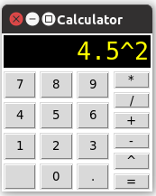
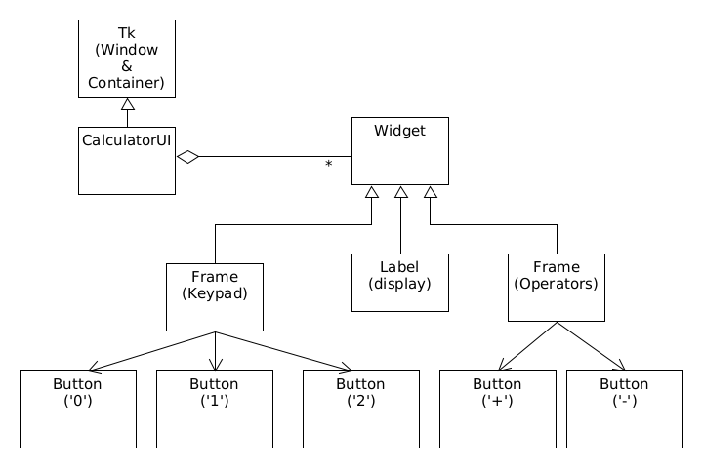
Calculator UI with Containers

Slide 6
Calculator UI with Keypad
window = tk.Tk()
# Frame (container) for digits
keypad = tk.Frame(window)
digit1 = Button(keypad, text="1", command=handle_digit)
digit2 = Button(keypad, text="2", command=handle_digit)
digit3 = Button(keypad, text="3", command=handle_digit)
digit1.grid(row=0, column=0)
digit2.grid(row=0, column=1)
...
# Frame (container) for operators using Buttons
operator_pad = tk.Frame(window)
for op in ['+', '-', ...]:
op_key = Button(operator_pad, text=op, command=...)
op_key.grid(row=next(rownum), column=0)
# Layout frames in window
keypad.pack(side=tk.LEFT, fill=True, expand=tk.X)
operator_pad.pack(side=tk.RIGHT, fill=True, expand=...)

Slide 7
Bundled Item in Shopping App
Context:
A store wants to offer a special price on a "bundle" of Items for sale in the store. The customer gets special price if he buys Items in a bundle, e.g. buy Beer & Peanuts.
Forces:
The promotions change often. The store doesn't want to modify the software to know about promotions.
Solution:
Define a special "bundled item" with its own UPC code.
The software treats a "bundled item" like any other product.
The "bundled item" contains all items in the bundle.

Slide 8
Bundled Item
Classes
Sale - contains the items in a purchase
LineItem - a single item in a purchase
BundleItem - composite LineItem
UML Diagram - in class
Consequences
Adds complexity to the way items are added to a Sale, and how items are removed from a Sale.

