Slide 1
Design Patterns
James Brucker

Slide 2
Reusable Solutions
All engineering disciplines reuse proven good solutions
Civil Engineer
standard designs and construction methods based on experience
Circuit Designer
reuse component designs in integrated circuits
Architect
reuse design patterns in home and building design

Slide 3
Reusable Ideas in Software
Developers reuse knowledge, experience, & code
Application Level
reuse the design & code of a similar project
Design Level
apply known design principles and design patterns
Logic Level
apply known algorithms to implement behavior
Method Implementation (Coding) Level
use programming idioms for common tasks

Slide 4
A Programming Idiom
Problem: process every element of an array
Idiom: 1. initialize result 2. loop over the array 3. process each element of the array
// add the values of all the coupons we have sold...
Coupon [ ] coupons = ...
double total = 0; // initialize
for( int k=0; k<coupons.length; k++ ) { // loop
total += coupons[k].getTotal(); // process each one
}

Slide 5
An Algorithm
Problem:
find the shortest path from node A to node B in a graph
Solution:
apply Dykstra's Shortest Path algorithm

Slide 6
Reusable Code
Requirement:
sort a List of Persons by last name. Ignore case.
Solution:
Write a Comparator and use Collections.sort
List<Person> people = registry.getPeople( );
Comparator<Person> compByName = new Comparator<>() {
public int compare(Person a, Person b) {
return a.getLastname().compareToIgnoreCase(
b.getLastname());
}
};
java.util.Collections.sort( people, compByName );

Slide 7
Reusable Code
Requirement:
keep a log of activity & events in a file, so we have a record of what was done and any problems that occur.
Solution:
Use the open-source Log4J or slf4j framework.
public class Purse {
private static final Logger log =
Logger.getLogger(Purse.class);
public boolean insert(Money m) {
if (m == null) log.error("argument is null");
else log.info("inserting " + m);

Slide 8
Logger Output
Log File:
You control where logging is output, and how much detail is recorded. Config file: log4j.properties.
Example:
6:02:27 Purse insert INFO inserting 10 Baht
6:03:00 Purse insert INFO inserting 20 Baht
6:03:10 Purse insert ERROR argument is null
6:03:14 Purse withdraw INFO withdraw 10 Baht
Class and Method
message
Severity

Slide 9
What is a Design Pattern?
A situation that occurs over and over, along with a reusable design of a solution.

Slide 10
Format for Describing a Pattern
Pattern Name: Iterator
Context
We need to access elements of a collection.
Motivation (Forces)
We want to access elements of a collection without the need to know the underlying structure of the collection.
Solution
Each collection provides an iterator with methods to get the next element and check for more elements.
Consequences
Application is not coupled to the collection. Collection type can be changed w/o changing the application.

Slide 11
Diagram for Iterator
Iterator Design Pattern
T is a type parameter
Iterator in Python
<<abstract>>
Iterator[T]
__next__(): T
<<interface>>
Iterator<T>
hasNext(): bool
next(): T
ConcreteIterator
hasNext(): bool
next(): T
ConcreteIterator
__next__(): T

Slide 12
How do you Get an Iterator?
Context:
We want to create an Iterator to iterate over some objects, without knowing the class of the group of objects.
Forces:
We don't want the code to be coupled to a particular collection. We want to create iterators in the same way.
Collection<String> stuff = Foo.getElements();
Iterator<String> iterator = stuff.iterator();

Slide 13
Solution: Define a Factory Method
A factory method is a method that creates other objects.
<<interface>>
Iterable<T>
iterator( ): Iterator<T>
<<interface>>
Iterator<T>
hasNext( ): bool
next( ): T
creates
Collection
iterator()
ConcreteIterator
creates

Slide 14
Structure of Iterator Pattern
access elements of
Application
Collection
iterator( ): Iterator
Iterator
hasNext( ): bool
next( ): Element
creates
ConcreteIterator
cursor
hasNext( ): bool
next( ): Element
Data Source

Slide 15
Example
List<String> list = new ArrayList<>( );
list.add( "apple" );
. . . // add more elements
Iterator<String> iter = list.iterator( );
while( iter.hasNext( ) ) {
System.out.println( iter.next() );
}

Slide 16
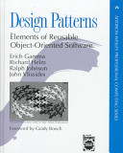
Design Patterns - Gang of Four book
The "Gang of Four"
The first book to popularize the idea of software patterns:
Gamma, Helm, Johnson, Vlissides Design Patterns: Elements of Reusable Object-Oriented Software. (1995)

Slide 17
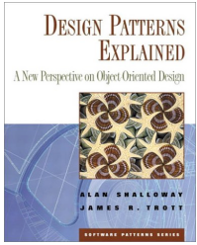
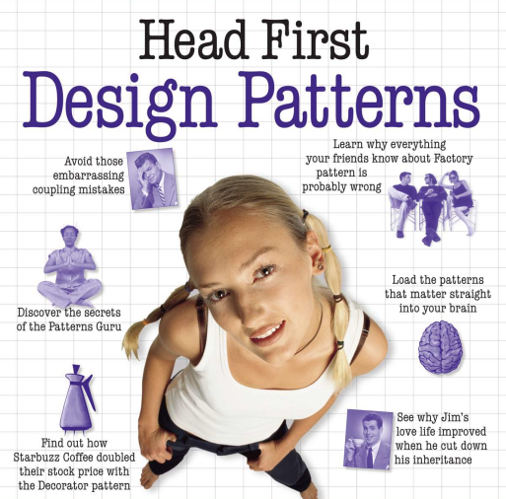
Good Design Patterns Books
Good for Java programmers
Design Patterns Explained, 2E (2004) by Allan Shallow & James Trott also wrote: Pattern Oriented Design.
Head First Design Patterns (2004) by Eric & Elizabeth Freeman
Visual & memorable examples, code is too simple.

Slide 18
Structure of Patterns in Gang of Four book
Name of Pattern
Intent
what the pattern does.
Motivation
Why this pattern. When to apply this pattern
Structure
Logical structure of the pattern. UML diagrams.
Participants and Collaborators
What are the elements of the pattern? What do they do?
Consequences
The benefits and disadvantages of using the pattern.

Slide 19
Iterator Pattern
Pattern Name: Iterator
Context
We need to access elements of a collection.
Motivation (Forces)
We want to use or view elements of a collection without the need to know the underlying structure of the collection.
Solution
Each collection provides an iterator with methods to check for more elements and get the next element.

Slide 20
Design Patterns To Know
1. Iterator
2. Adapter
3. Factory Method
4. Decorator
5. Singleton
6. Strategy - Layout Manager, used in a Container
7. State
8. Command
9. Observer
10. Facade

Slide 21
SKE Favorite Design Patterns
The SKE12 Software Spec & Design class was asked:
"What patterns are most instructive or most useful?"

Slide 22
SKE12 Favorite Patterns
Pattern Votes
MVC 18
State 17
Factory Method 16
Command 15
Strategy 15
Facade 12
Singleton 12
Iterator 11
Observer 11
Adapter 8
Decorator 4
Template Method 3

Slide 23
Categories of Patterns
Creational - how to create objects
Structural - relationships between objects
Behavioral - how to implement some behavior

Slide 24
Situations (Context) not Patterns
Learn the situation and the motivation (forces) that motivate the solution.
Pay attention to Applicability for details of context where the pattern applies. (Avoid applying the wrong pattern.)

Slide 25
Adding New Behavior
Situation:
we want to add some new behavior to an existing class
Forces:
1. don't want to add more responsibility to the class
2. the behavior may apply to similar classes, too
Example:
Scrollbars

Slide 26
Changing the Interface
Situation:
we want to use a class in an application that requires interface A. But the class doesn't implement A.
Forces:
1. not appropriate to modify the existing class for the new application
2. we may have many classes we need to modify
Example:
change an Enumeration to look like an Iterator

Slide 27
Convenient Implementation
Situation:
some interfaces require implementing a lot of methods. But most of the methods aren't usually required.
Forces:
1. how can we make it easier to implement interface?
2. how to supply default implementations for methods?
Example:
MouseListener (6 methods), List (24 methods)

Slide 28
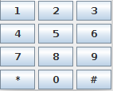
A Group of Objects act as One
Situation:
we want to be able to use a Group of objects in an application, and
the application can treat the whole group like a single object.
Forces:
There are many objects that behave similarly. To avoid complex code we'd like to treat as one object.
Example:
KeyPad in a mobile phone app.

Slide 29
Creating Objects without Knowing Type
Situation:
we are using a framework like OCSF.
the framework needs to create objects.
how can we change the type of object that the framework creates?
Forces:
1. want the framework to be extensible.
2. using "new" means coupling between the class and the framework.
Example:
JDBC (Java Database Connection) creates connections for different kinds of databases.

Slide 30
Do Something Later
Situation:
we want to run a task at a given time (in the future)
Forces:
we don't want our "task" to be responsible for the schedule of when it gets run.
This situation occurs a lot, so we need a reusable solution.
Example:
We're writing a digital clock. We want an alarm to sound at a specified time.

