Slide 1
Design Patterns
James Brucker

Slide 2
Reusable Solutions
All engineering disciplines reuse proven good solutions
Civil Engineer
standard designs and construction methods based on experience
Circuit Designer
reuse component designs in integrated circuits
Architect
reuse design patterns in home and building design

Slide 3
Reusable Ideas in Software
Developers reuse knowledge, experience, & code
Application Level
reuse the design & code of a similar project
Design Level
apply known design principles and design patterns
Logic Level
apply known algorithms to implement behavior
Method Implementation (Coding) Level
use programming idioms for common tasks

Slide 4
A Programming Idiom
Problem: apply a function to every element in a list
Idiom: 1. Need result as a list? Use a list comprehension.
2. Will result be processed further? Are there many values? Consider map instead:
map(f, mylist)
result = [f(x) for x in mylist]

Slide 5
An Algorithm
Problem:
find the shortest path from node A to node B in a graph
Solution:
apply Dykstra's Shortest Path algorithm

Slide 6
Reusable Code
Requirement:
Sort a List of Persons by last name, ignoring case.
Solution:
Use sorted(iterable, key=function)
people = [Person("Joseph","Biden", ...),
Person("Prayut","Chan-o-cha", ...),
Person("Jing Ping", "Xi", ...)
]
sorted(people, key=lambda p: p.last_name)

Slide 7
Libraries of reusable code
Requirement:
Download data from the Internet in JSON format, and convert it to a dictionary of key-values.
Solution:
Use the requests package. (pip install requests)
"""Get info about a github user."""
import requests
url = f"https://api.github.com/users/{username}"
response = requests.get(url)
# parse the response, same as json.loads(response.text)
data = response.json()
print(data)

Slide 8
What is a Design Pattern?
A situation that occurs over and over, along with a reusable design of a solution.

Slide 9
Format for Describing a Pattern
Pattern Name: Iterator
Context
We need to access elements of a collection or data src.
Motivation (Forces)
We want to access each element of a collection without knowing the underlying structure of the collection.
Solution
Each collection provides an iterator with a method to get the next element.
Consequences
Application is not coupled to any specific kind of collection. Our code can work with any collection that provides an iterator.

Slide 10
UML Diagram for Iterator
<<interface>>
Iterator<T>
hasNext(): bool
next(): T
implements
ConcreteIterator
hasNext(): bool
next(): T

Slide 11
Interface
Interface = specifies behavior (method signatures) but not an implementation of the behavior.
Example:
USB Interface specifies how a USB connection should behave. Any manufacturer of USB devices can implement the USB interface, according to the specification.
USB devices from different manufacturers can inter-operate if they conform to the same specification.

Slide 12
Python 'Type' as Interface
Python defines "types" for Iterator & Iterable in package collections.abc
https://docs.python.org/3/library/collections.abc.html#collections-abstract-base-classes
Annoyance
These types were defined in the typing package (which made sense!) but have been deprecated and replaced by types in collections.abc package.
<<type>>
Iterator[T]
__next__(): T

Slide 13
Diagram for Iterator
In the Design Pattern
In Python
<<interface>>
Iterator<T>
hasNext(): bool
next(): T
Iterator[T]
__next__(): T
implements
provides
ConcreteIterator
hasNext(): bool
next(): T
ConcreteIterator
__next__(): T

Slide 14
Examples of Iterator
What Iterators have you used?
In Python you rarely use iterators directly, but you can.
>>> fruit = ["Apple", "Banana", "Durian", ...]
>>> it = iter(fruit) # creates an iterator
>>> next(it)
'Apple'
>>> next(it)
'Banana'
>>> next(it)
'Durian'

Slide 15
Iterator in Python
collections.abc.Iterator - abstract base class
Since Python 3.9, this ABC accepts type parameter:
Iterator[date] = an iterator for date objects.
Example: a Calendar class provides iterators for Events in your calendar:
class Calendar(Iterator[Event])

Slide 16
How do you Get an Iterator?
Context:
We want to create an Iterator without depending on the API for a particular collection or data source.
Forces:
We don't want the code to be coupled to a particular collection type. We want to always create iterators in the same way for any collection.

Slide 17
Solution: Define a Factory Method
Define a method iterator() that creates an Iterator.
<<interface>>
Iterable<T>
iterator( ): Iterator<T>
<<interface>>
Iterator<T>
hasNext( ): bool
next( ): T
creates
implements
implements
Collection
iterator()
ConcreteIterator
creates

Slide 18
Iterable in Python
In Python, an Iterable has a __iter__ method that returns an Iterator.
<<factory>>
Iterable[T]
__iter__( ): Iterator[T]
Iterator[T]
__next__( ): T
creates
provides
provides
MyCollection
__iter__()
MyIterator
creates

Slide 19
What Uses an Iterable?
Anything that is Iterable or Iterator can be used as the data source in a "for" loop, list comprehension, or map.
for loop:
for x in iterable:
list comprehension
[f(x) for x in iterable if condition(x)]
map function:
map( function, iterable)
builtin functions:
max(iterable), min(iterable),
sum(iterable), any(iterable), ...

Slide 20
Benefit: Polymorphism & Code Reuse
The benefit of Iterable is that this built-in code will work with any Iterable object -- even objects the programmer defines.
for x in iterable:
[f(x) for x in iterable if condition(x)]
map( function, iterable)
max(iterable), min(iterable),
sum(iterable), any(iterable), ...

Slide 21
What objects are Iterable?
list
set
dict (iterator over keys)
file: file = open("somefile.txt"). Iterator returns lines
strings, Generators, Maps
Are strings really iterable??
>>> s = "hello there"
>>> iterator = iter(s)
>>> next(iterator)
'h'
...

Slide 22
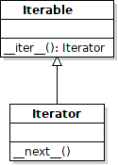
Python Iterator is Unusual
In Python, Iterable is a subtype of Iterator
Iterators can create new iterators.
Just call iter(iterator)

Slide 23
Example
In the Wallet app, we want a way to view (but not modify) what is in the wallet.
Solution:
Provide an __iter__ method that returns an iterator over the Enrollments in our CourseList.
Benefit:
Apps don't need to know the internal structure of the wallet. They use the standard Iterator interface.

Slide 24
Example Code
from collections.abc import Iterable # Python 3.9
class CourseList(Iterable[Enrollment]):
def __init__(self):
"""Initialize an empty courselist."""
self._enrollments = []
def __iter__(self) -> Iterator[Enrollment]:
"""Return an iterator for enrollments"""
return iter(self._enrollments)
List is Iterable, so we use iter(list) to create an iterator.

Slide 25
Using the Iterator
mycourselist = CourseList()
mycourselist.enroll(Course("01219116",...))
mycourselist.enroll(Course("01219244",...))
mycourselist.enroll(...)
# show what we have enrolled
for enrollment in mycourselist:
print(enrollment)
# how many credits?
sum(e.course.credits for e in mycourselist)

Slide 26
Learn Design Patterns on the Web
Many good resources!
https://refactoring.guru/design-patterns
Examples use pseudo-code (similar to Java)
Game Programming Patterns
https://gameprogrammingpatterns.com/contents.html
Uses C++ for examples.
The explanations are not so good (in my opinion).

Slide 27
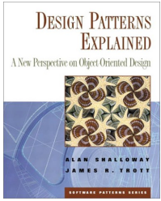
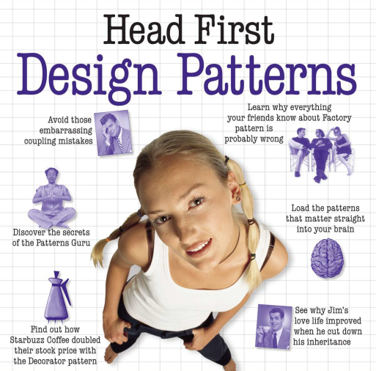
Good Design Patterns Books
Good for Java programmers
Design Patterns Explained, 2E (2004) by Allan Shallow & James Trott also wrote: Pattern Oriented Design.
Head First Design Patterns (2020, 2004) by Eric & Elizabeth Freeman
Visual & memorable examples, code is too simple.

Slide 28
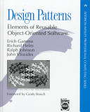
The Classic "Gang of Four" book
The "Gang of Four"
The first book to popularize the idea of software patterns:
Gamma, Helm, Johnson, Vlissides Design Patterns: Elements of Reusable Object-Oriented Software. (1995)

Slide 29
Structure of Design Patterns in Gang of Four book
Name of Pattern
Intent
what the pattern does.
Motivation
Why this pattern. When to apply this pattern
Structure
Logical structure of the pattern. UML diagrams.
Participants and Collaborators
What are the elements of the pattern? What do they do?
Consequences
The benefits and disadvantages of using the pattern.

Slide 30
Design Patterns To Know
1. Iterator
2. Adapter
3. Factory Method
4. Decorator
5. Singleton
6. Strategy - Layout Manager, used in a Container
7. State
8. Command
9. Observer
10. Facade

Slide 31
SKE Favorite Design Patterns
I asked SKE12 Software Spec & Design class:
"What patterns are most instructive or most useful?"

Slide 32
SKE12 Favorite Patterns
Pattern Votes
MVC 18
State 17
Factory Method 16
Command 15
Strategy 15
Facade 12
Singleton 12
Iterator 11
Observer 11
Adapter 8
Decorator 4
Template Method 3

Slide 33
Categories of Patterns
Creational - how to create objects
Structural - relationships between objects
Behavioral - how to implement some behavior

Slide 34
Situations (Context) not Patterns
Learn the situation and the motivation (forces) that motivate the solution.
Pay attention to Applicability for details of context where the pattern applies. (Avoid applying the wrong pattern.)

Slide 35
Adding New Behavior
Situation:
we want to add some new behavior to an existing class
Forces:
1. don't want to add more responsibility to the class
2. the behavior may apply to similar classes, too
Example:
Scrollbars

Slide 36
Changing the Interface
Situation:
we want to use a class in an application that requires interface A. But the class doesn't implement A.
Forces:
1. not appropriate to modify the existing class for the new application
2. we may have many classes we need to modify
Example:
change an Enumeration to look like an Iterator

Slide 37
Convenient Implementation
Situation:
some interfaces require implementing a lot of methods. But most of the methods aren't usually required.
Forces:
1. how can we make it easier to implement interface?
2. how to supply default implementations for methods?
Example:
MouseListener (6 methods), List (24 methods)

Slide 38
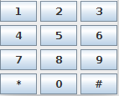
A Group of Objects act as One
Situation:
we want to be able to use a Group of objects in an application, and
the application can treat the whole group like a single object.
Forces:
There are many objects that behave similarly. To avoid complex code we'd like to treat as one object.
Example:
KeyPad in a mobile phone app.

Slide 39
Creating Objects without Knowing Type
Situation:
we are using a framework like OCSF.
the framework needs to create objects.
how can we change the type of object that the framework creates?
Forces:
1. want the framework to be extensible.
2. using "new" means coupling between the class and the framework.
Example:
JDBC (Java Database Connection) creates connections for different kinds of databases.

Slide 40
Do Something Later
Situation:
we want to run a task at a given time (in the future)
Forces:
we don't want our "task" to be responsible for the schedule of when it gets run.
This situation occurs a lot, so we need a reusable solution.
Example:
We're writing a digital clock. We want an alarm to sound at a specified time.

