Slide 1
Observer Pattern
Context:
An object (Subject) is the source of events. Other objects (Observers) want to know when an event occurs.
Or
several objects should be updated whenever the state of one object changes, e.g. an editor with live preview.
Forces:
We don't want the observers to poll for changes, which is inefficient.
We don't want the Subject to be coupled to the observers.

Slide 2

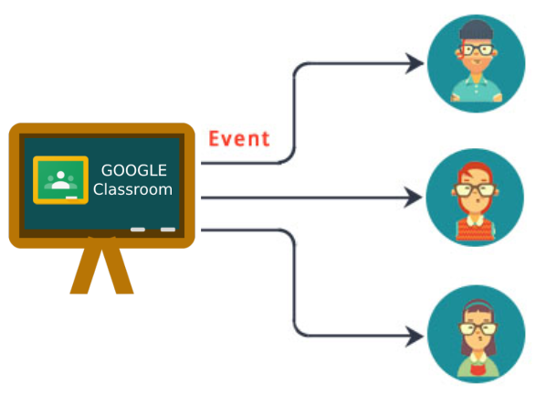
Example
Students using Google Classroom want to be notified when there is something new in one of their classes.
A new assignment is an "event". Google Classroom notifies interested Observers.
Each observer can choose how he/she wants to be notified.
Event
Notify

Slide 3
Observer Pattern
Solution:
(1) Subject provides a method for Observer to register itself to receive event notification.
(2) When an event occurs, Subject calls a "notify" method -- this method notifies Observers.
(3) To avoid complicating the Subject, implement the registration and notification code in a separate class.
This class can be a superclass of the Subject, or another class that the Subject delegates to.

Slide 4
UML for Observer Pattern
(1) Subject provides a method for Observers to register themselves as wanting to be notified of events. Method: addObserver( )
(2) Each Observer implements a known method (notify) for the Subject to invoke when an event occurs.
Observable
- observers: Collection
+addObserver(observer)
+deleteObserver(observer)
+notifyObservers(info)
Observer
+update( event: Object )
...
ConcreteObserver
+update( event )
...
AnotheObserver
+update( event )
...
ConcreteSubject

Slide 5
Button uses Observer
Subject: Button is the source of events.
Event: button press
Observer: an object that want to know when the button is pressed. In Tkinter, this can be simply a function.
button.bind('<event>', observer)

Slide 6
What is an Event? What is a notification?
In Tkinter, what is the function signature of the "update" method?
Example: button press
button = tk.Button(root, text="Do It")
button.bind('<Button>', event_handler)
def event_handler(?, ?, ...) -> ?:

Slide 7
Event Handler Signature?
What is the function signature for an event handler?
name and type of the parameters
type and meaning of the return value
If you don't know how to find the answer, try:
https://docs.python.org/3/library/tkinter.html
read the section "Binding and Events".

Slide 8
How to Get Source of an Event?
An Event Handler may be...
attached to many components (widgets)
Example: button handler for many 'keys'
used to handle many different events
How can an event handler determine the source of an event?

Slide 9
Example: get the button text
def handle_click( ) -> :
text = (get source text)
print(text)
button1 = tk.Button(root, text="1")
button2 = tk.Button(root, text="2")
button1.bind('<Button>', handle_click)
button2.bind('<Button>', handle_click)

Slide 10
Button Observer in JavaFX
This observer counts button presses.
/** An observer that counts button presses */
public class ClickCounter implements EventHandler<ActionEvent> {
private int count = 0;
/** Method to receive event notification. */
public void handle(ActionEvent evt) {
count += 1;
System.out.println("Click number "+count);
}
public int getClickCount() { return count; }
}

Slide 11
Register the Observer
We must add ClickCounter as an observer of the Button.
This is called registering an observer.
Button button = new Button("Press Me");
ClickCounter counter = new ClickCounter();
// register the observer
button.addEventHandler(ActionEvent.ACTION,
counter );

Slide 12
Benefits of using Observers
1. Button is not coupled to the actual observer classes.
Button depends only on the interface for observers.
2. We can add new observers any time (extensible).
3. We can reuse the same code for many components.

Slide 13
Table for Identifying a Pattern
Name In Pattern | Name in Application: this is for a Button
Subject | Button
Observer | EventHandler
Concrete Observer | a class that implements EventHandler
addObserver( Observer ) | addEventHandler( ) or setOnAction(this)
notify( Event ) [in the observer] | handle( ActionEvent )
notifyObservers [in Subject] | fireEvent( ActionEvent )

Slide 14




Adding Observers to your App
How can we use the Observer Pattern in our code?
Example: A UI for Wallet that shows what the balance is.

Slide 15
Observer Pattern in Java
Java provides an Observable class and Observer interface that make it easy to use the Observer pattern..
Observable
- observers: Collection
+addObserver(Observer)
+deleteObserver(...)
+notifyObservers(Object)
Observer
+update( Observable, Object )
addObserver(this)
YourApplication
-event( )
...
YourObserver
+update( observable, event )
...
void event( ) {
setChanged( );
notifyObservers(obj);

Slide 16
Using the Observable class
(1) Declare that your Subject class extends Observable
public class Purse extends Observable
{
/** An event the observers want to know about */
public boolen insert(Valuable money) {
doSomeWork( );
// now notify the observers
setChanged( );
notifyObservers( ); // can include a parameter
}
(2) When an event or change occurs, invoke setChanged() and notifyObservers()

Slide 17
Writing an Observer
(3) Declare that observers implement the Observer interface.
public class MyObserver implements Observer {
/* This method receives notification from the
* subject (Observable) when something happens
* @param subject Observable that caused notif.
* @param message is value of parameter sent
* by subject. May be null.
*/
public void update( Observable subject,
Object message ) {
purse = (Purse)subject;
...
}
(4) update receives notifications from the Observable Subject.

Slide 18
Last Step: add Observers to Subject
Call addObserver() to register the Observers with subject.
public static void main(String [] args) {
Purse subject = new Purse( );//Observable
MyObserver observer = new MyObserver( );
subject.addObserver( observer );
subject.run( );
}

Slide 19
Example for Wallet
What are the interesting events?
GUI observers
Observable
notifyObservers()
extends
Wallet
insert( Money )
withdraw(amount)

Slide 20
Wallet with observer notification
The purse should notify observers when the state of the purse changes.
Draw a sequence diagram of what happens, using insert() as example.

Slide 21
C# Delegates as Observers
Delegate is a type in the C# type system.
It describes a group of functions with same parameters.
Delegate can act as a collection for observers.
/** define a delegate that accepts a string **/
public delegate void WriteTo( string msg );
/** create some delegates **/
WriteTo observers = new WriteTo( out.WriteLine );
observers += new WriteTo( button.setText );
observers += new WriteTo( textarea.append );
/** call all the observers at once! **/
observers("Wake Up!");

