Slide 1
Introduction to Graphical Interface Programming in Java
Introduction to AWT and Swing

Slide 2
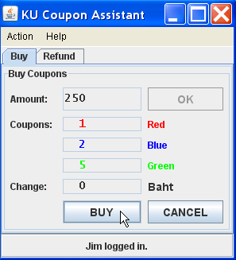
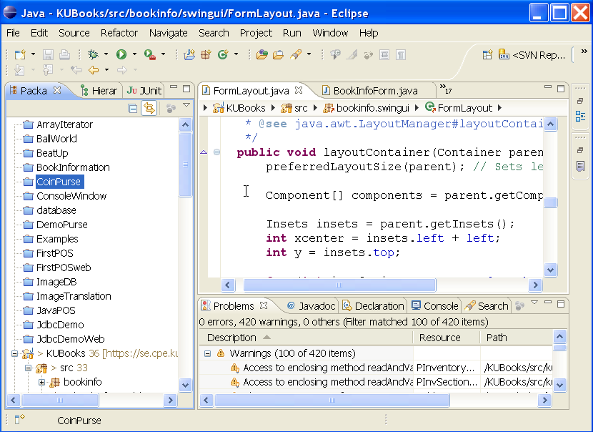
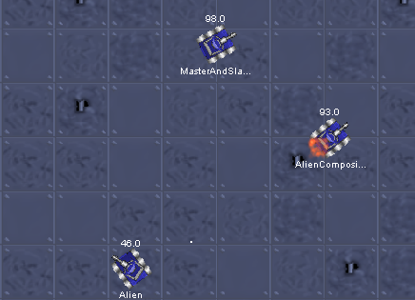
GUI versus Graphics Programming
Graphical User Interface (GUI)
Display info and accept user input
Built using components
"Forms" applications
Graphics Programming
Manipulate graphical elements on a display
points, lines, curves, shapes
texture and lighting
animation, 3D effect

Slide 3
Java Graphics Toolkits
Java provides frameworks for building graphical UIs.
AWT - Abstract Windowing Toolkit
  the first Java graphics framework
Swing - OS-independent framework.
JavaFX - layout specified in XML (fxml), like Android
  use SceneBuilder to create a layout
  can also create layout in code (like Swing)
SWT - Standard Widget Toolkit used in Eclipse, Firefox.
Designed for efficiency. An Eclipse project.

Slide 4

Simple GUI Application
A graphical interface consists of components, containers, and layouts.
Label (read-only)
TextField (input)
Button
Container contains Components

Slide 5
Designing a Simple GUI
1. create a window (a container)
2. create components
label = new Label("Username:");
input = new TextField( 12 ); // 12 = field width
button = new Button("Login");
3. layout components in a container
add( label );
add( input );
add( button );
4. display the container (frame is the container here):
frame.setVisible( true );
5. wait for user to do something

Slide 6
Graphics Toolkits
Java provides complete "frameworks" for building graphical applications.
A framework contains all the components and logic needed to manage a graphical interface.
You provide:
select components and set their properties
write application logic that controls how application responds to user actions
you may extend (subclass) existing components to create custom components

Slide 7
AWT Graphics Toolkit - java.awt
Java's first GUI toolkit
uses graphical UI components of operating system, e.g. Windows, MacOS, X-windows.
efficient, low overhead
applications look different on each platform
difficult to write and test good quality applications
different bugs on each OS, hence the slogan . . .
"Write once, debug everywhere"

Slide 8
AWT Example
import java.awt.*;
public class AwtDemo {
Frame frame;
public AwtDemo( ) {
frame = new Frame("Please Login");
// create components
Label label = new Label("Username:");
TextField input = new TextField(12);
Button button = new Button("Login");
// layout components in the container
frame.setLayout(new FlowLayout());
frame.add(label);
frame.add(input);
frame.add(button);
frame.pack();
}

Slide 9
AWT Example (continued)
To display the window, call setVisible( true )
public static void main(String [] args) {
AwtDemo demo = new AwtDemo( );
demo.frame.setVisible( true );
}
}

Slide 10
Swing Graphics Framework
Improved, OS-independent GUI framework
classes in javax.swing and sub-packages
Swing implements all components in software
applications look & behave the same on all platforms
applications may not look like native GUI apps (but you can change that by applying a LookAndFeel)
part of the Java Foundation Classes (JFC).
JFC also includes a 2D API and drag-and-drop API

Slide 11
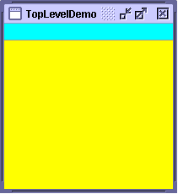
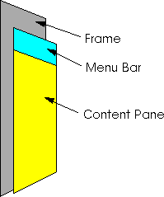
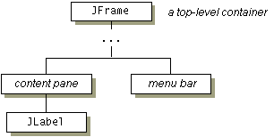
Swing Containers
JFrame is the top level container for most applications
has a title bar, menu bar, and content pane
JFrame is a heavy weight component.

Slide 12
Swing Example
import javax.swing.*;
public class SwingDemo {
JFrame frame;
public SwingDemo( ) {
frame = new JFrame("Please Login");
// create components
JTextField label = new JLabel("Username:");
JTextField input = new JTextField(12);
JButton button = new JButton("Login");
// layout components in the container
ContentPane pane = frame.getContentPane();
pane.setLayout(new FlowLayout());
pane.add(label);
pane.add(input);
pane.add(button);
pane.pack();
}

Slide 13
Swing Example (continued)
To display the window use setVisible( true )
public static void main(String [] args) {
SwingDemo demo = new SwingDemo( );
demo.frame.setVisible( true );
}
}
This is Bad Programming!
We should not directly access the private attributes of an object. We should invoke public behavior instead.

Slide 14
Demo
Create the simple "Login" interface.

Slide 15
What is Running My Program?
In the main method, setVisible(true) returns immediately.
main() exits.
But, the application is still running!
What is in control? Where is the control of flow?
public static void main(String [] args) {
SwingDemo demo = new SwingDemo( );
demo.frame.setVisible( true );
System.out.println("UI started. Bye.");
}
}

Slide 16
Swing creates its own Thread
Swing runs in a separate thread.
Or more than one thread.
One thread is special: the Event Dispatcher Thread
The Event Dispatcher Thread receives and "dispatches" all events involving the UI.
You should perform all UI updates in this thread.

Slide 17
Top Level Containers
A window that be displayed on screen:
JFrame - title bar, menu, and content pane
JWindow - no title bar or menu.
JDialog - a dialog window, has title bar
JApplet - for Applets (run in web browser).
Deprecated now.

Slide 18
What's a Component?
Also called "widgets".
Label
Textbox
Button
Slider
Checkbox
ComboBox
RadioButton
ProgressBar
xxx

Slide 19
Know your components
You need to know the available components
... and what they can do.
Visual Guide to Components
Sun's Java Tutorial
…/tutorial/ui/features/components.html
for Windows:
tutorial/ui/features/compWin.html

Slide 20
What Can a Component Do?
Common Behavior
setLocation( x, y )
setIcon( imageIcon )
setBackground( color )
setForeground( color )
setEnabled( boolean )
setVisible( boolean )
setToolTipText( string )

Slide 21
Important Components to Know
Component and JComponent provide most of the behavior that all components have!
Object
Component
AWT
Container
JComponent
Window
Panel
JPanel
JLabel
JList
Swing
Frame
Applet
JTextBox
JSlider
JButton
JComboBox
JMenuItem
JFrame
JApplet

Slide 22
Hierarchy of Graphics Components
Component
paint( graphics )
resize( ... )
Liskov Substitution Principle:
Any place where the program is expecting a Component you can use a JButton, JLabel, etc. and the program will work correctly.
JComponent
JButton
JLabel
MyComponent
...
JTextbox

Slide 23
Playing with a JButton
import java.awt.*;
import javax.swing.*;
JButton button = new JButton( "Press Me" );
//TODO: add button to a frame and pack
button.setBackground( Color.YELLOW );
button.setForeground( Color.BLUE );
button.setToolTipText( "Make my day." );
button.setFont( new Font( "Arial", Font.BOLD, 24 ) );
button.setEnabled( true );

Slide 24
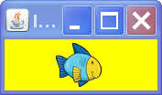
Components don't have to be boring
filename, URL, or InputStream.
Can by GIF, JPEG, PNG
ImageIcon icon = new ImageIcon("d:/images/fish.png");
button.setIcon( icon );

Slide 25
Containers and Components
A GUI has many components in containers.
Use add to put component in a container.
A container is also a component; so a container may contain other containers.
add(component)
container
component
component
add(...)
add(component)
container
container
component
component
component
component

Slide 26
Lightweight Containers
A lightweight container is one that is not a window.
You must place it inside another container.
Cannot be drawn on screen by itself.
JPanel simple rectangular area - most common
JTabbedPane - multiple panels with a tab on top
JSplitPane
JInternalFrame - like a JFrame inside a JFrame

Slide 27
Learning Java Graphics
Java Tutorial: Creating a GUI with JFC/Swing
The section "Using Swing Components" contains "How To..." examples for many components.
Good explanation and examples of Layout Managers.
"JDK Demos and Samples"
jdk_dir/demo/jfc/*
Great demos with jar files (run) and source code. http://www.oracle.com/technetwork/java/javase/downloads/index.html
Big Java, Chapter 19.

Slide 28
WindowBuilder for Eclipse
A graphical editor for creating UI with Swing or SWT.
Windowbuilder is included in Eclipse, but you may need to download & install extra components.
To find the Window Builder "Update Site" for your version of Eclipse, see:
http://www.eclipse.org/windowbuilder/download.php

Slide 29
