Slide 1
Multi-dimensional Arrays
James Brucker

Slide 2

2-Dimensional Arrays
A scalar variable is like “a box to store a number in”
A 1-dimensional array is like “a filing cabinet with a set of boxes to store numbers in (each box)”
A 2-dimensional array is like a set of “pigeonholes” with rows and columns to store numbers.

Slide 3
Multi-dimensional Arrays
An array can have more than one index:
/* score[j][k] = score of student j on lab k */
int NSTUDENT = 70; // we have 70 students
int NLAB = 10; // there are 10 labs
int [ ][ ] score = new int[NSTUDENT][NLAB];
/* read the lab scores */
for(int student=0; student< NSTUDENT; student++) {
for(lab=0; lab < NLAB; lab++)
score[student][lab] = scanner.nextInt();
}
Define an array of size 70 (rows) by 10 (columns)

Slide 4
2-D Array in Memory
The last index varies most quickly.
score[0] --> score[0][1], score[0][2], ..., score[0][9]
score[1] --> score[1][1], score[1][2], ..., score[1][9]
score[2] --> score[2][1], score[2][2], ..., score[2][9]
score[k] is an array object of type int[10]

Slide 5
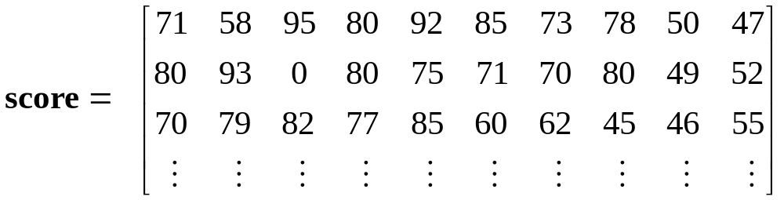
Student Lab Scores
score[ ][3] = (column 3) scores for all students on lab 3.
Scores for student 2:
score[2][0] = 70, score[2][1] = 79, ...
All scores for this student: score[2] = 1-dim. array of int

Slide 6
Using the Student Lab Scores
Sum the scores for student n:
int sum = 0;
for(int lab=0; lab<NLAB; lab++)
sum = sum + score[n][lab];
Find the average score on lab 5:
int sum = 0;
int lab = 5;
for(int j=0; j<NSTUDENT; k++)
sum = sum + score[j][lab];
float average = sum/NSTUDENT;

Slide 7
2-dimensional Array Syntax
Define a two-dimensional array reference like this:
float [ ][ ] score;
Create an array object with storage for a 4 x 5 array :
score = new float[4][5];
Or, perform both steps at once:
float [ ][ ] score = new float[4][5];
To access element (j,k) of array score:
score[j][k] = input.nextFloat( );

Slide 8
Array Properties
Two-dimensional arrays have a .length:
int [][] a = ...;
a.length is the number of rows in a
a[0].length is the number of elements in row 0
a[1].length is the number of elements in row 1
score.length is 70 (rows)
score[0].length is 10 (columns)

Slide 9
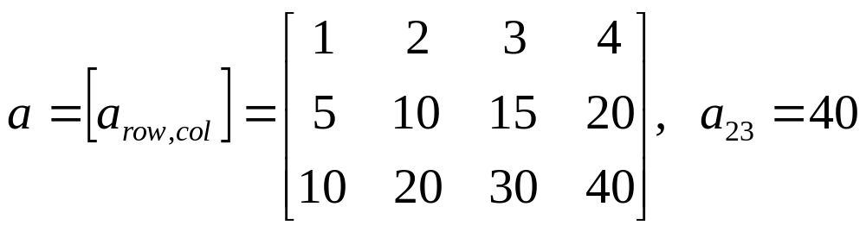
Example: 2-dimensional array
columns
rows
int [][] a = new int[3][4];
a[ 1][ 2] = 15;
a[ 0][ 3] = 4;
System.out.println( a.length ); // = 3
System.out.println( a[1].length ); // = 4

Slide 10
Common Array Usage
To process every element in an array, a common usage is two nested "for" loops like this:
/* sum all elements in the array */
int sum = 0;
for(int row=0; row < score.length; row++) {
for(int col=0; col < score[row].length; col++) {
/* process element a[row][col] */
sum = sum + score[row][col];
}
/* finished processing of this row */
}

Slide 11
Initializing a 2-D array
Example: set all elements to 1
Example: initialize b[row][col] = row+col
/* intialize all elements of array a */
for(int j=0; j<a.length; j++) /* rows */
for(int k=0; k<a[j].length; k++) /* cols */
a[j][k] = 1;
for(int j=0; j<b.length; j++) { /* rows */
for(int k=0; k<b[j].length; k++) { /* cols */
// process element b[j][k]
b[j][k] = j + k;
}
}

Slide 12
"fill": initialize a 2-D array
Arrays.fill( arr[], value ) sets all elements of a 1-dimensional array to a desired value:
/* intialize all elements of array a */
boolean [] answer = new boolean[100];
Arrays.fall( answer, true );
// sets answer[0] = answer[1] = ... answer[99] = true
Let's write a fill() method for 2-D arrays.
public static void fill( int [][] arr, int value ) {
if ( arr == null ) return;
for(int row=0; row < arr.length; row++) {
for(int col=0; col < arr[row].length; col++)
arr[row][col] = value;
}
}

Slide 13
"fill" syntax explained
The fill() method for 2-D int arrays.
fill( score, 0 );
void: this method doesn't return any value
int[][]: this parameter is a 2-D array of int
public static void fill( int [][] arr, int value ) {
if ( arr == null ) return;
for(int row=0; row < arr.length; row++) {
for(int col=0; col < arr[row].length; col++)
arr[row][col] = value;
}
}
avoid a NullPointerException by testing whether the array reference is null.

Slide 14
Make "fill" Polymorphic
We want "fill()" to work for all types of arrays: int[][] array, float[][] array, String[][] array. Write multiple implementations...
public static void fill( float [][] arr, float value ) {
if ( f == null ) return;
for(int row=0; row < f.length; row++) {
for(int col=0; col < arr[row].length; col++)
f[row][col] = value;
}
}
public static void fill( String [][] s, String value ) {
if ( s == null ) return;
for(int row=0; row < s.length; row++) {
for(int col=0; col < s[row].length; col++)
s[row][col] = value;

Slide 15
What is the name of this property?
You can have several methods with the same name if (a) the number of parameters is different, or
(b) the datatype of the parameters is different.
void fill( int [][] arr, int value);
void fill( long [][] arr, long value );
void fill( float [][] arr, float value );
Polymorphism: "many formed" (adj, polymorphic)
"poly" means many,
"morph" means form

Slide 16
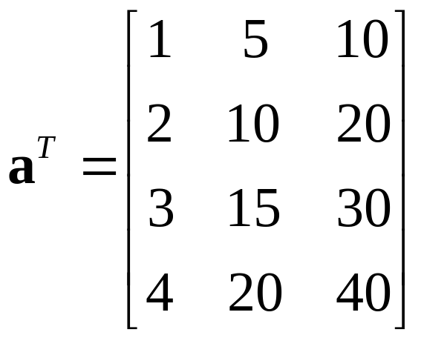
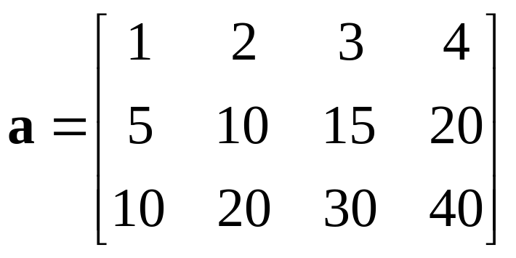
Transpose an Array
A common task to to switch the rows and columns of an array.
transpose
If a is a 3 x 4 array,
then b = transpose(a) is a 4 x 3 array,
such that b[j][k] = a[k][j] for all j, k.

Slide 17
Transpose an Array (2)
A transpose method must return a new array.
int[][]: the return value is a 2-D array of int
int[][] a: this parameter is a 2-D array of int
public static int [][] transpose( int [][] a ) {
int rows = a.length;
int cols = a[0].length;
int [][] atrans = new int[cols][rols];
.
.
.
.
return atrans;
}
new array for the transpose of a
return a reference to an int[][] array.

Slide 18
Transpose an Array (3)
Inside the method we use the standard pattern:
for(int row=0; row < number_of_rows; row++)
for(int col=0; col < number_of_cols; col++)
process element a[row][col]
public static int [][] transpose( int [][] a ) {
int rows = a.length;
int cols = a[0].length;
int [][] atrans = new int[cols][rols];
for(int row = 0; row < rows; row++) {
for(int col=0; col < cols; col++)
atrans[col][row] = a[row][col];
}
return atrans;
}
return a reference to the new array.

Slide 19
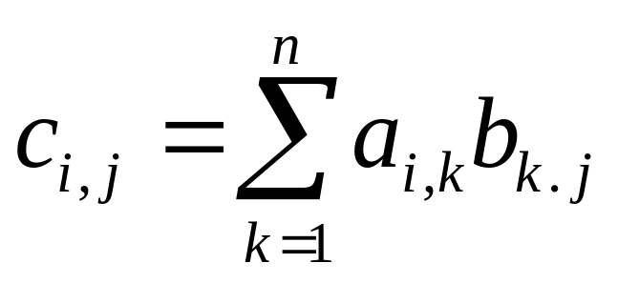
Array Multiplication
Let
A = [ a_{i j} ] = array of size m x n
B = [ b_{i j} ] = array of size n x p
What is C = A * B ?
What are the dimensions of C? m x p
Formula for computing C = [ c_{i j} ]

Slide 20
Example: Contamination
An environmental engineer is assessing the levels of contaminant in the soil at a polluted site. The contaminated area has been divided into a grid and the level of contaminant (C) has been measured in each rectangle in the grid.
This data can be stored as a 2D array and analysed
grid of sample locations
contaminated site

Slide 21
Contamination Example (2)
A student collects the data and enters it in an array...
double [][] c = {
{ 0.002, 0.005, 0.004, 0.007, 0.006 },
{ 0.003, 0.001, 0.008, 0.009, 0.010 },
{ 0.002, 0.003, 0.006, 0.009, 0.008 },
{ 0.001, 0.002, 0.005, 0.008, 0.007 },
{ 0.001, 0.002, 0.004, 0.005, 0.003 },
{ 0.002, 0.001, 0.004, 0.003, 0.002 } };
Q: What are the dimensions of the C array?
Q: Why do we have nested parenthesis?
double [][] c = { { a, b, c}, { d, e, f}, ... { m, n, o} } ;

Slide 22
Contamination Example (2)'
You can also initialize each row separately...
double [][] c = new double[6][]; // 6 rows
c[0] = { 0.002, 0.005, 0.004, 0.007, 0.006 };
c[1] = { 0.003, 0.001, 0.008, 0.009, 0.010 };
c[2] = { 0.002, 0.003, 0.006, 0.009, 0.008 };
c[3] = { 0.001, 0.002, 0.005, 0.008, 0.007 };
c[4] = { 0.001, 0.002, 0.004, 0.005, 0.003 };
c[5] = { 0.002, 0.001, 0.004, 0.003, 0.002 };
This method works even if the rows are different sizes.

Slide 23
Contamination Example (3)
We have another array of data with the soil depth (in cm) in each grid cell (depth of soil down to bedrock).
double [][] depth = { // dept in centimeters
{ 285, 310, 320, 315, 300 },
{ 275, 305, 310, 320, 295 },
{ 270, 300, 300, 310, 280 },
{ 260, 290, 280 ,270, 255 },
{ 255, 285, 270, 265, 250 },
{ 250, 280, 265, 260, 240 } };
What is the depth of this cell?

Slide 24
Contamination Example (4)
The size of each cell is 2 meter by 2 meter.
So the area of each cell is 4 m² = 40,000 cm².
the formula for calculating from concentration (c) is:
the volume of one cell is 40,000 * depth.
the mass of pollutant in cell [j][k] is:
mass in cell [j][k] = c[j][j] * volume
= c[j][k]* ( 40000 * depth[j][k] );
we need to sum this over all cells in the grid.
mass = concentration * volume ;

Slide 25
Contamination Example (5)
Use nested for loops to sum the pollution over all grid cells...
double [][] c = { /* concentration data */ };
double [][] depth = { /* grid depth data */ };
double area = 40000; // surface area per cell
double sum = 0.0;
for (int row=0; row < c.length; row++) {
for (int col=0; col < c[row].length; col++)
sum += c[row][col] * area * depth[row][col];
}
// sum = total mass of pollutant

Slide 26
Building Materials
A company makes 3 grades of cement. Each grade uses a different proportion of 4 raw materials.
Input: the number of tons (1000 kg) of each product that will be produced.
Output: how many tons of filler, binder, hardener, and sealant are needed?
Filler Binder Hardener Sealant
Product 1 0.80 0.18 0.02 0.00
Product 2 0.74 0.20 0.02 0.04
Product 3 0.64 0.22 0.04 0.10

Slide 27
Building Materials (2)
Let amount of each product to produce be:
prod[1] = tons of Product 1
prod[2] = tons of Product 2
prod[3] = tons of Product 3
Output: tons of filler, binder, hardener, and sealant
filler = 0.80*prod[1] +0.74*prod[2] +0.64*prod[3]
binder = 0.18*prod[1] +0.20*prod[2] +0.22*prod[3]
harden = 0.02*prod[1] +0.02*prod[2] +0.04*prod[3]
Filler Binder Hardener Sealant
Product 1 0.80 0.18 0.02 0.00
Product 2 0.74 0.20 0.02 0.04
Product 3 0.64 0.22 0.04 0.10

Slide 28
Building Materials (3)
/** Compute the amount of raw materials needed to
* produce a given quantity of 3 products.
* @param product is an array of quantities of
* the 3 products.
* @return amount of raw materials needed.
*/
public double [] materials( double [] product ) {
// mat = matrix of raw material per unit prod
// mat[k] = { filler, binder, harden, sealant}
// for product k.
double [][] mat = { {0.80, 0.18, 0.02, 0.0 },
{0.74, 0.20, 0.02, 0.04 },
{0.64, 0.22, 0.04, 0.10 } };

Slide 29
Building Materials (4)
double [][] mat = { {0.80, 0.18, 0.02, 0.0 },
{0.74, 0.20, 0.02, 0.04 },
{0.64, 0.22, 0.04, 0.10 } };
// how many raw materials are there?
int materials = mat[0].length;
// define an array for returned values
double [] quantity = new double[ materials ];
// compute the quantity of each
// raw material: sum over all products
for(int m= 0; m < materials; m++) {
double sum = 0;
for(int k= 0; k < product.length; k++)
sum = sum + product[k]*mat[k][m];
quantity[m] = sum;
}

Slide 30
The Truth about 2-D Arrays
Java doesn't have 2-dimensional array!

Slide 31
2-D array is an array of 1-D arrays
2-D array in Java is really an array of arrays.
Each row of the array is an array reference.
final int N = 10;
double [][] a;
a = new double[N][ ]; // create rows (an array)
for(int k=0; k<N; k++)
a[k] = new double[k+1]; // create columns
a[0] =
a[0] is an array: = new double [1]
a[1] =
a[1] is an array: = new double [2]
a[2] =
a[2] is an array: = new double [3]
a[3] =
a[2] is an array: = new double [1]

Slide 32
Ragged Array Example
We record the rainfall month for the days when it rains.
How would you read this data into a 2-D array?
How would you compute the total rainfall each month?
Rainfall data
jan 5 1.5 2.3 0.5 2.0 0.1
feb 4 1.1 0.3 0.3 1.0
mar 3 1.0 1.3 0.3
apr 0
may 0
jun 0
jun 0
jul 1 1.5
aug 4 0.8 1.2 1.8 0.9
sep 10 2.4 1.8 3.0 2.0 1.5 2.0 1.8 3.2 1.1 0.9
No rain

Slide 33
Output from Rainfall Problem
Month Total Rain Number of Rain days
Jan 6.4 5
Feb 2.7 4
Mar ... ...

Slide 34
Algorithm for Rainfall Problem
Open file of rainfall data
Create arrays to hold names of rows and rainfall data
month [] = row names
rain[][] = rain each day of each month
more data?
read month[k]
read number of data points this month.

Slide 35
Examples of 2-D Arrays

Slide 36
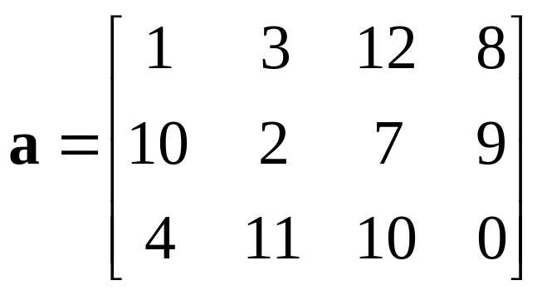
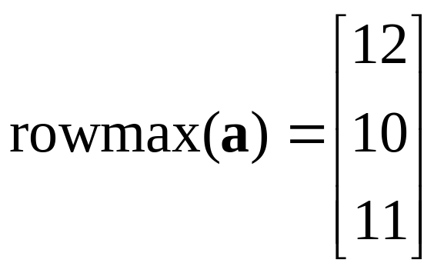
rowmax: find the max in each row
rowmax( int[][] a) returns the max value from each row
in each row, find the maximum element like this:
/* find the largest value in this row */
max = a[row][0];
for(int col=1; col < a[row].length; col++)
if ( a[row][col] > max ) max = a[row][col];
/* done processing this row. save max value. */
rowmax[ row ] = max;

Slide 37
rowmax: find the max of each row (2)
rowmax returns an array: one element for each row of a
public static int [] rowmax( int [][] a ) {
int max;
int rows = a.length;
int [] rowmax = new int[ rows ];
for(int row = 0; row < rows; row++) {
/* find the largest value in this row */
max = a[row][0];
for(int col=1; col < a[row].length; col++)
if ( a[row][col] > max ) max = a[row][col];
/* record the max value for this row. */
rowmax[ row ] = max;
}
return rowmax;
}

Slide 38
Pascal's Triangle
Pascal's Triangle is a pyramid of binomial coefficients.
Each element is the sum of 2 elements above it.
1
1 1
1 2 1
1 3 3 1
1 4 6 4 1
1 5 10 10 5 1
Pascal's triangle can be applied to combinatorial problems. It can also be used in algebra:

Slide 39
Pascal's Triangle (2)
Implement Pascal's Triangle as a 2-D array of size n.
1. Create a 2-D array with n rows:
2. Create each row (say, row number row)
3. Compute elements using Pascal's rule
int [][] p = new int[n];
p[row] = new int[row+1];
p[row][0] = p[row][row] = 1;
p[row][k] = p[row-1][k] + p[row-1][k-1];

Slide 40
Pascal's Triangle (3)
Implement Pascal's Triangle as a 2-D array.
/** generate Pascal's triangle of size n rows */
int [][] Pascal( int n ) {
// create array for row references
int [][] p = new int[n];
// create row = 0, 1, ..., n-1 of triangle
for(int row=0; k < n; k++) {
p[row] = new int[row+1];
p[row][0] = 1;
for(int k=1; k<p[row]; k++)
p[row][k] = c[row-1][k] + p[row-1][k-1];
p[row][row] = 1;
}
return p; // return reference to 2-D array
}

Slide 41
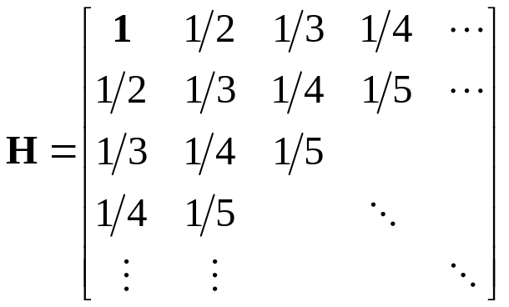
The Hadamand Matrix
// define and initialize a Hadamand array
final int SIZE = 10;
float [][] a = new int[SIZE][SIZE];
for(int j = 0; j < SIZE; j++) {
for (k=0; k<SIZE; k++) a[j][k] = 1.0/(1.0 + j + k);
}

Slide 42
Vector-Matrix Multiplication
How would you multiply a 2-dimensional array a by a 1-dimensional array x?
/* return a vector that is the product of a*x (matrix * vector) */
public static double [] multiply( double[][] a, double [] x) {
int nrows = a.length;
int ncols = x.length;
double [ ] y = new double[ nrows ];
for(int i = 0; i < nrows; i++ ) {
double sum = 0.0;
for(int j = 0; j < ncols; j++)
sum += a[i][j]*x[j];
y[i] = sum;
}
return y;
}

