Slide 1
Review of Java
… or maybe not

Slide 2
Complete this class
public _____ Foo _____ Bar _____ Comparable {
/** name of this Foo */
private String name;
/** initialize a new Foo */
public ____ Foo(String name) {
______________ = ________
}
public String toString() { return name; }
// what other method is required?
}

Slide 3
Make the name immutable
public _____ Foo _____ Bar _____ Comparable {
/** name of this Foo */
private _________ String name;
...
immutable means you cannot change the value after it is set the first time.

Slide 4
Write an access & mutator for size
public class TShirt {
/** the size of the t-shirt (inches) */
private int size;
/** Get the size of t-shirt (in inches) */
public ______ _________________ {
}
/** Set the size of this t-shirt. */
public ______ _______________ {
}
}

Slide 5
What is the difference between left & right?
boolean int double char | String Integer Date Scanner System

Slide 6
Name these Primitives
________ 32-bit whole numbers -9999 …. 0, 1, 0x10
________ 64-bit whole numbers, written like 4L
________ 'ก', 'ด', \u0420
________ 2.98E+08
________ 8-bit values 0, 1, …, 255 (not int values)
What are the other 3 primitive types?
________ ________ ________

Slide 7
Wrapper Classes
Primitive Wrapper
boolean Boolean
char Character
byte Byte
short Short
int Integer
long Long
float Float
double Double
double root = Math.sqrt( 2.0 );
Double d1 = new Double( root );
// same thing: automatic boxing
Double d2 = root;
// print as a string
out.println( d2.toString( ) );
// static method to make a string
out.println( Integer.toString( 2 ) );

Slide 8
Numeric Constants
1. What is the largest possible "int" value?
int max = ___________________________;
2. What happens if you go beyond that?
int tooBig = max + 1;
a) exception thrown
b) error
c) converts to "long"
d) wrap around to negative value
3. What are the largest and smallest (magnitude) double values?

Slide 9
What is the result?
> char c = 'A';
> c+1
> ++c
> (short) c
> (byte) c
> (char) 66
(int) c means "convert the value to an int".
This is called a cast.
You can use class name in a cast, too:
(Character) c

Slide 10
What is the result?
> c = 'ก' ; (gau gai)
> (int) c
> ++c
> (char) c
Java uses Unicode for char and Strings,
but the output may not be readable if the output device doesn't use Unicode

Slide 11
How are these different?
// 1 Billion + 2 Billion
> 1000000000 + 2000000000
> 1000000000L + 2000000000L
> 1E9 + 2E9
// in Java 7 you can write _ in numbers
> 1_000_000_000L + 2_000_000_000L

Slide 12
Bizarre Numbers
System.out.println( 12 );
System.out.println( 012 );
System.out.println( 0x12 );
System.out.println( 012 + 0x12 );

Slide 13
Which data type should you use for ...
// the day of the month
________ day = 13; // 13th of Jan
// population of the world
________ worldPop = (7 billion) ;
// Bank account number
// example: 001230055555
________ accountNumber = . . .

Slide 14
How to Convert Primitive to Object?
A List (like ArrayList) can only contain objects.
How can we add primitive values (like int) to a List?
List mylist = new ArrayList( );
int n = 51651111;
mylist.add( n ); // Wait? How is this possible?
Try in BlueJ Codepad:
> List list = new ArrayList( );
> list.add( "hello" )
> list.add( 10 ) // what is being put in the List?
> list.get( 0 )
"apple" (String)
> list.get( 1 )
<object reference> (Integer)

Slide 15
Methods to convert to/from String
int n = 29*31;
// convert n to a String
String product = Integer.toString(n);
// parse integer value of a String
String s = "123";
int m = Integer.__________ (s);
// parse double value of String s
double d = ______________________;

Slide 16
parseInt(string) versus valueOf(string)
What is the difference?
String s = "123";
Integer.parseInt( s )
Integer.valueOf( s )

Slide 17
Useful Constants in Numeric Wrapper classes
What is the largest "int" value?
What is the smallest "long" value?
What is the range (smallest, biggest) of double?
int maximum =
long minimum =
double minsize =
double maxsize =

Slide 18
What value is after the biggest value?
int n = Integer.MAX_VALUE;
n = n + 1;
System.out.println( n );
double d = Double.MAX_VALUE;
d = d + 1;
System.out.println( d );
d = d * 1.000001;
System.out.println( d );

Slide 19
Packages
Java uses packages to organize classes.
Packages reduce size of name space and avoid name collisions (like Date in java.util and java.sql).
Q: Which package contain these classes?
  Java language core classes (Object, String, System, ...).
  You never have to import this.
  Classes for input and output, like InputStream, FileReader
  Date classes and collections (List, ArrayList)
  Utilities Scanner, Arrays,
  Java Graphics frameworks (2 packages)

Slide 20
Name these Packages
 | Java language core classes Object, String, System, Integer, Double, Math, Thread.
 | Classes for input and output InputStream, BufferedReader, File
 | Date/time classes, collections, utilities Calendar, Date, List, ArrayList, Set, Arrays, Formatter, Scanner
 | java compiler always "import"s this package, so you don't need to.

Slide 21
Useful Packages added in Java 8
java.datetime | New date and time classes.
java.util.stream | Classes and interfaces for "streams" style programming. A very cool and handy feature, found in other languages.

Slide 22
Packages
What package are these classes in?
String …
System ...
Scanner …
Date …
InputStream and FileReader …

Slide 23
What is the output?
System.out.println( 3 + 4 );
System.out.println( "3" + 4 );
System.out.println( '3' + 4 );
System.out.println( 3 + "4" );

Slide 24
Bit Operations
> int a = 7;
> int b = 10;
> a & b
> a | b
> a ^ b
> a == b
> a = b
> a && b

Slide 25
Arguments are passed by value
public static void swap(int a, int b) {
int temp = a;
a = b;
b = temp;
}
// elsewhere in the code...
int m = 10;
int n = 20;
swap( m, n );
What is m?

Slide 26
Person class
Person
- name: String
<<constructor>>
Person( name: String )
getName( ): String
setName( newname: String ): void
toString(): String
Person p = new Person( "Pee" );
p.setName( "Nong" );
System.out.println( p.toString() ); // prints "Nong"

Slide 27
Passing arguments, again
public void swap(Person a, Person b) {
Person temp = a;
a = b;
b = temp;
}
// elsewhere in the code...
Person m = new Person( "Meaw" );
Person n = new Person( "Nok" );
swap( m, n );
What is m.toString() ?

Slide 28
How about this?
public void swapName(Person a, Person b) {
String temp = a.getName();
a.setName( b.getName() );
b.setName( temp );
}
// elsewhere in the code...
Person m = new Person( "Meaw" );
Person n = new Person( "Nok" );
swapName( m, n );
What is m.toString() ?

Slide 29
Difference between "==" and .equals?
> Double x = new Double(10);
> Double y = new Double(10);
> x == y
> String s = "yes";
> String t = "yes";
> s == t
> String u = new String("yes");
> s == u
> s.equals(u)

Slide 30
How to write equals( )
You should usually define equals( ) like this:
public class Person {
public boolean equals( Object other ) { … }
Not like this:
public boolean equals( Person other ) { ... }

Slide 31
JAR files
What is a JAR file?
Why use them?
How to create one?
WHERE ARE THE JDK CLASSES?
Classes in the Java SE API:
4,024 in java 7
3,793 in java 6
3,279 in java 5.0
Actually there are MORE classes that this – some classes are not documented in the API. And this number does not include interfaces.
These classes are on your computer (in the JDK). Where are they?

Slide 32
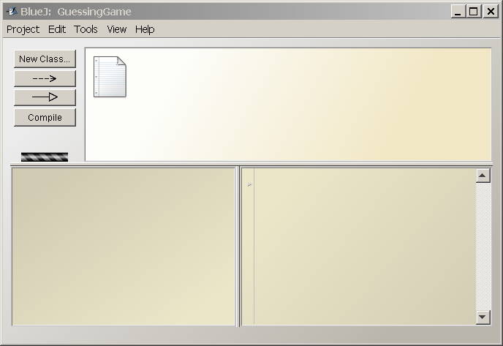
BlueJ IDE Layout
Current Project
Object Bench
Code Pad

