Slide 1
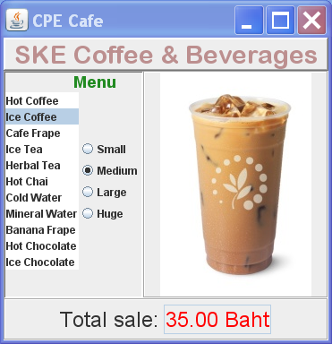
Layout a User Interface
How would you create this user interface?

Slide 2
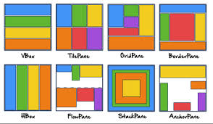
Containers, Layouts, & Controls
Graphics frameworks use containers to divide the U.I. into regions, and to layout components in each region.
In JavaFX, a Pane is a container with built-in layout :
The color blocks show how components are layed out inside of different Panes (containers).

Slide 3
Define Regions & Choose a Layout
Divide the UI into Regions using a container.
A BorderPane
TOP
LEFT
RIGHT
or
CENTER
BOTTOM

Slide 4
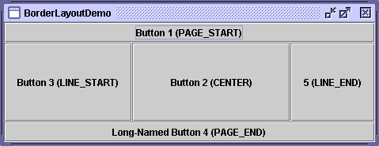
Choose a Layout
BorderPane divides a region into 5 sub-regions.
If a sub-region is empty, it is not shown.
Each sub-region grows to fit its contents.
Center gets preference for space.
use: borderpane.setTop(node) or .setCenter(node) ...
TOP
LEFT
CENTER
RIGHT
BOTTOM
Label title = new Label("SKE Coffee & ..");
borderpane.setTop(title);

Slide 5
Layout the Left Region (Menu)
We need a separate container to layout the left side.
Label with title
TOP
Label or Pane with Image
LEFT
CENTER
BOTTOM

Slide 6
Layout & Controls for Left Region
BorderPane or GridPane will work.
Label with title
TOP
RIGHT
VBox containing RadioButtons
LEFT
ListView
for menu items

Slide 7
Refine the Bottom Region
We can use a FlowPane for the bottom region.
Use pane.setAlignment() so the contents are centered.
FlowPane
BOTTOM
Label with text
Read-only TextField with price

Slide 8
Put Container inside Container
Build the overall GUI from the parts
TOP
LEFT
BorderPane for menu
RIGHT
or
CENTER
BOTTOM
FlowPane
for total

Slide 9
Controls inside Container
A GUI consists of components in containers.
A container contains other components.
JavaFX calls them Nodes, Pane, and Group
add(component)
Pane (container)
component
component
add(...)
add(component)
container
container
component1
component1
component1
component2
component2

Slide 10
How Does this Work?
A Pane or Group contains one or more Nodes.
Every control is a subclass of Node.
Subclasses of Pane provide special layouts.
Pane
contains & arranges *
Node
Control
BorderPane,
FlowPane,
HBox, etc.
Button
Label

Slide 11
A Pane is also a Node!
A Pane is also a subclass of Node.
So a Pane can contain other Panes (composition).
Pane
contains & arranges *
Node
Pane
Control
BorderPane,
FlowPane,
HBox, etc.
Button
Label

Slide 12
Composite Design Pattern
A Composite contains components,
and the Composite itself is also a kind of Component.
Composite
contains 1 or more
Component
Composite is a Component
Label
Button

Slide 13
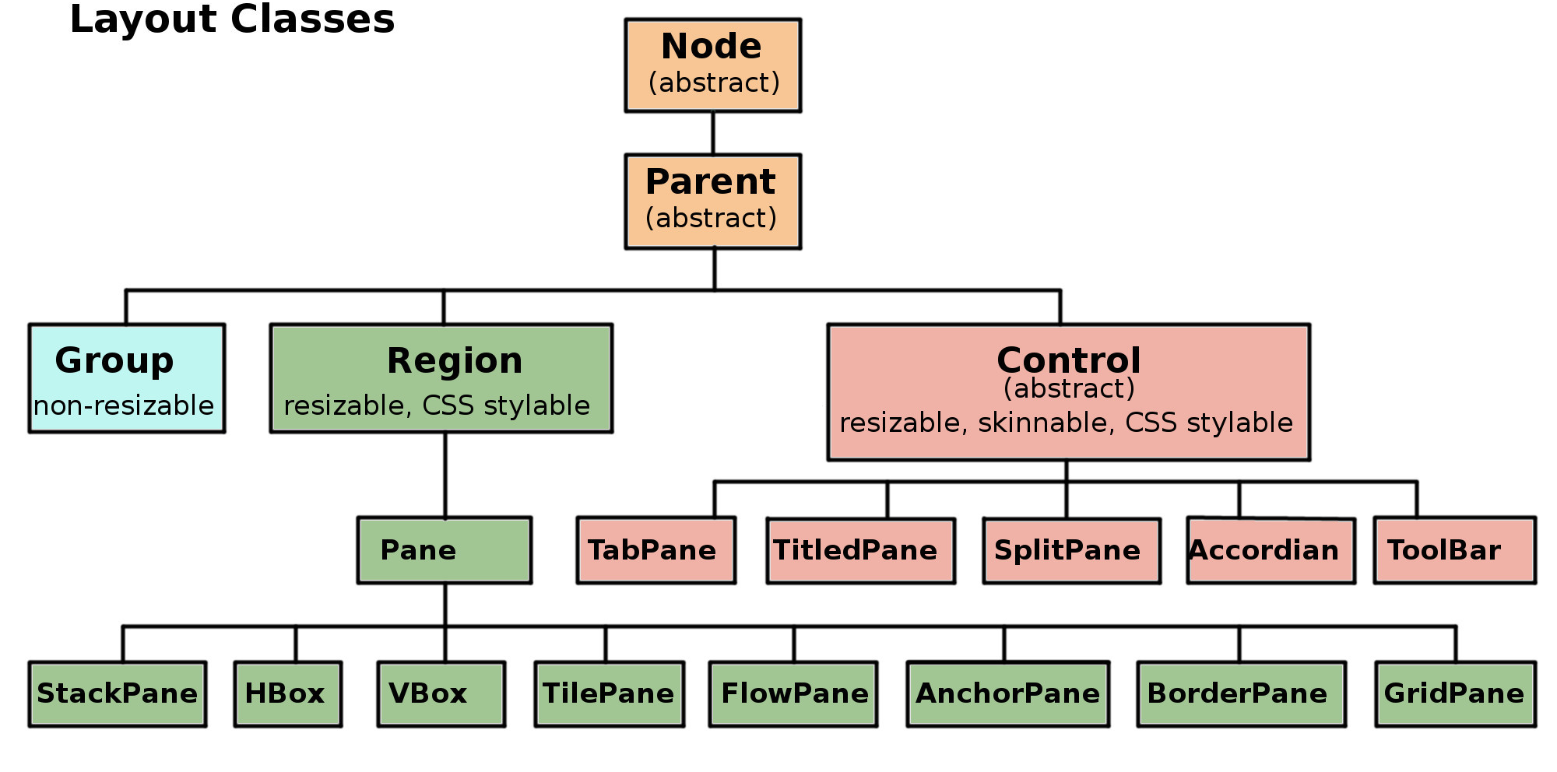
JavaFX Classes class hierarchy
Pane and Group are containers for other Nodes.
Button, TextField, etc. are subclasses of Control.
Containers

Slide 14
What You Need to Know
What are the Containers? How to they Look?
FlowPane - components "flow" to available space
BorderPane - 5 regions
GridPane - a flexible grid of components. Node can span multiple columns or rows.
VBox - vertical boxes of different sizes

Slide 15
How To Customize the Layout?
You need to know the properties you can set.
This is easier using SceneBuilder
setAlignment( Pos.CENTER )
setVGap( 2.0 ) // space between components
setHGap( 5.0 )
setPadding( new Insets(10.0) ) // space around edges
setPrefWidth( 50.0 ) // try to avoid this
prefWidthProperty().bind( scene.getWidthProperty() )
// make width match the size of the scene or parent

Slide 16
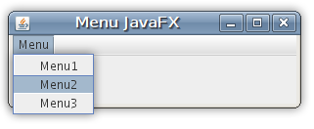
Adding a MenuBar
A JavaFX MenuBar is a Control and also a Region.
Use a Pane (container) as root node of the Scene.
Add MenuBar to a sub-region of the Pane
Example using VBox:
MenuBar
VBox
rest of the UI.
GridPane or BorderPane will also work.

Slide 17
GridPane with MenuBar & Scene graph
public void start(Stage primaryStage) {
// container for all the UI controls
Pane ui = initComponents();
// create MenuBar & add Event Handlers
MenuBar menubar = makeMenuBar();
// A Layout for MenuBar & UI
VBox root = new VBox();
root.getChildren().addAll(menubar, ui);
// the rest you already know
primaryStage.setScene(new Scene(root));
// TODO customize scene & stage?
primaryStage.show();
}

Slide 18
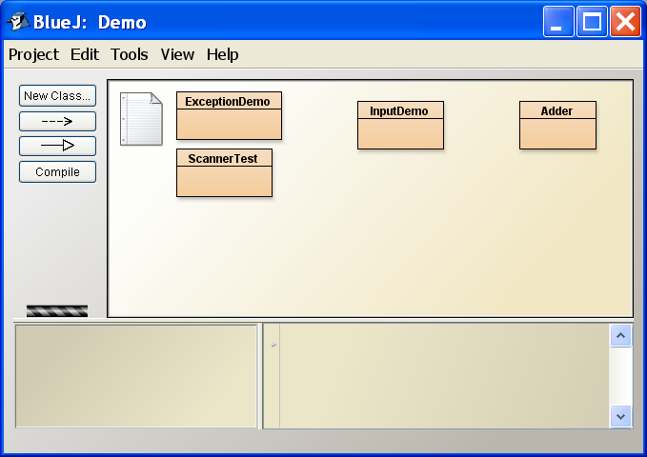
BlueJ uses nested containers
MenuBar
Container with a row of buttons
and other controls
text component
a SplitPane with 2 adjustable regions

Slide 19
Learn More
Using Built-in Layouts (Oracle JavaFX tutorial)
https://docs.oracle.com/javafx/8/layout/builtin_layouts.htm
JavaFX Tutorial on Java2s.com - http://www.java2s.com/Tutorials/Java/JavaFX/index.htm
SceneBuilder
visual layout tool - use Panes and Controls, and experiment with setting properties

