Slide 1
Polymorphism & OO Programming

Slide 2
Three Pillars of O-O Programming
Encapsulation:
an object contains both data and the methods that operate on the data. It may expose some of these members to the outside and hide others.
This design separates the public interface from the implementation, and enforces data integrity.
Inheritance:
one class can inherit attributes and methods from another class.
Polymorphism:
a behavior can be invoked on different kinds of objects, without knowing the type of object that will perform the behavior

Slide 3
Polymorphism
Poly + morph = many + forms
We can invoke a behavior (method) without knowing what kind of object will perform the behavior.
Many kinds of objects can perform the same behavior.
Object x = new Double(3.14);
x.toString(); // calls toString() of Double class
x = new Date( );
x.toString(); // calls toString() of Date class
Polymorphism

Slide 4
How does println( ) work?
System.out.println( Object x ) can print any kind of object.
Even object types we define ourselves (like Student).
How is it possible for one method to "print" any kind of object?
any kind of Object
Object x = new Something( );
System.out.println( x ); // prints String form of x

Slide 5
println( ) uses Polymorphism
println(x) calls x.toString().
This always invokes toString() of the correct class... by polymorhism.
println(x) doesn't know the type of object that x refers to.
Object x = new Date( );
System.out.println( x ); // calls x.toString()
// invokes toString of Date class
x = new Student("Bill Gates");
System.out.println( x );
// invokes toString of Student class

Slide 6
Enabling Polymorphism
The key to polymorphism asking an object to do something (call its method) without knowing the kind of object.
Object a = ...;
a.toString( );
a.run( );
How can we invoke an object's method without knowing what class it belongs to?
a.toString() always works for any kind of object. Why?
This is an error. a might not have a "run" method. Why?

Slide 7
Enabling Polymorphism
The key to polymorphism is calling a method (asking an object to do something) without knowing the kind of object.
x.run( ) // huh? Does x have a run() ?
For this to work, we must guarantee that different kinds of objects will have the method we want to invoke.

Slide 8
Two Ways to Enable Polymorphism
In Java there are two ways to "guarantee" that a class has some behavior (method):
1. Inheritance
If a superclass has a method, then all its subclasses inherit that method.
Subclasses can use the parent's method, or override it with their own implementation.
2. Interface
An interface specifies one or more methods.
A class that implements an interface must provide that method.

Slide 9
Inheritance and Polymorphism
Every class is a subclass of Object.
Therefore, every object is guaranteed to have all the methods from the Object class.
Object
equals(Object): boolean
toString(): String
...
Every object is guaranteed to have equals(Object) and toString( ) methods.
We can invoke them for any kind of object.
X
equals(Object): boolean
toString(): String
...

Slide 10
Methods from Object
Every Java class is a subclass of the Object class.
Therefore, every object has the public methods from Object.
Usually, classes will override these methods to provide useful implementations.
Object
equals(Object): boolean
getClass(): Class
hashCode(): int
toString(): String
notify()
wait()
...
Every class inherits these methods automatically.
So, we can always use obj.toString() or obj.equals(obj2) for any kind of object.

Slide 11
Interface
Interface is a specification for some required behavior, without an implementation.
A Java interface specifies behavior which will be provided by classes that implement the interface.
Example: USB interface specifies (a) connector size, (b) electrical properties, (c) communications protocol, ...
Anyone can implement the USB interface on their device.
We can use any USB port the same way, without knowing the actual type (manufacturer) of the device.

Slide 12
java.lang.Runnable interface
public interface Runnable {
/**
* The method to invoke. It doesn't
* return anything.
* @see java.lang.Runnable#run()
*/
public void run( );
}
abstract method = method signature only, no implementation

Slide 13
Runnable example
Declare that this class has the run( ) behavior.
public class MyTask implements Runnable {
/** The required method. */
public void run() {
System.out.println("I'm running!");
}
}
Implement the required method.

Slide 14
Use the interface in an app
public class TaskRunner {
/**
* Run a task n times.
* @param task a Runnable to perform
* @param count number of time to do it.
*/
public void repeat(Runnable task, int count)
{
while(count > 0) {
task.run( );
count--;
}
}

Slide 15
Example: print message 5 times
TaskRunner runner = new TaskRunner();
Runnable mytask = new MyTask( );
runner.repeat(mytask, 5);
I'm running.
I'm running.
I'm running.
I'm running.
I'm running.

Slide 16
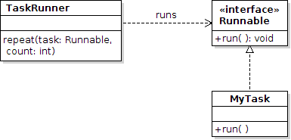
UML for interface
UML class diagram for this example.
Notice that TaskRunner does not depend on MyTask.

Slide 17
Make MyTask more flexible
Modify MyTask so we can use it to print any message.
public class MyTask implements Runnable {
/** @see java.lang.Runnable#run() */
public void run() {
System.out.println("_โฆษณาที่นี่: 02-9428555_");
}
}

Slide 18
java.util.Comparable interface
public interface Comparable {
/**
* compare two objects of the same type.
* @param obj is another object to
* compare to this object.
* @return ...
*/
public int compareTo(Object obj);
}
abstract method = method signature, but no implementation

Slide 19
Comparable example
public class Coin
implements Comparable<Coin> {
int compareTo(Coin other) {
if (other == null) return -1;
return this.value - other.value;
}
}
Declare that this class has the behavior specified by the Comparable interface.
Implement the required method.

Slide 20
Polymorphism using Interface
A class can guarantee to have a compareTo method by implementing the Comparable interface.
Arrays.sort( Comparable[ ] array ) can sort any array of objects that implement Comparable
Example:
Date implements Comparable (interface)
String implements Comparable
Double implements Comparable
Coin implements Comparable
=> we can call compareTo of any of these objects.

Slide 21
Polymorphism using Interface
Arrays.sort( ) - a method in java.util.Arrays class
// sort array of String
String[] words = new String[] {"dog","bird","ant"};
Arrays.sort( words );
// sort array of Student
Student [] students = new Student[] { ... };
Arrays.sort( students );
uses string1.compareTo( string2 )
uses student.compareTo(student)
Arrays.sort can sort any kind of objects if they have a compareTo method. ("X implements Comparable")
Arrays.sort doesn't know the type of object that performs compareTo.

Slide 22
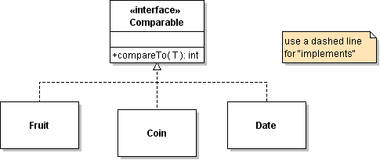
Using interface for Polymorphism
Comparable x = new Coin();
Comparable y = new Coin();
x.compareTo( y ) // calls compareTo of Coin
x = new Fruit( );
y = new Fruit();
x.compareTo( y ) // calls compareTo of Fruit

Slide 23
Polymorphism and Collections
<<interface>>
Collection
add( Object )
remove( Object )
contains( Object )
size( )
Collection specifies methods for all types of collections (List, Set, ...)
<<interface>>
List
add( k: int, Object )
get( k: int )
remove( k: int )
indexOf( Object )
List interface specifies additional methods that Lists must have.

Slide 24
What Polymorphism is called...
"Don't ask what kind"
Not Polymorphism:
if (shape instanceof Circle) {
((Circle)shape).getCenter();

Slide 25
Polymorphism and Collections
<<interface>>
List
add( k: int, Object )
get( k: int )
remove( k: int )
indexOf( Object )
The List interface defines the public methods for all kinds of lists.
ArrayList and LinkedList are specific implementations of the list interface.
ArrayList
LinkedList

Slide 26
Interface and Inheritance
<<interface>>
List
add( k: int, Object )
get( k: int )
remove( k: int )
indexOf( Object )
The List interface has 25 methods. Its a lot of work to implement all of them.
AbstractList implements most of the methods for you.
AbstractList
Implements most of the methods of List.
Your List class implements only a few methods.
YourList
implement add, get, size, remove

Slide 27
java.util.Comparable (interface)
public interface Comparable<T> {
/**
* compare two objects of type T.
* @param obj is another object to compare
* to this object.
* @return ...
*/
public int compareTo(T obj);
}
abstract method = method signature, but no implementation

Slide 28
Comparable example
public class Coin
implements Comparable<Coin> {
}
Declare that this class has a compareTo method as required by the interface.

Slide 29
Using interface for Polymorphism
Comparable x = new Coin();
Comparable y = new Coin();
x.compareTo( y ) // calls compareTo of Coin
x = new Fruit( );
y = new Fruit();
x.compareTo( y ) // calls compareTo of Fruit

Slide 30
Polymorphism and Collections
<<interface>>
Collection
add( Object )
remove( Object )
contains( Object )
size( )
Collection specifies methods for all types of collections (List, Set, ...)
<<interface>>
List
add( k: int, Object )
get( k: int )
remove( k: int )
indexOf( Object )
List interface specifies additional methods that Lists must have.

Slide 31
Polymorphism and Collections
<<interface>>
List
add( k: int, Object )
get( k: int )
remove( k: int )
indexOf( Object )
The List interface defines the public methods for all kinds of lists.
ArrayList and LinkedList are specific implementations of the list interface.
ArrayList
LinkedList

Slide 32
Interface and Inheritance
<<interface>>
List
add( k: int, Object )
get( k: int )
remove( k: int )
indexOf( Object )
The List interface has 25 methods. Its a lot of work to implement all of them.
AbstractList implements most of the methods for you.
AbstractList
Implements most of the methods of List.
Your List class implements only a few methods.
YourList
implement add, get, size, remove

Slide 33
Inheritance
One class can "inherit" all the behavior and attributes of another class.
The subclass can "override" (redefine) any methods its wants to change.
Example: we override toString(), equals() in our classes.
public class CountingGame extends Game {
// inherits attributes from the Game class
// inherits methods from the Game class
}

Slide 34
A Point Class
Point
-x : double
-y : double
Point( x, y )
getX( ) : double
getY( ) : double
draw( )
A Point encapsulates its state (x,y) and the behavior of a point.
ColorPoint inherits call the behavior of a Point.
ColorPoint can choose to override some of the behavior, e.g. draw().
ColorPoint
-color : Color
ColorPoint( x, y )
setColor( Color )
getColor( ) : Color
draw( )

Slide 35
Inheritance Example
Design a JButton that toggles between ON and OFF
OnOffButton is a subclass of JButton.
OnOffButton can reuse all behavior of JButton, so we don't have to write them again
We can add custom behavior to implement the on/off status and change appearance. constructor
class OnOffButton extends JButton {
private boolean on; // true if button on
public OnOffButton ( boolean on ) {
super( on ? "on" : "off" );
this.on = on ;
}
public boolean isOn( ) { return on; }

Slide 36
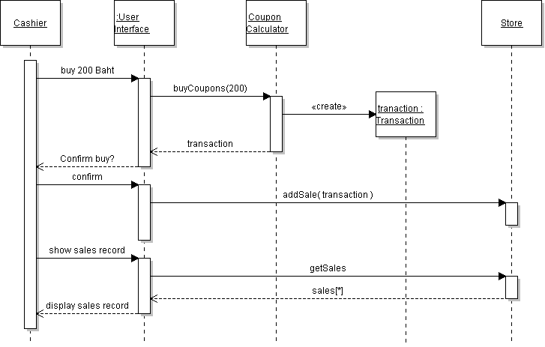
Objects and Programs
An OO program consists of objects that interact with each other.

Slide 37
Summary
Polymorphism in OOP means that many kinds of objects can provide the same behavior (method), and we can invoke that behavior without knowing which kind of object will perform it.

Slide 38
Enabling Polymorphism (1)
To enable polymorphism, we have to guarantee that the object always has the method we invoke.
x.toString( ) // the class must have toString method
How can we ensure this??
1. Use inheritance: a subclass has all the methods of its superclass.
Example: Object class defines toString().
Since every class is a subclass of Object, Java knows that every object has a toString()

Slide 39
Enabling Polymorphism (2)
2. Use an Interface: an interface specifies a required behavior without implementing it.
Every class that implements the interface is promising that it provides the interface's behavior.
Example:
Date implements Comparable (interface)
String also implements Comparable (interface).
Therefore, we can sort an array of Date or String.

