Slide 1
Relationships Between Classes
Window
dependency
open()
close()
move()
display()
handle(e : Event)
Event
<<handles>>
stereotype
generalization
(inheritance)
association
ConsoleWindow
DialogBox
Control

Slide 2
Dependency
One class uses the definition of another class.
Includes "association".
GameConsole
Game
public class GameConsole {
// no Game attribute
public void play(Game game) {
...
boolean correct = game.guess( number );
String hint = game.getHint( );

Slide 3
Association
One class has an attribute of another class.
GameConsole
Game
game
public class GameConsole {
private Game game;
/** constructor */
public GameConsole(Game game) {
this.game = game;

Slide 4
Association with Multiplicity
One class has an attribute of another class.
CardDeck
Card
52
public class CardDesk {
private Card[] cards;
public CardDesk() {
cards = new Card[52];
for(int k=0; k<52; k++) {
cards[k] = new Card("...");
}

Slide 5
Association with Variable Multiplicity
* = any (0 or more)
1..n = 1 to n
n = exactly n
MailBox
MailMessage
*
public class MailBox {
private List<MailMessage> messages;
public MailBox() {
messages = new ArrayList<MailMessage>();
}
public void addMessage(MailMessage m) {
message.add( m );
}

Slide 6
Vehicle has at least 4 Wheels
Only vehicles with at least 4 wheels are allowed on the motorway. A vehicle must have at least 4 wheels.
Vehicle
Wheel
4..*
public class Vehicle {
private Wheel[] wheels;
public Vehicle(int n) {
wheels = new Wheel[n];
}
public boolean isCar() {
return wheels.length >= 4;
}

Slide 7
Association Names
name direction
name
Works for
Person
Company
association

Slide 8
Roles
association
Person
Company
employee
employer
role name
role name

Slide 9
Multiplicities
multiplicity
1..*
*
Person
Company
employee
employer
association

Slide 10
Association Classes
1..*
*
Person
Company
employee
employer
Job
association class
description
dateHired
salary
fire()

Slide 11
Aggregation: whole-parts relationship
One class "collects" or "contains" objects of another
MailBox
MailMessage
*
public class MailBox {
private List<MailMessage> messages;
/* a MailBox consists of MailMessages */

Slide 12
Aggregation
Open diamonds denote aggregation
  Aggregation is the UML term for the part–whole relationship
  The parts can exist without the whole
The diamond is placed at the “whole” (car) end.
Recommendation: Don't show aggregation. (UML Distilled, Chapter 5.)
Just show it as association.
If it is really "composition" then show composition.

Slide 13
Composition: ownership relationship
One class "owns" objects of the other class.
Test: if the "whole" is destroyed, the parts are destroyed, too.
MailBox
MailMessage
*
public class MailBox {
private List<MailMessage> messages;
/* a MailBox consists of MailMessages */

Slide 14
Other Features of Class Diagrams
Company
(aggregation)
composition!
1
*
1..*
1..*
*
Location
Department
Office
*
0..1
constraint
*
{subset}
*
Headquarters
member
1..*
1
manager
Person
name : string
PersonnelRecord

Slide 15
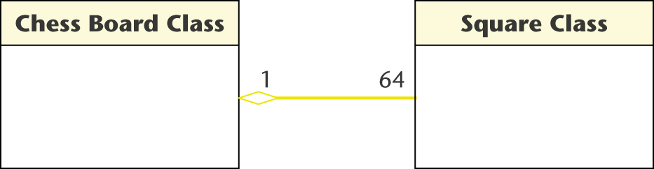
Aggregation and Composition
Aggregation example: Every chess board consists of 64 squares
Expresses "has a" relationship, but the components can exist without the whole
For modeling, aggregation is not as useful as composition.

Slide 16
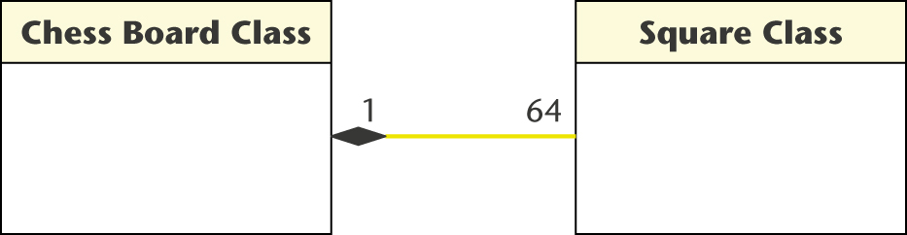
Composition
Depicted by a solid diamond
Composition means the whole owns the parts.
If the whole is destroyed, then the parts are destroyed, too.
A chess board is composed of Squares. The Squares don't exist without a chess board.

Slide 17
Inheritance
Animal
Object
Feline
Number
Tiger
Double
Also called "generalization" and "specialization".

Slide 18
Objects
account : BankAccount
account is an instance of class BankAccount
Syntax: object : ClassName
  colon means “instance of”
  use underscore

Slide 19
Abbreviated Notation
account : class name omitted
: BankAccount instance of BankAccount,
instance name omitted

Slide 20
Exercise
A Coin has a value (double).
class Coin {
private double value;
public Coin(double value) ...;
public double getValue( ) { ... }
public boolean equals(Object other) { ... }
}
A Purse contains zero or more coins:
class Purse {
private List<Coin> list = new ArrayList<Coin>();
public boolean add(Coin coin) {...}
}

