Slide 1
Polymorphism & OO Programming

Slide 2
Three Pillars of O-O Programming
Encapsulation:
an object contains both data and the methods that operate on the data. It may expose some of these members to the outside and hide others.
This design separates the public interface from the implementation, and enforces data integrity.
Inheritance:
one class can inherit attributes and methods from another class.
Polymorphism:
a behavior can be invoked on different kinds of objects, without knowing the type of object that will perform the behavior

Slide 3
Encapsulation
In OOP, encapsulation means that an object contains both the data and the methods that operate on the data.
A Purse encapsulates the Coins and behavior of a purse.
We can use a Purse without knowing how a Purse performs its job.
We don't need to know how the Purse implements its methods or how it stores Coins.

Slide 4
Polymorphism
Polymorph = poly + morph
= many + forms
We can invoke a behavior without knowing what kind of object will perform the behavior.
Many kinds of objects can respond to the same message.
Object x;
x = new Double(Math.PI);
System.out.println( x.toString() ); // toString() of Double
x = new Date( );
System.out.println( x.toString() ); // toString() of Date
Polymorphism

Slide 5
Polymorphism Example
x.toString() always calls toString of the correct class. We don't know to know the type of object that x refers to.
Object x = new Date( );
System.out.println( x ); // calls x.toString()
// invokes toString of Date class
x = new Double(Math.PI);
System.out.println( x ); // calls x.toString()
// invokes toString of Double class
any kind of Object

Slide 6
Polymorphism Example
Arrays.sort( ) - a method in java.util.Arrays class
// sort array of String
String[] words = new String[] {"dog","bird","ant"};
Arrays.sort( words );
// sort array of Student
Student [] students = new Student[] { ... };
Arrays.sort( students );
uses string1.compareTo( string2 )
uses student.compareTo(student)
Arrays.sort can sort any kind of objects if they have a compareTo method. ("X implements Comparable")
Arrays.sort doesn't know the type of object that performs compareTo.

Slide 7
Enabling Polymorphism
The key to polymorphism asking an object to do something (call its method) without knowing the kind of object.
Object a = ...;
a.toString( );
a.compareTo ( b );
How can we tell Java that a has a compareTo method even if we don't know what class a belongs to?
a.toString() always for any kind of object. Why?
How can we guarantee that a has compareTo ?

Slide 8
Two Ways to Enable Polymorphism
Java provides two ways to "guarantee" that a class object has some behavior.
1. Inheritance
If a superclass provides a behavior, then all its subclasses inherit that behavior.
Subclasses can use the method code of the parent class, or override it with their own implementation.
2. Interface
An interface is a specification of a behavior.
A class that implements an interface must provide that behavior.

Slide 9
Methods from Object
Every Java class is a subclass of the Object class.
The Object class defines basic behavior (see below).
Most classes will override these methods to provide useful implementations.
Object
equals(Object): boolean
getClass(): Class
hashCode(): int
toString(): String
notify()
wait()
...
Every class inherits these methods automatically.
So, we can always use obj.toString() or obj.equals(obj2) for any kind of object.

Slide 10
Inheritance and Polymorphism
Since every class inherits the non-private behavior of its parent class, we can treat objects from subclasses just like the parent.
Object
equals(Object): bool
toString(): String
...
Every object is guaranteed to have a toString( ) method.
System.out.print( obj ) can print any object by calling obj.toString(), without knowing the object's type.
X
equals(Object): bool
toString(): String
...

Slide 11
Interface
A Java interface specifies behavior which will be provided by classes that implement the interface.
  Interface is a specification for a required behavior, without an implementation.
Example: USB interface specifies (a) connector size, (b) electrical properties, (c) communications protocol, ...
Anyone can implement the USB interface on their device.

Slide 12
java.util.Comparable interface
public interface Comparable {
/**
* compare two objects of type T.
* @param obj is another object to
* compare to this object.
* @return ...
*/
public int compareTo(Object obj);
}
abstract method = method signature, but no implementation

Slide 13
Comparable example
public class Coin
implements Comparable<Coin> {
int compareTo(Coin other) {
if (other == null) return -1;
return this.value - other.value;
}
}
Declare that this class has the behavior specified by the Comparable interface.
Implement the required method.

Slide 14
Polymorphism using Interface
A class can guarantee to have a compareTo method by implementing the Comparable interface.
Arrays.sort( ) can sort any kind of objects that implement Comparable
Example:
Date implements Comparable (interface)
String implements Comparable
Double implements Comparable
Coin implements Comparable
=> we can call compareTo of any of these objects.

Slide 15
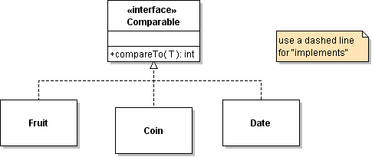
Using interface for Polymorphism
Comparable x = new Coin();
Comparable y = new Coin();
x.compareTo( y ) // calls compareTo of Coin
x = new Fruit( );
y = new Fruit();
x.compareTo( y ) // calls compareTo of Fruit

Slide 16
Polymorphism and Collections
<<interface>>
Collection
add( Object )
remove( Object )
contains( Object )
size( )
Collection specifies methods for all types of collections (List, Set, ...)
<<interface>>
List
add( k: int, Object )
get( k: int )
remove( k: int )
indexOf( Object )
List interface specifies additional methods that Lists must have.

Slide 17
What Polymorphism is called...
"Don't ask what kind"
Not Polymorphism:
if (shape instanceof Circle) {
((Circle)shape).getCenter();

Slide 18
Polymorphism and Collections
<<interface>>
List
add( k: int, Object )
get( k: int )
remove( k: int )
indexOf( Object )
The List interface defines the public methods for all kinds of lists.
ArrayList and LinkedList are specific implementations of the list interface.
ArrayList
LinkedList

Slide 19
Interface and Inheritance
<<interface>>
List
add( k: int, Object )
get( k: int )
remove( k: int )
indexOf( Object )
The List interface has 25 methods. Its a lot of work to implement all of them.
AbstractList implements most of the methods for you.
AbstractList
Implements most of the methods of List.
Your List class implements only a few methods.
YourList
implement add, get, size, remove

Slide 20
Enabling Polymorphism (1)
To enable polymorphism, we have to guarantee that the object always has the method we invoke.
x.toString( ) // the class must have toString method
How can we ensure this??
1. Use inheritance: a subclass has all the methods of its superclass.
Example: Object class defines toString().
Since every class is a subclass of Object, Java knows that every object has a toString()

Slide 21
Methods from Object
Every object has the methods defined in Object.
Usually the classes will override these methods to provide useful implementations.
Object
equals(Object): boolean
getClass(): Class
hashCode(): int
toString(): String
notify()
wait()
...

Slide 22
Enabling Polymorphism (2)
2. Use an Interface: an interface specifies a required behavior without implementing it.
Every class that implements the interface is promising that it provides the interface's behavior.
Example:
Date implements Comparable (interface)
String also implements Comparable (interface).
Therefore, we can sort an array of Date or String.

Slide 23
java.util.Comparable (interface)
public interface Comparable<T> {
/**
* compare two objects of type T.
* @param obj is another object to compare
* to this object.
* @return ...
*/
public int compareTo(T obj);
}
abstract method = method signature, but no implementation

Slide 24
Comparable example
public class Coin
implements Comparable<Coin> {
}
Declare that this class has a compareTo method as required by the interface.

Slide 25
Using interface for Polymorphism
Comparable x = new Coin();
Comparable y = new Coin();
x.compareTo( y ) // calls compareTo of Coin
x = new Fruit( );
y = new Fruit();
x.compareTo( y ) // calls compareTo of Fruit

Slide 26
Polymorphism and Collections
<<interface>>
Collection
add( Object )
remove( Object )
contains( Object )
size( )
Collection specifies methods for all types of collections (List, Set, ...)
<<interface>>
List
add( k: int, Object )
get( k: int )
remove( k: int )
indexOf( Object )
List interface specifies additional methods that Lists must have.

Slide 27
Polymorphism and Collections
<<interface>>
List
add( k: int, Object )
get( k: int )
remove( k: int )
indexOf( Object )
The List interface defines the public methods for all kinds of lists.
ArrayList and LinkedList are specific implementations of the list interface.
ArrayList
LinkedList

Slide 28
Interface and Inheritance
<<interface>>
List
add( k: int, Object )
get( k: int )
remove( k: int )
indexOf( Object )
The List interface has 25 methods. Its a lot of work to implement all of them.
AbstractList implements most of the methods for you.
AbstractList
Implements most of the methods of List.
Your List class implements only a few methods.
YourList
implement add, get, size, remove

Slide 29
Inheritance
One class can "inherit" all the behavior and attributes of another class.
The subclass can "override" (redefine) any methods its wants to change.
Example: we override toString(), equals() in our classes.
public class CountingGame extends Game {
// inherits attributes from the Game class
// inherits methods from the Game class
}

Slide 30
A Point Class
Point
-x : double
-y : double
Point( x, y )
getX( ) : double
getY( ) : double
draw( )
A Point encapsulates its state (x,y) and the behavior of a point.
ColorPoint inherits call the behavior of a Point.
ColorPoint can choose to override some of the behavior, e.g. draw().
ColorPoint
-color : Color
ColorPoint( x, y )
setColor( Color )
getColor( ) : Color
draw( )

Slide 31
Inheritance Example
Design a JButton that toggles between ON and OFF
OnOffButton is a subclass of JButton.
OnOffButton can reuse all behavior of JButton, so we don't have to write them again
We can add custom behavior to implement the on/off status and change appearance. constructor
class OnOffButton extends JButton {
private boolean on; // true if button on
public OnOffButton ( boolean on ) {
super( on ? "on" : "off" );
this.on = on ;
}
public boolean isOn( ) { return on; }

Slide 32
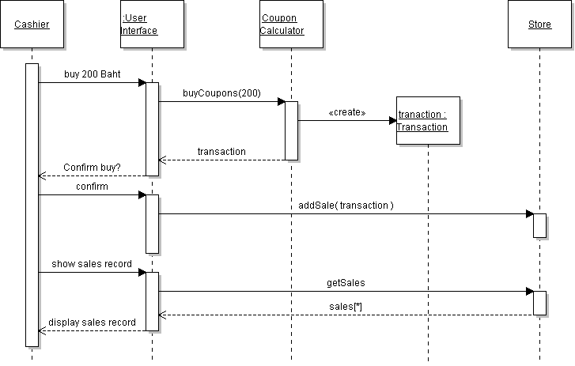
Objects and Programs
An OO program consists of objects that interact with each other.

Slide 33
Interfaces You Should Know
Interface What it specifies
Comparable<T> compareTo( T other )
Comparator<T> compare(T x, T y)
Iterator<T> hasNext() and next()
iterating over collections
Iterable<T> iterator()
a way of creating iterators
Cloneable safe to call clone()

