Slide 1
Week 1 Exercises

Slide 2
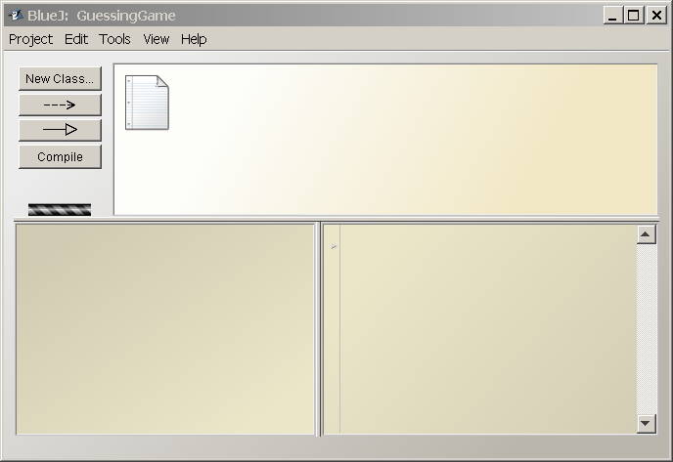
BlueJ IDE Layout
Current Project
Object Bench
Code Pad

Slide 3
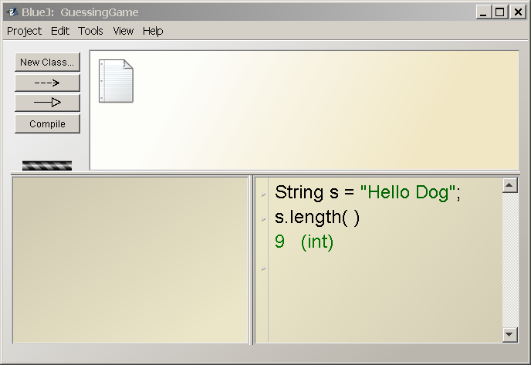
Type Commands in CodePad

Slide 4
> int n = 10;
> n++
(a) 10 (b) 11 (c) Neither of these
Java Math. What is the output?
> n = 10;
> ++n
(a) 10 (b) 11 (c) Neither of these
> int n = 10;
> int y = n+++n+++n++;
(a) 30 (b) 32 (c) 33 (d) 34 (e) Error

Slide 5
What is the result?
> char c = '5';
> c + 1
> (int) c
> (short) c
> (byte) c
> (char) 51
(int) c means "convert the value to an int".
This is called a cast.
You can use class name in a cast, too:
(Character) c

Slide 6
What is the result?
> c = 'ก' ; (gau gai)
> (int) c
> ++c
> (char) c
Java uses Unicode for char and Strings,
but the output may not be readable if the output device doesn't use Unicode

Slide 7
What is the output?
System.out.println( 3 + 4 );
System.out.println( "3" + 4 );
System.out.println( '3' + 4 );
System.out.println( 3 + "4" );

Slide 8
What is the output?
System.out.println( 'A' );
System.out.println( 'A' + 1 );
System.out.println( "A" + 1 );
System.out.println( "A" + "1" );

Slide 9
Bizarre Numbers
System.out.println( 12 );
System.out.println( 012 );
System.out.println( 0x12 );
System.out.println( 012 + 0x12 );

Slide 10
Bit Operations
> int a = 7;
> int b = 10;
> a & b
> a | b
> a ^ b
> a == b
> a = b
> a && b

Slide 11
How are these different?
// 1 Billion + 2 Billion
> 1000000000 + 2000000000
// You can also write numbers as:
> 1_000_000_000 + 2_000_000_000
> 1000000000L + 2000000000
> 1E9 + 2E9

Slide 12
Difference between "same" and equal?
> Double x = new Double(10);
> Double y = new Double(10);
> x == y
> String s = "yes";
> String t = "yes";
> s == t
> String u = new String("yes");
> s == u
> s.equals(u)

Slide 13
Add the Java JDK "bin" directory to your Path
To add for just one shell (command prompt):
Open a command prompt window.
At the command prompt, add to existing PATH:
cmd> set PATH = c:\SomeDirectory\java\bin;%PATH%
To add permanently:
My Computer -> Properties.
Choose "Advanced" and "Environment Variables"
Choose "User variables for xxxxx" (not System vars).
Add a PATH variable or edit existing PATH
PATH = c:\Some Directory\java\bin;xxxxxxxx

