Slide 1
Commands
A command is something you want someone else to perform.
Instead of directly issuing a command, we can write it down and give it to someone to perform.
Written commands can be reused, cataloged, etc.
Sometimes they also contain "undo" commands, too.

Slide 2
Command Objects
In Java, we encapsulate a command in an object.
The command contains a method we want another object (the receiver) to perform.
Invoker
Receiver
perform
Command

Slide 3
Swing Command Objects
A class that implements ActionListener is a command.
JButton button1 = new JButton( "Just Do It" );
button1.setActionListener( new OnAction() );
// an inner class for invoking action
class OnAction implements ActionListener {
public void actionPerformed(ActionEvent evt) {
lightbulb.turnOn( );
}
}

Slide 4

Programmable Invoker
The invoker (JButton) does not need to know what command it is invoking, or what object will perform it.
Just Do It
onAction
JButton
(invoker)
(performer)
LightBulb
(receiver)

Slide 5
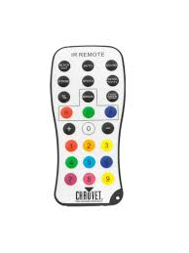
Programmable Interfaces
Use commands to "program" the user interface, instead of embedding logic haphazardly in components.
Action1
Action7
Action2
Action8
Action9
A programmable remote control

Slide 6
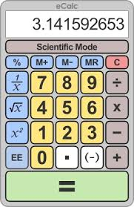
Calculator Application
UI (invoker)
InvertCommand
MultiplyCommand
SqrtCommand
SubtractCommand
PowerCommand
EqualsCommand
Calculator
setOperand( num )
setOperator( op )
perform( )
getResult( )
(receiver)

Slide 7
Swing Action
<<interface>>
ActionListener
Swing Action interface ...
is ActionListener
has name, icon, state
contains a map for property values
can be enabled and disabled
<<interface>>
Action
setEnabled( )
putValue(key,val)
addPropertyChangeListener( )
AbstractAction
setEnabled( )
putValue(key,val)
. . .

Slide 8
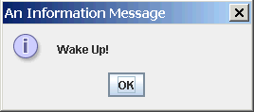
Message Dialog
// basic message dialog
JOptionPane.showMessageDialog( null,
"Wake Up!");
// message dialog with a title and message type.
JOptionPane.showMessageDialog( null, "Wake Up!", "An Information Message",
JOptionPane.INFORMATION_MESSAGE );
Syntax:
static void showMessageDialog( Component parent, Object message )
static void showMessageDialog( Component parent ,
Object message ,
String title_line ,
int messageType )
messageType is one of: INFORMATION_MESSAGE,
QUESTION_MESSAGE, WARNING_MESSAGE, ERROR_MESSAGE

Slide 9
Modal or Non-Modal Dialog?
Graphics frameworks support 2 ways of using dialogs:
Modal Dialog - user must close the dialog (click OK, Cancel, etc) before he can work in the parent window. Example: "Open file" dialog.
Non-modal Dialog - user can go back and work in the parent window while the dialog is still open.
JOptionPane.showMessageDialog( parent, "Wake Up!" );
First parameter is a reference to parent window.
if parent == null, it displays a non-modal dialog.
if parent != null, it displays a modal dialog

Slide 10
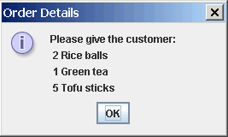
Multi-line Message Dialog
String message = "Please give the customer:\n"
+ "2 Rice balls\n"
+ "1 Green tea\n"
+ "5 Tofu sticks");
JOptionPane.showMessageDialog( null,
message, "Order Details",
JOptionPane.INFORMATION_MESSAGE );
Use correct singular / plural
Avoid errors like this:
You have 1 new messages

Slide 11
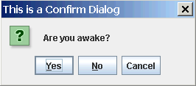
Confirm Dialog
int choice;
choice = JOptionPane.showConfirmDialog( null,
"Are you awake?",
"This is a Confirm Dialog",
JOptionPane.YES_NO_CANCEL_OPTION );
if ( choice == JOptionPane.NO_OPTION )
JOptionPane.showMessageDialog( null, "Liar!" );
Syntax:
static int showConfirmDialog(
Component parent,
Object message ,
String title_line,
int optionType )
optionType is: YES_NO_OPTION or YES_NO_CANCEL_OPTION
return value is: YES_OPTION, NO_OPTION, or CANCEL_OPTION

Slide 12
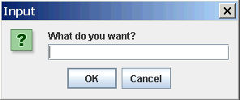
Input Dialog
String reply;
reply = JOptionPane.showInputDialog( null,
"What do you want?",
"This is an Input Dialog",
JOptionPane.QUESTION_MESSAGE );
if ( reply == null ) /* user pressed CANCEL */ ;
else doSomething( reply );
Syntax:
static String showInputDialog(
Component parent,
Object message,
String title_line,
int messageType )
return value is null if "Cancel" pressed; else string typed in textbox.

Slide 13
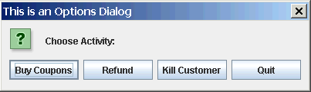
Option Dialog
String [] choices = { "Buy Coupons",
"Refund", "Kill Customer", "Quit"};
int reply =
JOptionPane.showOptionDialog(
null, // parent
"Choose Action:", // message
"This is an Options Dialog", // title string
JOptionPane.YES_NO_OPTION, // useless
JOptionPane.QUESTION_MESSAGE, // msg type
null, // no icon
choices, // array of choices
choices[0] // default choice
);
switch( reply ) {
case 0: couponDialog( ) ; break;
case 1: refundDialog( ) ; break;
case 2: killCustomer( ) ; break;
default: confirmQuit( ) ;
}

Slide 14
JOptionPane Usage
These 4 dialogs are static methods: you don't need to create an instance of JOptionPane.
JOptionPane also has instance methods for more control over dialogs. See the Java API.
JOptionPane is in javax.swing:
import javax.swing.JOptionPane;
or:
import javax.swing.*;

Slide 15
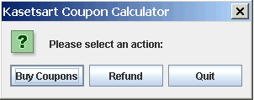
KU Coupons Design using Dialogs
Draw a UML state chart diagram.
Start
Input wait state (display choice dialog)
"Buy" action
"Quit" action
"Refund" action
Buy Coupons dialog
Confirm quit
dialog
Refund dialog
OK
cancel
cancel
OK
cancel
OK
error
make coupons, show result
compute refund, show result
error
Exit
OK
OK

Slide 16
Bad Input Dialog
String red = JOptionPane.showInputDialog( null,
"How many red?",
"Red Dialog",
JOptionPane.QUESTION_MESSAGE );
String blue = JOptionPane.showInputDialog( null,
"How many blue?",
"Blue Dialog",
JOptionPane.QUESTION_MESSAGE );
String green = JOptionPane.showInputDialog( null,
"How many green?",
"Green Dialog",
JOptionPane.QUESTION_MESSAGE );
// now parse the Strings
Too many dialogs!
No feedback from previous dialog (how many red and blue did he enter?).

Slide 17
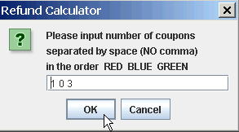
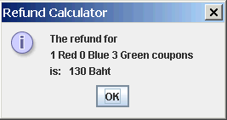
Better Input Dialog
Display input data for verification and feedback.

Slide 18
Hints
How to convert a String containing a number like "123" to a number?
Use results of Homework 2, or use Scanner.
How to process a String containing several numbers, such as "12 25 7.5 4"?
Look at the API for the "Scanner" class.
There is a constructor that accepts a String argument
Scanner( String source );
String reply = /* string containing numbers */ ;
Scanner scan = new Scanner( reply );
/* now use Scanner methods to read the values */

Slide 19
Crashable Input Method
private void withdrawDialog( ) {
String reply =
JOptionPane.showInputDialog( null,
"Please input amount to withdraw",
"Withdraw Calculator",
JOptionPane.QUESTION_MESSAGE );
Scanner scan = new Scanner( reply );
// if user presses CANCEL this will crash!
amount = scan.nextDouble( );
// crash! if no nextDouble
// what if user inputs TOO MUCH data?

Slide 20
Writing a Crash-proof Method
private void withdrawDialog( ) {
String reply = JOptionPane.showInputDialog( null,
. . . , // same as previous slide
JOptionPane.QUESTION_MESSAGE );
if ( reply == null ) return; // dialog cancelled
Scanner scan = new Scanner( reply );
boolean inputOK = true;
// test before reading
if ( scan.hasNextDouble() ) red = scan.nextInt( );
else inputOK = false;
// test for too much data
inputOK = inputOK && ( ! scan.hasNext() );
if ( inputOK ) { /* compute withdraw */ }
else { /* display error message */ }

Slide 21
Making Your Program Crash-proof
Don't assume input exists or is of expected type.
Ask someone else to test your program!
Tester should be malicious.

